Slide 1
Artificial Intelligence In Pharmacy
By: Cole Smith PharmD Candidate 2021
University of Findlay
Notes:
Hello everyone! My name is Cole Smith and I am Josh’s APPE student this month from the University of Findlay. Today I’ll be talking a little about AI in the practice of pharmacy.

Slide 2
Outline:
What is Artificial Intelligence or AI?
How is it Used Currently in Pharmacy Practice?
ASHP’S Stance On AI
Why is AI Important?
Looking into the Future
Potential Problems
What is the Pharmacist’s Role in AI?
Notes:
Here is a quick outline of what I will be going over today. *Read through Outline*

Slide 3
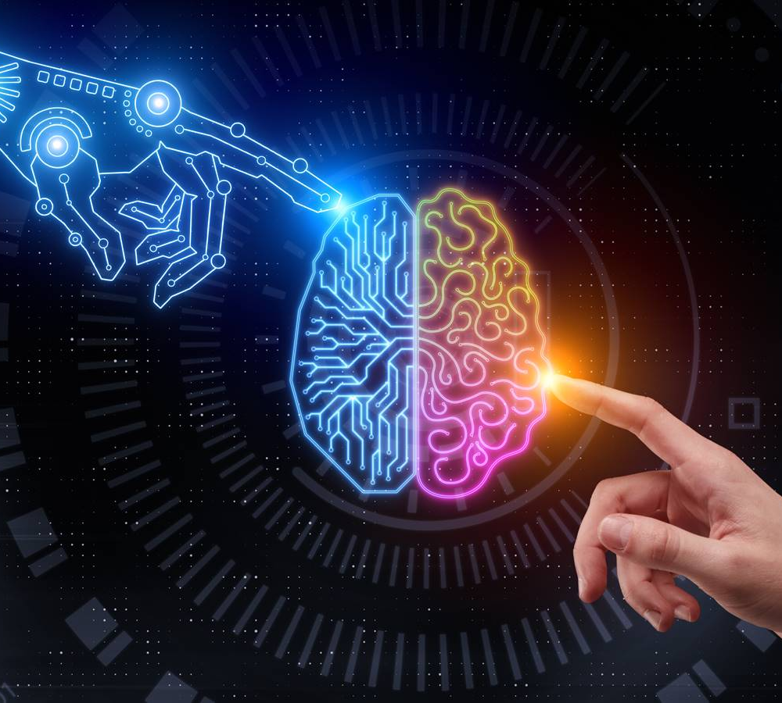
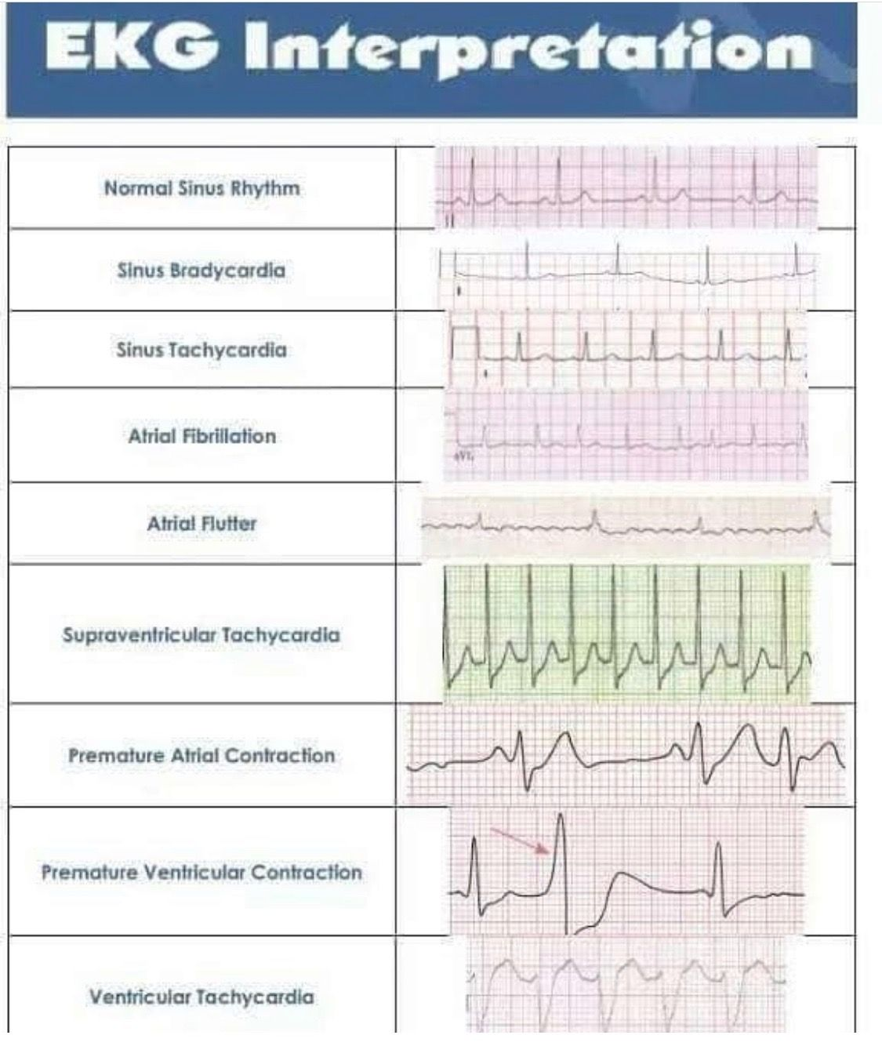
What is Artifical Intelligence or AI?
Definition: the theory and development of computer systems able to perform tasks that normally require human intelligence, such as visual perception, speech recognition, decision-making, and translation between languages.
Notes:
So, to get started, on the slide I have listed the definition of AI and I’ll let you all read that but as an example of its use in the healthcare industry
I’ve actually cited automated readings of EKGs.
I find this as a really cool application of AI.
So, basically, EKGs are uploaded for many different patients, and then the diagnosis for each patient is also uploaded
These are stored and eventually once there is enough data, a computer is able to look at EKGs and start making diagnoses and even predict future diagnoses
Of note, these AI systems are not only known to be as efficient as physicians but also are able to predict future issues from small variations in EKGs that are not noticeable to the human eye.
With that said, these AI systems are still to be used in conjunction with a physician’s clinical judgement because they are not 100% accurate.
With that said, I consider reading EKG’s one of the more complex areas of medical practice and if AI can be utilized for this, it can definitely be applied to pharmacy practice.

Slide 4
AI in Pharmacy Practice
Drug Interactions
Duplicate Therapies
Dosing Parameters
Automatic Ordering
Notes:
So, that’s awesome for cardiologists, but how is AI useful in the practice of pharmacy?
We already use AI everyday in our practice when computer prompts alert us to duplicate therapies, drug interactions, Dose parameters, automatic ordering of medication. The list goes on and on.
All of these very important tools to help improve patient care, save money, and make the pharmacist’s life easier.

Slide 5
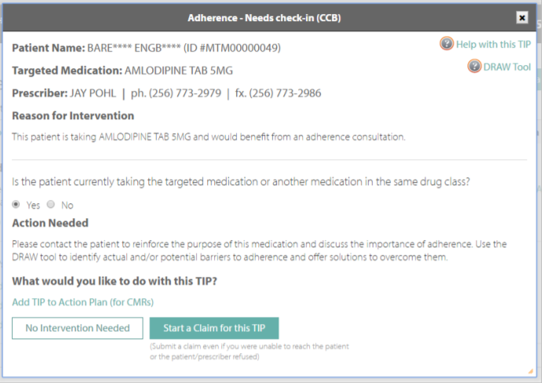
AI in Pharmacy Example:
Notes:
One of the best examples of AI in pharmacy is the work being done with MTM or medication therapy management. The computer automatically reviews patient fill data and if a patient is not filling their prescriptions on time. It prompts the pharmacist to call the patient and see if there are any issues or barriers that they can help them overcome. This is also a great time to explain the importance of the medication to the patient. Not only does this intervention help the patient, it helps the healthcare system.
More recently, in 2019, a study examined whether a pharmacist-led nonadherence intervention reduced the burden on the Australian healthcare system. The retrospective observational study examined a de-identified database of dispensing data from 20,335 patients (n=11,257 on rosuvastatin, n=6,797 on Irbesartan, and n=2,281 on desvenlafaxine). Each patient received a pharmacist-led medication intervention, and the data six months before was compared with six months after. Across the three disease states, the cost of medication nonadherence was estimated to be $517 per adult, or $10.4 billion. After the intervention, costs were estimated to decrease by $95 per adult and saving the Australian healthcare system $1.9 billion.
https://www.ncbi.nlm.nih.gov/pmc/articles/PMC6537038/

Slide 6
ASHP’s Stance on AI
“AI of proven value should be adopted and used so that pharmacists can make better decisions and focus their expertise on solving new and confounding problems”
Notes:
ASHP is fully on-board and believes that AI is the cornerstone of improving pharmacy practice so long as it is done correctly.
This quotation is taken directly from a document published by ASHP regarding AI in pharmacy practice.
*read quote*

Slide 7
Pharmacist’s Role in Artificial Intelligence
Determine what processes can safely implement AI
Investigate effectiveness of AI in different processes
Adjust AI data sets, and improve on existing AI
Develop new AI systems to advance pharmacy practice and free up valuable time for other important pharmacy functions
Notes:
ASHP feels that pharmacists have an important role when it comes to AI in pharmacy because we can help with a variety of tasks.
We can help- *Read bullets*

Slide 8
Importance of AI
“The quadruple aim” (improving access, reducing costs, improving outcomes, and optimizing clinician satisfaction)
Notes:
ASHP mentions something called “the quadruple aim” and it perfectly summarizes the importance of AI. It can help improve the access, reduce cost, improve outcomes, and optimize clinician satisfaction revolving around healthcare.

Slide 9
Potential Problems
Development based on correct, factually based data.
Information continually updated for most accurate treatment/decision making
Information reviewed often for problems and interpretablity
Notes:
As with anything in life, there are downsides and problems associated with AI. Original development of AI needs to be an organized process utilizing factual, and up to date information. The information utilized also needs to be updated frequently in order to provide the best treatment and decision-making for practice. Lastly, because data is constantly changing, AI is also changing and needs to be re-evaluated often in order to ensure problems are identified early.
Most of us have experienced some of the issues associated with AI that come from lack of data input or need for optimization. So, AI is only as good as it is designed to be.

Slide 10
Looking into the Future
Develop new medications
Diagnose mental illness
Find patients for drug trials
Filter patients for needed medication therapy
Manage inventory, scheduling and other administrative tasks
Notes:
Looking into the future there are many ongoing AI projects to look forward to: Some interesting ones involve- *Read bullets*
Talk about bullet for new meds, drug trials, and scheduling

Slide 11
COVID-19 and AI
Prediction and Tracking
Contact Tracing
Early diagnosis (AI in Xray)
Protein structure prediction
Notes:
https://www.ncbi.nlm.nih.gov/pmc/articles/PMC7692869/
COVID has had a huge impact on AI in healthcare specifically when it comes to things like *read bullets*
Prediction and tracking- by collecting information on who has been infected, and how many people are infected, rates of transmission and projected numbers of people can be predicted. They can also utilize smart device data to do things like contact trace in order to find the epicenters of some mass-infection events. Early diagnosis of COVID-19 can also be predicted with AI by comparing Xrays of people with covid and Xrays of people without. Lastly, protein structure prediction can help improve treatments for covid19 and help develop vaccines that work in different ways to fight the virus. These types of AI can be applied to a large magnitude of different situations in healthcare and COVID pushed the development of these.

Slide 12
Additional Readings:
AI during COVID19 https://www.pharmacytimes.com/news/enter-ai-how-technology-is-changing-the-pharmaceutical-industry-for-the-better
AI in specialty Pharmacy https://www.pharmacytimes.com/news/the-future-is-now-artificial-intelligence-and-machine-learning-in-specialty-pharmacy
Artificial Intelligence Used to Predict Chemotherapy Resistance in Breast Cancer Patients https://www.pharmacytimes.com/news/artificial-intelligence-used-to-predict-chemotherapy-resistance-in-breast-cancer-patients
Rise of Artificial Intelligence in Pharmacy https://www.indianapharmacists.org/news/the-rise-of-artificial-intelligence-ai/
Notes:
https://www.ncbi.nlm.nih.gov/pmc/articles/PMC7692869/
COVID has had a huge impact on AI in healthcare specifically when it comes to things like *read bullets*
Prediction and tracking- by collecting information on who has been infected, and how many people are infected, rates of transmission and projected numbers of people can be predicted. They can also utilize smart device data to do things like contact trace in order to find the epicenters of some mass-infection events. Early diagnosis of COVID-19 can also be predicted with AI by comparing Xrays of people with covid and Xrays of people without. Lastly, protein structure prediction can help improve treatments for covid19 and help develop vaccines that work in different ways to fight the virus. These types of AI can be applied to a large magnitude of different situations in healthcare and COVID pushed the development of these.

Slide 13
References:
https://www.dicardiology.com/content/ai-tool-allows-automated-ecg-interpretation-cardiac-diagnostics#:~:text=The%20new%20study%20demonstrates%20that,had%20already%20been%20diagnosed%20manually.
file:///C:/Users/cole5/Downloads/ASHP%20Statement%20on%20the%20Use%20of%20Artificial%20Intelligence%20in%20Pharmacy.pdf
https://www.digitalauthority.me/resources/artificial-intelligence-pharma/#:~:text=Artificial%20intelligence%20helps%20pharma%20companies,the%20patients%20to%20take%20them.
Google images
https://www.ncbi.nlm.nih.gov/pmc/articles/PMC6537038/

Slide 14
Thanks!
Any questions?
Contact Info:
smithc14@findlay.edu

