Slide 1
Path to graduation
Jarrett Medford
Internship Culminating Project: ESL Classroom Guidance
COSC 694 – Internship 2
North Charleston High School

Slide 2
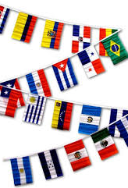
The students
All students are multilingual learners.
Students have various levels of literacy/understanding of the English language.
90% of the students are Hispanic, remaining 10% are African-American, Asian, Middle Eastern or Caucasian.
Majority of the students identify as undocumented persons, specific amount if unknown due to sensitivity.
The total number of multilingual students is 150 and fluctuates. School has seen a consistent increase in multilingual registrations.

Slide 3

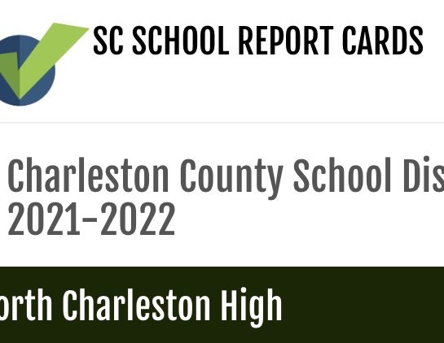
DATA sources
25% of students in the multilingual program are chronically absent. (Powerschool)
Only 25% of ML students met their proficiency target the year prior. (Report Card)
34% of students received a C or higher in English. (Report Card)
10% of students received a C or higher in Algebra. (Report Card)
9 seniors were identified by staff to be urgent high-risk for dropping out of high school due to aging out, chronic absenteeism, and/or lack of motivation/effort to pursue learning English which leads to poor grades. (Powerschool)
There were 30+ new student registrations and 95% of those registrations were newcomers to America. Around 80% of those new registrations are in the lowest level ESL class since their English proficiency level was minimal. This number is double the year previous for registrations. (Powerschool)

Slide 4
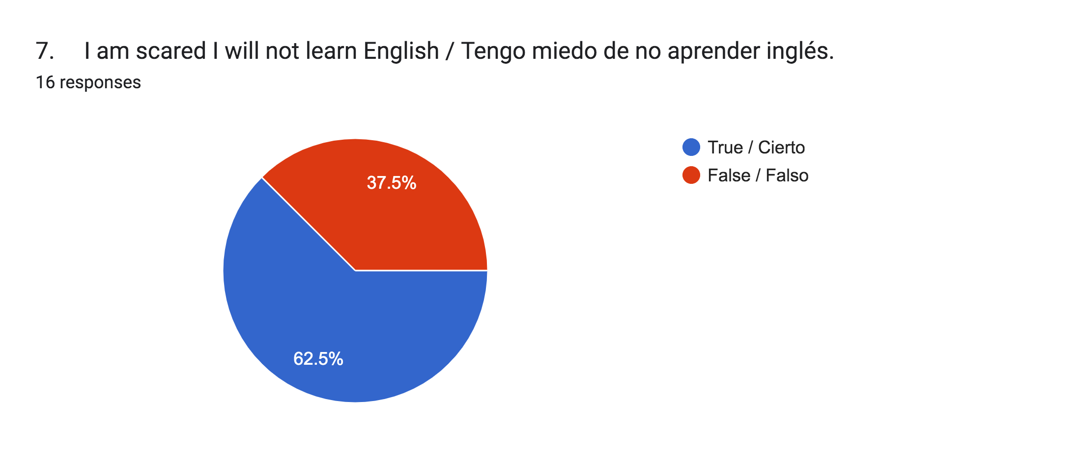
Needs assessment: ESL Students
64% of the students in the multilingual program are scared/afraid that they will not learn English.
25% of students are not comfortable asking their teachers for help.
35% of students have received at least one referral for discipline/tardiness.
37% of students feel they get in trouble for not knowing English well because they are misunderstood or confused.

Slide 5
Needs assessment: administration
Administrators were questioned in interview on student needs.
Question: Would counselor involvement be useful with students in the ESL department given that 2 ESL teacher positions are vacant?
Reponses: 6/6 administrators responded a strong yes
Concerns:
  Student performance given the lack of certified teachers in the ESL department (4/6 are certified)
  Students have limited social emotional interactions with non-Spanish speaking staff, which is said to not the essential to make a connection with students.
  Some non-ESL teachers often struggle to make connections with ESL students.

Slide 6
Needs assessment: teachers
Teachers were interviewed on ESL student needs:
Question (both ESL and non-ESL teachers): What would be some concerns with ESL students’ well-being and learning?
All ESL teachers (4) are concerned with the well being of ESL students because not all teachers/staff are able to communicate effectively with the ESL students.
2 ESL teachers shared: Students are still adjusting and learning how to communicate with their teachers.
Non-ESL teachers (11) shared that *some shared more than one concern*
  9 teachers said ESL students struggle interacting with other students
  7 teachers reported that they struggle finding a communication strategy for the ESL students.

Slide 7
4 classroom Lessons
Why I Need to Graduate
Jobs for Multilingual Persons
Feeling Words/Communication
What I Need to Graduate/Attendance

Slide 8
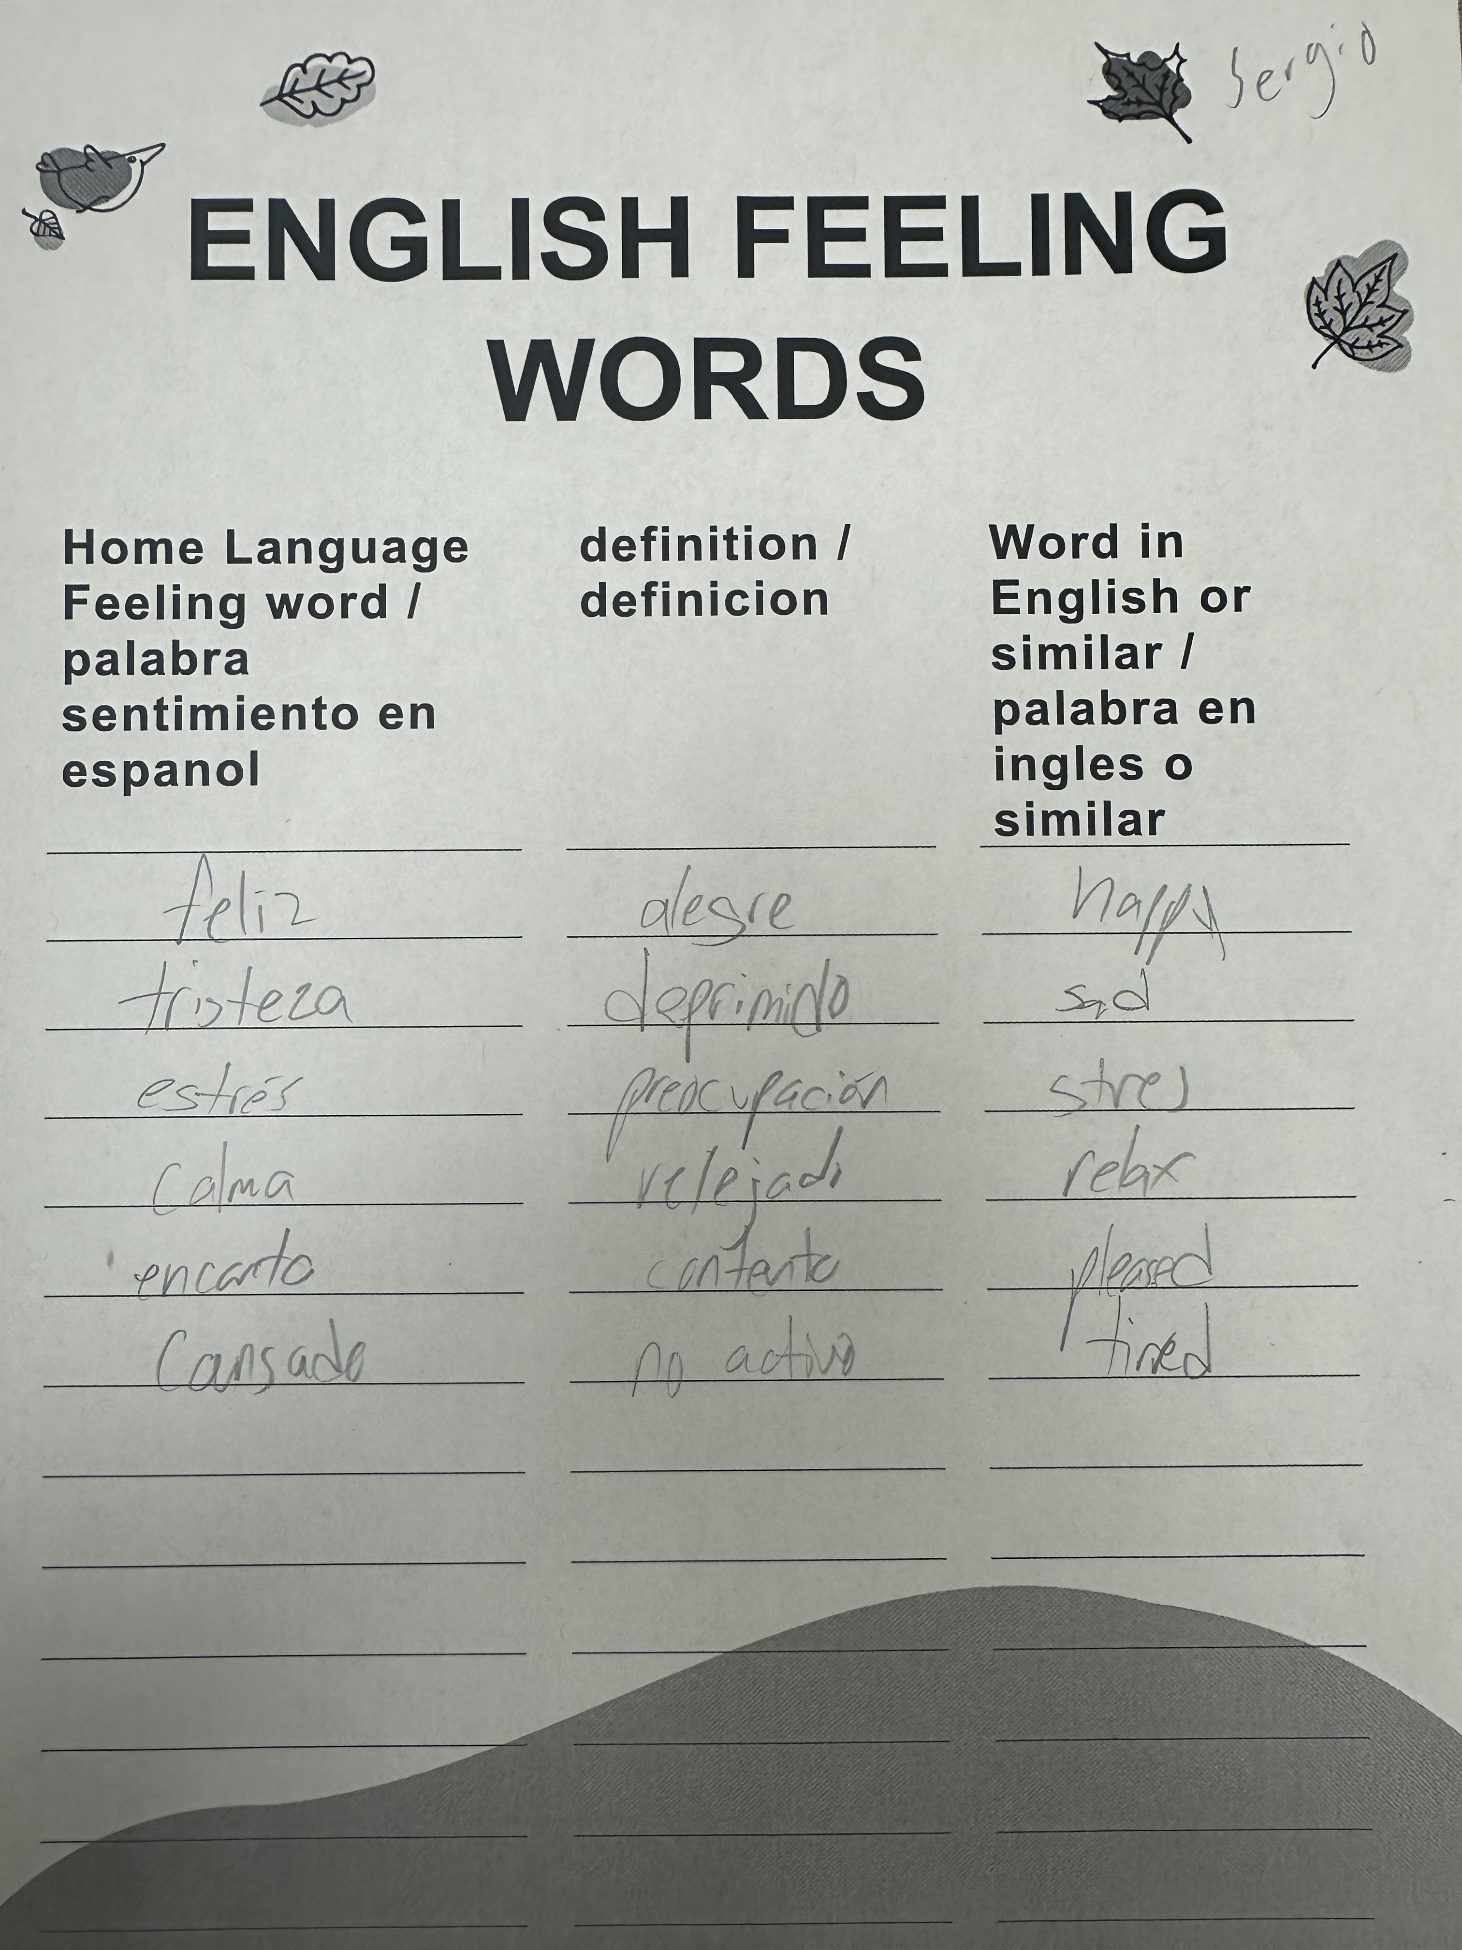
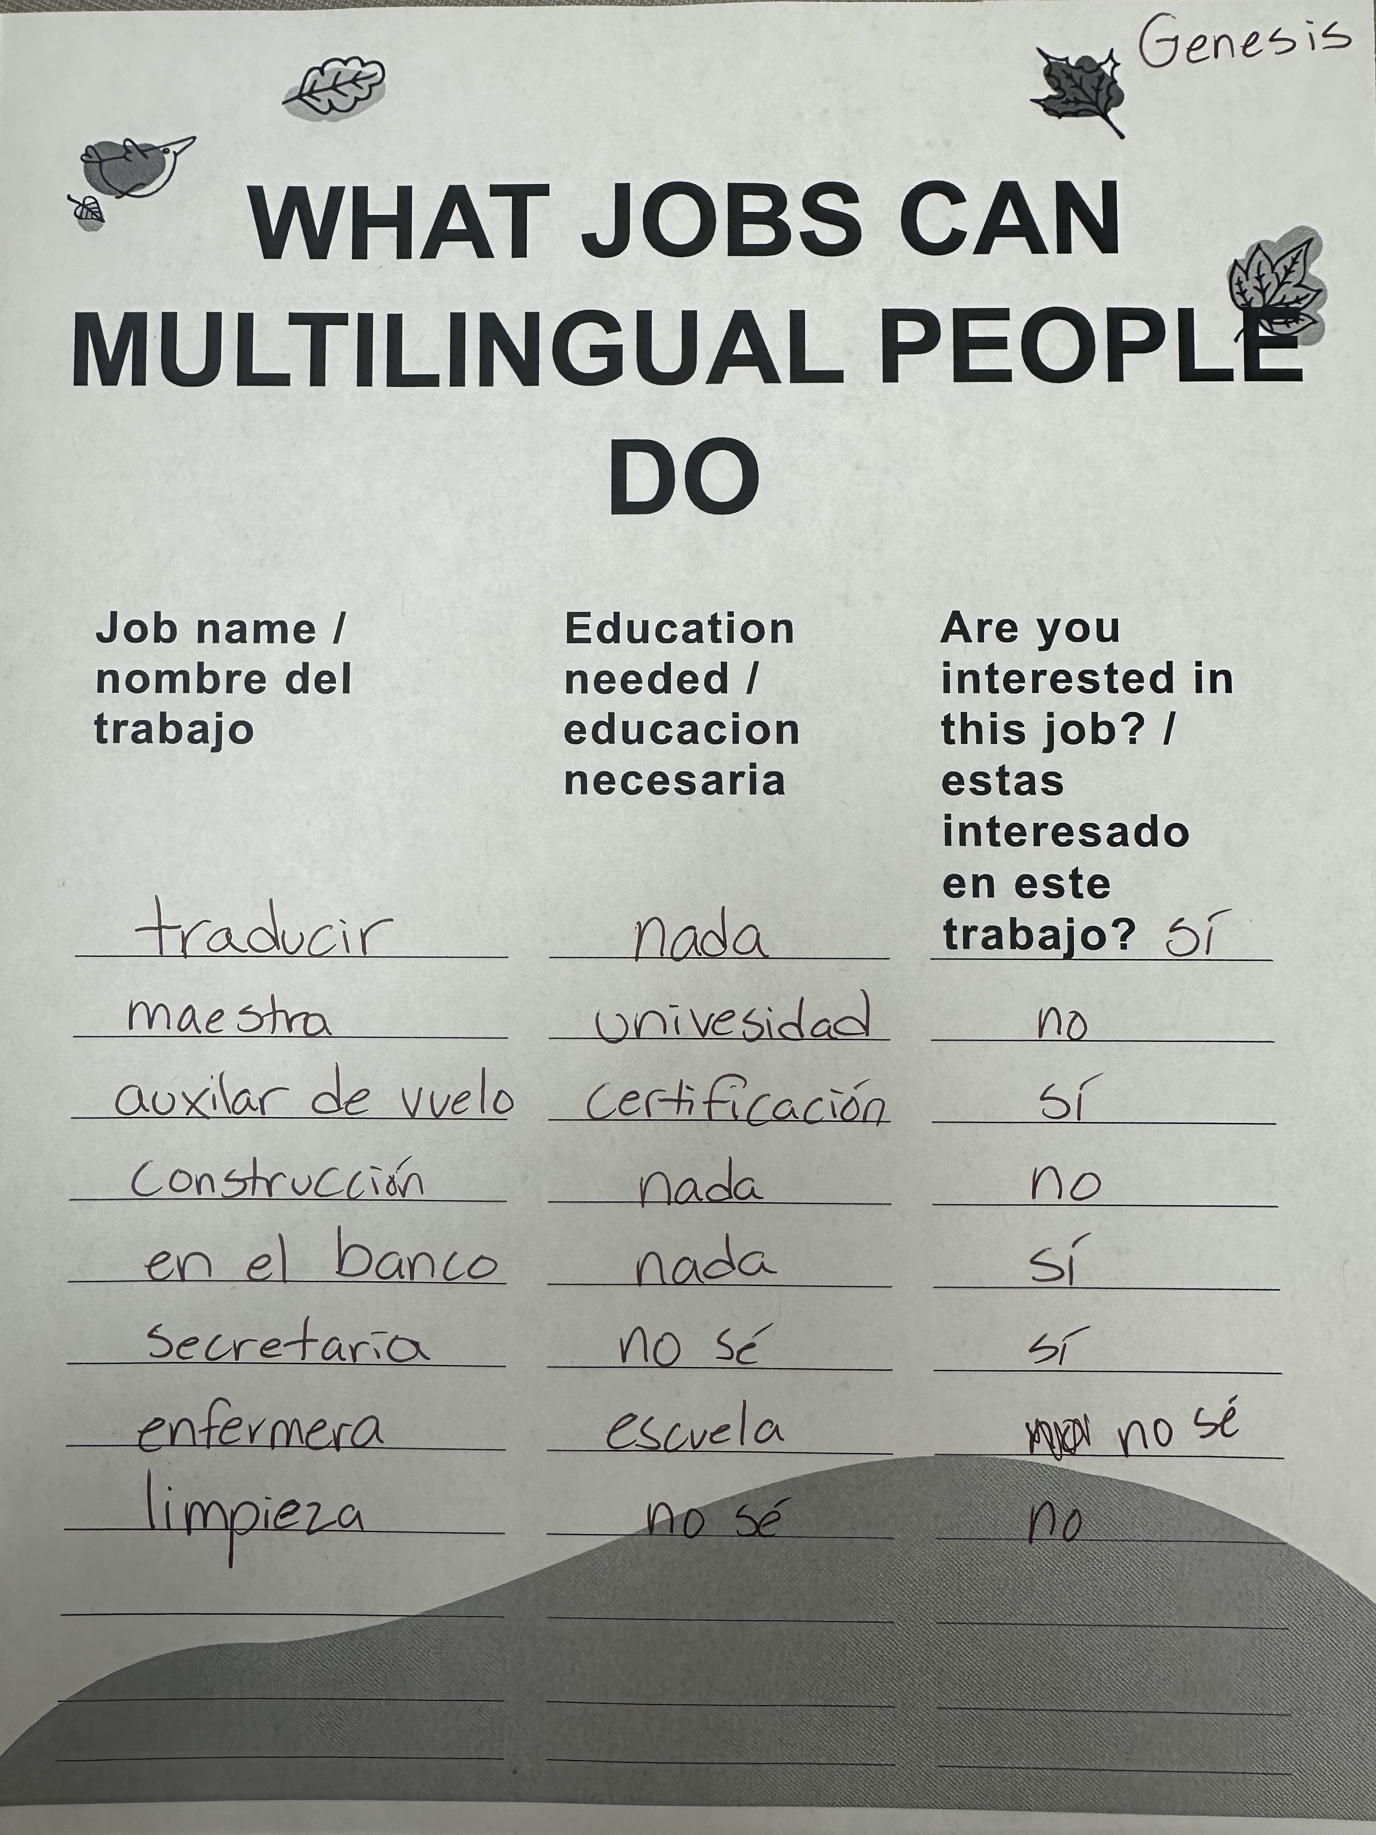
Classroom artifacts

Slide 9
AIA alignment
    Diversity and Advocacy: Multilingual learners are marginalized and face many barriers in education.
Assessment: Counselor will assess the needs of the multilingual students and teachers as well.
Academic Development: These lessons promote academic success and development as multilingual learners have a different education experience than other students.
Collaboration: Counselor will consult with teachers on observed needs of their students.

Slide 10
ASCA Mindsets and behaviors
Learning:
B-LS 2: Creative approach to learning
B-LS 4: Self-motivation/direction for learning
B-LS 7: Long/Short term academic goals
B-LS 8: Engagement in challenging coursework
Self-Management:
B-SMS 1: responsibility for self
B-SMS 5: perseverance to achieve long/short term goals
B-SMS 6: Ability to identify and overcome barriers
B-SMS balance of school, home, and community activities
Social Skills:
B-SS 1: Effective communication skills
B-SS 3: positive relationships with adults to support success
B-SS 8: advocacy skills for self and others and ability to assert self, when necessary
B-SS 10: cultural awareness, sensitivity and responsiveness

Slide 11
Cultural sensitivity
Native culture is incorporated into lessons (Ex. Strong family values in many cultures
Most students in the program speak Spanish (90%) the other 10% of students speaks one or more of the following: Russian, Turkish, Arabic, Swahili and/or Chinese. The lessons cater to all languages in their broadness of topic allowing for the student to express themselves by way of their own culture.
Lessons take place in classrooms made up completely of students in the multilingual program. These multilingual classrooms are seen as the “safe spaces” for these students. The intern counselor has also spent extended time in the multilingual classrooms to build rapport with the students while conducting the occasional social emotional lessons/activities.

Slide 12
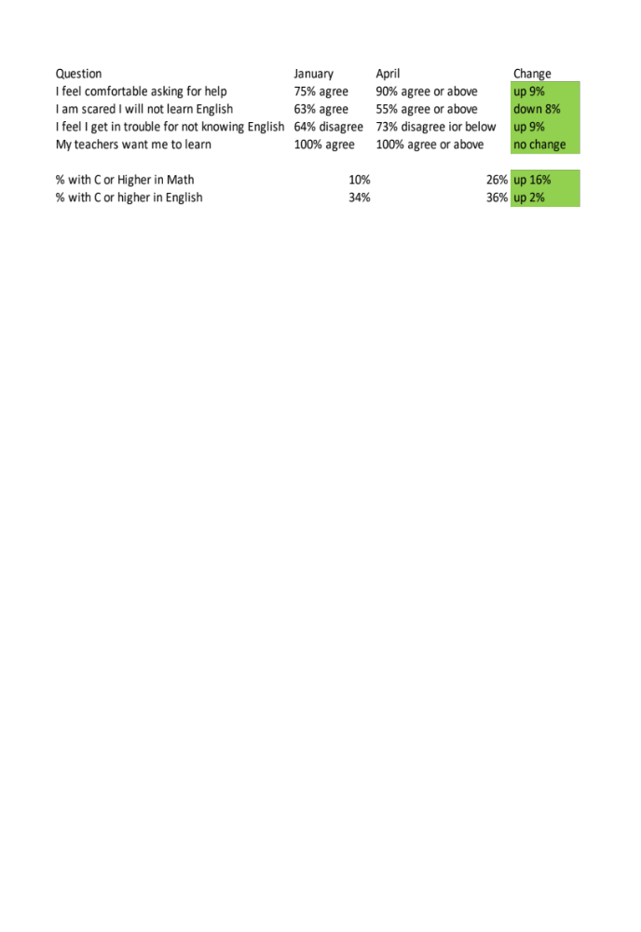
Evaluation

Slide 13
limitations
Post test evaluation used different answer choices than the pre-test so that the answers could be more specific.
Students who speak a language other than Spanish had to translate test questions using their computer since the counselor only understands English and Spanish.
Grades used to measure change in Evaluation are current grades, not report card grades due to presentation’s due date in May.

