Slide 1

Honoring Diversity and Transition
at Somerset Canyons Academy
Amy Sparkman
COSC611
Notes:
I’d like to welcome you to today’s presentation on honoring diversity and transition at Somerset Canyons Academy.

Slide 2


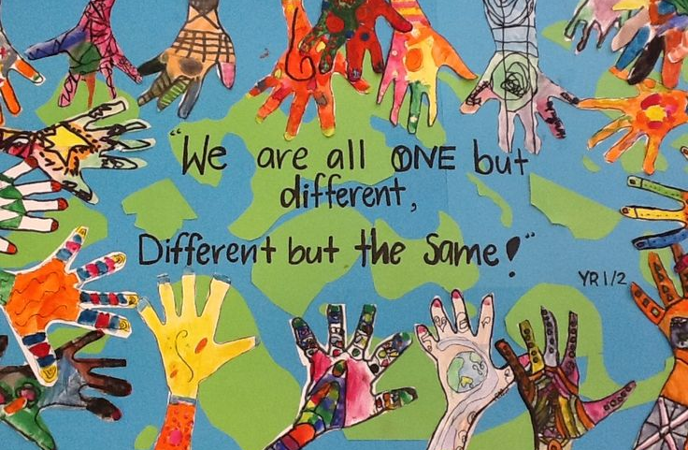
What is Diversity?
Dictionary.com defines “diversity” as, “the inclusion of individuals representing more than one national origin, color, religion, socioeconomic stratum, sexual orientation, etc.,” (n.d.).
Notes:
“Diversity” is defined as “the inclusion of individuals representing more than one national origin, color, religion, socioeconomic stratum, sexual orientation, etc.,” At Somerset Canyons, we have an extremely diverse population of students. This is what makes us special, but this diversity also comes with its challenges.

Slide 3
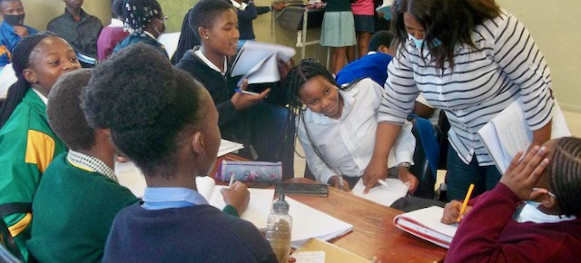
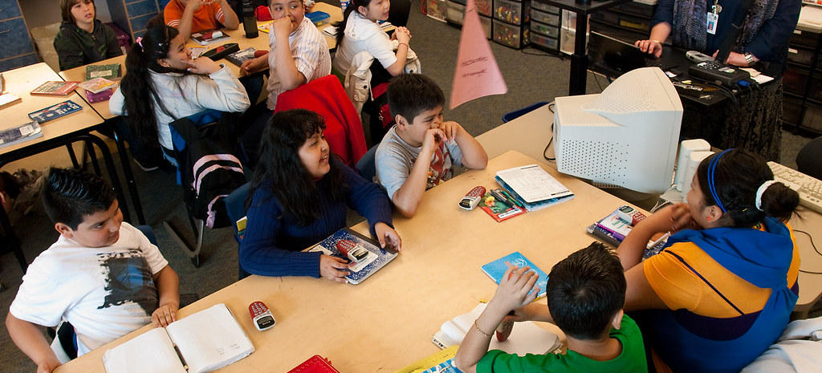
What does diversity look like in the classroom?
Notes:
What does diversity look like in the classroom?

Slide 4
A classroom with a varied student body is one where there are students from a variety of cultural backgrounds, including different religious backgrounds, disabilities, and levels of giftedness and linguistic proficiency.
(du Plessis & Bisschoff, 2007)
Notes:
According to a study by du Plessis & Bisschoff, a diversified classroom is a classroom with students from various cultures, different religions, various disabilities, languages, and levels of giftedness. Here at Somerset, we definitely fit this description!

Slide 5
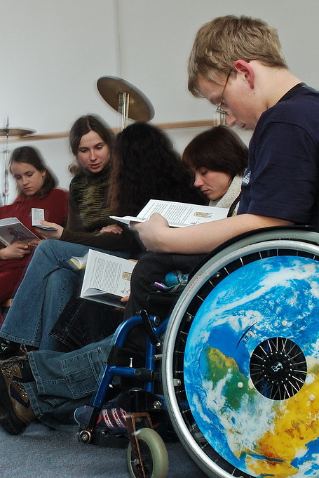

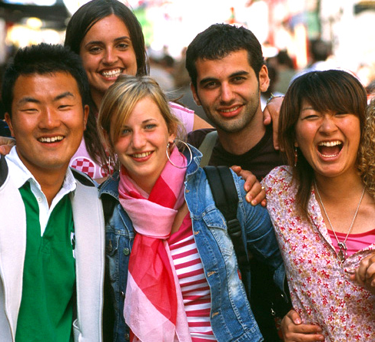
What are some characteristics and needs of diverse students?
Notes:
What are some of the characteristics and needs of diverse students?

Slide 6
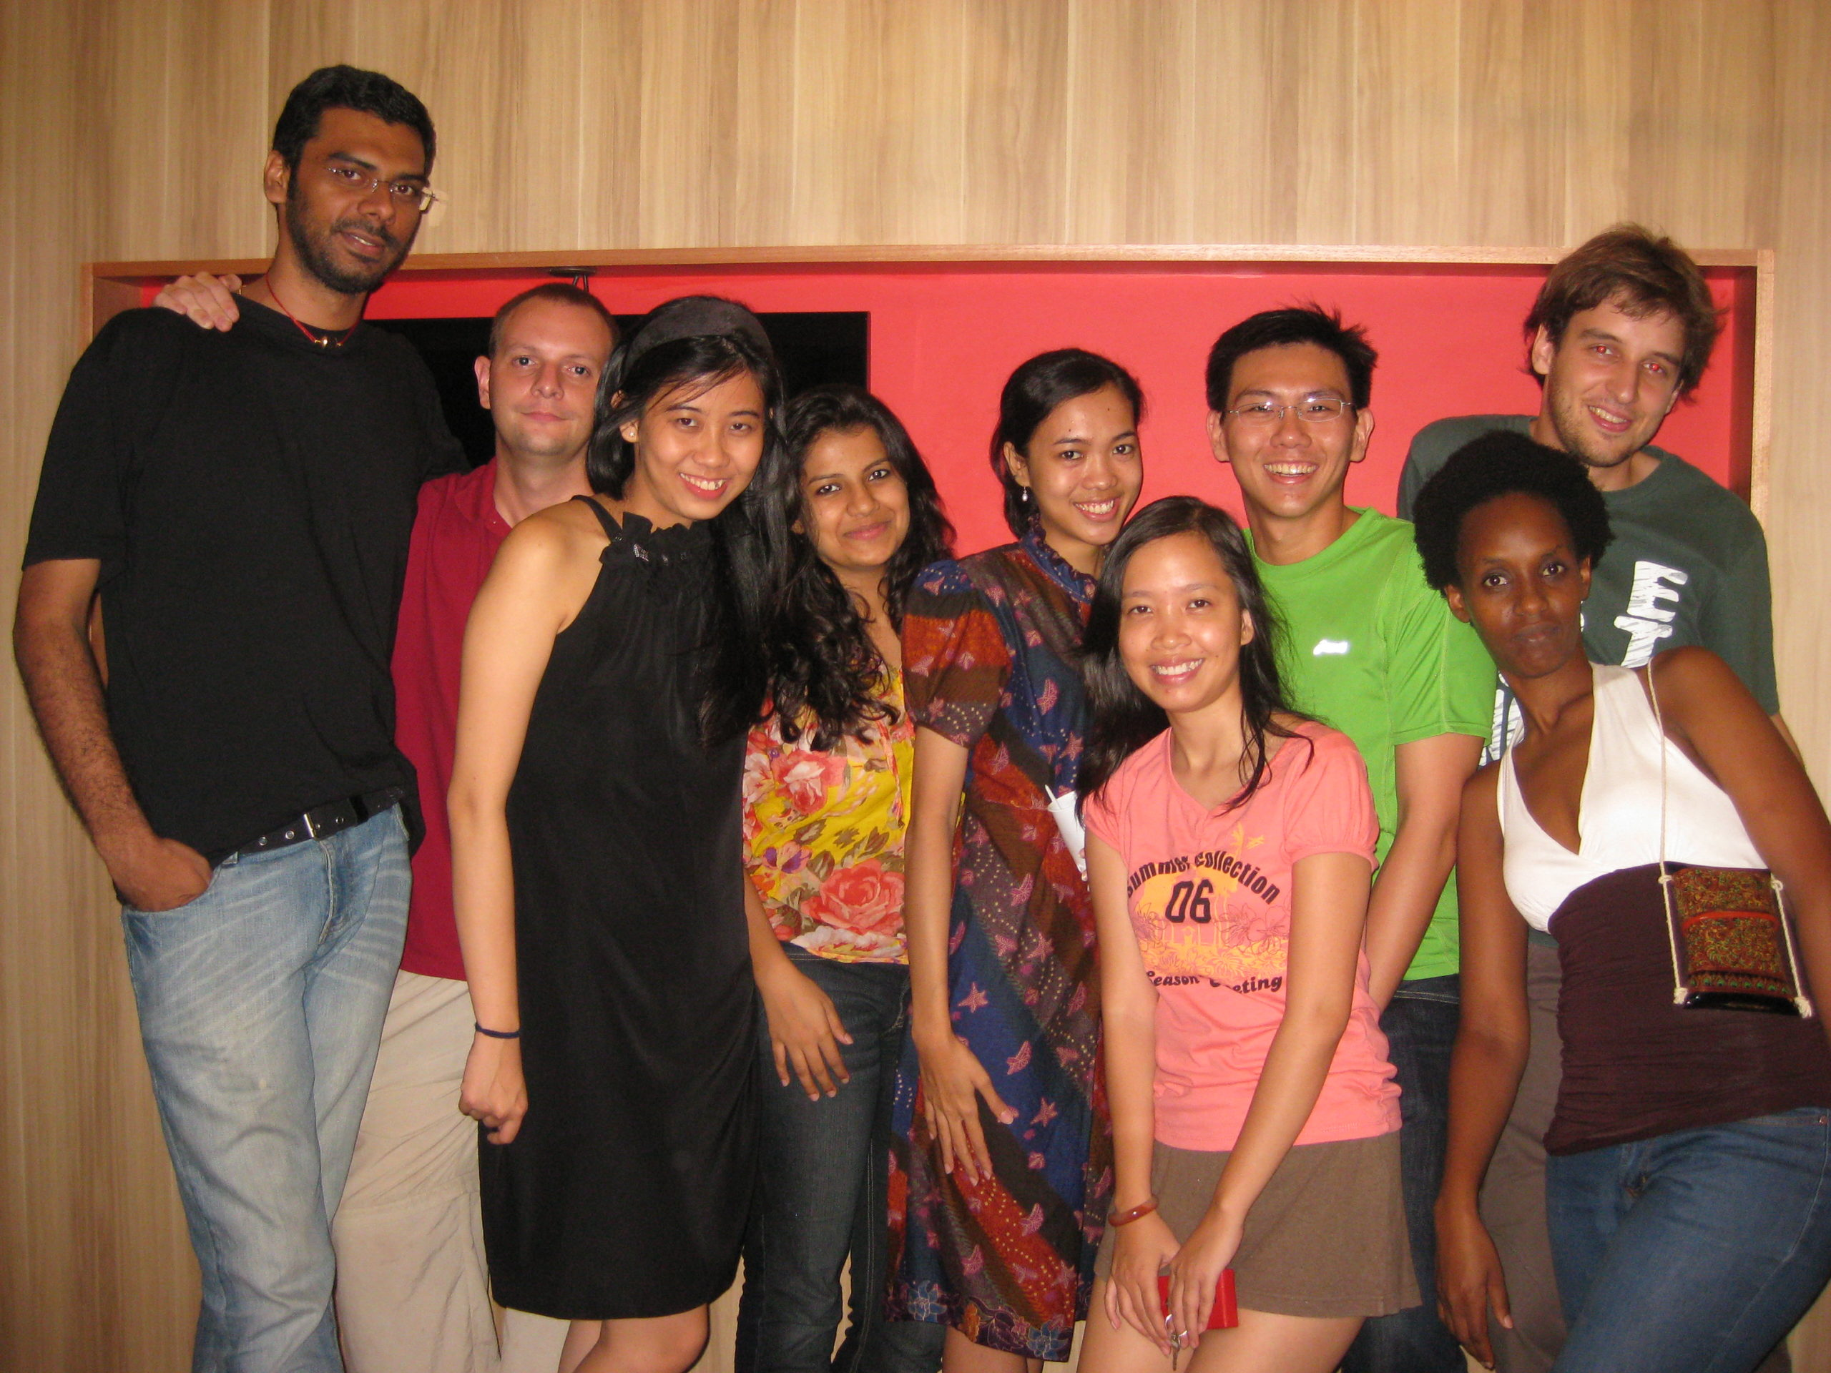
Characteristics and needs of diverse students include:
Various backgrounds, which manifest as abilities, knowledge, family and community traits, and experiences.
Language, subject matter, educational differences, religions, and cultural strengths.
Notes:
Diversity within ethnic groups, like that found in our students, must be considered when teaching. We must also consider the differences among our students, with a combination of gender, cultural heritage, socioeconomic status, and talent. According to research, both poor and high performers can benefit greatly from instruction that is sensitive to student diversity.

Slide 7

How can we promote an inclusive environment and encourage diversity in the classroom?
Notes:
How can we promote an inclusive environment and encourage diversity in the classroom?

Slide 8
How can we promote an inclusive environment and encourage diversity in the classroom?
Motivation and meaningful engagement in relevant, student-centered activities.
A sense of purpose and direction in learning.
A willingness to use your resources to learn new things and to persevere when faced with difficult tasks.
Materials that show fair and favorable representations of various populations.
(Ernst-Slavit & Egbert, n.d.)
Notes:
To promote an inclusive environment and encourage diversity in our school, we need to make sure that our lessons are motivational, relevant, and student-centered. We need to give our students a sense of purpose and direction. When we are faced with difficulties, we need to be willing and open to new things and we need to be conscious to use materials that are relevant to our students and demonstrate favorable representations of all students. (Ernst-Slavit & Egbert, n.d.)
The goal of effective instruction is to improve student performance.. Students succeed when they get high-quality instruction, which supports the learning of diverse individuals. Our teachers need to create and upholds standards for learning. When not accompanied by high-quality instruction, high expectations are insufficient..

Slide 9
Schools should be equipped to address students' developmental and multicultural needs in a holistic way that considers spiritual and religious needs as a natural part of human development connected to students' family structures and worldviews, permeating the counselor-student relationship and school counseling procedures.
(Kimbel & Schellenberg, 2013, p. 78)
Notes:
According to Kimbel & Schellenberg, successful schools are prepared to address students' developmental and multicultural needs in a comprehensive manner that considers spiritual and religious needs as a natural part of human development connected to students' family structures and worldviews. (Kimbel & Schellenberg, 2013, p. 78)

Slide 10

Social Emotional Learning (SEL) Factors to remember:
Teachers and school faculty should be familiar with the various cultural backgrounds and traditions of the students.
We need to be aware of how children from these various backgrounds are impacted socially and emotionally.
Education and human development both include social and emotional learning (SEL). In order to develop healthy identities, manage emotions, accomplish personal and group goals, feel and demonstrate empathy for others, build and maintain supportive relationships, and make caring decisions, all young people and adults must go through the process of SEL (CASEL, 2023).
We should also be knowledgeable about the difficulties students may encounter at school and how to address such difficulties.
Notes:
As we look at focusing on diversity at Somerset Canyons, we need to consider some important social emotional (SEL) factors. Not only do we need to consider the various cultural backgrounds and traditions of our students; we need to also be conscious of the social and emotional effects on kids from these varied backgrounds. We should also be educated about the challenges that students can face at and how to deal with those challenges.
Social and emotional learning (SEL) is a component of both human development and education. All children and adults must go through the SEL process to create positive identities, control their emotions, achieve individual and group objectives, feel and show empathy for others, establish and sustain supportive relationships, and make good decisions (CASEL, 2023).

Slide 11
3 Practical Tips for
Promoting Diversity in the Classroom:
Recognize Student Diversity
Recognize and celebrate diversity in socioeconomic backgrounds, gender, sexual orientation, and ethnicity.
Promote student interaction
Students are more inclined to stick with something if they feel academically and socially connected.
Encourage a Positive School Climate
The involvement and learning of students can be strongly and positively impacted by a positive climate.
(du Plessis & Bisschoff, 2007)
Notes:
Here are some practical tips that can help our teachers promote diversity in your classrooms:
1: Recognize the diversity of your students and celebrate this diversity.
2. Promote student interaction and participation. Students will be more likely to work hard when they feel seen and understood.
3. Encourage a positive school climate or atmosphere. A good classroom climate can have a significant and positive impact on the engagement and learning of students.
(du Plessis & Bisschoff, 2007)

Slide 12
At Somerset Canyons, 72% of our students are economically challenged.
As a school with students in 6th-12th grade, we are uniquely able to address these issues early, starting a post-secondary transition program for our students as early as 6th grade.
Additionally recent data suggests that only 30% of our students are currently seeking postsecondary opportunities, such as apprenticeships, job training, college admissions, military, etc.
Studies show that too frequently, high school does not adequately prepare students for postsecondary education or the demands of a job in an information-based economy (Bangser, 2008).
Notes:
Here at Somerset Canyons, 72% of our students are challenged economically. Also, only 30% of our students are seeking postsecondary opportunities after graduation.
According to studies, high school students are often not fully prepared for postsecondary education or the demands of a job in our information-based economy (Bangser, 2008).
We are ideally positioned to address these concerns early as a school with students in grades 6 through 12, beginning a post-secondary transition program for our kids as early as 6th grade.

Slide 13
GEAR UP
Somerset Canyons Transition Program
GEAR UP aims to raise the proportion of low-income students who are ready to enroll in and succeed in postsecondary education.
Beginning no later than the seventh grade, GEAR UP provides services to students, continuing with them through high school.
Low-income students can also receive college scholarships thanks to GEAR UP funding.
(U.S. Department of Education, 2023)
Notes:
GEAR UP is a grant-funded program, offered by the U.S. Department of Education that offers our low-income students with extra help to help them work towards success and postsecondary education. We will enroll students in either 6th or 7th grade and the GEAR UP program will offer them services for free all the way through high school. Additionally, GEAR UP offers college scholarships to participating students (U.S. Department of Education, 2023.

Slide 14

Goal
Our goal is for every GEAR UP student to have access to, attend, graduate from, and be a successful individual in their respective communities with a certificate, degree, or specialized training.
Notes:
The goal of our GEAR UP program is that every GEAR UP student should be able to access, enroll in, complete, and graduate from a certificate, degree, or other specialized training program to be successful in their local communities.

Slide 15
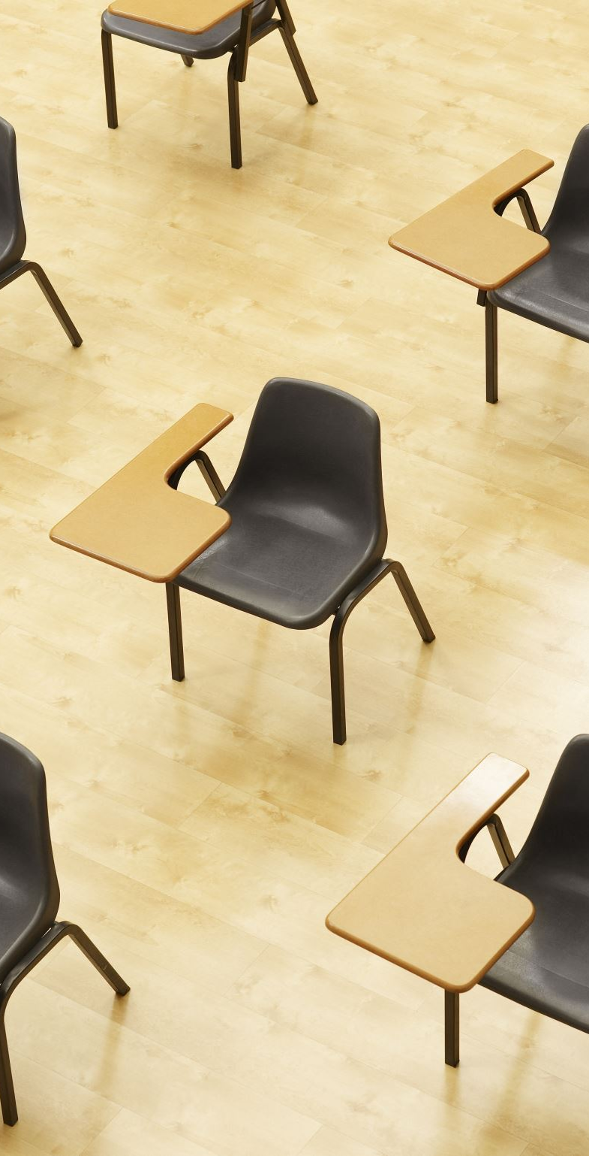
What is GEAR UP?
GEAR UP aids students in their transition from middle school to high school and helps them as they enter higher education and the workforce.
GEAR UP is intended for students who are considering postsecondary alternatives and their parents, who may have questions or who may wish to participate in the process.
The seven-year program's objective is to enhance children's academic achievement and workforce and college readiness.
Our students can choose from a wide range of academic and professional options. The preparation for post-secondary education includes a variety of hands-on activities, college visits, career discovery, and other activities.
The project aids students as they move into higher education and careers and supports them throughout their time in middle school and high school.
Notes:
What exactly is GEAR UP?
-GEAR UP supports students when they move from middle to high school, as well as when they start college or the employment.
-Parents who might have concerns or who might want to get involved in the process, as well as students who are thinking about college options, are the target audience for GEAR UP.
-The goal of the seven-year program is to improve children's academic performance and preparation for both the workforce and higher education.
-Our students will have access to a broad range of academic and career possibilities. Numerous hands-on activities, college tours, career exploration, and other activities are part of the preparation for post-secondary education.
The program supports students throughout their time in middle school and high school and helps them as they transition into higher education and careers.

Slide 16
Activities include:
Specialized pre-assessment evaluations of students' career interests, needs assessments, and standardized test scores creating a career plan for them to concentrate on.
Classroom Guidance meetings, Individual Counseling, Staff Training, and Peer Support Groups
Meetings for students and parents to meet in person or virtually to discuss activities such as counseling, college guidance, and career exploration
Interactive, hands-on activities and online learning opportunities during the summer.
College visits and other activities to prepare for college.
Notes:
Included in the activities that our students will be offered are:
-A career plan to focus on based on specialized pre-assessment evaluations of their career interests, needs assessments, and test scores.
-Guidance sessions in the classroom, private counseling, staff development, and peer support groups
-Meetings where parents and kids can interact digitally or in person to talk about topics like job discovery, college help, and counseling.
-Summertime learning opportunities that are interactive, practical, and online.
-College visits and other related activities.

Slide 17
Communication with parents & families
Information will be provided to students in school through meetings with the guidance counselor and by attending college programs that are held during school hours.
Information will be provided to parents through email and quarterly meetings.
Information about postsecondary alternatives will be provided to parents so they can advise and support their children.
Notes:
We will continually communicate with our parents and families, as well. Parents will receive information through email and at quarterly meetings. Parents will receive information on postsecondary options so they may counsel and assist their children.

Slide 18
Evaluation
Transition Assessments: Post-assessments, comparing results from pre-assessments, that include tracking the development of post-school results, making plans to accommodate students’ shifting preferences, interests, needs, and abilities.
In addition to official evaluations like academic, cognitive, and adaptive examinations, there will also be periodic informal evaluations such as surveys and observations.
(US Department of Education, 2023)
Notes:
We will evaluate this program with transition assessments. Post-assessments will be used to compare results to pre-assessments, track post-school results, and make plans to consider students' changing preferences, interests, requirements, and abilities. Periodic informal evaluations like surveys and observations will be conducted in addition to formal assessments like academic, cognitive, and adaptive exams.

Slide 19
References:
Bangser, M. (2008, August). Preparing high school students for successful transitions to ... - MDRC. betterhighschools.org. https://www.mdrc.org/sites/default/files/PreparingHSStudentsforTransition_073108.pdf
CASEL. (2023, June 29). Fundamentals of sel. CASEL. https://casel.org/fundamentals-of-sel/
Dictionary.com. (n.d.). Diversity definition & meaning. Dictionary.com. https://www.dictionary.com/browse/diversity
du Plessis, P., & Bisschoff, T. (2007). Diversity and complexity in the classroom: valuing racial and cultural diversity. Educational Research and Review, 2(9), 245–254. https://doi.org/http://www.academicjournals.org/ERR
Duval County Public Schools. (n.d.). Gear UP / about Us. GEAR UP / About Us. https://dcps.duvalschools.org/domain/10301

Slide 20
References (cont.):
Kimbel, T. M., & Schellenberg, R. (2013). Meeting the holistic needs of students: A proposal for spiritual and religious competencies for school counselors. Professional School Counseling, 17(1), 76–85. https://doi.org/10.1177/2156759x0001700110
Milsom, A., & Hartley, M. T. (2005). Assisting Students with Learning Disabilities Transitioning to College: What School Counselors Should Know. Professional School Counseling, 8(5), 436–441. https://doi.org/https://www.jstor.org/stable/42732486
United States Department of Education. (2023, May 26). A transition guide to postsecondary education and employment for students and youth with disabilities (Aug. 2020). Individuals with Disabilities Education Act. https://sites.ed.gov/idea/idea-files/policy-guidance-transition-guide-postsecondary-education-employment-students-youth-disabilities-august-2020/
United States Department of Education (ED). (2023, June 15). Gaining early awareness and readiness for Undergraduate Programs (Gear UP). Home. https://www2.ed.gov/programs/gearup/index.html

