Slide 1
Youth Mental Health and Well-Being
Amy Sparkman

Slide 2
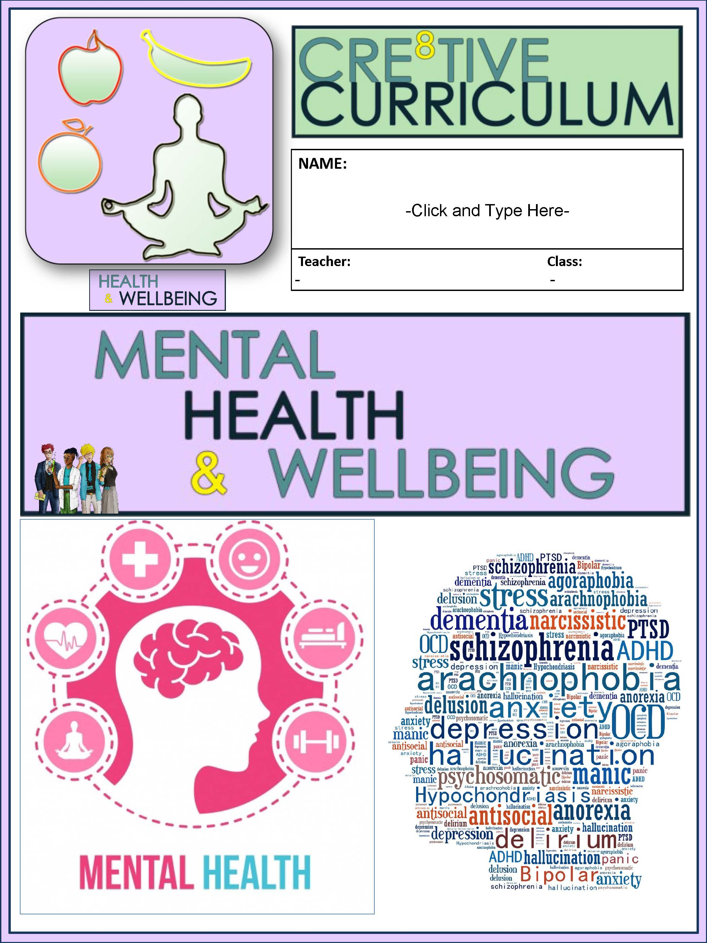
(Cre8tive Resources, n.d.)

Slide 3
Existing Data Sources
Individual F.A.S.T. test results
School Discipline Referral Log
Students’ Individual SIS (student information system) file

Slide 4
Needs Assessment
There were 11 high school students (11th and 12th grade) in the participating class.The teachers who have been teaching the students in the class for the last year were asked to complete a survey to find out if they had any concerns about any of the participating students. From this survey, I was able to get some insightful details on the students.
This was an Intensive Reading class and these students have all had struggles with reading and comprehension in school. The teacher described them as “good” kids, but not very motivated. He recommended this class, in particular, because several of them have struggled academically and have a relatively low self-image. He mentioned that several of them have struggled with self-esteem and anxiety.

Slide 5
Project Description
01
02
Screen Time Safety
Mental Health & Well-Being
03
04
Self Harm & Well-Being
Promoting Emotional Well-Being
To explore how technology and social media can negatively impact your mental health, to understand the impact screen addiction is having on society, and to evaluate how technology and smartphones can both be rewarding and damaging in our lives.
To describe what mental health and mental illness is, to explore different types of mental illnesses, and to understand what you can do to help someone with their mental health.
To understand that self-harm is a behaviour and not an illness, to understand that some people who self-harm are trying to communicate that they are distressed, to evaluate what support networks are available to help those that are self-harming.
To understand what well-being might look like in someone’s life, to understand the meaning of mental health and emotional well-being, to learn strategies to improve yours and others’ emotional well-being.

Slide 6
AIA Specialty Standards and Rationale
Counseling Prvention & Intervention (D.2)
Assessment (H.3)
Research & Evaluation (J.3)
Collaboration & Consultation (N.3)
Analyzes assessment information in a manner that produces valid inferences when evaluating the needs of individual students and assessing the effectiveness of education programs.
Provides individual and group counseling and classroom guidance to promote the academic, career, and social/emotional development of students.
Consults with teachers, staff, and community-based organizations to promote student academic, career, and social/emotional development.
Analyzes and uses data (and relevant technology) to enhance school counseling programs.
(Liberty University, n.d.)

Slide 7
ASCA Mindsets & Behaviors and Rationale
B-SMS 6
B-SMS 7
B-SS 5
Ability to identify and overcome barriers.
Effecitve coping skills
Ethical decision-making and social responsibility
(American School Counselor Association, 2019)

Slide 8
Florida State Academic Standard (Applications of Psychological Science Domain: Health)
SS.912.P.19.1
SS.912.P.19.2
SS.912.P.19.7
Define stress as a psychophysiological reaction.
Identify and explain potential sources of stress.
Distinguish between effective and ineffective means of dealing with stressors and other health issues.
(Florida Department of Education, 2023)

Slide 9
Cultural Sensitivity
The class was made up of 6 Afro-Americans and 5 Hispanics. Every group meeting began with a discussion of the group norms and regulations to remind to them to respect each other’s. It was critical that every student in the class always feels free to express their emotions and experiences without worrying about facing prejudice. It was imperative that I take into consideration the unique family culture of each student.
Several recommendations for inclusive thinking are provided by McGoldrick et al., which is required for evaluating family issues and typical adaption in a cultural setting. Among these recommendations are understanding that a family's cultural, social class, religious, and political background shapes how its members interpret their issues and that having a strong bond with one's family of origin enhances one's feeling of mental health and well-being (2005).

Slide 10
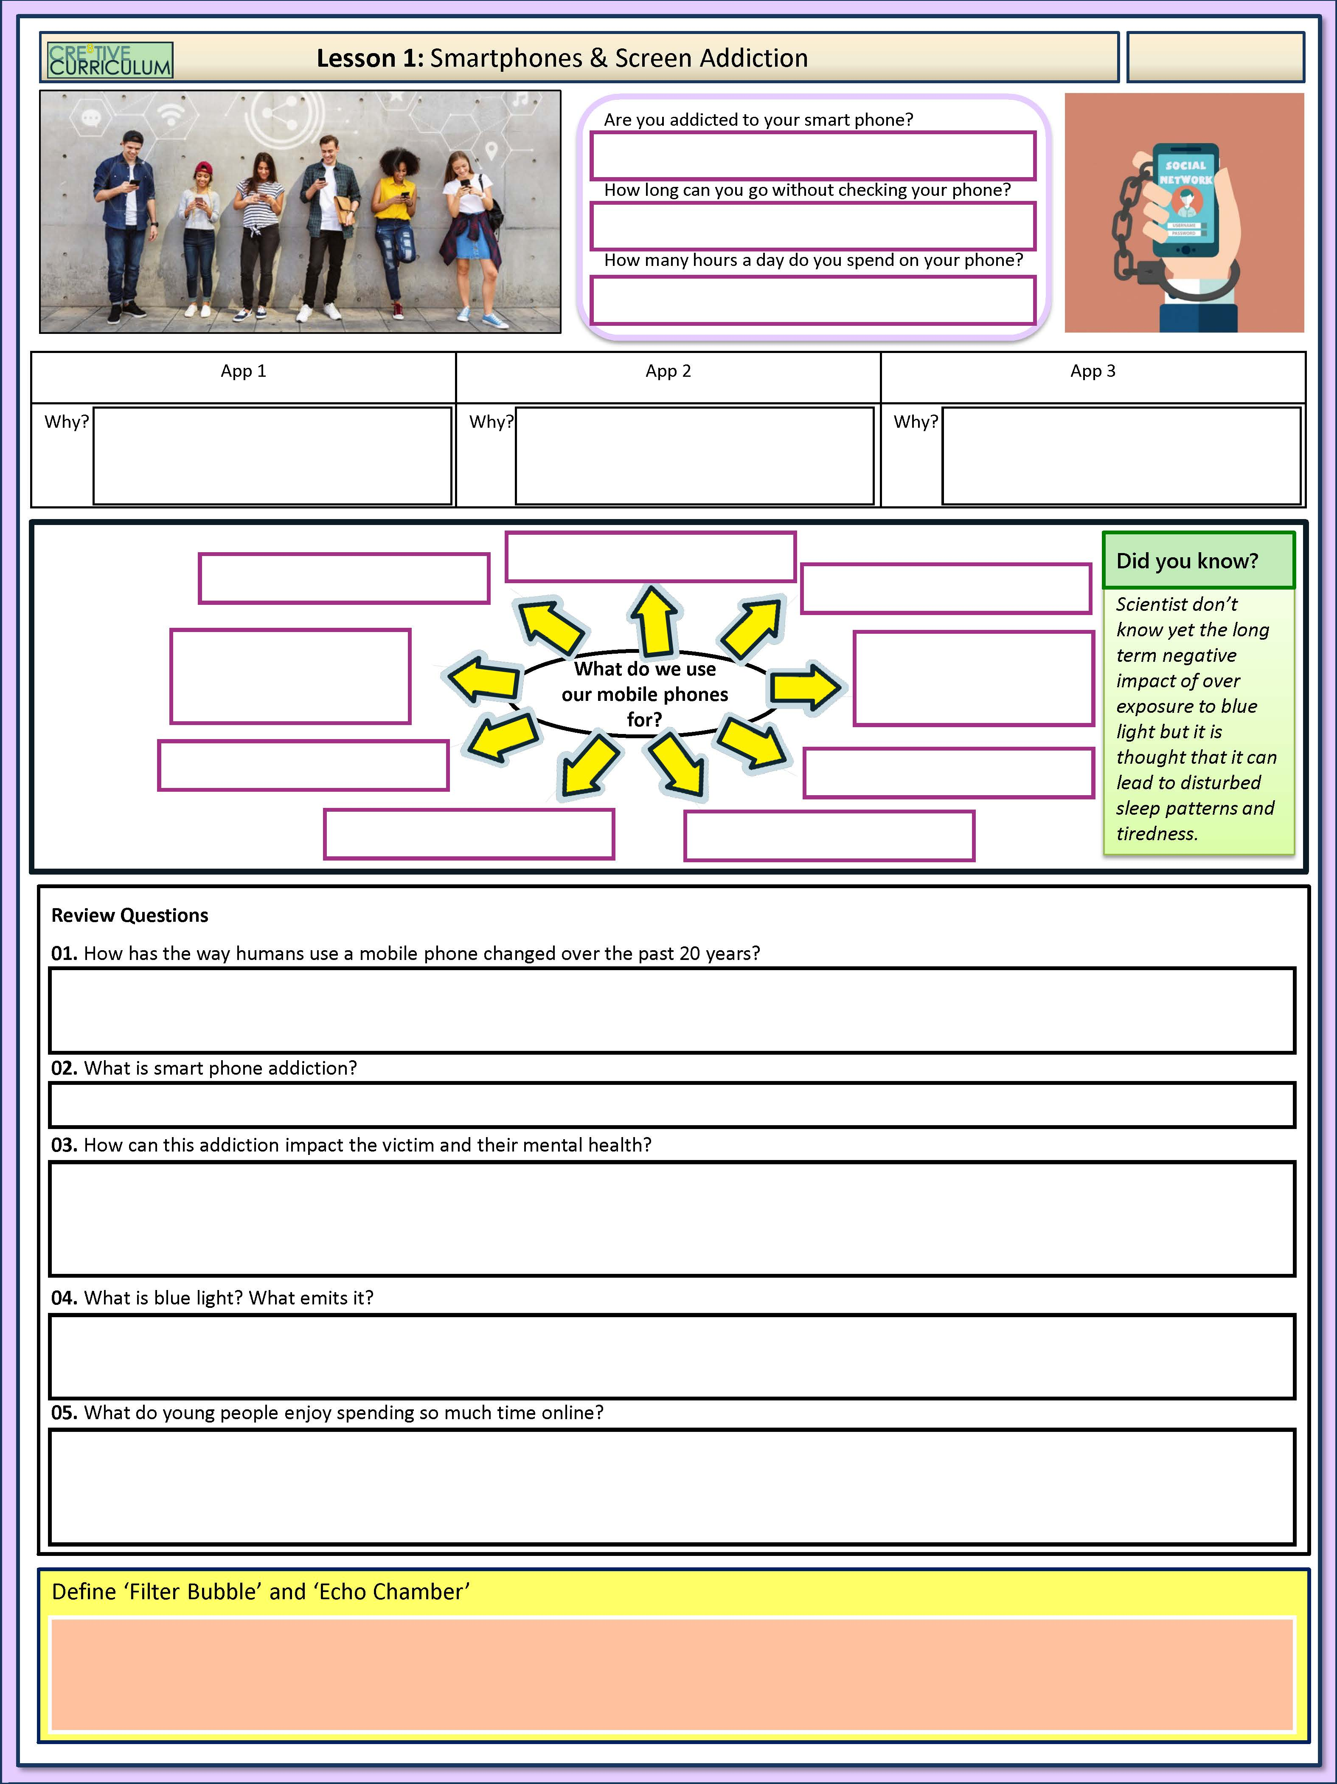
Lesson 1: Smartphone & Screen Addiction
(Cre8tive Resources, n.d.)

Slide 11
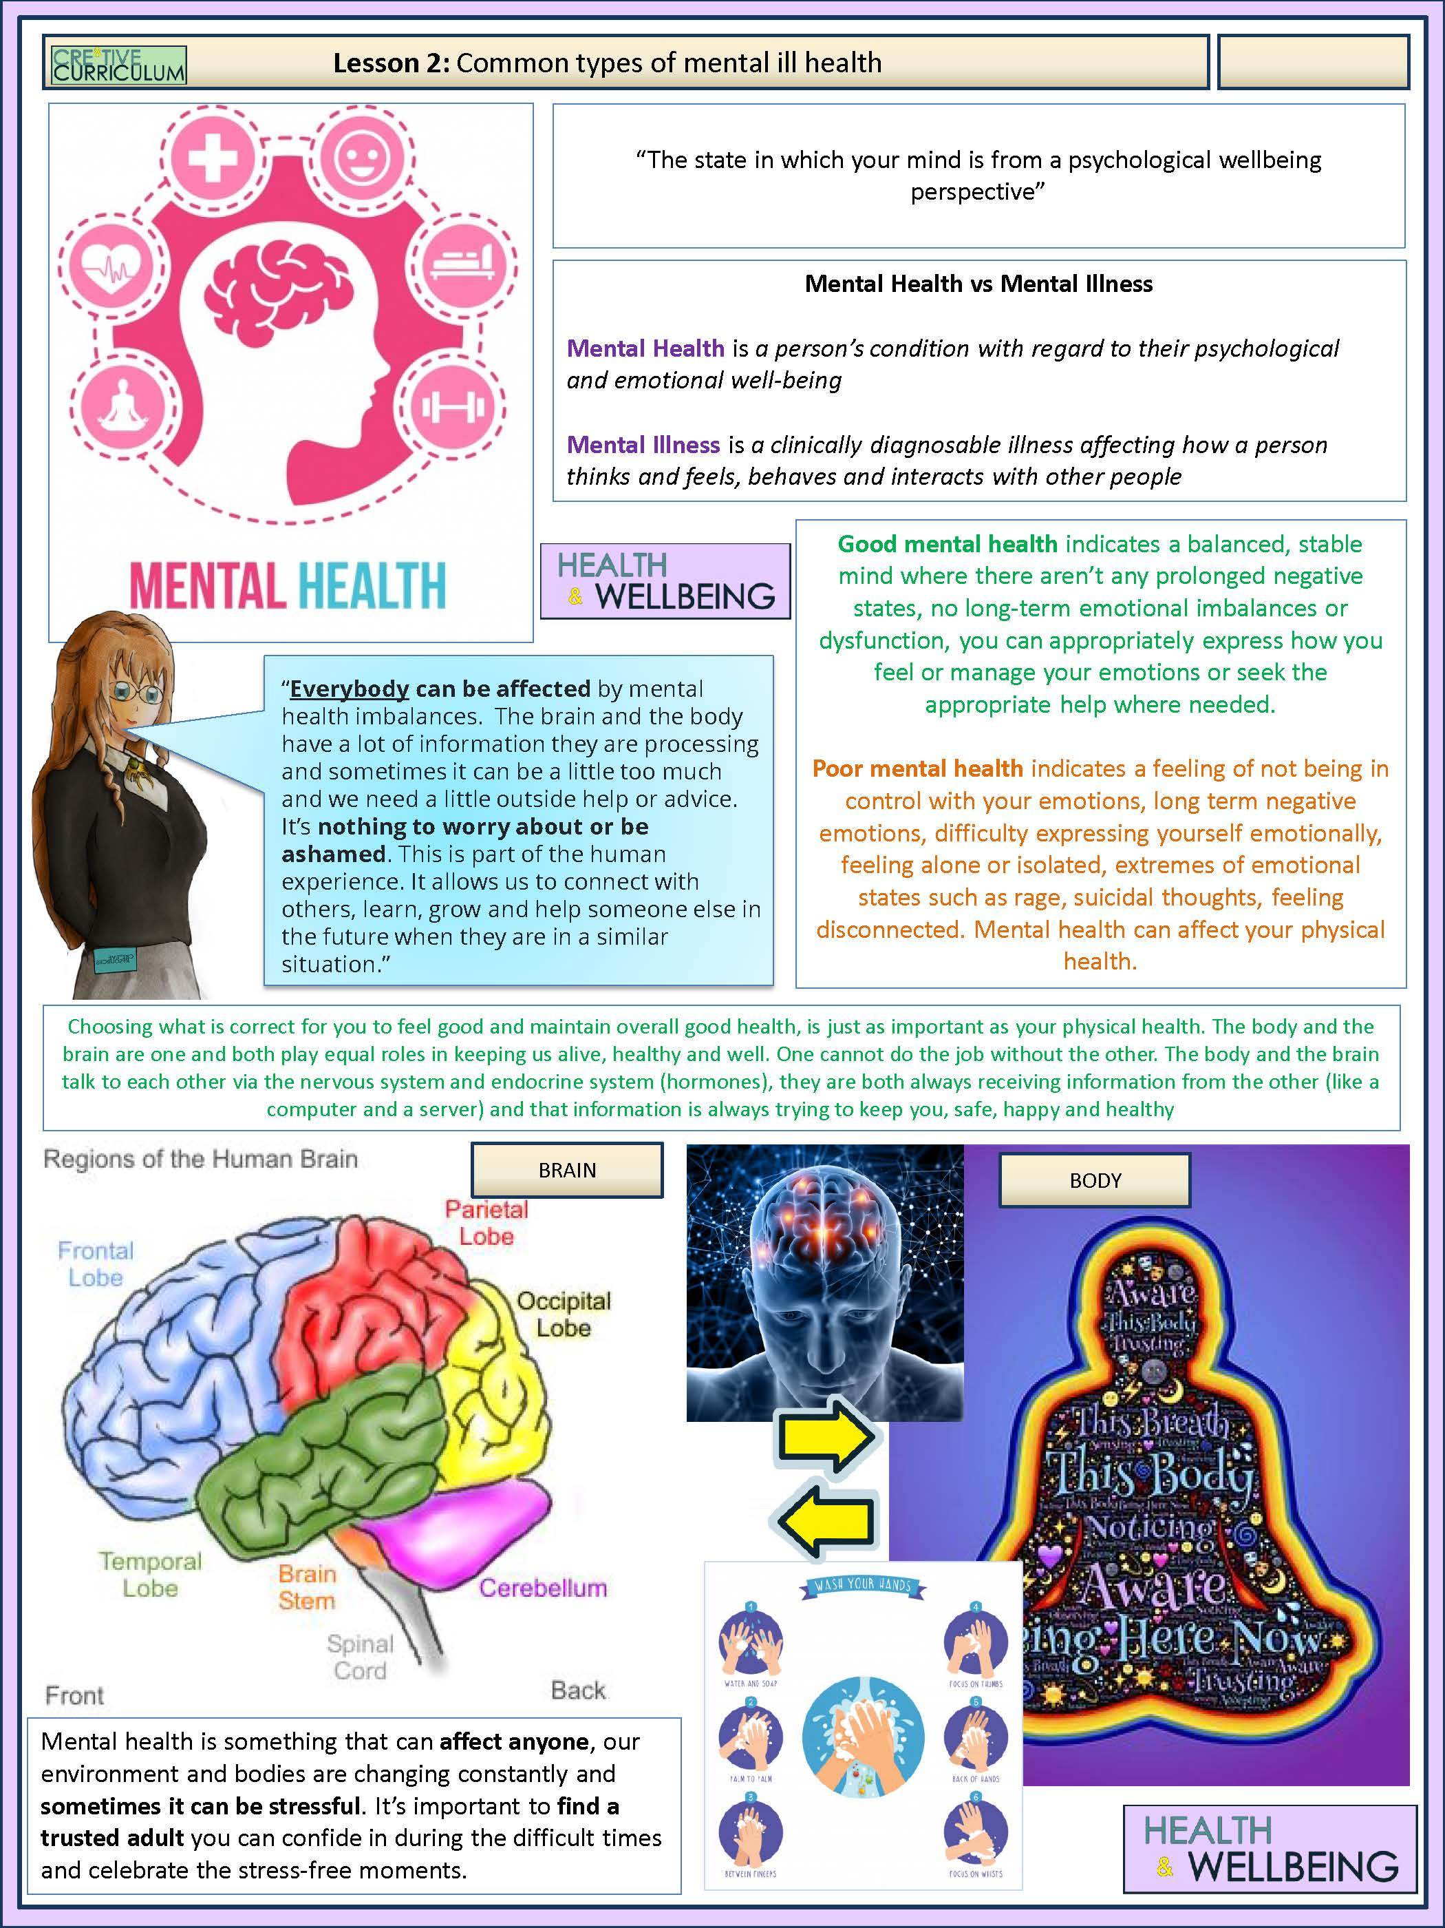
Lesson 2: Common Types of Mental Health
(Cre8tive Resources, n.d.)

Slide 12
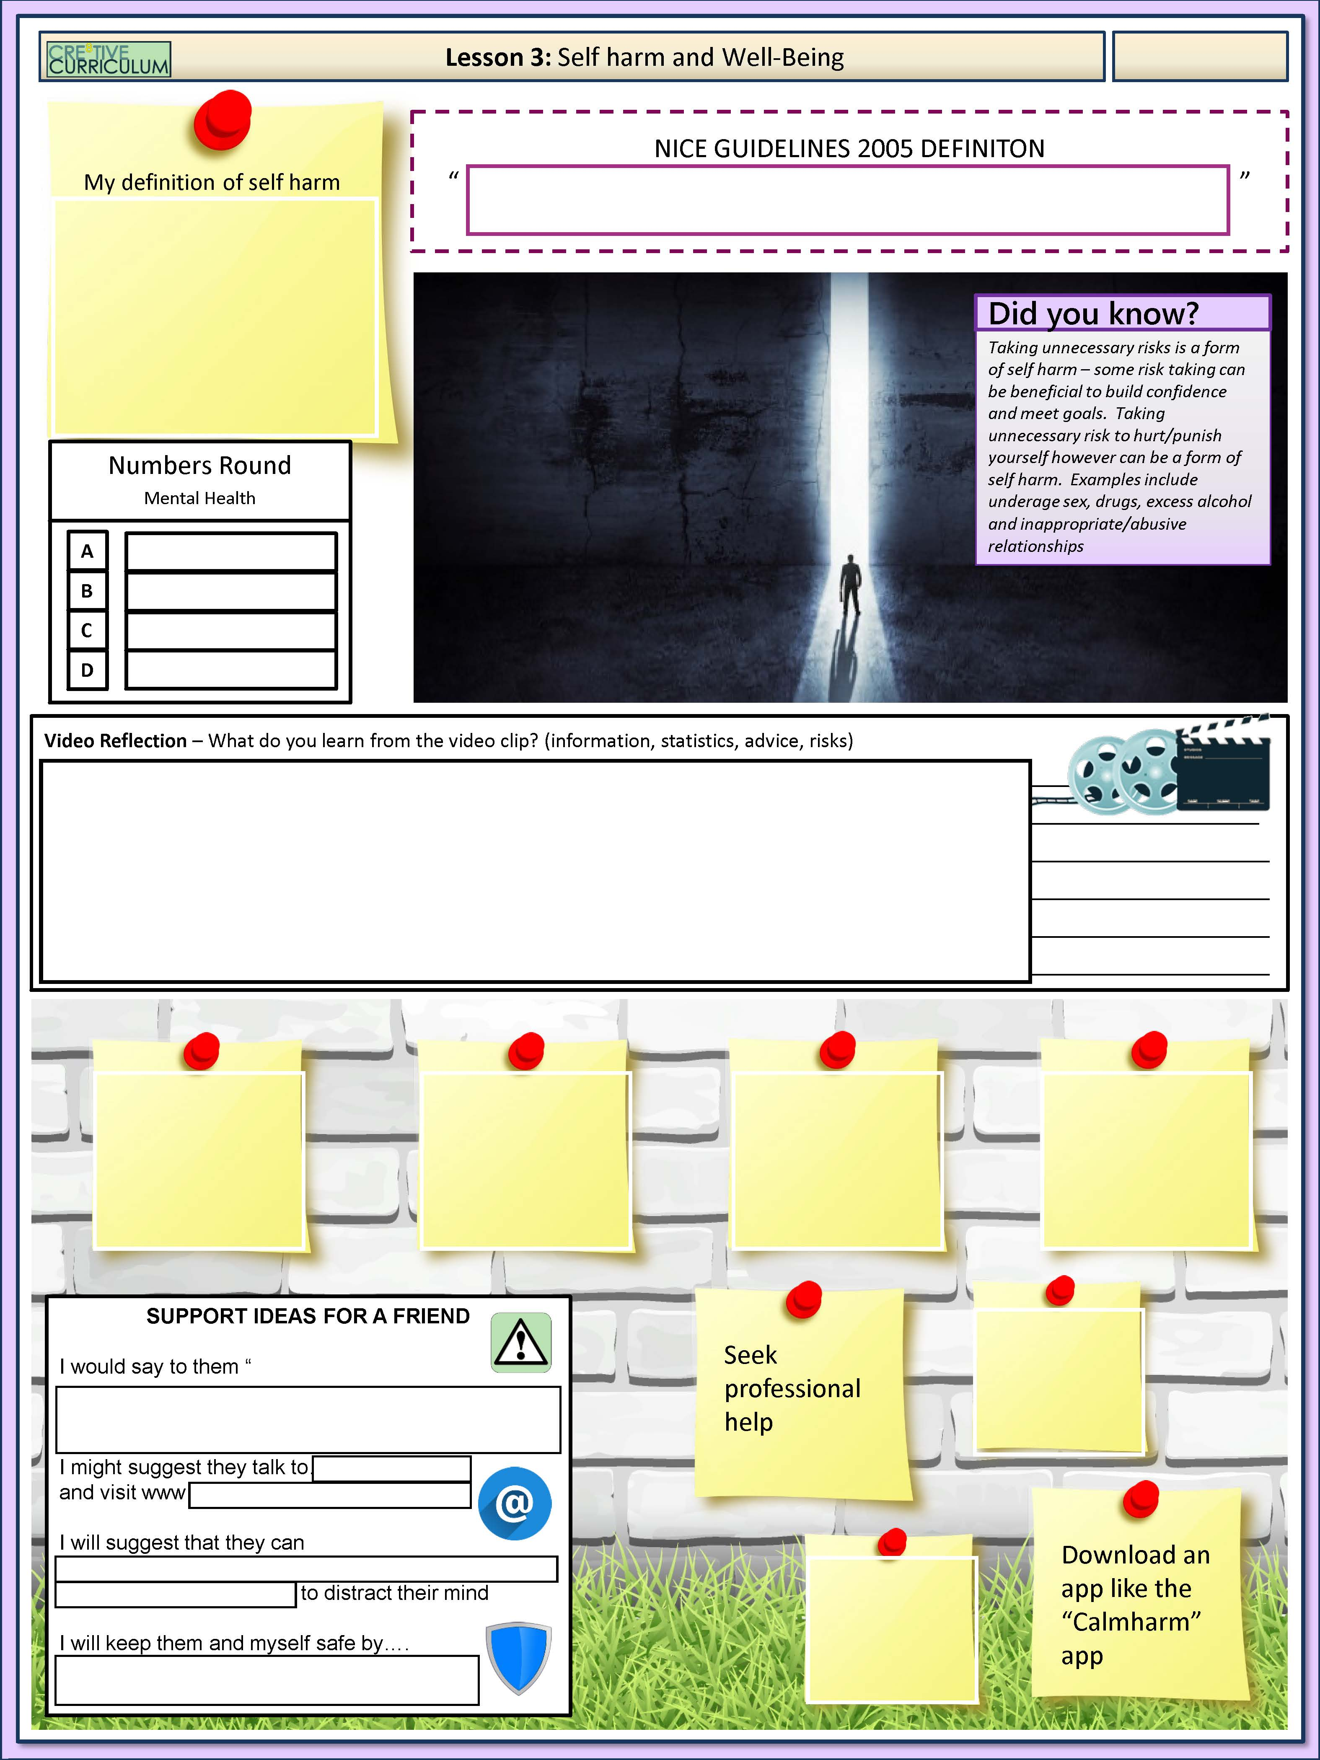
Lesson 3: Self Harm & Well-Being
(Cre8tive Resources, n.d.)

Slide 13
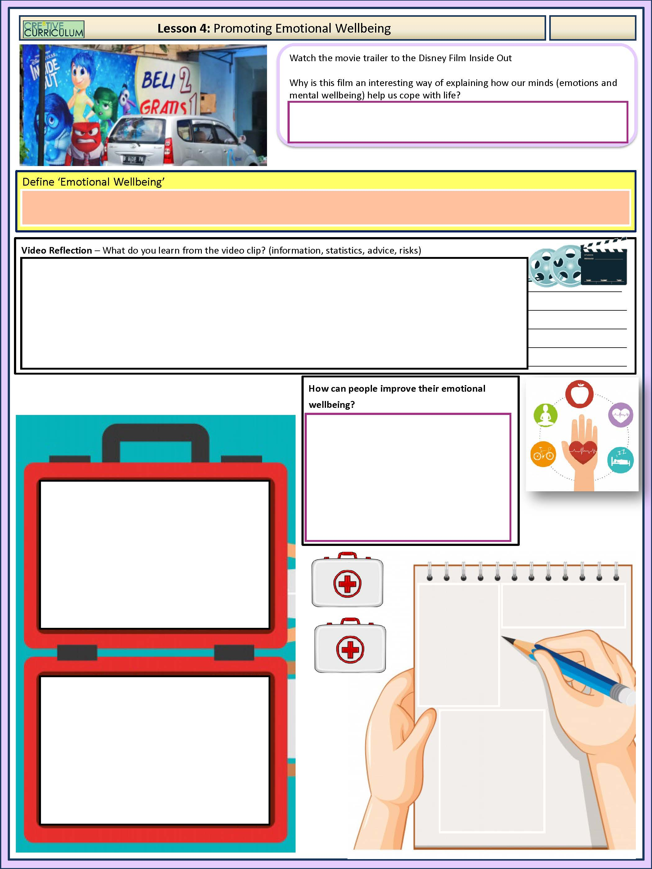
Lesson 4: Promoting Emotional Wellbeing
(Cre8tive Resources, n.d.)

Slide 14
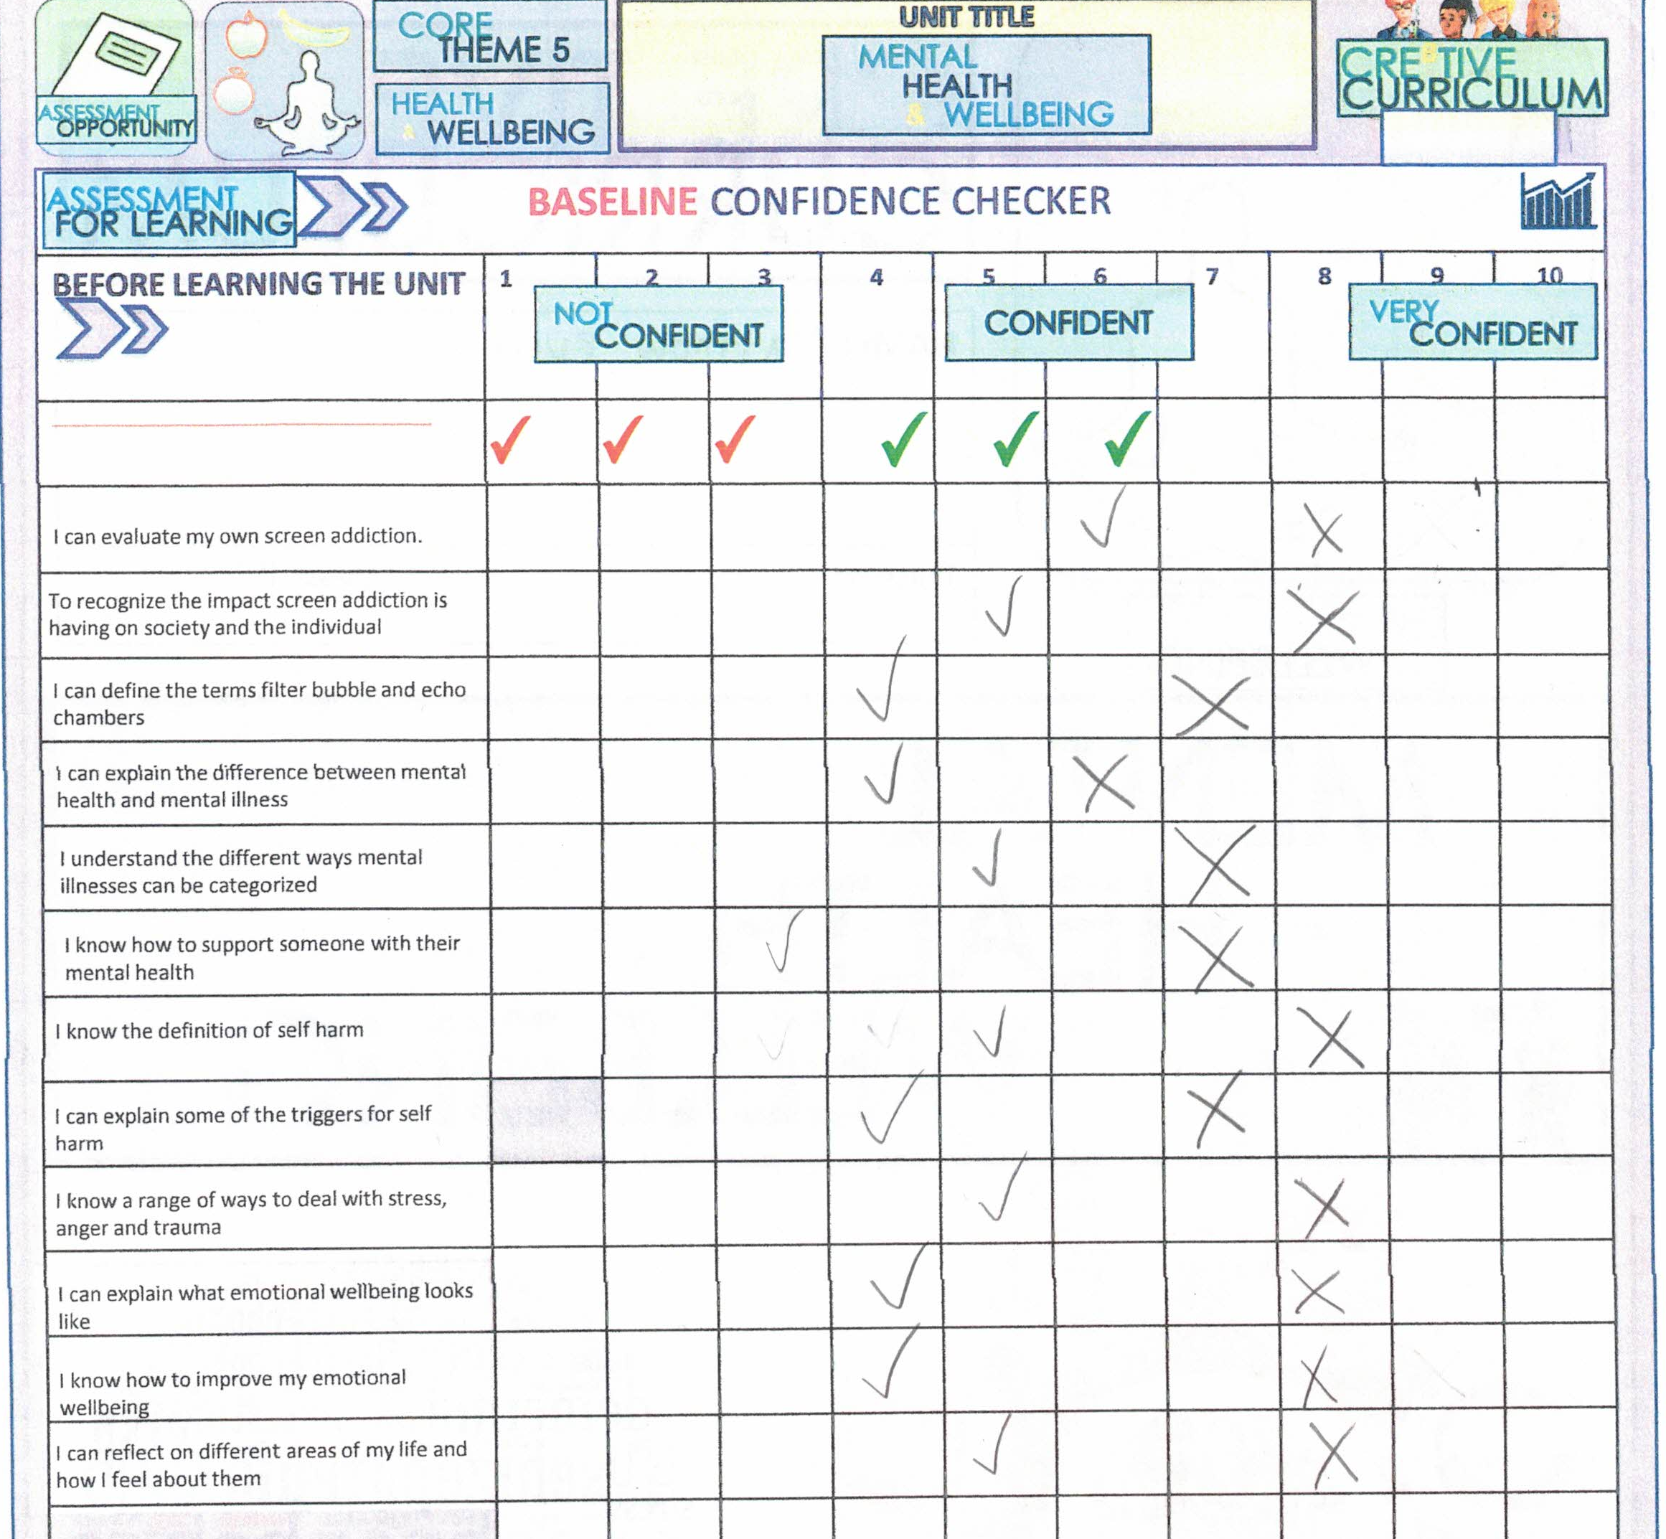
Evaluation
(Cre8tive Resources, n.d.)

Slide 16
Resources
ASCA. (2019). ASCA National Model: A Framework for School Counseling Programs (4th ed.). American School Counselor Association.
Cre8tive Resources. (n.d.). Mental Health & Wellbeing: Sel bundle of lessons. TPT. https://www.teacherspayteachers.com/Product/Mental-Health-Wellbeing-SEL-Bundle-of-Lessons-5494738
Florida Department of Education. (2023). Florida Department of Education. Florida’s State Academic Standards, Health Education, 2023. https://www.fldoe.org/core/fileparse.php/20653/urlt/6-4.pdf
Liberty University. (n.d.). PRE-ADVANCED INTERNSHIP ASSESSMENT (PRE-AIA): COSC 698. School of Behavioral Sciences &lt; Liberty University. https://catalog.liberty.edu/graduate/colleges-schools/behavioral-sciences/
McGoldrick, M., Giordano, J., & Garcia-Preto, N. (2005). Ethnicity and family therapy (3rd ed.). Guilford Press.

