Slide 1
Becoming your best self
Hailie Gerhardt

Slide 2
Agenda
Existing Data Sources
Needs Assessment
Description of Project
A.I.A Specialty Standards & Rationale
ASCA Mindsets and Behaviors
Artifacts
Cultural Sensitivity
Evaluation

Slide 3
Existing data sources

Slide 4
Data
Panorama Social-Emotional Learning: Student Competency and Well-Being Measures
  A survey of grades 3-5 given by the school psychologist
  Measures the needs of the school climate
Allowed the counselor to see the needs of the school, and the top result was self-efficacy.
2022-2023 Counseling S.M.A.R.T Goals
  Use of the previous year’s S.M.A.R.T goals as they align with the needs in the Panorama Social-Emotional Learning assessment
The S.M.A.R.T goals correlated positively with the need for self-efficacy support for our students.

Slide 5
Needs Assessments

Slide 6
Needs Assessments & Collaborations
Survey of the elementary students to determine the highest need
  Grades 3-5. 4th Grade was the highest need.
Questions in the needs assessment included:
  self-esteem, school success, social situations, and physical/emotional needs.
The school counselor, classroom teachers, the school psychologist, and administration collaborated on this project.

Slide 7
Description of Project

Slide 8
Becoming Your Best Self
This guidance unit aimed to improve the self-efficacy of fourth-grade students. The students will learn skills and gain knowledge of four out of the five components of self-efficacy. Self-efficacy is the belief in one’s capabilities to perform the necessary actions to achieve their goals. (Vaughan-Johnston., et. al., 2020).
Four lessons on:
  Performance Outcomes (previous experiences): Focused on school success.
  Vicarious Experiences (observed experiences by others): Focus on peer pressure.
  Verbal Persuasion (coaching and feedback): Focused on resilience.
  Psychological Feedback (experience of physical and emotional sensations): Focus on self-control.

Slide 9
A.I.A Specialty Standards and Rationale

Slide 10
Standards and rationale
Foundation: “Demonstrates the ability to apply and adhere to ethical and legal standards in school counseling.” (AIA, 2023). AND “Demonstrates the ability to articulate, model, and advocate for an appropriate school counselor identity and program.” (AIA, 2023) Understanding the legal and ethical standards of school counselors and using ASCA national model to build a needs-based guidance lesson unit.
Counseling Prevention and Intervention: “Provides individual and group counseling and classroom guidance to promote the academic, career, and social/emotional development of students.” (AIA, 2023). This guidance lesson unit provides students with the tools they need to be successful in their academia, career planning, and their socio-emotional well-being.
Diversity and Advocacy: “Demonstrates multicultural competencies in relation to diversity, equity, and opportunity in student learning and development.” (AIA, 2023). The lesson delivered in this unit is applicable to students of all multiculturalism and can allow space for students to be open about their personal struggles in or out of school.
Assessment: “Analyzes assessment information in a manner that produces valid inferences when evaluating the needs of individual students and assessing the effectiveness of educational programs.” (AIA, 2023). Using assessment data to execute a successful lesson unit by adapting to the needs of the students.

Slide 11
Standards and Rationale Continued…
Research and Evaluation: “Analyzes and uses data (and relevant technology) to enhance school counseling programs.” (AIA, 2023). Use of different types of data to determine the need and the focus of the group.
Academic Development: “Conducts programs designed to enhance student academic development.” (AIA, 2023). Guidance lesson unit focuses on school success.
Collaboration and Consultation: “Consults with teachers, staff, and community -based organizations to promote student academic, career, and social/emotional development.” (AIA, 2023). Collaborated with site supervisor, classroom teachers, and school psychologist.
Leadership: “Participates in the design, implementation, management, and evaluation of a comprehensive developmental school counseling program.” (AIA, 2023). Working closely with site supervisor to execute a successful lesson unit and successful counseling program.

Slide 12
ASCA Mindsets & Behaviors

Slide 13
Mindsets and Behaviors
M1. “Belief in development of whole self, including a healthy balance of mental, social/emotional, and physical well-being.” (ASCA, 2022).
M 3. “Positive attitude toward work and learning.” (ASCA, 2022).
M 5. “Belief in using abilities to their fullest to achieve high-quality results and outcomes.” (ASCA, 2022).
B-LS 7. “Long-and short-term academic, career, and social/emotional goals.” (ASCA, 2022).
B-SMS 1. “Responsibility for self and actions.” (ASCA, 2022).
B-SMS 6. “Ability to identify and overcome barriers.”(ASCA, 2022).
B-SS 8. “Advocacy skills for self and others and ability to assert self when necessary.” (ASCA, 2022).

Slide 14
Artifacts

Slide 15
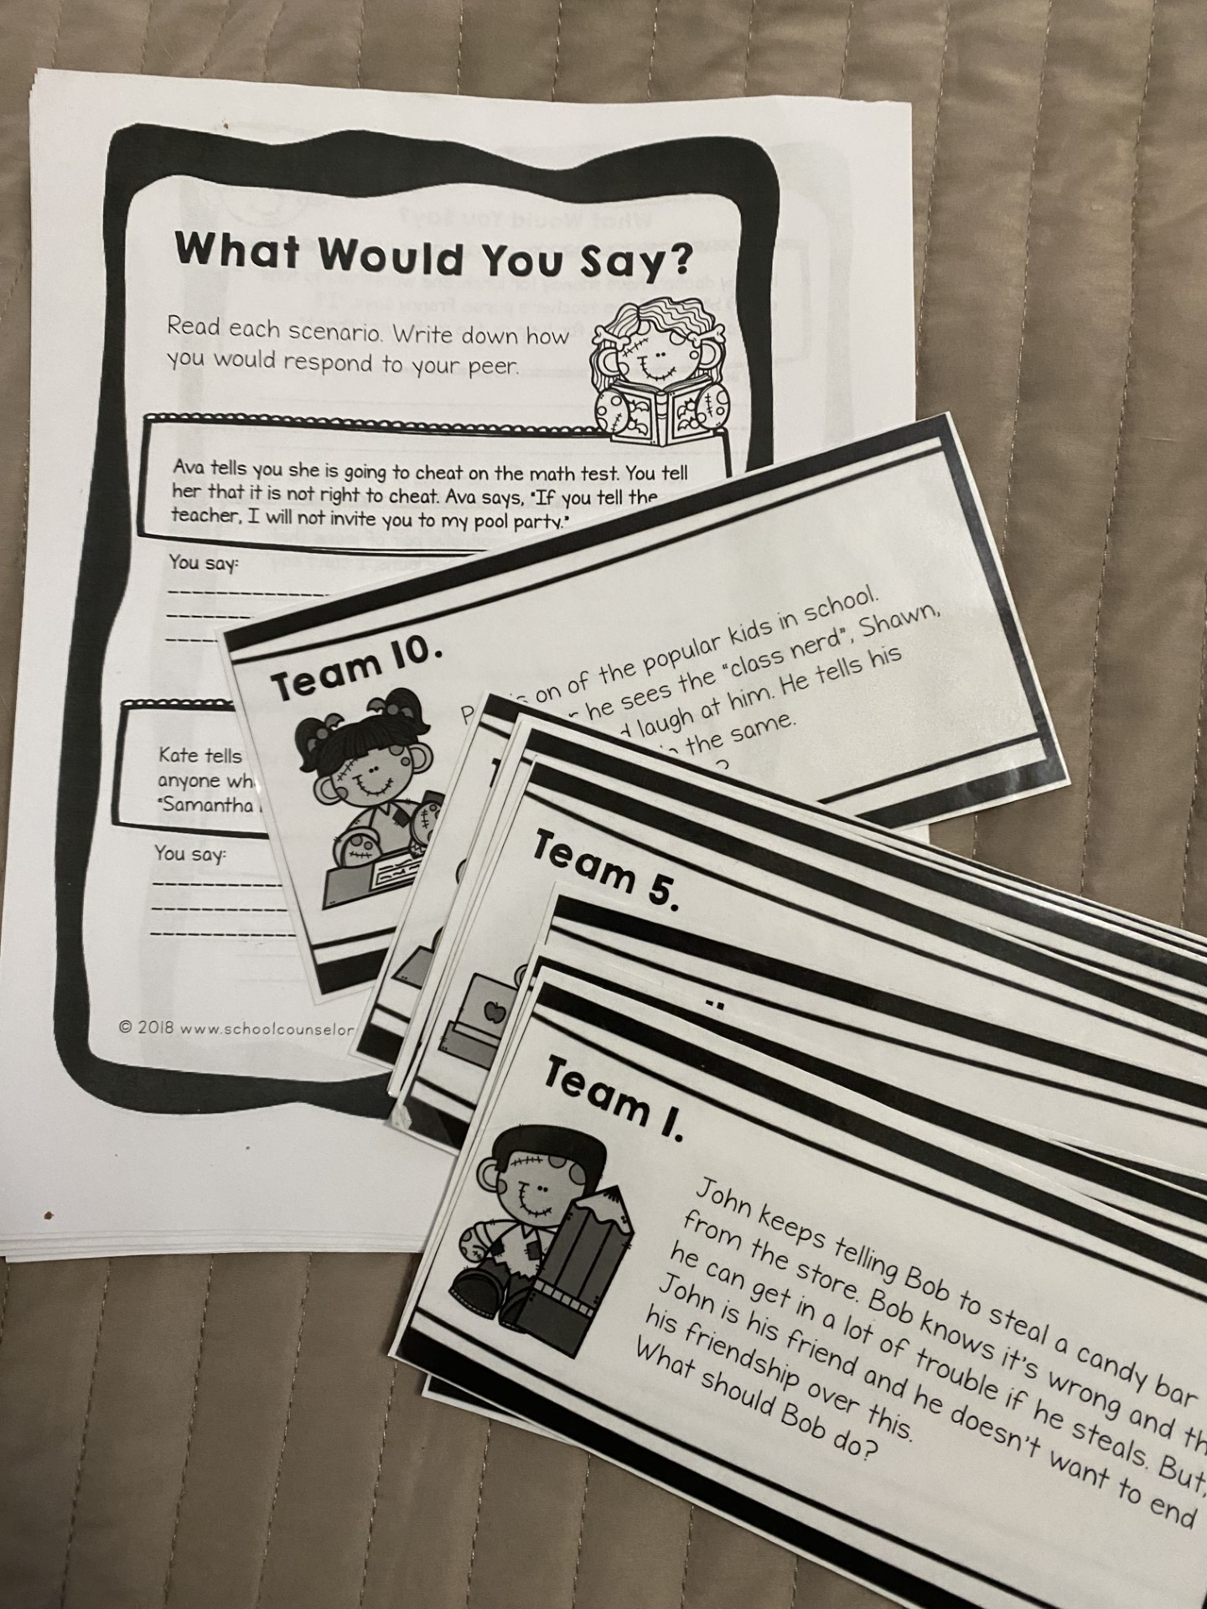
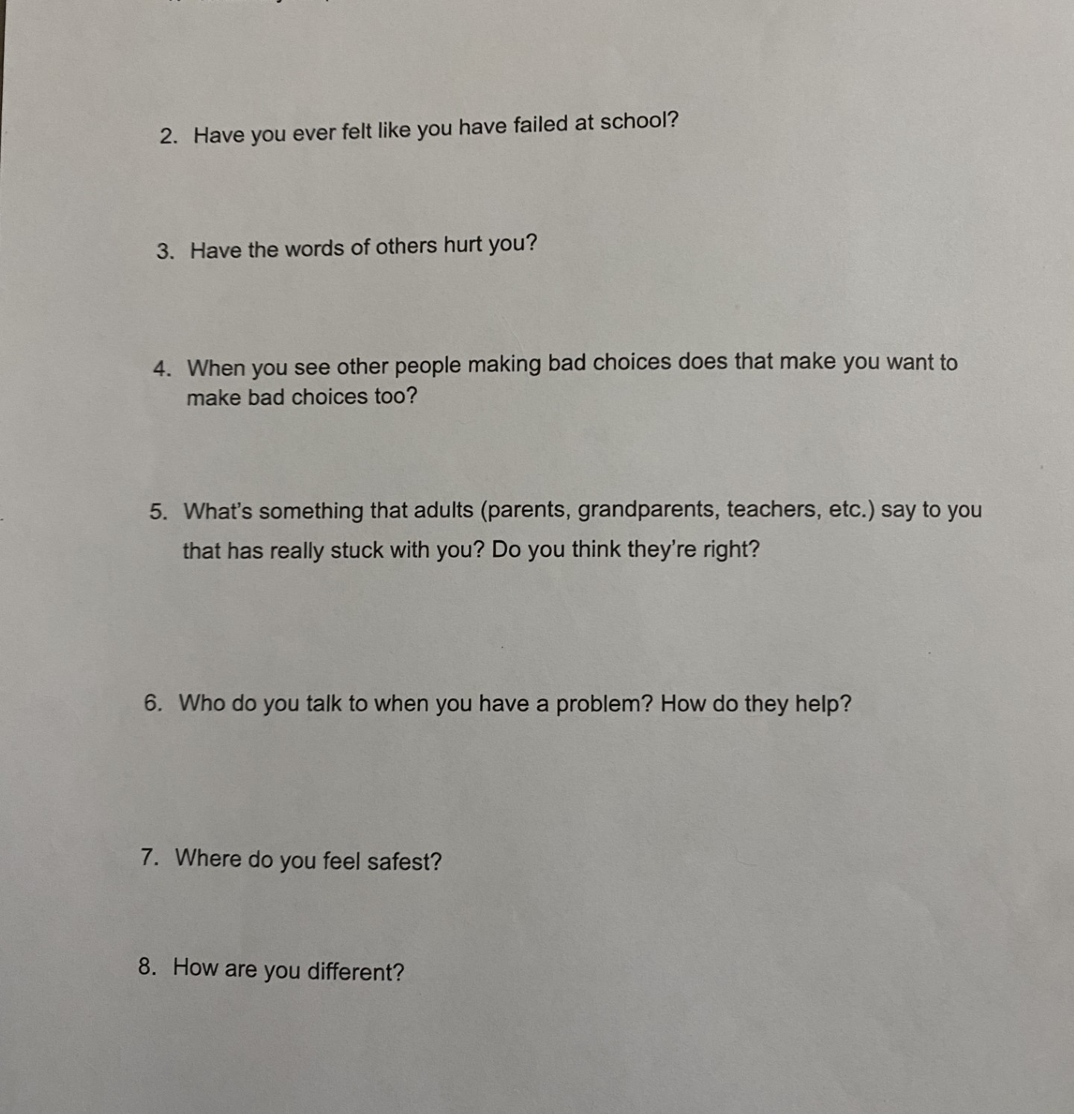
Check out our work!

Slide 16

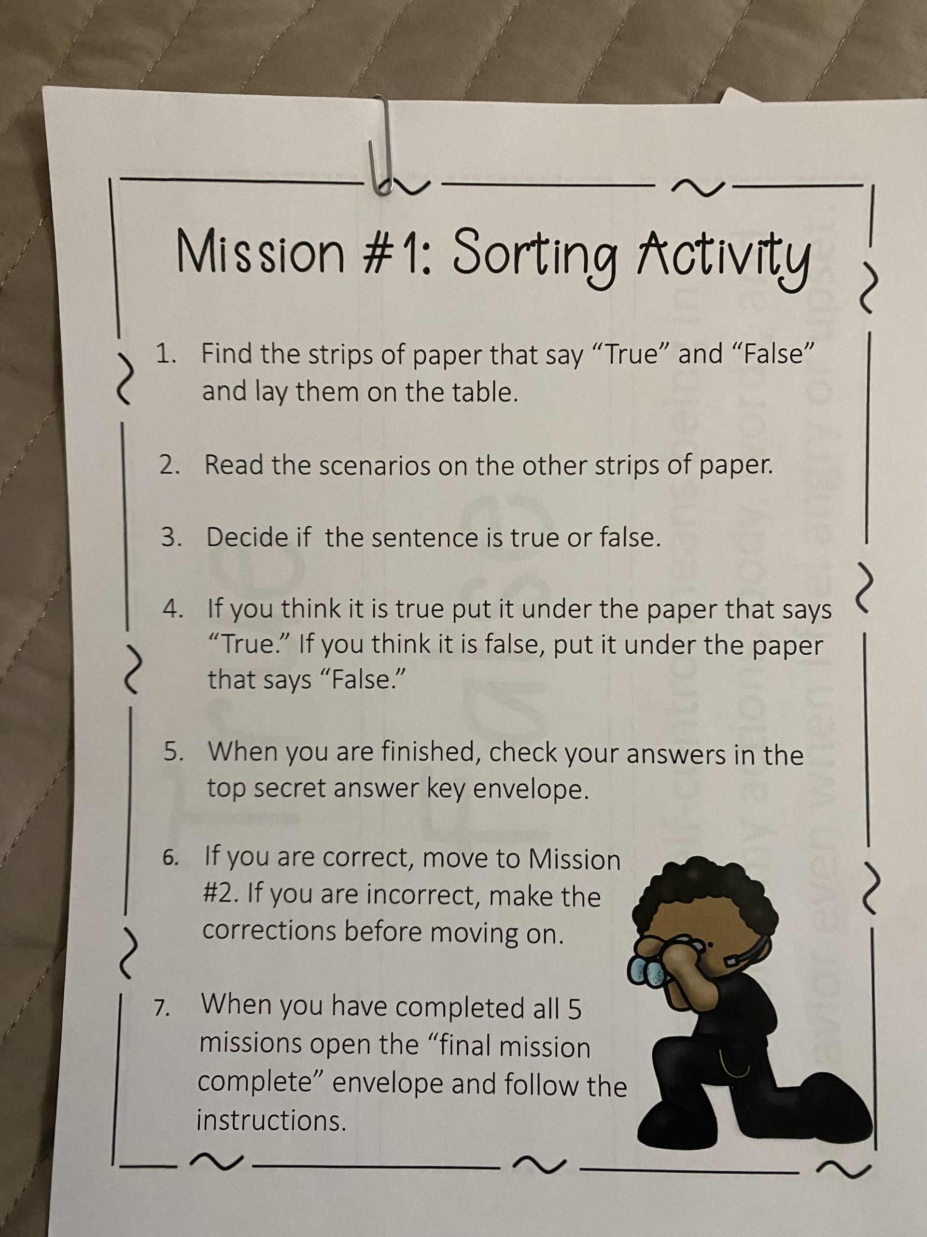
More artifacts

Slide 17
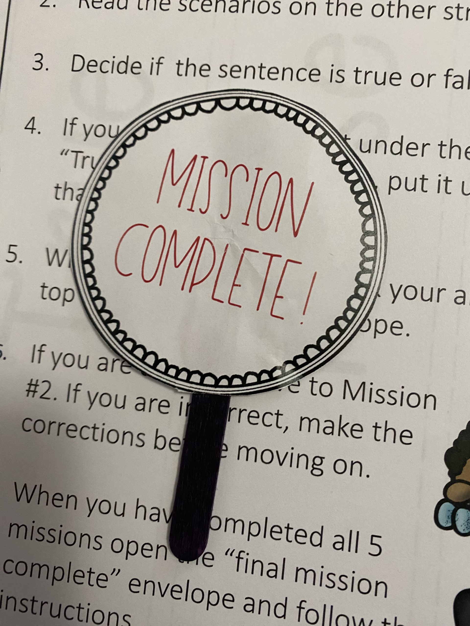
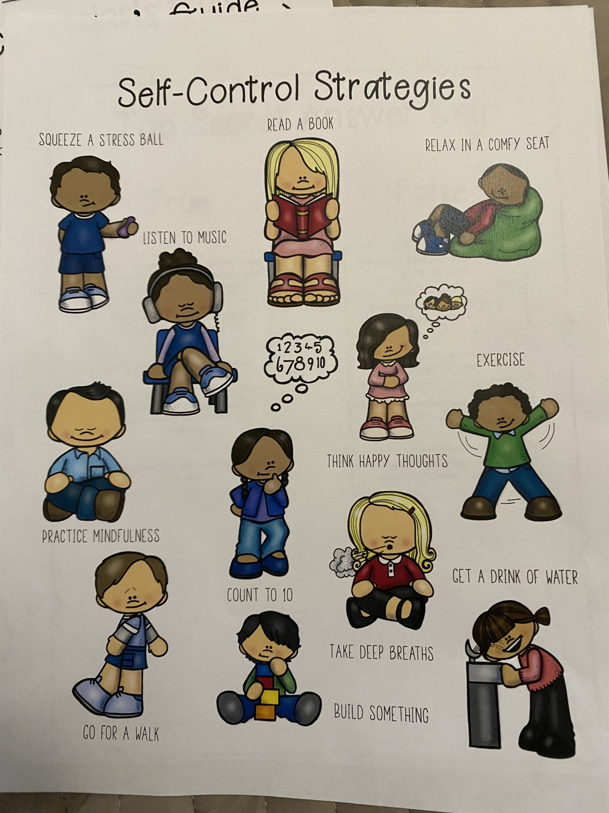
Artifacts

Slide 18
Cultural Sensitivity

Slide 19
Cultural Sensitivity
This unit was culturally sensitive because it applied to all multiculturalism. Studies have shown that students begin to develop self-efficacy issues at the elementary level. (Gallagher, 2018).
In the first lesson, I promoted a positive, caring, and safe learning group by establishing group norms. We also reviewed these norms at the beginning of every lesson. Making the students aware that a classmate may share a personal struggle and that it is not to leave our safe meeting space.

Slide 20
Evaluation

Slide 21
Evaluation of Intervention
A pre-/post-test was given to the students. I could see their growth and the new things they have learned.
Using the same questions, the students were familiar with the assessment, which was truly standardized. The assessment showed growth in 2 out of 4 areas for growth.
  To improve upon their skills, I continued lessons on self-control and peer pressure.

Slide 22
References
AIA, (2023)., “Demonstrates the ability to apply and adhere to ethical and legal standards in school counseling.”, Liberty University.
AIA, (2023)., “Demonstrates the ability to articulate, model, and advocate for an appropriate school counselor identity and program.”, Liberty University.
AIA, (2023)., “Provides individual and group counseling and classroom guidance to promote the academic, career, and social/emotional development of students.”, Liberty University.
AIA, (2023)., “Demonstrates multicultural competencies in relation to diversity, equity, and opportunity in student learning and development.”, Liberty University.
AIA, (2023)., “Analyzes assessment information in a manner that produces valid inferences when evaluating the needs of individual students and assessing the effectiveness of educational programs.”, Liberty University.
AIA, (2023)., “Analyzes and uses data (and relevant technology) to enhance school counseling programs.”, Liberty University.
AIA, (2023)., “Conducts programs designed to enhance student academic development.”, Liberty University.
AIA, (2023)., “Consults with teachers, staff, and community -based organizations to promote student academic, career, and social/emotional development.”, Liberty University
AIA, (2023)., “Participates in the design, implementation, management, and evaluation of a comprehensive developmental school counseling program.”, Liberty University
ASCA., (2022)., ASCA Student Standards: Mindsets & Beliefs for Student Success, M.1” Belief in development of whole self, including a healthy balance of mental, social/emotional and physical well-being.”
ASCA., (2022)., ASCA Student Standards: Mindsets & Beliefs for Student Success, M 3. “Positive attitude toward work and learning.”

Slide 23
References continued…
ASCA., (2022)., ASCA Student Standards: Mindsets & Beliefs for Student Success, M 5. “Belief in using abilities to their fullest to achieve high-quality results and outcomes.”
ASCA., (2022)., ASCA Student Standards: Mindsets & Beliefs for Student Success, B-LS 7. “Long-and short-term academic, career, and social/emotional goals.”
ASCA., (2022)., ASCA Student Standards: Mindsets & Beliefs for Student Success, B-SMS 1. “Responsibility for self and actions.”
ASCA., (2022)., ASCA Student Standards: Mindsets & Beliefs for Student Success, B-SMS 6. “Ability to identify and overcome barriers.”
ASCA., (2022)., ASCA Student Standards: Mindsets & Beliefs for Student Success, B-SS 8. “Advocacy skills for self and others and ability to assert self when necessary.”
Gallagher, M. W., & Gallagher, M. W. (2018). Chapter 4. In The Oxford Handbook of Hope. essay, Oxford University Press
Klassen, R.M. and Usher, E.L. (2010), "Self-efficacy in educational settings: Recent research and emerging directions", Urdan, T.C. and Karabenick, S.A. (Ed.) The Decade Ahead: Theoretical Perspectives on Motivation and Achievement (Advances in Motivation and Achievement, Vol. 16 Part A), Emerald Group Publishing Limited, Bingley, pp. 1-33. https://doi.org/10.1108/S0749-7423(2010)000016A004
Vaughan‐Johnston, T. I., & Jacobson, J. A. (2020). Self‐efficacy theory. The Wiley Encyclopedia of Personality and Individual Differences, 375–379. https://doi.org/10.1002/9781119547143.ch62

