Slide 1
Your Future Starts Today!
Hailie Gerhardt
School of Behavioral Science, Liberty University
Notes:
This guidance lesson unit provided 7th grade students with the opportunity to explore their future college and career paths. It was a 4-week lesson that covered topics from college applications to resume building, and interview skills.

Slide 2
Agenda
Existing Data Sources
Needs Assessment
Description of Project
AIA Specialty Standards & Rationale
ASCA Mindsets and Behaviors
Artifacts
Cultural Sensitivity
Evaluation
Notes:
Agenda

Slide 3
Existing Data Sources
Notes:
Existing Data Sources

Slide 4
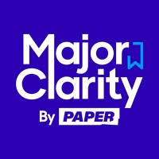
Data
MajorClarity reports of student progress
  Students use MajorClarity in Career Connections class
District wide reports from MajorClarity
  County wide report of students’ progress and goals in the MajorClarity system
Notes:
I used MajorClarity for the data behind this lesson unit. MajorClarity provided reports of our students progress and I was able to access the county’s reports of our students and their ACP’s. This was helpful because I was able to look at the data and focus lesson planning on the needs of the students.

Slide 5
Needs Assessment and Collaboration
Notes:
Needs Assessments and Collaboration

Slide 6
Needs Assessment and Collaboration
Google Survey of students in 7th Grade gym class
  Questions included: MajorClarity, college planning, career goals, etc..
Collaboration with teachers, site supervisor, and administrators
Notes:
I used Google to survey the 7th grade gym students. All 7th graders must complete the ACP’s in MajorClarity so that was part of the reasoning for choosing this age group.

Slide 7
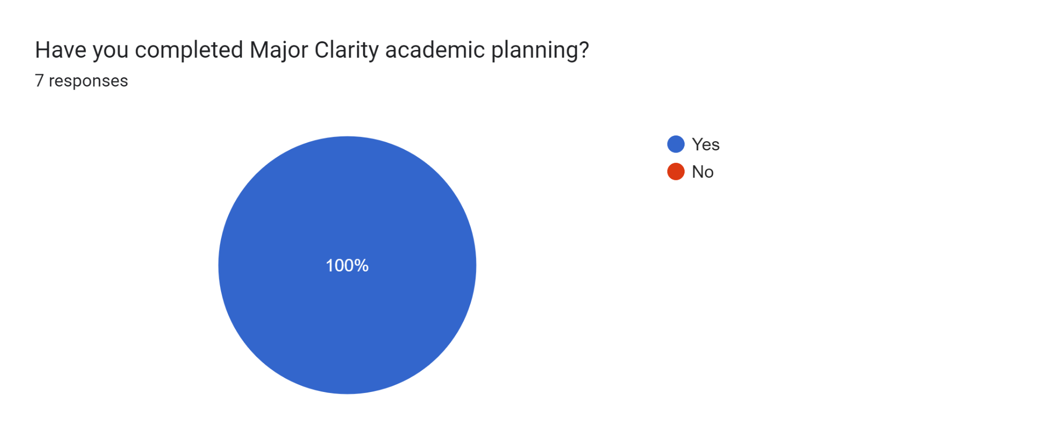
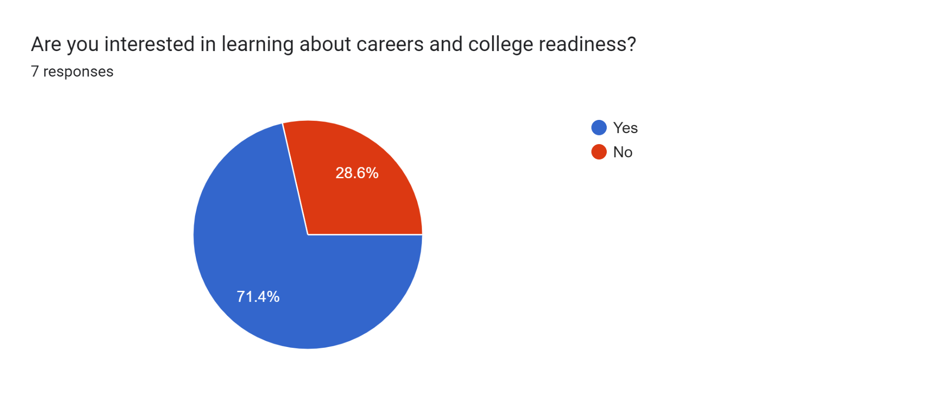
Needs Assessment Results
Notes:
Google Survey results.

Slide 8
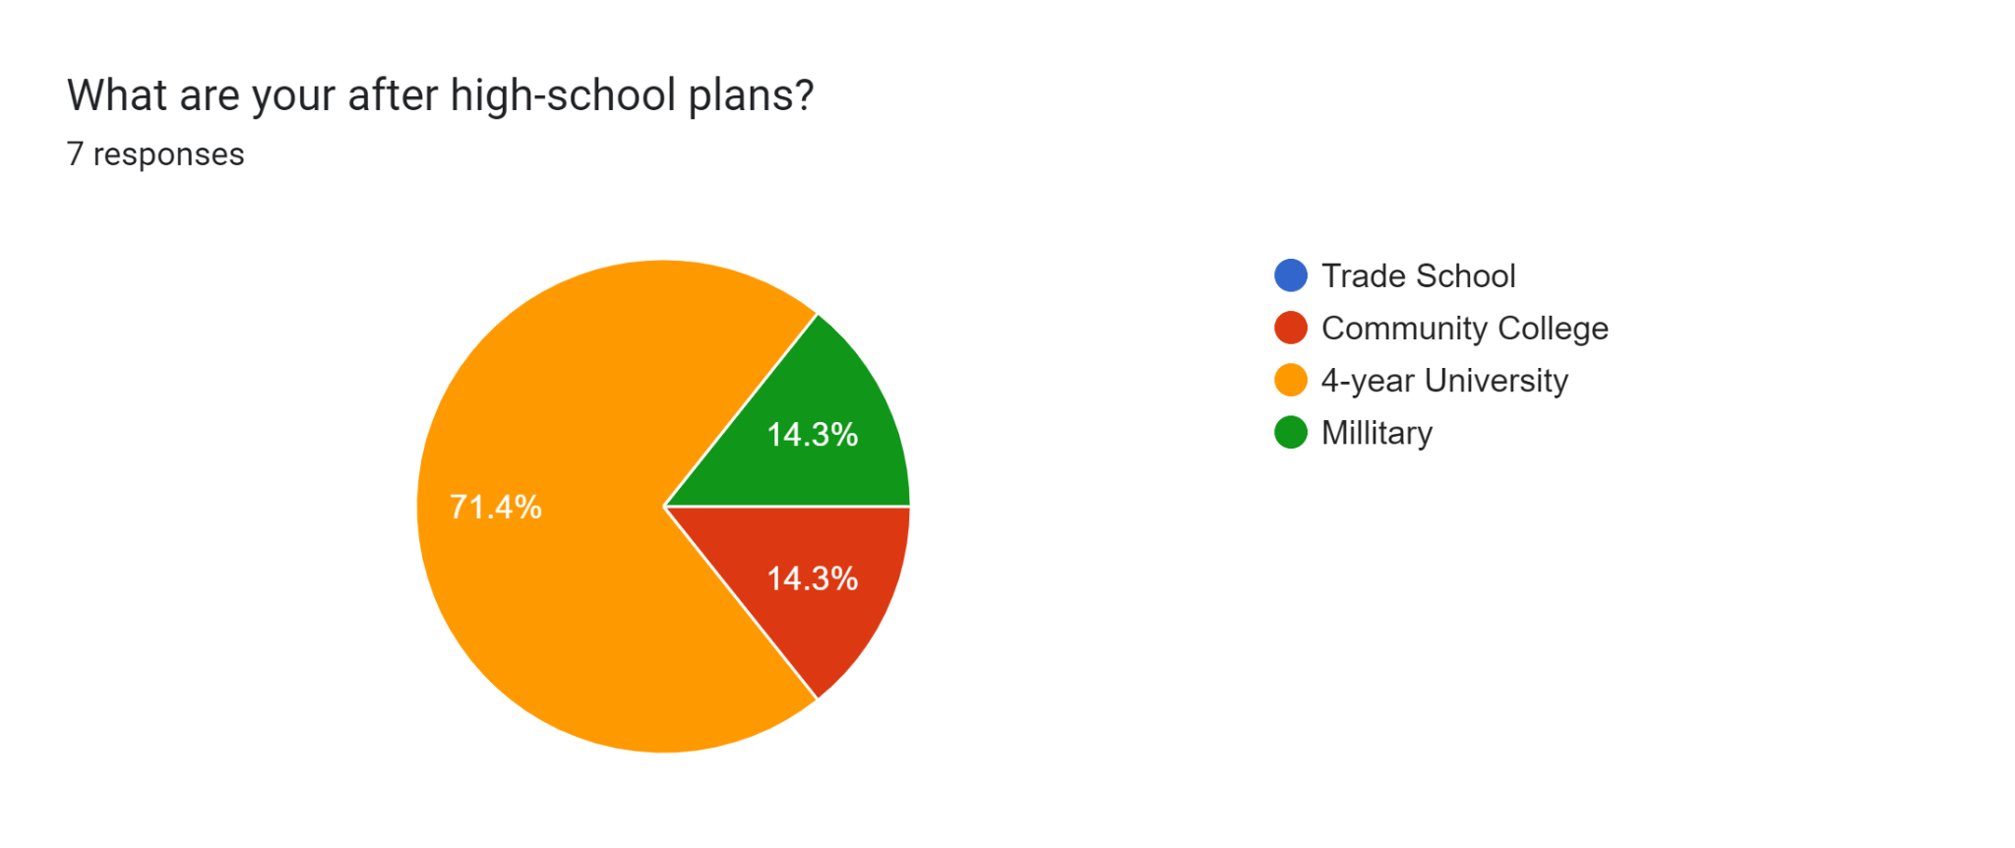
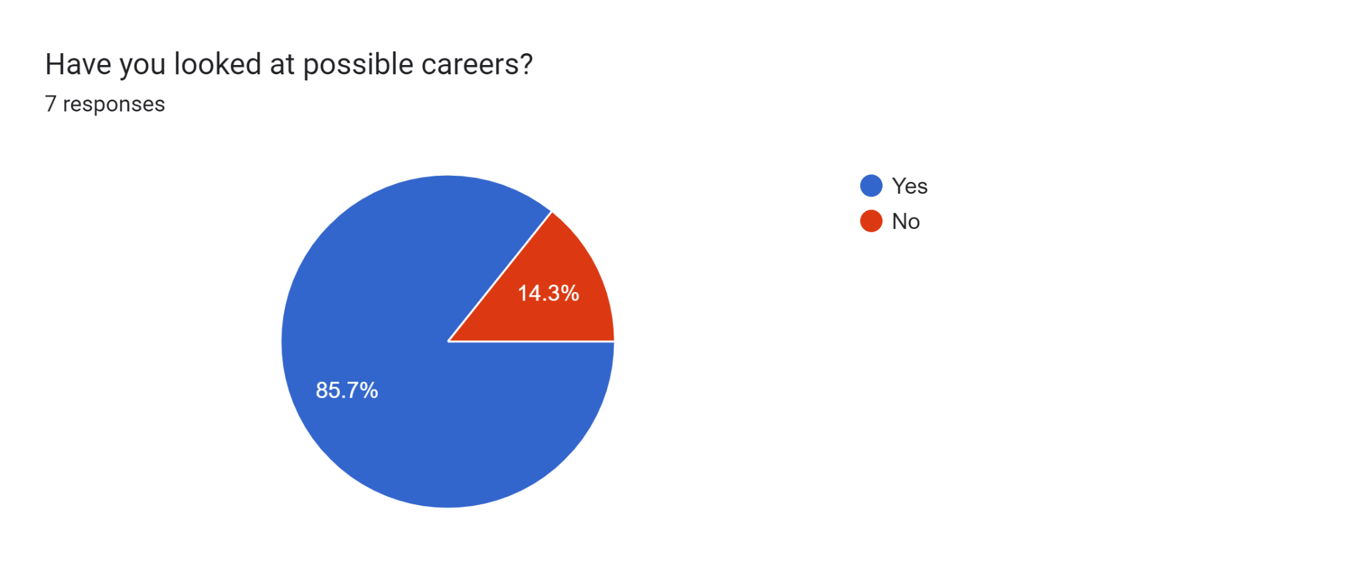
Results Continued
Notes:
Google Survey results.

Slide 9
Description of Project

Slide 10
Project
Seventh grade students will learn about post-secondary opportunities. They will gain insight on career planning, resume building, college, and other post-secondary opportunities.
Lessons:
Classroom guidance lesson 1: Career Exploration in Major Clarity
Classroom guidance lesson 2: Individual Career Research
Classroom guidance lesson 3: College Planning
Classroom guidance lesson 4: Resume Building

Slide 11
A.I.A Specialty Standards and Rationale

Slide 12
A.I.A Specialties
Foundations: “Demonstrates the ability to articulate, model, and advocate for an appropriate school counselor identity and program.” (AIA, 2023).
Counseling Prevention and Intervention: “Provides individual and group counseling and classroom guidance to promote the academic, career, and social/emotional development of students.” (AIA, 2023).
Diversity and Advocacy: “Advocates for the learning and academic experiences necessary to promote the academic, career, and social/emotional development of students.” (AIA, 2023).
Assessment: “Selects appropriate assessment strategies that can be used to evaluate a student’s academic, career, and social/emotional development.” (AIA, 2023).
Research and Evaluation: “Analyzes and uses data (and relevant technology) to enhance school counseling programs.” (AIA, 2023).
Academic Development: “Implements strategies and activities to prepare students for a full range of postsecondary options and opportunities.” (AIA, 2023).
Collaboration and Consultation: “Consults with teachers, staff, and community -based organizations to promote student academic, career, and social/emotional development.” (AIA, 2023).
Leadership: “Intern works with others within and outside of the school community to influence policy, enhance services, and promote a developmentally appropriate, comprehensive school counseling program.” (AIA, 2023).

Slide 13
ASCA Mindsets and Behaviors

Slide 14
Mindsets
“M 1. Belief in development of whole self, including a healthy balance of mental, social/emotional and physical well-being.” (ASCA, 2022).
“M 6. Understanding that postsecondary education and lifelong learning are necessary for long-term success.” (ASCA, 2022).

Slide 15
Behaviors
“B-LS 7. Long- and short-term academic, career and social/emotional goals.” (ASCA, 2022).
“B-SMS 5. Perseverance to achieve long and short-term goals.” (ASCA, 2022).
“B-SS 9. Social maturity and behaviors appropriate to the situation and environment.” (ASCA, 2022).

Slide 16
Artifacts

Slide 17
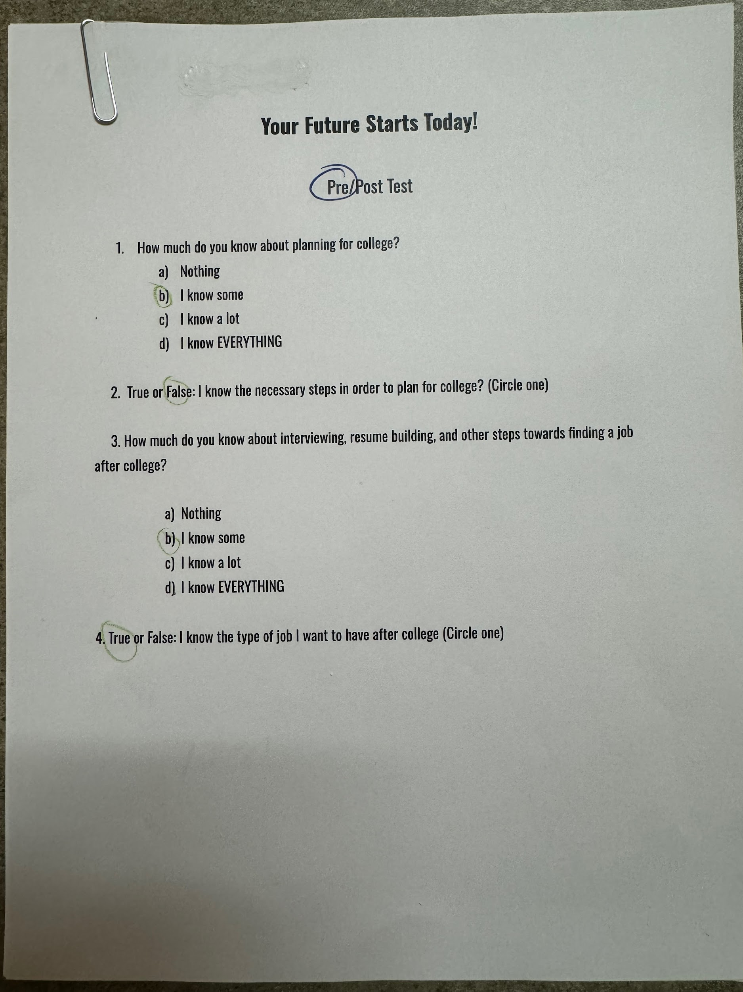
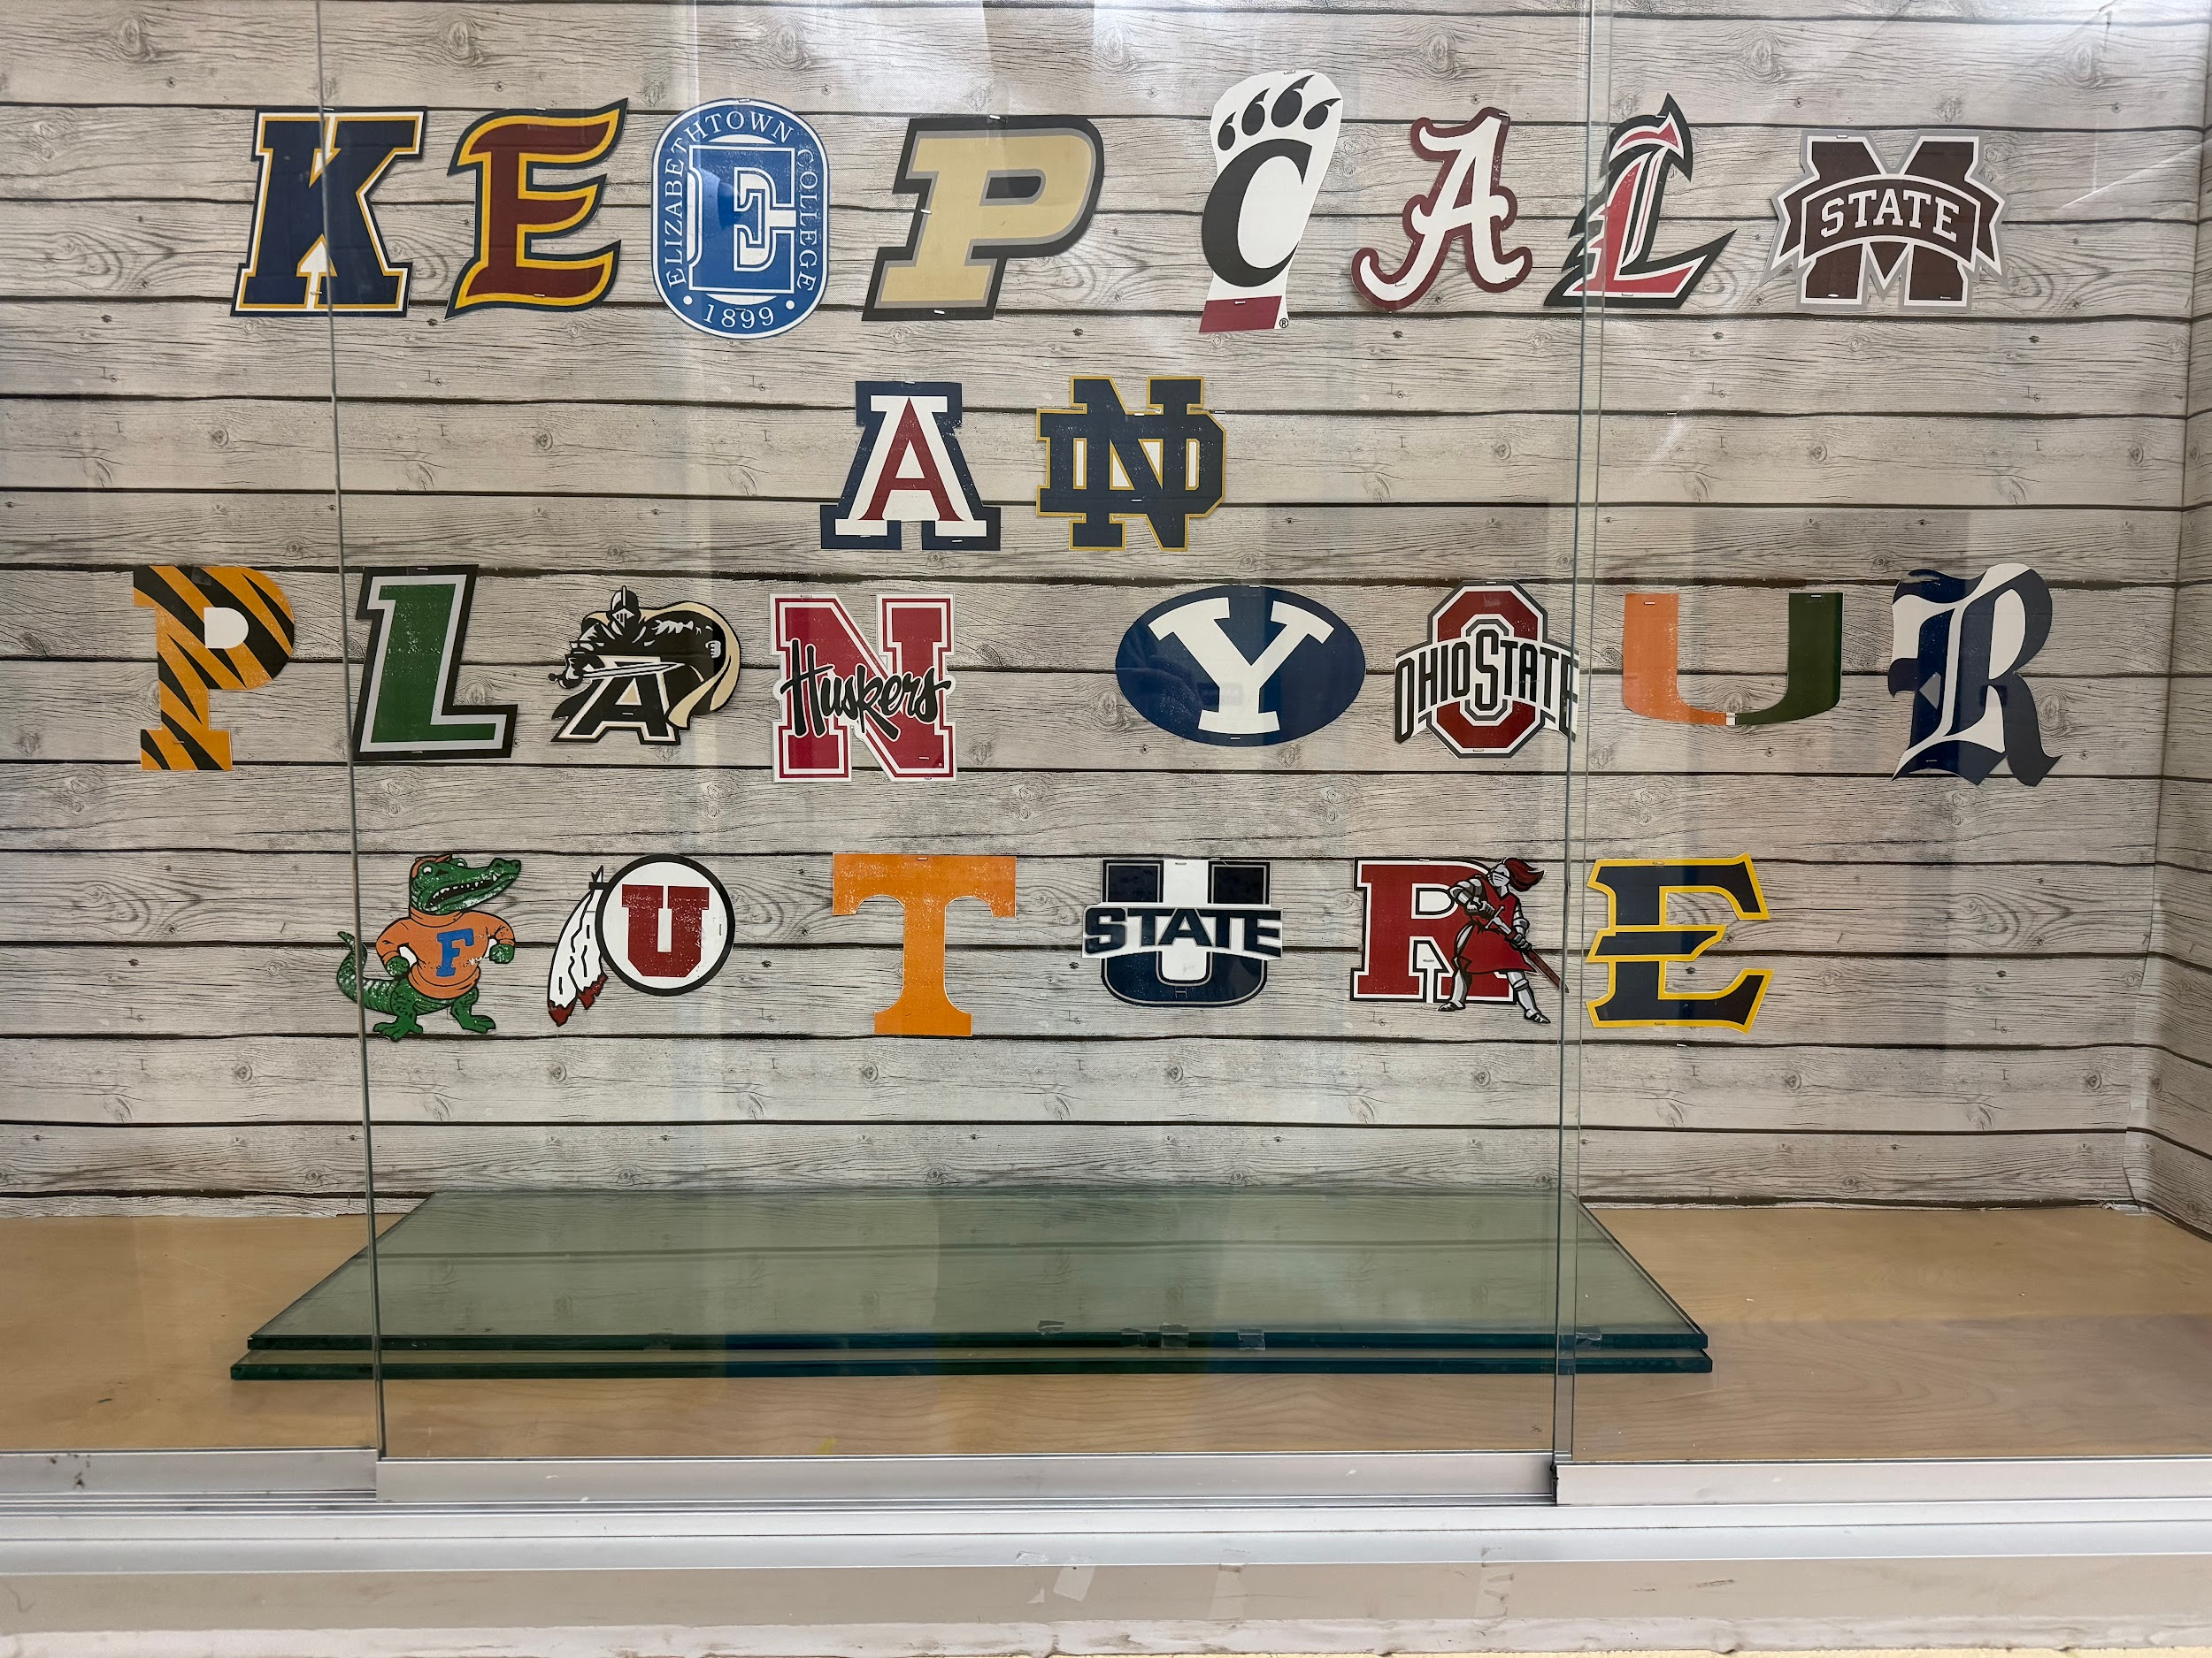
Check out Our Work!
Notes:
Our pre-/post-test and the “bulletin board” the students wanted to promote college readiness in the school.

Slide 18
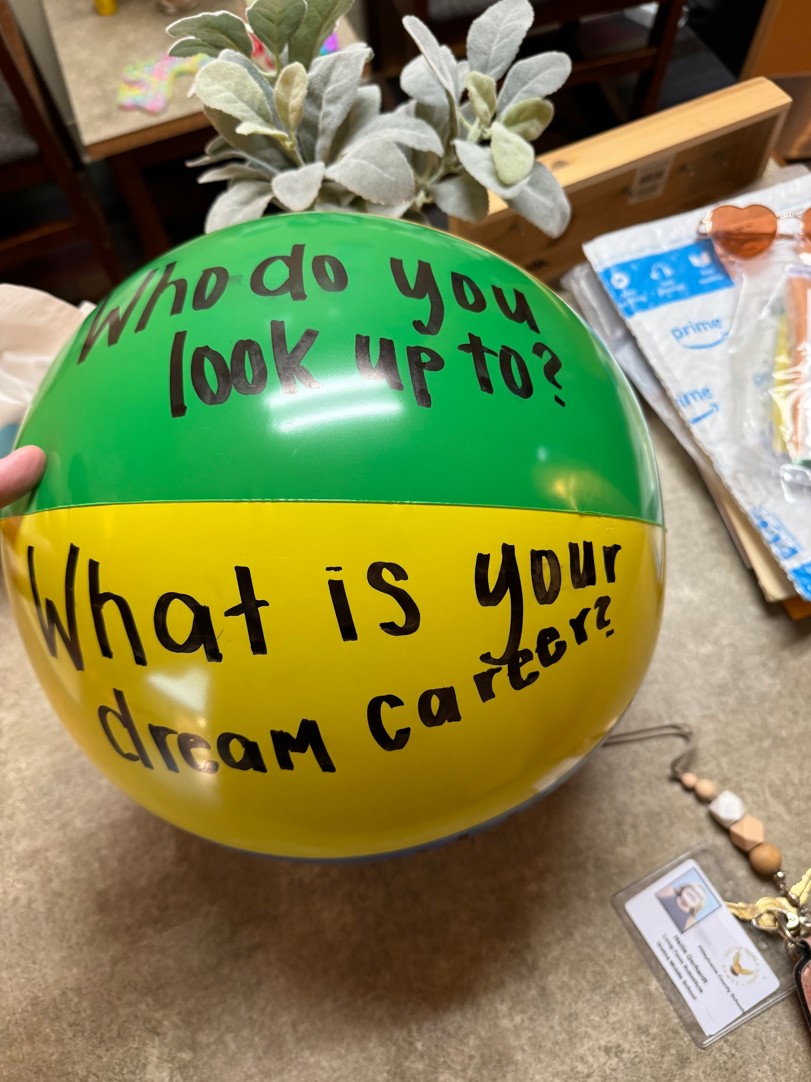
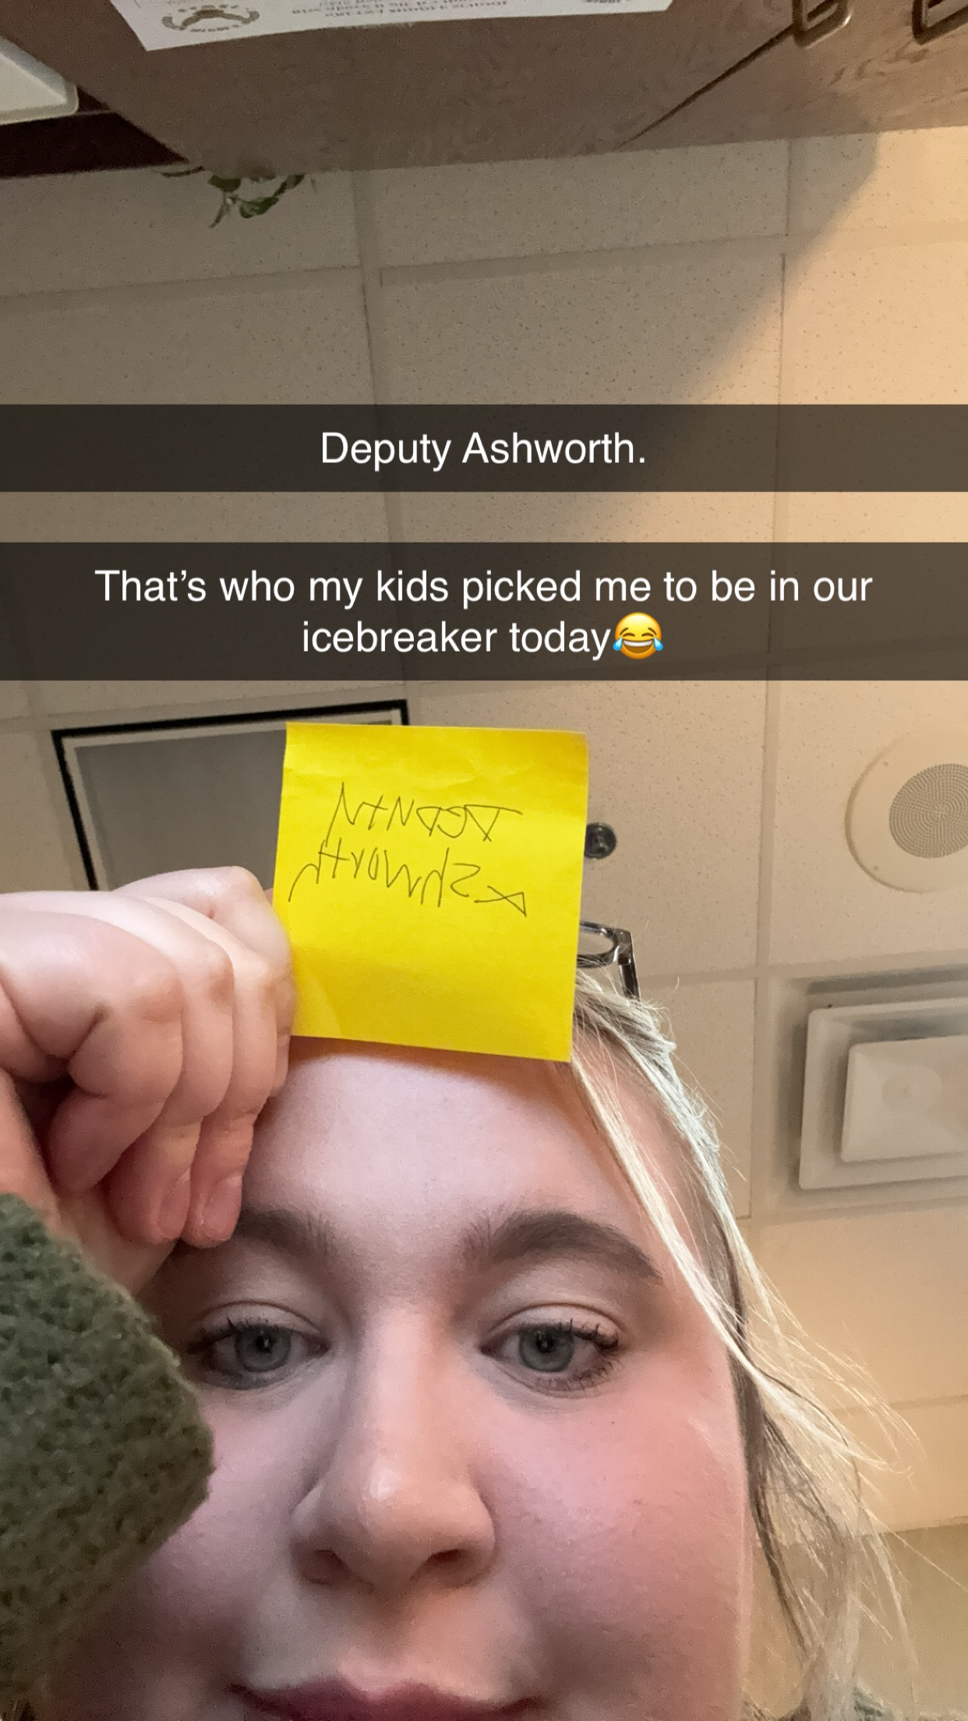
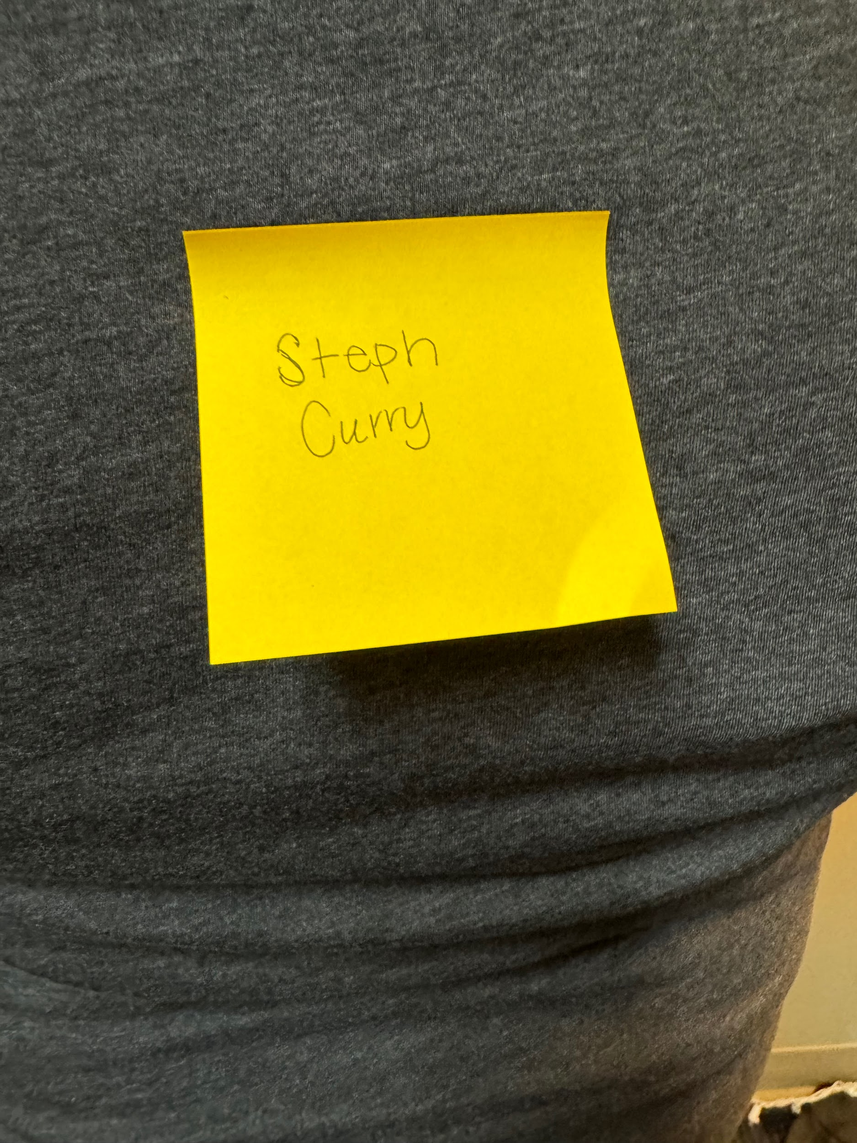
Notes:
A few pictures of our icebreakers

Slide 19
Cultural Sensitivity

Slide 20
Cultural Sensitivity
This lesson was culturally sensitive because it is applicable to students of all cultural backgrounds. We promoted a safe learning environment by creating group norms and practicing the norms throughout the duration of the lessons.
A wide demographic of students present for lessons. Included: 7 Caucasian, 5 African American, and 1 Hispanic student. All students varied in socio-economic status.

Slide 21
Evaluation

Slide 22
Evaluation of Intervention
A pre-/post-test was given to the students. By using the same questions, it was standardized and the students were familiar with the contents.
  All students increased in their knowledge and understanding of lesson material.
I was able to see their growth and their understanding of new materials learned in this lesson.
I would change my form of collecting the pre-/post-test to have easier to view data.

Slide 23
References

Slide 24
References
American School Counselor Association (2021). ASCA Student Standards; Mindsets and Behaviors for Student Success. Alexandria, VA
Liberty University, (2024)., Advanced Internship Assessment, https://www.liberty.edu/behavioral-sciences/counselor-ed/wp-content/uploads/sites/43/2021/02/ADVANCED-INTERNSHIP-ASSESSMENT_ASCA-1.pdf

