Slide 1

Career development
Program proposal
Presented by
Jennifer van Dijk

Slide 2
Introduction
Who?
What?
Where?
Notes:
This presentation is intended to be a career development program proposal for the administrative team at the American International School of Jeddah in Jeddah, Saudi Arabia.
The population that I will be serving is all tenth grade High School students who attend the American International School of Jeddah. The school is located in an urban setting on the Red Sea. The population is mostly Arab, with a few other nationalities from both western and non-western countries. The school has a total population of twelve hundred students, from pre-k through twelfth grade. I will be delivering this proposed program to approximately seventy students.

Slide 3
Rationale
Why?
How?
Overarching Goals of the Proposed Program
Needs Assessment Methods
Notes:
The overarching goal of this program is to provide an opportunity for all tenth grade students at AISJ to explore their interests and values and connect them to potential career opportunities. Hutchison et al (2015) state that research demonstrates that career-focused interventions are strongly correlated with positive academic outcomes for students. As always, the school counseling program at AISJ aims to support the academic mission and vision of the school and the success of all students.
In order to determine the specific career development needs of tenth grade students at AISJ, I created an anonymous survey in SurveyMonkey (n.d.) as a needs assessment tool. The link to this survey can be found in the presentation notes: https://www.surveymonkey.com/r/VQGDRW6. I will use the survey data to determine the areas of greatest need for this population. A second assessment tool that will be used as data is a pre-/post-test for students that will demonstrate evidence of student learning and success after the career development interventions. The American School Counselor Association (2023) states that pre-/post-tests that are aligned with mindset and behavior standards can be a valuable data tool for assessing changes in students' knowledge and skills. They can also reveal ways for school counselors to improve their practice and strengthen the validity of a data-driven, evidence-based school counseling practice.
Holland's theory of career choice and Super’s life-space, life-span theory provide the theoretical frameworks behind this program and will be explained throughout this presentation. Bhat and Stevens (2021) point out that College and Career Readiness (CCR) programs that are implemented in ninth and tenth grades can be very beneficial to students and help ease the process when they transition out of high school.

Slide 4
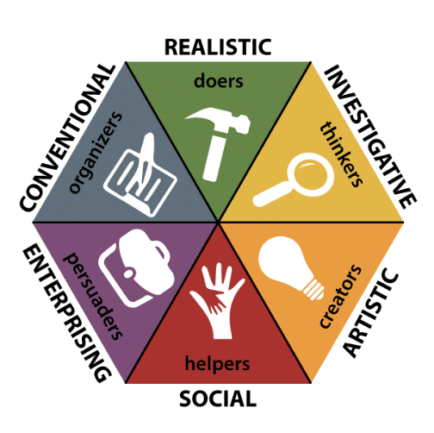
Holland's RIASEC Hexagonal Model
Notes:
This is a visual example of Holland's RIASEC hexagonal model.
Harper, H. (2023, February 7). How are you intelligent? an introduction to the holland codes (RIASEC). The Career Project. Retrieved May 6, 2023, from https://www.thecareerproject.org/blog/how-are-you-intelligent-an-introduction-to-the-holland-codes-riasec/

Slide 5
Program Standards
National Career Development Guidelines (NCDG) Framework Indicators
GOAL CM1: Create and manage a career plan that meets your career goals.
GOAL CM2: Use a process of decision making as one component of career development.
GOAL CM3: Use accurate, current, and unbiased career information during career planning and management.
(Niles & Harris-Bowlsbey, 2022)
ASCA (2023) Mindset and Behavior Standards
M 4. Self-confidence in ability to succeed
B-LS 7. Long- and short-term academic, career and social/emotional goals
B-LS 9. Decision-making informed by gathering evidence, getting others’ perspectives and recognizing personal bias

Slide 6
Measurable Learning Objectives
By the end of the first semester, all tenth-grade students will be able to identify their top three career-related interests and top three career-related values.
By the end of the second semester, all tenth-grade students will be able to identify one short-term and one long-term SMART goal related to their career development.
By the end of the school year, all tenth-grade students will have developed a career portfolio that contains their SMART goals, the results from the interest survey, their Values Venn diagram, reflections from the career day presentations they attended, and self-reflections from any small group career counseling sessions they attended.
Notes:
These are the learning objectives that will be measured. They were created from the standards identified and based on the results from the needs assessment.

Slide 7
Career Development Interventions
Career Interest Inventory
Values Venn Diagram
Small Group Counseling Sessions for Career-Related Values
Career Day
Notes:
The career development interventions have been designed to be delivered to students in this order.

Slide 8
The Career Interest Survey
Theoretical orientation
Delivery (Evidence-based interventions)
Cultural sensitivity
Notes:
The theoretical orientation of this intervention comes from Holland’s Theory of Types: Realistic, Investigative, Artistic, Social, Enterprising, Conventional (Niles & Harris-Bowlsbey, 2022).
Evidence-based interventions: In their quantitative review of the efficacy of career inventories, Hanna and Rounds (2020) concluded that “the present meta-analysis demonstrates that interest inventories have a substantial level of criterion-related validity for predicting career choice. Specifically, interest inventories accurately predict individuals’ career choices about 50% of the time. This prediction rate indicates that measured interests are important predictors of both educational and occupational membership" (p. 787). The RIASEC Inventory from the hollandcodes.com (2023) website offers a quick and simple survey for students to fill out. It is a cost-effective, efficient and empirically validated tool to assist students in discovering their career-related interests.
Cultural sensitivity: Niles & Harris-Bowlsbey (2022) summarize research findings that conclude that Holland’s model “is generalizable across ethnicity, gender, and socioeconomic status” (page 70).

Slide 9
2. Values Venn Diagram
Theoretical orientation
Delivery (Evidence-based interventions)
Cultural sensitivity
Notes:
The theoretical orientation behind this intervention comes from Super’s life-space, life-span theory, a leading developmental approach to career counseling (Niles & Harris-Bowlsbey, 2022). According to this approach, the three aspects of career development that are most important are life span, life space and self-concept.

Slide 10
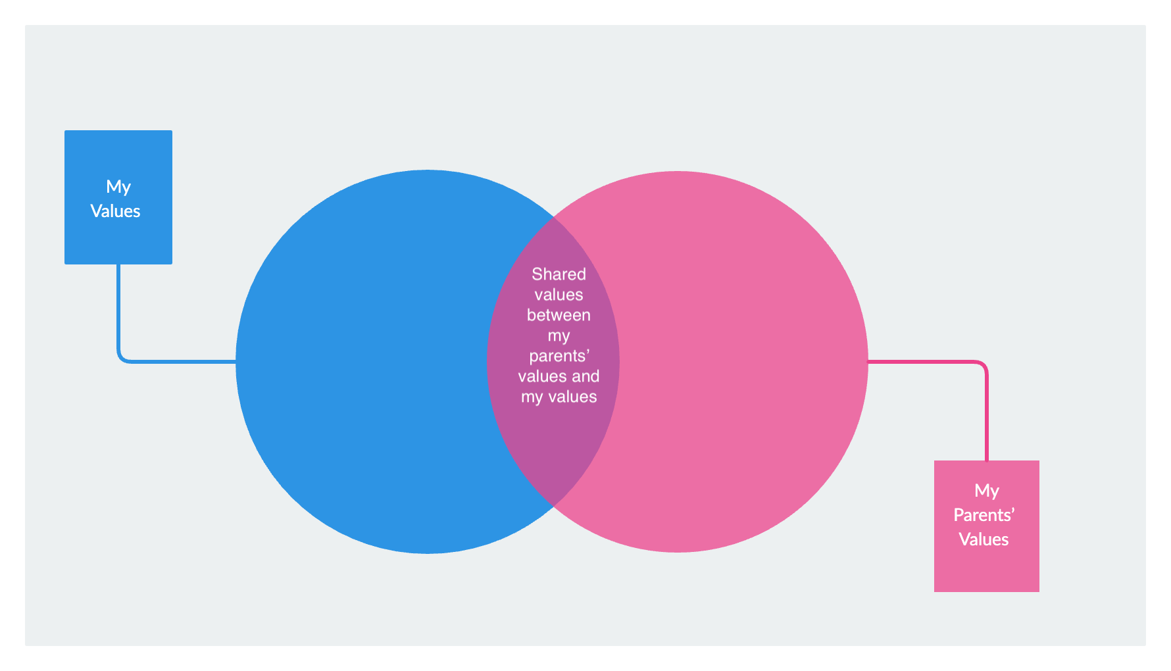
Values Venn Diagram:
A Visual Sample
Notes:
Here is a visual example of the Values Venn Diagram that I created. This intervention is for all tenth grade students. It fits into the career development component of the ASCA (2023) model. During classroom guidance lessons, the school counselor would give students a list of values and ask them to choose at least ten (career) values that are important to them. The school counselor would also ask students to identify five or more values that they believe are important to their parents in terms of their child’s career choices. After guiding students through this lesson, students would be asked to fill in a Venn diagram that is similar to the one on the screen. On one side, the students will list values that are important only to them. On the other side, the students will list values that are only important to their parents from their perspective. In the center, students will list values that are shared between them and their parents.
Cultural sensitivity: AISJ has an Arab majority population and most students are from collectivist cultures where parents have a major influence on all career-related decisions.

Slide 11
3. Small Group Counseling Sessions for Career-Related Values
Theoretical orientation
Delivery (Evidence-based interventions)
Cultural sensitivity
Notes:
The theoretical orientation behind this intervention comes from Super’s life-space, life-span theory and is intended to be a follow-up intervention to the Values Venn Diagram intervention (Niles & Harris-Bowlsbey, 2022). Bhat and Stevens (2021) point out the benefits of peer-to-peer learning, especially in High School. This group intervention was designed in response to the research that supports group counseling approaches to career counseling in schools. It is a cost-effective way to engage the highest number of students within a limited time frame and gives school counselors an opportunity to benefit from the group setting.
This evidence-based intervention, inspired by Super’s theory, is a small group counseling intervention aimed at students who are experiencing cognitive dissonance between what their values are and what their parents’ values are. The goal of the small group counseling sessions will be to give the students a safe space to process their Venn diagrams in a group setting with other students who are experiencing a similar inner tug-of-war when their career-related values are not aligned with parental expectations of them.
In terms of cultural sensitivity, Niles and Harris-Bowlsbey (2022) reiterate the importance of Super’s salient life roles theory: “Because people seek to express specific values in each of the life roles they play, career development practitioners must encourage their clients to clarify and articulate the values they seek to express in the life roles that are important to them. Once clarified and articulated, clients can be encouraged to identify outlets for values expression within each of their salient life roles” (page 34). This intervention was specifically designed with this population in mind because values conflicts are often a source of distress for students who feel torn between following their passions and dreams and wanting to please their parents. This is a common struggle for students who come from collectivist cultures and family systems that discourage students from self-actualization or individuation.

Slide 12
4. Career Day
Theoretical orientation
Delivery (Evidence-based interventions)
Cultural sensitivity
Notes:
Kutlu and Bedel (2021) conducted a research study into the impact of career days on irrational beliefs that many tenth grade students hold around career choice and decision-making as it relates to career choice. The research concluded that career days are very effective at addressing fears and irrational beliefs surrounding career-based decision-making.
Evidence-based interventions: All tenth grade students will participate in Career Day. Guest speakers will be invited to the school and students will attend four sessions of their choosing throughout the day. Each session will be one hour in length. Presenters and session leaders will be parents and community volunteers from a variety of different professions. School counselors will facilitate Career Day. Teachers will supervise the sessions and assist presenters on an as-needed basis. Students will be given a list of presenters ahead of time and asked to rank their choices. Teachers will assist school counselors in organizing and scheduling the sessions. Students will write a detailed reflection on each session they attend with guided questions provided to them by the school counselor.
Cultural sensitivity: The school counselor will ensure that presenters are from a variety of different backgrounds and that presenters from both genders are represented. The school counselor will ensure that students with exceptionalities are provided with presenters who can speak to their unique abilities and needs, and ways that they can find fulfillment and success in their post-secondary career pursuits.

Slide 13
Program Marketing
Word-of-mouth
Posters around the school
Morning Announcements

Slide 14

Program Marketing: An example
Notes:
This is an example of a poster to advertise Career Day. It would be posted strategically around the school and the goal would be to generate interest in and an excitement around the day. It would be something that ninth graders would see and be able to look forward to and something that would hopefully trigger positive memories for juniors and seniors of the career day that they attended during their sophomore year. I created this poster through CANVA (n.d.); an online design tool. Here is a link to the poster: https://www.canva.com/design/DAFiJDkKmdY/8OSscNHAcAcdD7cBHlc5xg/edit?utm_content=DAFiJDkKmdY&utm_campaign=designshare&utm_medium=link2&utm_source=sharebutton

Slide 15
Resources Needed and Potential Costs of the Program
Career Interest Inventory | Values Venn Diagram | Small Group Counseling Sessions for Career-Related Values | Career Day
The total cost of each RIASEC inventory is $5.00 USD. If 70 students participate, the total cost will be $350 USD (70X$5). | The students will complete their Venn diagrams online, using their laptops or tablets during classroom guidance lessons with the school counselor. There are no additional costs to consider. | The school counselor will lead the sessions and students will bring their devices with them to each session. There are no additional costs to consider. | The Career Day will be organized and facilitated by school counselors and supervised by teachers. The presenters will be invited on a volunteer basis. I propose that coffee, light snacks and lunch be provided for the presenters. If we can recruit 20 presenters, the approximate cost for the food and beverages would be $200 USD (20X$10 each).

Slide 16
Program Evaluation:
Pre-/Post-Test
Circle the response that is most accurate for you CURRENTLY:
I can identify my top three values as they relate to careers. Yes Somewhat No
2. I can identify my top three interests as they relate to careers. Yes Somewhat No
3. I have created one shot-term SMART goal related to career development. Yes Somewhat No
4. I have created one long-term SMART goal related to career development. Yes Somewhat No
5. I have created a career portfolio.
Yes Somewhat No
Notes:
One method of evaluation will be a pre-/post-test for students that is directly linked to the program objectives. The pre-test is a diagnostic assessment and will be administered to students at the beginning of the school year before the proposed interventions. The post-test is a summative assessment that will be administered to students at the end of the school year to measure whether or not the learning objectives were met.

Slide 17
Program Evaluation:
Career Day Reflections
Career Day Reflections
Presenter’s Name:
Presenter’s Occupation:
Which one of Holland’s six types does this career fit into? You may list more than one. Please explain your reasoning.
Please list 3 things you learned about this career during the presentation.
Does this career interest you? Why or why not?
Notes:
A second method of evaluation will be analyzing the answers to the reflection questions that students will answer after each career day presentation they attend. This summative assessment tool will measure the student’s learning in relation to the learning outcomes, specifically the ones related to the interest inventory and Holland’s Theory of Types.

Slide 18
Program Evaluation:
Portfolio
A third method of evaluation will be a thorough assessment of each student’s portfolio. Portfolios are a summative assessment that are measured against learning objectives to see if they have been met by students. Portfolios will be evaluated at the end of the second semester once all interventions have been administered.

Slide 19
References
ASCA student standards: Mindsets & Behaviors for student success. ASCA Student Standards: Mindsets & Behaviors for Student Success - American School Counselor Association (ASCA). (n.d.). Retrieved May 1, 2023, from https://www.schoolcounselor.org/Standards-Positions/Standards/ASCA-Mindsets-Behaviors-for-Student-Success
Bhat, C. S., & Stevens, M. M. (2021). College and Career Readiness Group Interventions for early high school students. The Journal for Specialists in Group Work, 46(1), 20–31. https://doi.org/10.1080/01933922.2020.1856250
Free design tool: Presentations, video, social media | CANVA. (n.d.). Retrieved May 6, 2023, from https://www.canva.com/
Hanna, A., & Rounds, J. (2020). How accurate are interest inventories? A Quantitative Review of Career Choice hit rates. Psychological Bulletin, 146(9), 765–796. https://doi.org/10.1037/bul0000269
Harper, H. (2023, February 7). How are you intelligent? an introduction to the holland codes (RIASEC). The Career Project. Retrieved May 6, 2023, from https://www.thecareerproject.org/blog/how-are-you-intelligent-an-introduction-to-the-holland-codes-riasec/
Hutchison, B., Niles , S. G., & Trusty , J. (2015, July 27). Career development interventions in the schools - researchgate. Research Gate. Retrieved April 29, 2023, from https://www.researchgate.net/publication/280579365_Career_Development_Interventions_in_the_Schools
KUTLU, A., & BEDEL, A. (2021). Effect of career days on high school students’ irrational beliefs about career choice and on decision making skills about career. Participatory Educational Research, 8(4), 454–467. https://doi.org/10.17275/per.21.100.8.4
Niles, S. G., & Harris-Bowlsbey, J. A. (2022). Career development interventions. Pearson.
Online career tests. Hollandcodes.com. (n.d.). Retrieved May 6, 2023, from https://www.hollandcodes.com/online.html#online
SurveyMonkey. (n.d.). Retrieved May 6, 2023, from https://www.surveymonkey.com/create/?sm=Q9yDSLkO8HV3l63nihY9VBcwb5sbugw2bojUO7_2B_2FkOI_3D&

