Slide 1
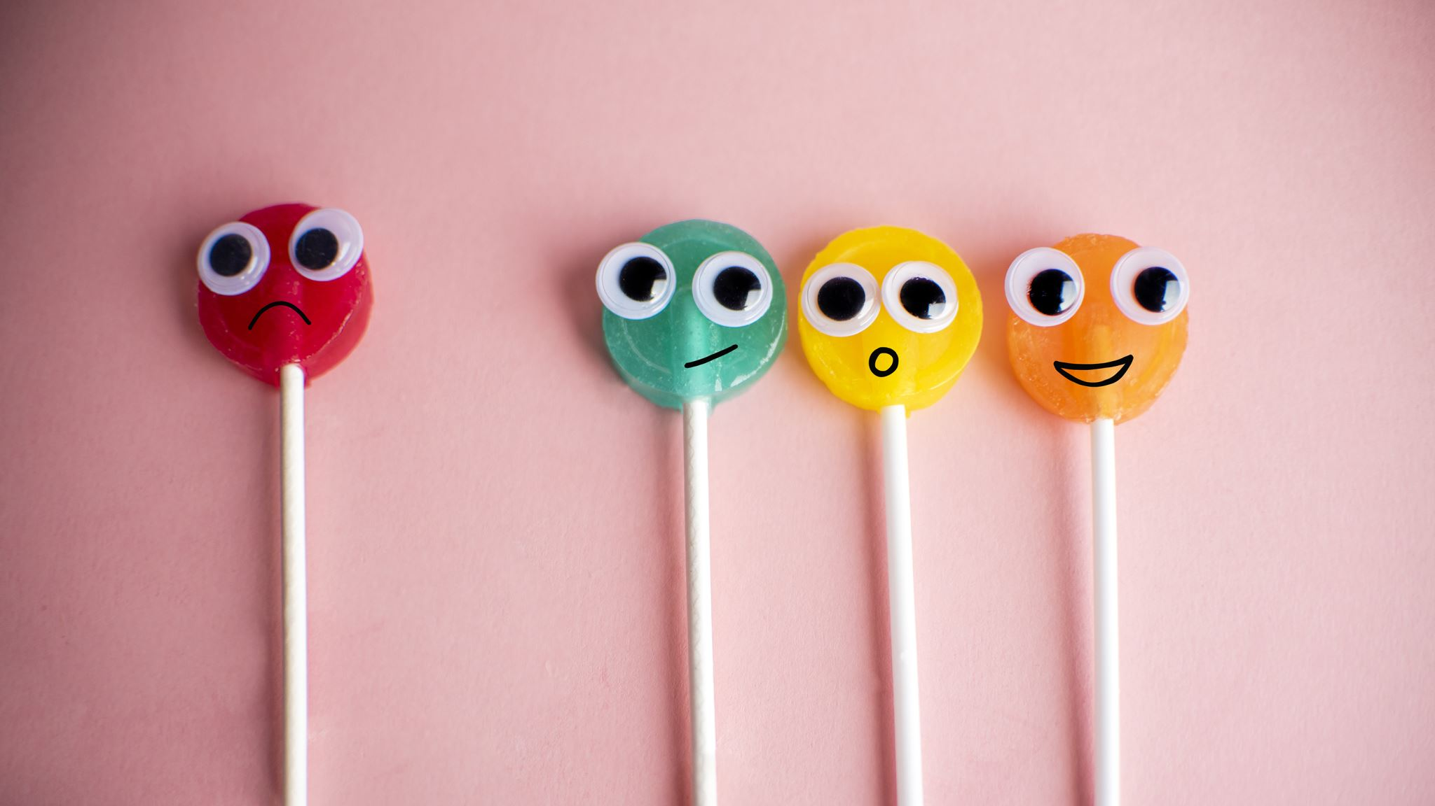
Worry Warriors
Small Group Psychoeducational Benchmark Presentation
By
Jen van Dijk
Notes:
The name of the group was inspired by Keri Powers, a school counselor who creates resources for fellow school counselors (Powers, 2023).

Slide 2
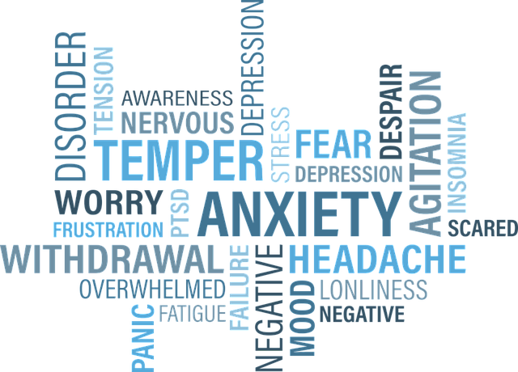
Introduction
Psycho-Educational Small Group Topic:
Anxiety Management
Grade Level of Small Group Participants:
Grades 1,2,4
Notes:
The group name I chose to use was Worry Warriors (Powers, 2023) because my site supervisor told me that in her experience, younger students have an easier time understanding the word worry, rather than the word anxiety. This group was for students in first through fourth grade, although there were no third grade students in the group. It was an anxiety management group.

Slide 3

The Goal: to help students learn skills to manage their worries
Notes:
Our goal in forming this group is to help students learn skills to manage their worries.

Slide 4
Data Sources
DESSA (2023) - Devereux Student Strengths Assessment
Referrals (from parents, teachers, student support staff, administrators)
Notes:
The first existing data source that identifies and supports the need for this group at AISJ is teacher feedback on a survey called the Devereux Student Strengths Assessment (DESSA, 2023). This is a component of Aperture Education and is aligned with CASEL (The Collaborative for Academic, Social, and Emotional Learning). CASEL defines social-emotional learning as “the process of developing the skills, behaviors, and attitudes that students need to effectively manage their emotions, cognitions, and social behavior (Etherington & Costello, 2018, par.1)”. The second existing data source that supports the need for this group at AISJ is the number of referrals to the school counselors based around anxiety-related issues. This includes referrals from teachers, parents, administrators, and student support staff.

Slide 5

Pre-/Post-Test Data:
Q1. What skill can you use when you have worry thoughts that are hard to control?
1) I can try hard not to worry.
2) I can bite my nails.
3) I can take a few deep breaths.
4) I can eat some candy.
Notes:
This is the first pre-/post-test question for students. At this age, we needed to read through the question with them to make sure that they understood what was being asked of them.

Slide 6
Pre-/Post-Test Data:
Q2. When your body feels tense, what can you do to help your body feel calm?
1) I can scream loudly.
2) I can do yoga.
3) I can eat some food.
4) I can buy some new clothes.
Notes:
This is the second pre-/post-test question for students. Again, at this age, we needed to read through the question with them to make sure that they understood what was being asked of them.

Slide 7
Pre-/Post-Test Data:
Q3. When I have worry thoughts, here are 3 things I can do to help myself feel calm again:
1) _______________________________
2) _______________________________
3) _______________________________
Notes:
This is the third pre-/post-test question for students. At this age, we needed to read through the question with them to make sure that they understood what was being asked of them, especially when they have been asked to write a response.

Slide 8
Needs Assessment Survey
Teachers (DESSA)
Parents
Students
Notes:
This is the order that we followed for the needs assessment survey. Teachers were surveyed first, using the mini-DESSA (2023). For those students who were flagged on the mini-DESSA, teachers were asked to complete the full DESSA. After we went over the results together, parents were contacted and were asked for their input. Finally, students were surveyed and verbally assessed by the school counselors.

Slide 9
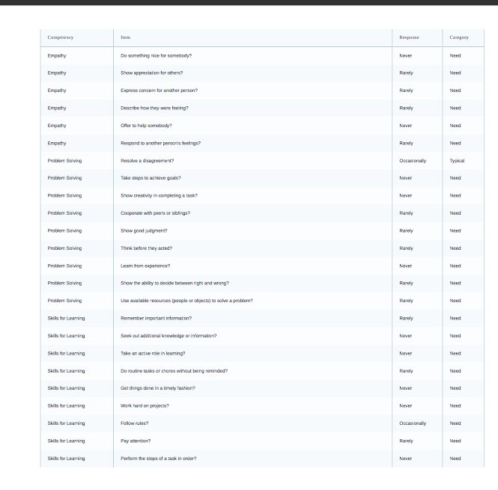
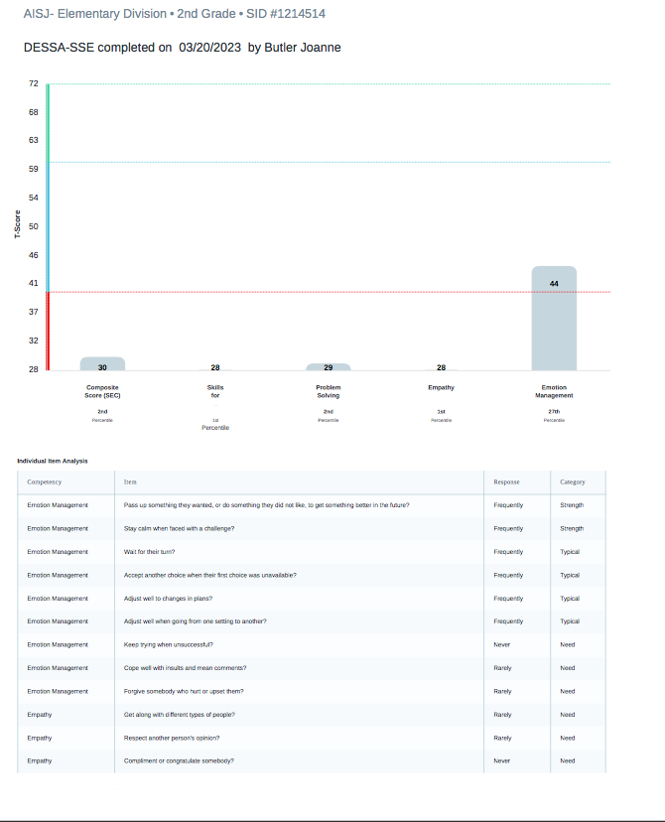
Needs Assessment Survey: DESSA
Notes:
The DESSA (2023) assesses for social-emotional skills. Teachers are asked to complete a survey for each one of their students. If a student is flagged ('need'), then they are asked to complete the full DESSA. These artifacts are screenshots of the DESSA. The example on the right is the mini-DESSA and the one on the left is the full DESSA for one of the students in our group.

Slide 10

Screening Process
Mini DESSA
Full DESSA
Discussion with teacher
Parental consent
Student interview
Student consent
Notes:
This is the order that we followed for the screening process. Teachers were surveyed first, using the mini-DESSA (2023). For those students who were flagged on the mini-DESSA, teachers were asked to complete the full DESSA. Results were discussed with teachers. After we went over the results with teachers, parents were contacted and were asked to sign a consent form if they agreed that their child was a good fit for the group. We then conducted interviews with students to screen them for the group. Once it was determined that they were a good fit, students signed a consent form.

Slide 11
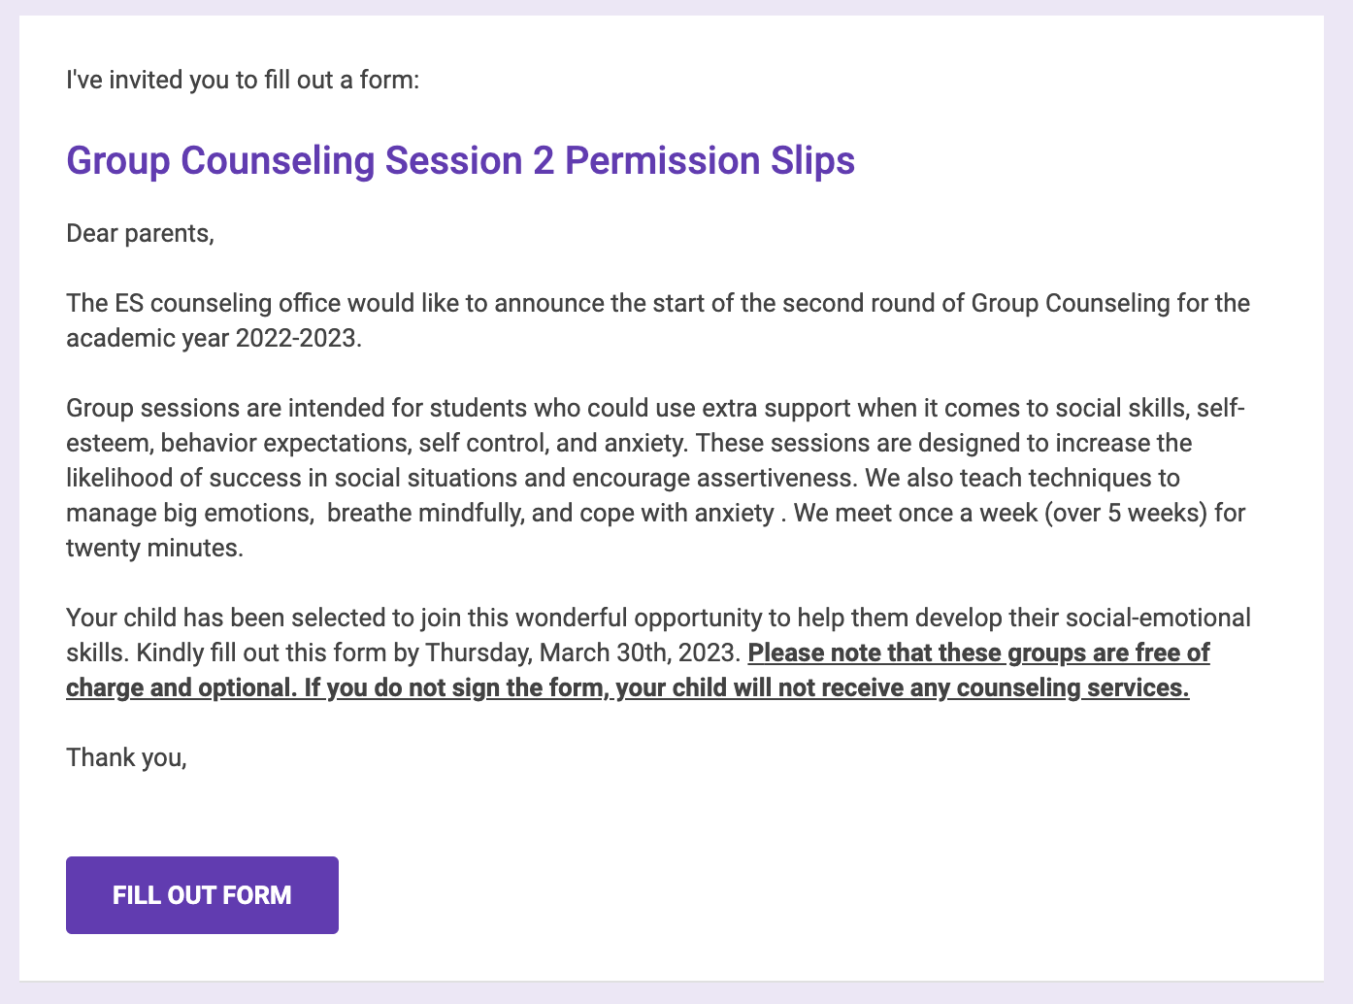
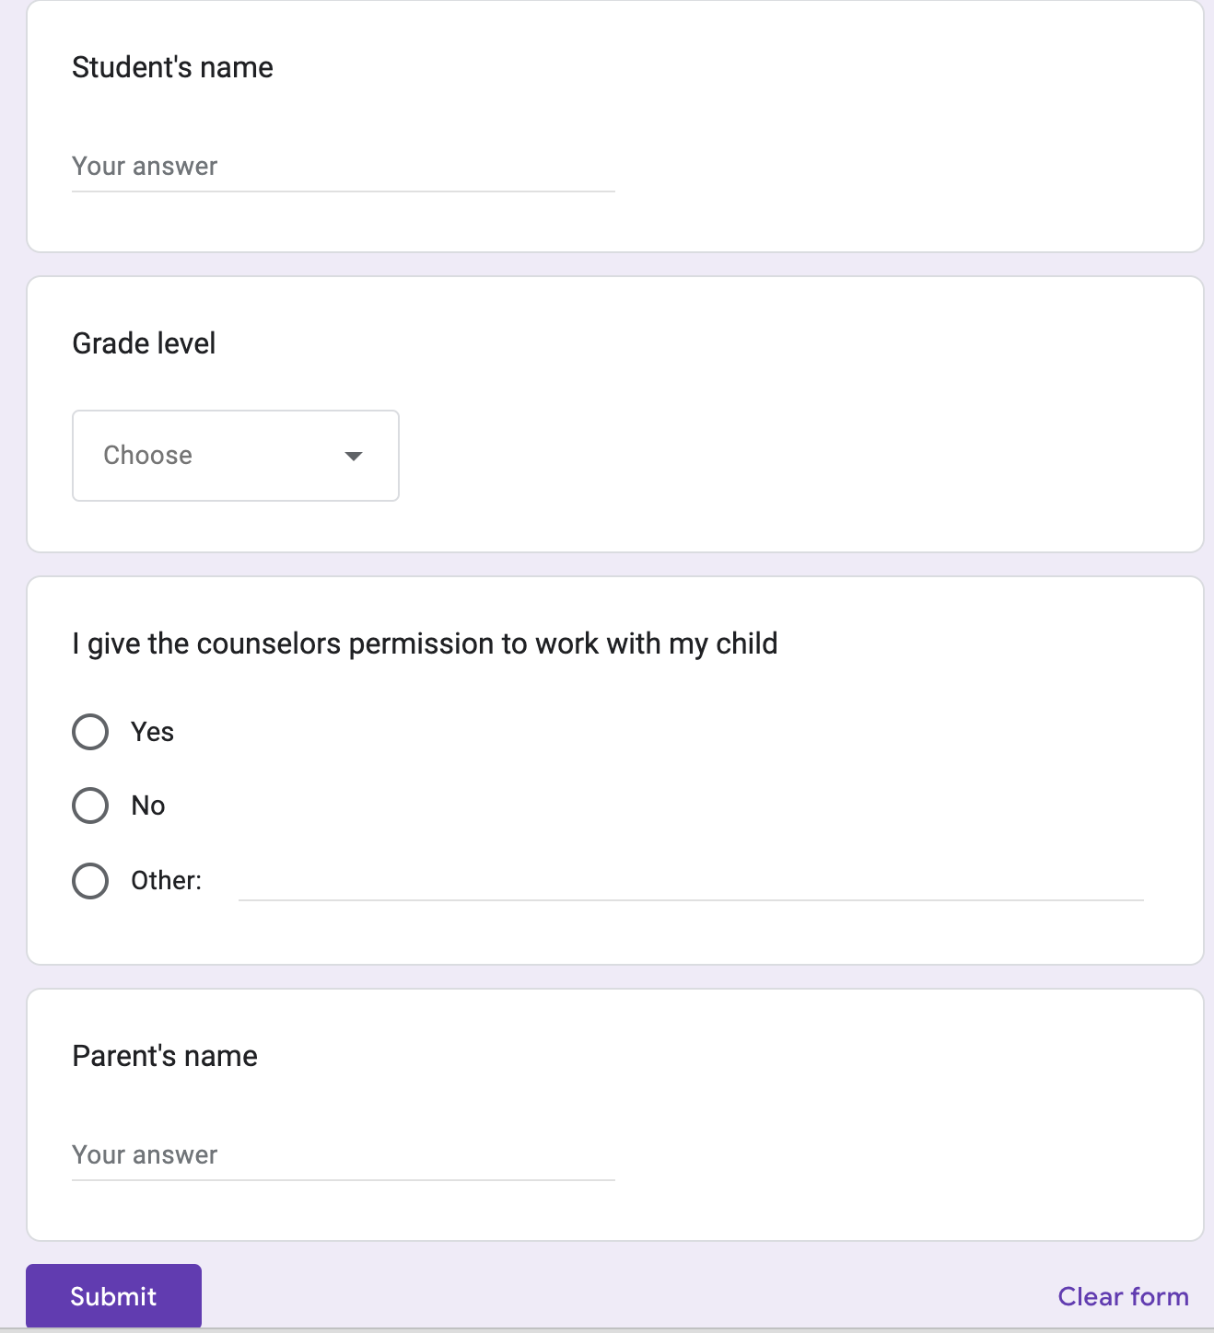
Consent Form For Groups @ AISJ
Notes:
The consent forms at AISJ are done electronically through a Google form. Parents fill it out and teachers keep an electronic record of parental consent for groups.

Slide 12
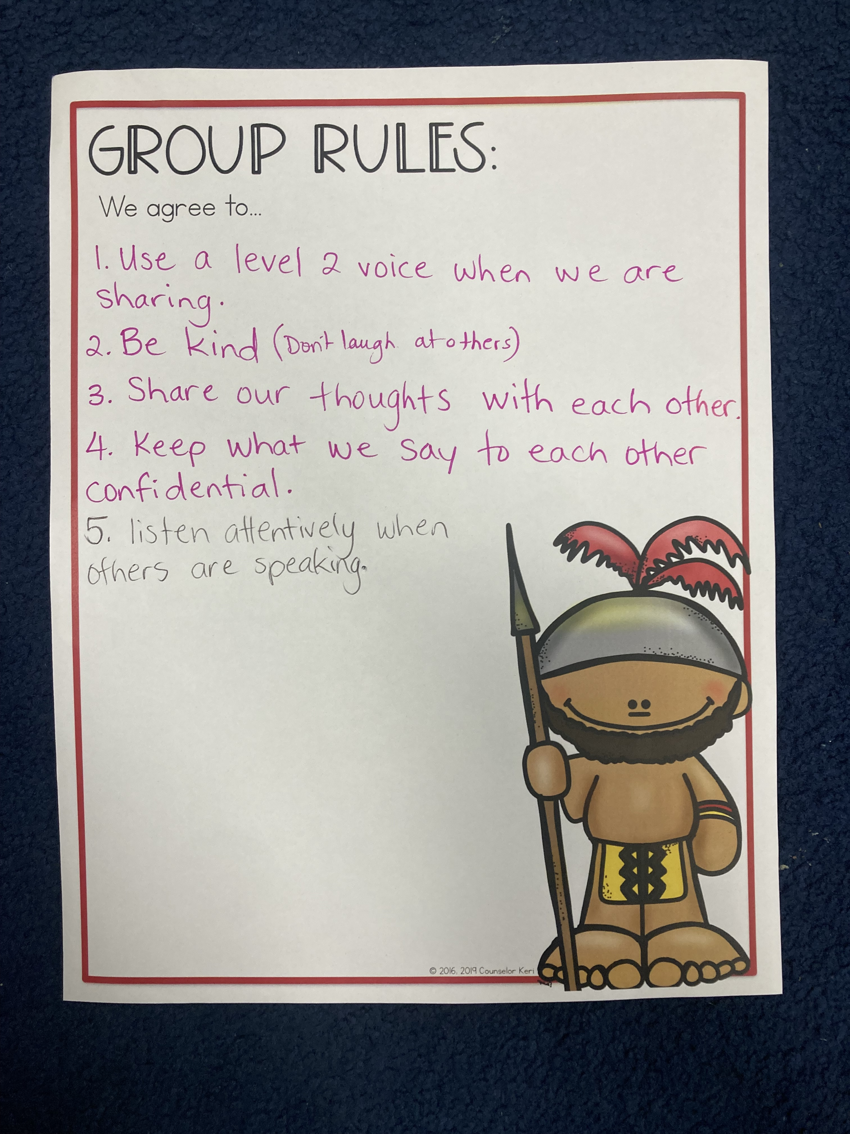
Forming Phase of the Group
Notes:
During the forming phase of the group, we worked together to come up with some group agreements. These were facilitated by me, but the students chose the rules that were important to them. The artifact shown here is a picture of the five rules we agreed to for our group. The group rules template was created by Katie Powers (2023) and included in her resource pack.

Slide 13
Pre-AIA Specialty Standards
FOUNDATIONS
COUNSELING PREVENTION & INTERVENTION
DIVERSITY & ADVOCACY
ASSESSMENT
RESEARCH & EVALUATION
ACADEMIC DEVELOPMENT
COLLABORATION & CONSULTATION
LEADERSHIP
Notes:
1. Foundations: I will be considering ethical and legal implications in all my decision-making with the group. I will look to the ASCA National Model for guidance. I will promote the use of “school counselor” rather than guidance counselor.
2. Counseling prevention and intervention: I will apply specific counseling theories and techniques in my interactions with the small group. I will go over AISJ’s crisis management plan with Ghinwa, my site supervisor and go over some referral resources.
3. Diversity & Advocacy: I will consider cultural, economic, and political issues during service delivery and program planning. I will be intentional about examining the congruence of policies, programs, and practices, in relation to the needs of students and families at AISJ.
4. Assessment: I will initiate discussions with Ghinwa about data collection to identify programming and student needs. I will be intentional about identifying potential barriers to student development. I will refer to the ASCA National Model for assessment guidance.
5. Research and Evaluation: I will discuss research findings related to program outcomes. I will use and share technology that is relevant to school counseling programming and student learning.
6. Academic Development: I will intentionally include within and outside of the school community for program planning and implementation. I will consider the use of differentiated instructional strategies during program planning.
7. Collaboration and Consultation: I will include others in my program planning and implementation. I will seek out supervision and consultation. I will ask about accessing existing peer programming.
8. Leadership: I will ask about Recognized ASCA Model Program (RAMP) and inquire about needs assessment for parent/teacher education.

Slide 14
Culturally Sensitive Considerations
Age range of students
Social class in a hierarchical system
Gender
Disability status
Religious beliefs
Ethnicity
Host culture values/beliefs
TCK (third culture kids)
Notes:
This psycho-educational small group is culturally diverse in many ways. Students range in age between 6 and 9. The students at the American School of Jeddah (AISJ) are largely from Arab countries, although there are students from Canada, Japan, The United States, Korea, China, South Africa, Australia, and other parts of Asia. Special attention will be paid to this culturally diverse population, especially in terms of values. Overall, the students who attend AISJ come from collectivistic cultures. Because I come from an individualistic culture, I will be especially aware of not imposing my cultural values onto them during our sessions together. Hays and Erford (2023) state that when practicing culturally responsive counseling, “counselors must also be aware of their own cultural identities and the cultural contexts for their approach to counseling” (page 545). Other aspects of culture to take into consideration for this group include culture-driven, gender-specific expectations around outward expressions of anxiety; the presence of learning disabilities for some of the group members; differences in religious beliefs; the range of ages (grades 1-4) amongst group members and the social class differences amongst group members within a hierarchical system. Another unique aspect of this group is that all members are third culture kids, meaning that they are expatriates in Saudi Arabia rather than natives to the country.

Slide 15
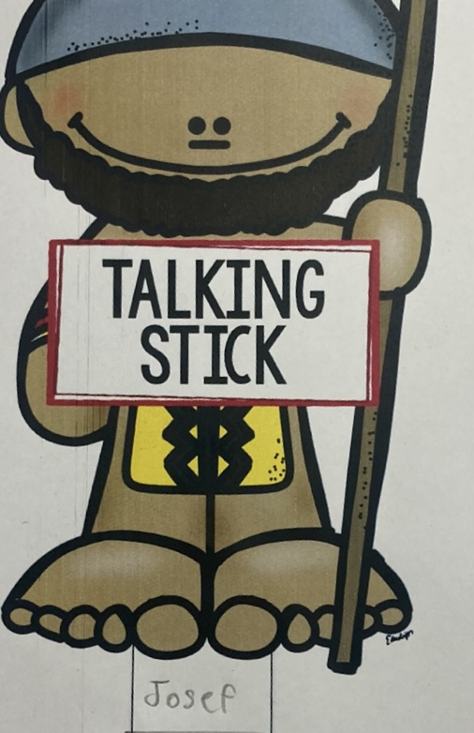
The Storming Phase of the Group
Conflict
Bias
Prejudice
Oppression
Discrimination
Notes:
When conflict came up in the group, I addressed it directly with the students in the moment. Initially, I made sure to co-create the group norms and agreements with the students, and during that process, we agreed that only one person would speak at a time and discussed what active listening looks like. Because these students are so young, I had to define words like ‘bias,’ ‘prejudice,’ ‘oppression,’ and ‘discrimination’ for them in child-friendly language. I gave them an opportunity to share about a time when they experienced bias, prejudice, oppression or discrimination and related it back to the feelings of anxiety/worry that can arise in these types of situations. The artifact shown here is a talking stick that was cut out and used throughout the sessions as a visual and tactile reminder to students that only one person is able to speak at time. Each person wrote his or her name on the bottom of the stick and it was passed around. Whoever was holding the stick was the only one speaking. The talking stick was created by Katie Powers (2023) and included in her resource pack.

Slide 16
The Learning Environment
Positive
Caring
Safe
Notes:
One of the strategies I used to promote a positive, caring, and safe learning group environment was modeling kindness and respect for all students in the group. I modelled active listening and reinforced the importance of this skill by using the school’s current motto for active listening: 'eyes watching, ears listening, voice quiet, body calm.' I demonstrated and modelled empathy as the students shared their feelings and stories. I reinforced the concept of confidentiality frequently so that students were aware of how important it is not to share what was talked about in the group with others. I began each session by going over confidentiality and the limits to it and supported it with a visual poster on the wall that I referred to. I ensured that students were following the agreed-upon group norms and gave gentle reminders as needed. Other strategies that I drew upon to ensure a positive, caring and safe learning environment were differentiated instruction for diverse learners and age differences, and I made sure to include students in creating group norms.

Slide 17
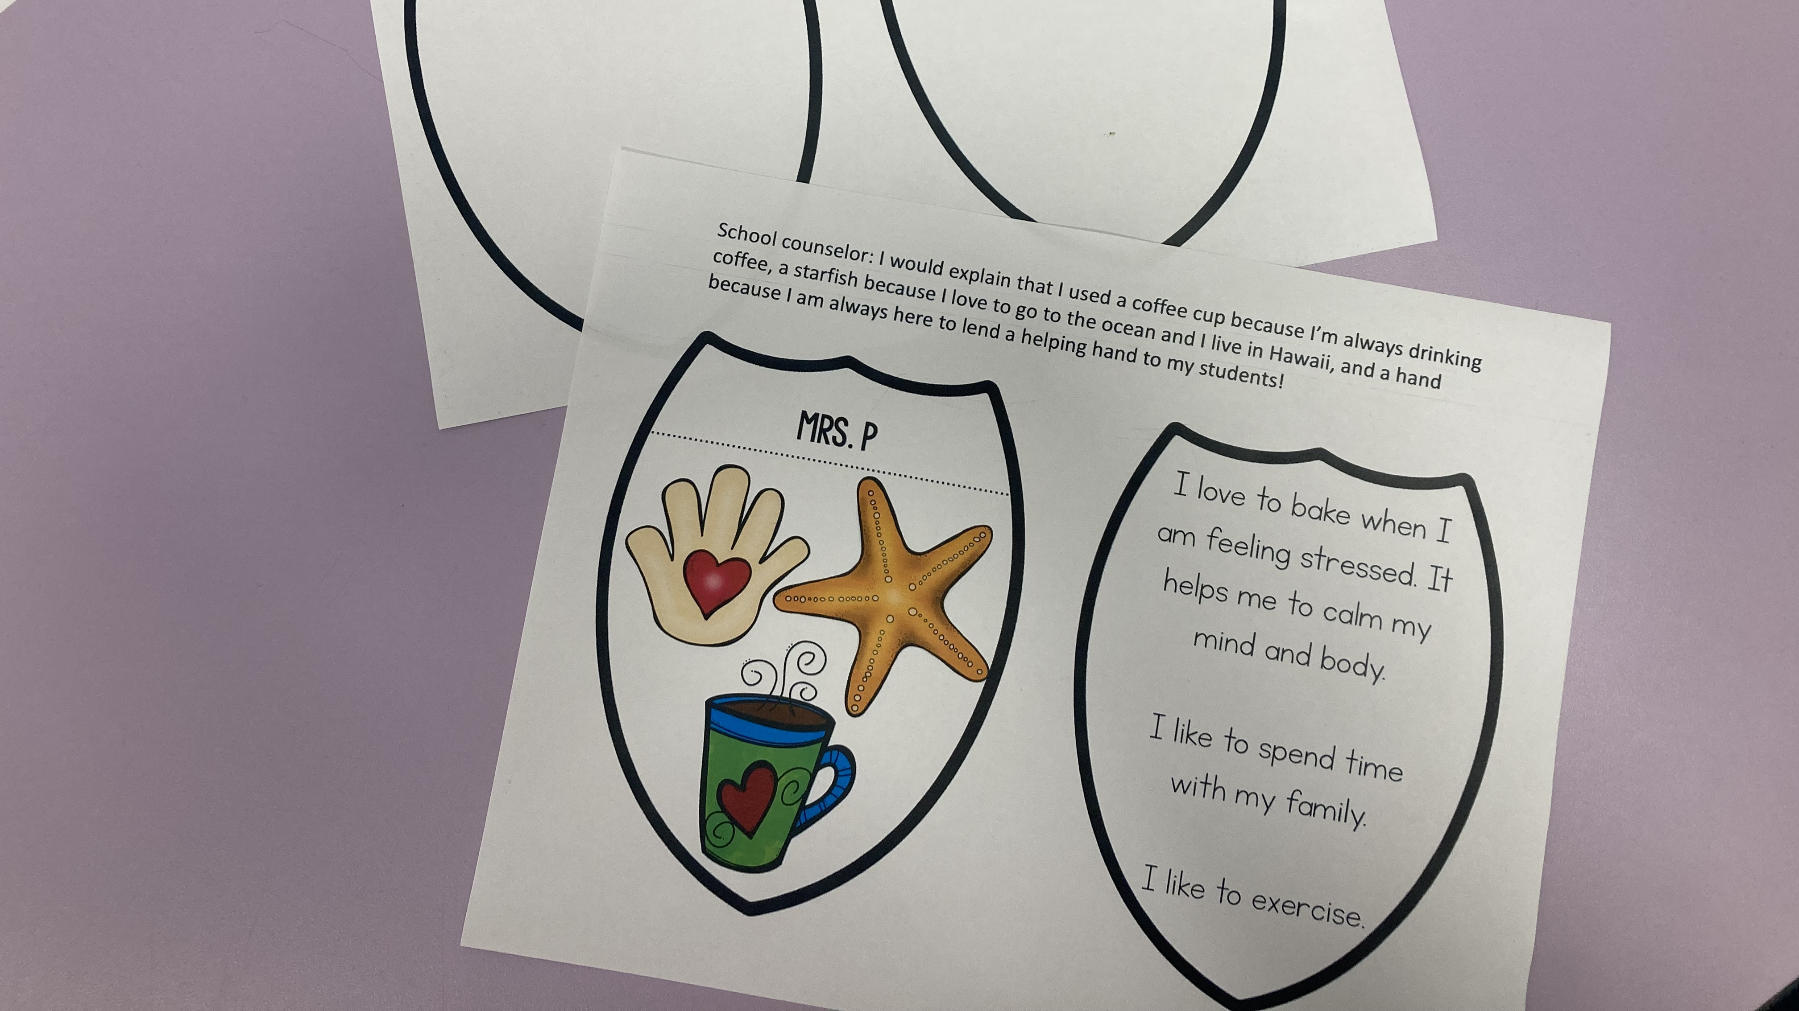
The Working Phase of the Group
Notes:
For the working phase of the group, I used Katie Powers' (2023) Worry Warriors resource packet for school counselors. This artifact is a sample that I used from that resource during our second session of the group. It requires students to draw and color three things that represent them on one shield and to write three things that they like to do on the right side. They cut their shields out, glue them together, share them in the group, and refer back to them at certain times later in the sessions.

Slide 18
Group Evaluation
Data for success: pre and post-test data comparison, re-administration of DESSA, stakeholder feedback, academic achievement scores
Areas for improvement: consistency of attendance for group members
Notes:
I evaluated the success of the group by asking students the same questions that I asked on the pre-test and compared their responses before and after the group counseling intervention. I interviewed teachers, school counselors, and the student support team before the group was formed and I will meet with them again to ask them if they have been able to observe any changes in the students I worked with once the post-group DESSA evaluations have been completed. I will ask the teachers to re-assess the students who participated in the group by administering the DESSA again and comparing each student’s initial score on the anxiety portion of the DESSA to the scores obtained after the group counseling intervention. I will compare each student’s academic achievement scores before the group to their academic achievement scores after the group to assess whether or not the group counseling intervention had an impact on academic achievement scores with any, or all, of the students who participated in the group. One area for improvement would be consistency of attendance during the group sessions. This group was happening during Ramadan here in Jeddah, and because of reduced time with students, the teachers were not sending their students down consistently.

Slide 19
References
ASSOCIATION, A. M. E. R. I. C. A. N. S. C. H. O. O. L. C. O. U. N. S. E. L. O. R. (2019). Asca National Model: A Framework for school counseling programs. AMERICAN SCHOOL COUNSELOR.
Dessa. Social and Emotional Learning - Aperture Education. (2022, October 13). Retrieved February 8, 2023, from https://apertureed.com/dessa/
Etherington, V., &amp; Costello, S. (2018). Comparing universal and targeted delivery of a mindfulness-based program for anxiety in children. Journal of Psychologists and Counsellors in Schools, 29(01), 22–38. https://doi.org/10.1017/jgc.2018.22
Hays, D. G., &amp; Erford, B. T. (2023). Developing multicultural counseling competence: A systems approach. Pearson Education Inc.
Powers , K. (2023). Resources to spark student growth. Counselor Keri. Retrieved April 15, 2023, from https://shop.counselorkeri.com/

