Slide 1
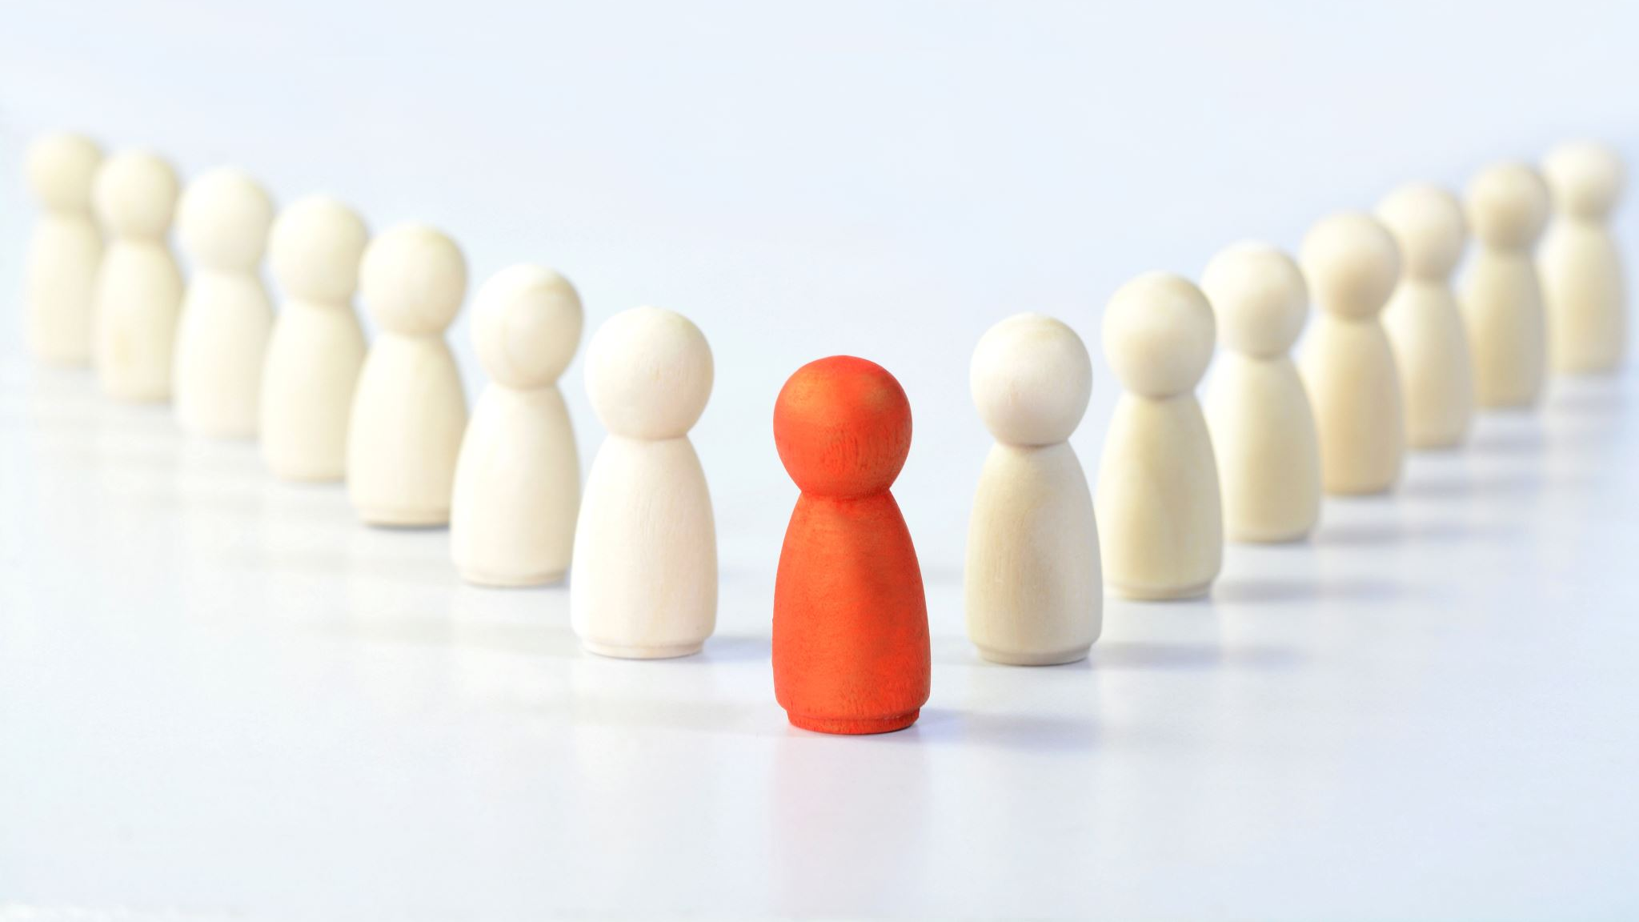
Bullying Prevention
SEL Unit
(Adapted from Second Step Curriculum)
4th Grade

Slide 2

Objective
The goal of this classroom guidance unit is to teach students what bullying is, how to recognize it, and the skills needed to refuse bullying and report it.

Slide 3
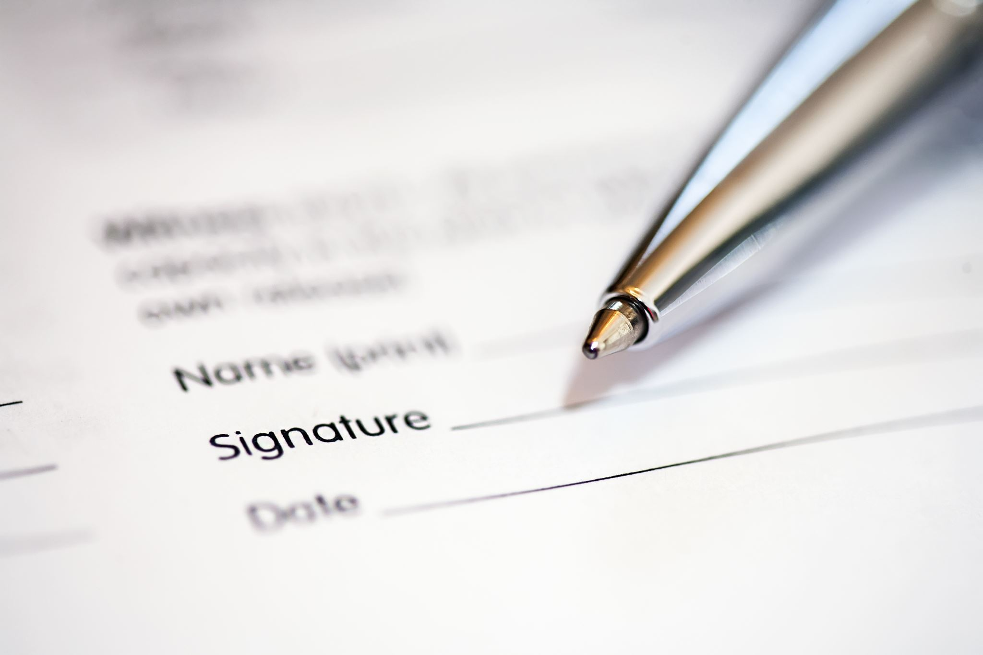
Data: Pre-/Post-Test
Google survey link to pre-test:
https://docs.google.com/forms/d/e/1FAIpQLSd_CdokuaaGdXwiOgETH4zYmVvBIA4daDG3KwF0fY7xNy3aAg/viewform?usp=sf_link
Survey
What is bullying?
I know the difference between a conflict and bullying.
I know how to report bullying at school.
Notes:
The first outcome data source will be a pre-/post-test. Fourth grade students will be given a diagnostic test to see what they already know about bullying. It will be given to students via google surveys so that survey responses can be analyzed before and after the bullying prevention unit.

Slide 4
Data: Student Reports of Bullying
Posters
QR Code
Ipads
Report
Support
Notes:
The second outcome data source will be student reports of bullying. There are several
posters around the school that have a QR code that students can scan to report bullying. All
students from kindergarten through fifth grade have an ipad and have been taught how to scan
the QR codes. For students who need support, parents and teachers are available to help. Once
students have scanned the bar code, they can report the bullying and school counselors and
administration receive a notification of a new bullying report via email. These bullying reports
are analyzed based on grade level and on an individual basis.

Slide 5
Needs Assessment
Parents/guardians
Teachers
Support staff
Administrators
Students
Notes:
All relevant stakeholders will be surveyed to support the need for this
classroom guidance unit, including parents/guardians, teachers, support staff, administrators, and
students.

Slide 6
AIA Alignment
Foundations
Counseling Prevention & Intervention
Diversity & Advocacy
Assessment
Research & Evaluation
Academic Development
Collaboration &Consultation
Notes:
1. FOUNDATIONS: I will demonstrate the ability to apply and adhere to ethical and legal
standards in school counseling and demonstrate the ability to articulate, model, and advocate for
an appropriate school counselor identity and program.
2. COUNSELING PREVENTION & INTERVENTION: This will be evidenced in my
practice as I demonstrate self-awareness, sensitivity to others, and the skills needed to relate to
diverse individuals, groups, and classrooms. During these lessons, I will provide classroom
guidance to promote the academic, career, and social/emotional development of students.
3. DIVERSITY & ADVOCACY: I will demonstrate multicultural competencies in relation to
diversity, equity, and opportunity in student learning and development. Additionally, I will
advocate for the learning and academic experiences necessary to promote the academic, career,
and social/emotional development of students.
4. ASSESSMENT: I will assess and interpret students’ strengths and needs, recognizing
uniqueness in cultures, languages, values, backgrounds, and abilities. I will also select
appropriate assessment strategies that can be used to evaluate a student’s social/emotional
development.
5. RESEARCH & EVALUATION: I will use DESSA to analyze and use data (and relevant
technology) to enhance the school counseling program at AISJ.
6. ACADEMIC DEVELOPMENT: During these classroom guidance lessons, I will implement
differentiated instructional strategies that draw on subject matter and pedagogical content in the
4th grade standards for learning.
7. COLLABORATION & CONSULTATION: I will consult with teachers, staff, and
community-based organizations to promote student academic, career, and social/emotional
development and I will use peer helping strategies in the school counseling program.

Slide 7

ASCA Mindsets and Behaviors
M 2. Sense of acceptance, respect, support and inclusion for self and others in the school environment
B-SMS 1. Responsibility for self and actions
B-SMS 2. Self-discipline and self-control
B-SMS 9. Personal safety skills
B-SS 1. Effective oral and written communication skills and listening skills.
B-SS 2. Positive, respectful, and supportive relationships with students who are similar to and different from them.
B-SS 4. Empathy
B-SS 5. Ethical decision-making and social responsibility
B-SS 8. Advocacy skills for self and others and ability to assert self, when necessary
B-SS 9. Social maturity and behaviors appropriate to the situation and environment

Slide 8
Cultural Sensitivity
Saudi Arabia (host culture)
Collectivist vs. Individualistic
Self-awareness
Single-parent families
SES
Students with exceptionalities (inclusion)
Modeling zero-tolerance for bullying
Active listening (eyes, ears, body, voice)
Confidentiality/limits
Classroom agreements/reminders
Notes:
This classroom guidance unit is culturally sensitive because I have considered cultural factors
that might impact the learners and/or the learning environment. Because I am teaching in Saudi
Arabia, I will take the cultural diversity of this population into consideration as I am teaching the
lessons, especially in terms of values. Overall, the students who attend AISJ come from collectivistic cultures. Because I come from an individualistic culture, I will be especially aware
of not imposing my cultural values onto them during our sessions together. Hays and Erford
(2023) state that when practicing culturally responsive counseling, “counselors must also be
aware of their own cultural identities and the cultural contexts for their approach to counseling”
(page 545). There are students who come from single parent families, so I will be sensitive to
their needs as I teach the concepts and lead discussions. Although most students come from
middle-income families, some students come from very high-income families and others from
lower income families, and it will be important to keep this in mind. Another diversity factor for
consideration is students with exceptionalities. I will include them as much as possible in our
discussions, while at the same time maintaining an awareness of their unique needs and potential
limitations.
Some of the strategies I will include in the classroom to promote a positive, caring, and
safe learning environment are modeling kindness and respect and a zero-tolerance stance for
bullying. I will model active listening and reinforce the importance of this skill by using the
school’s current motto for active listening; “eyes watching, ears listening, voice quiet, body
calm.” I will demonstrate and model empathy as the students share their feelings and stories. I
will reinforce the concept of confidentiality frequently so that students are aware of the
limitations. I will ensure that students are aware of the classroom agreements and give gentle reminders as needed.

Slide 9
Evaluation
Google survey link to post-test:
https://docs.google.com/forms/d/e/1FAIpQLSd_CdokuaaGdXwiOgETH4zYmVvBIA4daDG3KwF0fY7xNy3aAg/viewform?usp=sf_link
Survey:
1. What is bullying?
2. I know the difference between a conflict and bullying.
3. I know how to report bullying at school.

Slide 10

Evaluation
Successes:
Student participation/engagement was good
Content (SS) is evidence-based
Content led to good discussions with students
Areas for Improvement:
Supplement SS (groups, movement)
Spreading the unit out more (months)
End-of-unit celebration of learning

Slide 11
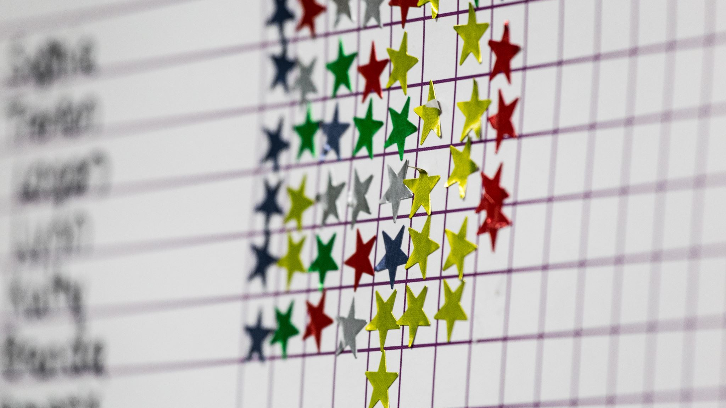
References
ASSOCIATION, A. M. E. R. I. C. A. N. S. C. H. O. O. L. C. O. U. N. S. E. L. O. R. (2019). Asca National Model: A Framework for school counseling programs. AMERICAN SCHOOL COUNSELOR.
Bullying prevention unit. Second Step. (n.d.)https://www.secondstep.org/bullying-prevention
Hays, D. G., &amp; Erford, B. T. (2023). Developing multicultural counseling competence: A systems approach. Pearson Education Inc.

Slide 12

Bullying
Grade 4 Lesson 1

Slide 13

Let's warm-up...
What are some of your classroom agreements?
Why are there are rules at school?

Slide 14

What is bullying?

Slide 15

Bullying
Bullying is when someone keeps being mean to someone else on purpose.
The person it's happening to hasn't been able to make it stop.
It is one-sided.
It is unfair.

Slide 16

What are some examples of bullying?

Slide 17

Some examples of bullying...
Hurting
Hurting someone's body or belongings
Using
Using words to hurt someone's feelings
Leaving
Leaving someone out on purpose
Getting
Getting others to be mean to or to exclude someone

Slide 18
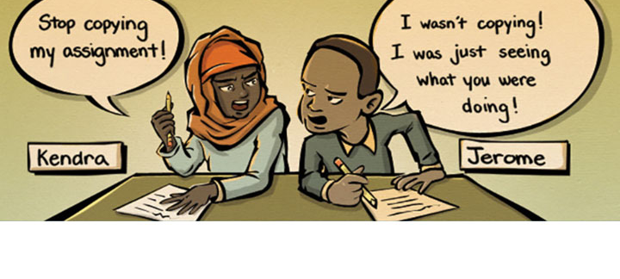
What do you think?

Slide 19

Let's review the 3 Rs of bullying...

Slide 20

The 3 Rs of Bullying...
Recognize
Report
Refuse

Slide 21

Video 1
As you watch the video, think about whether what you are seeing is a conflict or bullying.
https://learn.secondstep.org/product/bpu-kit/teach/grade-4/g4l01/g4l01-slm

Slide 22
TTT (Think, Turn, Tell)...
Do you think that Victor is being bullied?
How can you tell whether he is being bullied or not?
If you were in Victor's shoes, how would you feel?

Slide 23
Video 2
As you watch the video, look to see if anyone does or says anything to stop Zoe.
https://learn.secondstep.org/product/bpu-kit/teach/grade-4/g4l01/g4l01-slm

Slide 24
The 3 Rs of Bullying...
Recognize
Report
Refuse

Slide 25

Reporting
When Victor reported to Ms. Dia, he had to be assertive. What does being assertive look like and sound like?
How did reporting the bullying to Ms. Dia help Victor?
Why do you think it worked when Victor told Zoe to stop?

Slide 26

It's your turn to practice!
If you were being bullied, or you saw someone being bullied like Victor, what could you say or do to get the bullying to stop? Turn and practice what you would do or say with your partner.
Remember, your actions and words need to be respectful.
You are NOT acting out the bullying!!!

Slide 27
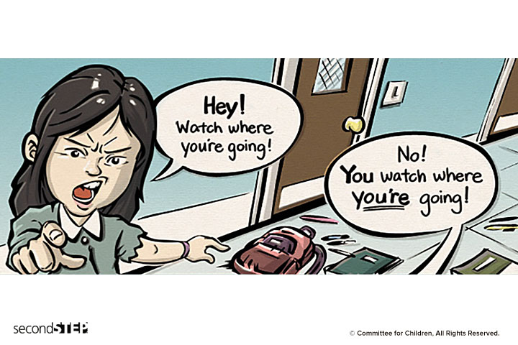
Bullying or not bullying?

Slide 28
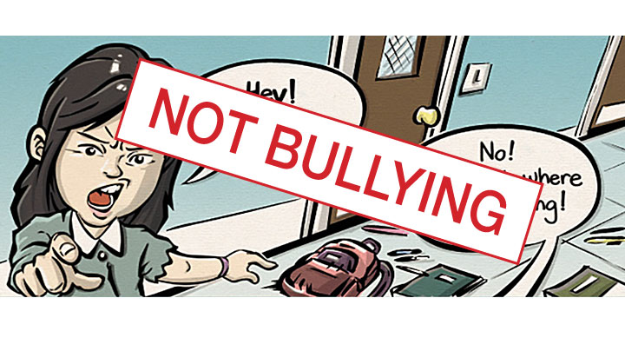

Slide 29
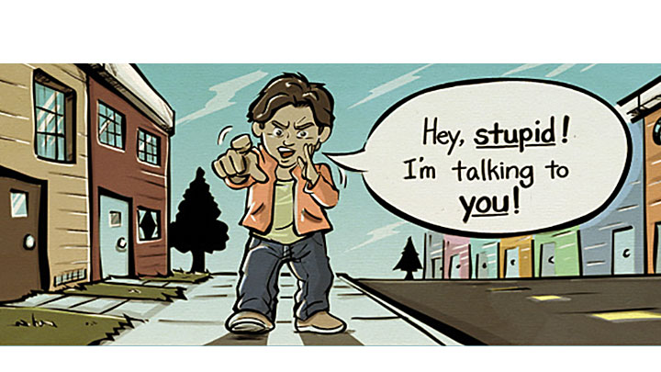
Bullying or not bullying?

Slide 30
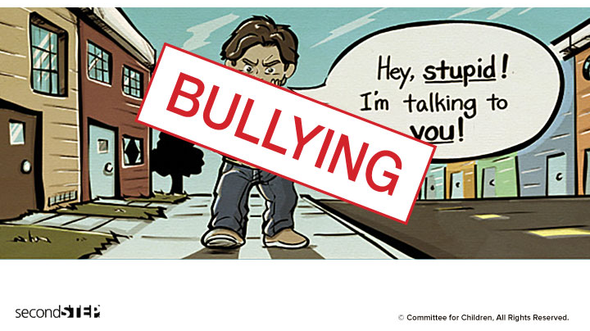

Slide 31
Let's Review the 3 Rs of Bullying...
Recognize
Report
Refuse

Slide 32
Bullying
Lesson 2

Slide 33
Let's Review the 3 Rs of Bullying...
Recognize
Report
Refuse

Slide 34
Introduction
Pay close attention to how you feel as you listen to the boy share...
https://learn.secondstep.org/product/bpu-kit/teach/grade-4/g4l02/g4l02-slm
When you see or know about bullying happening to someone else, what are you called?

Slide 35
You may have felt....
Sad for the student who is being bullied
Angry at but afraid of the student who is bullying
Frustrated for not knowing what to do
Guilty or ashamed for doing nothing to help
Relieved because you aren’t the one being bullied
Interested because you want to see what’s going on
Conflicted because you know it’s not right to bully but you don’t want to get involved

Slide 36

Video 1
Pay close attention to the bystanders as you watch this video:
https://learn.secondstep.org/product/bpu-kit/teach/grade-4/g4l02/g4l02-slm
1. How do you think Lenae feels about what just happened to Bria?
2. Do you think Val is bullying Bria? How do you recognize bullying?
3. Lenae thinks she and Tawny need to do something. What do you think they should do?

Slide 37
Video 2
How do you think it helps to have someone come with you when you report or refuse bullying?
02
How did Mr. Clay help stop the bullying?
03
How do you think Lenae and Tawny felt after they decided to support Bria and stand up to Val?
04
https://learn.secondstep.org/product/bpu-kit/teach/grade-4/g4l02/g4l02-slm
01

Slide 38
Let's review...
What are some ways you can support each other so that something like what happened to Bria doesn’t happen in your classroom?

Slide 39
Bullying
Lesson 3

Slide 40
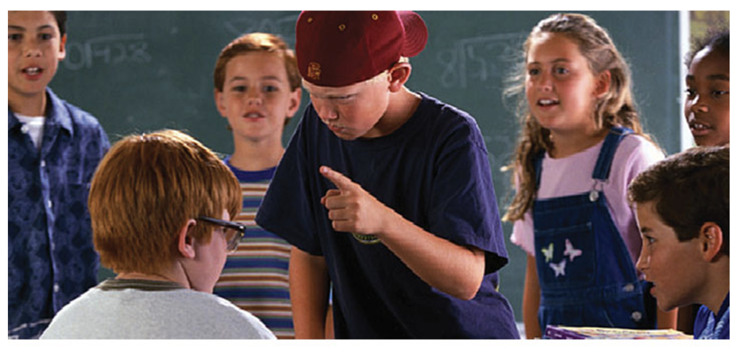
How are bystanders a part of the bullying problem?

Slide 41
Video 1
As you watch the video, imagine that you are a bystander. What could you do to help Andrew?
https://learn.secondstep.org/product/bpu-kit/teach/grade-4/g4l03/g4l03-slm
What do you think Isaac should do?
Let's see what he does.
https://learn.secondstep.org/product/bpu-kit/teach/grade-4/g4l03/g4l03-slm

Slide 42
It's your turn to practice!
In each of the following scenarios, you are going to practice doing the right thing as a bystander. You are NOT going to act out the bullying. You are going to take turns being a bystander with your partner.

Slide 43
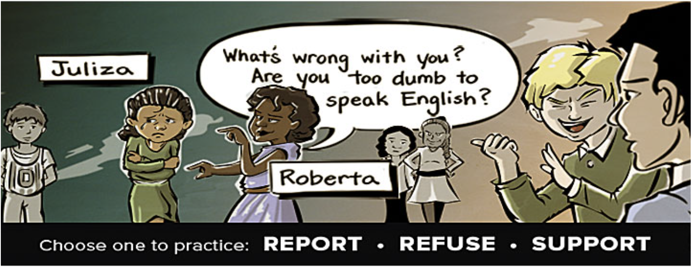
Scenario 1

Slide 44
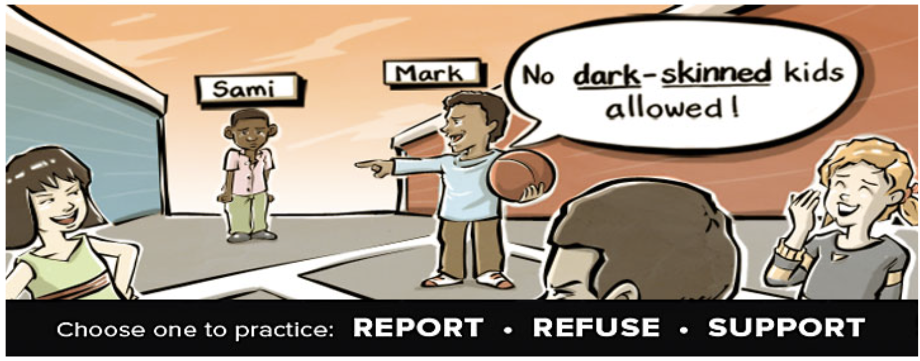
Scenario 2

Slide 45
Let's review...
How can bystanders become part of the bullying problem?
What are the right things for bystanders to do when they see or know about bullying happening?

Slide 46
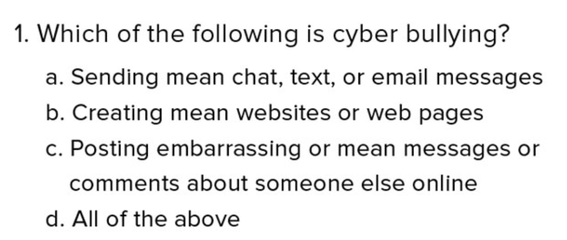

Slide 47
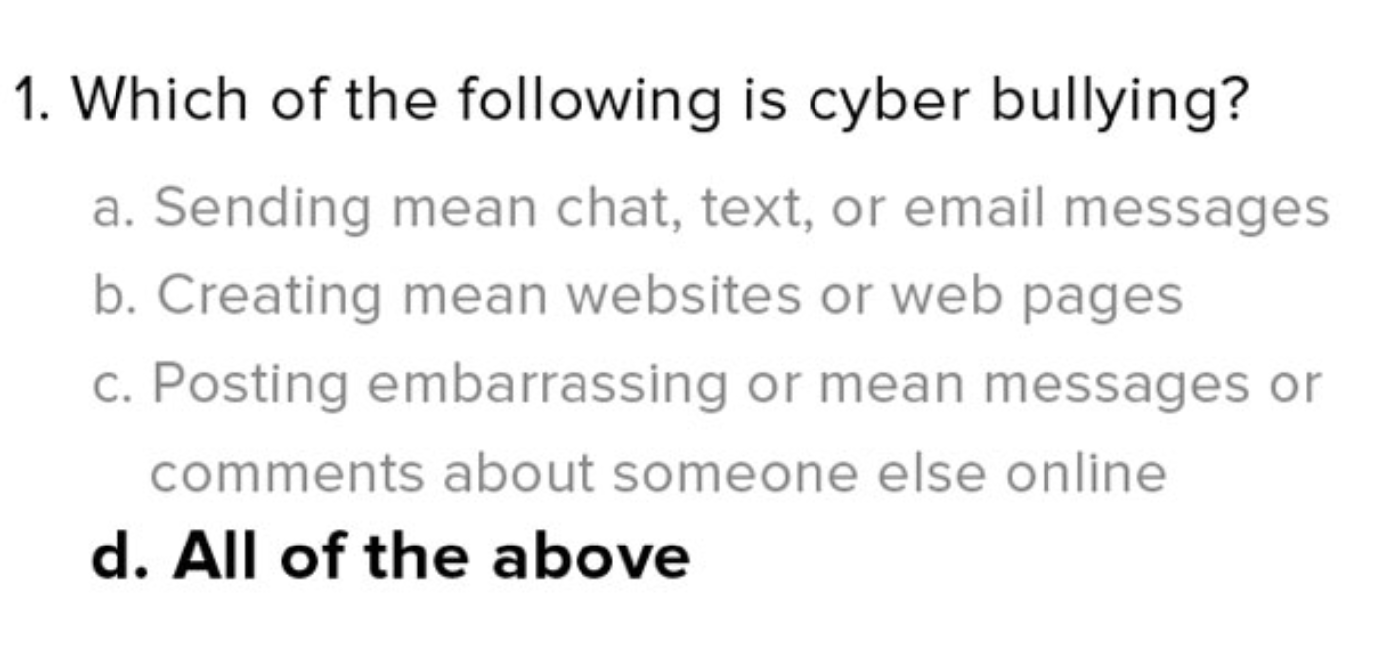

Slide 48
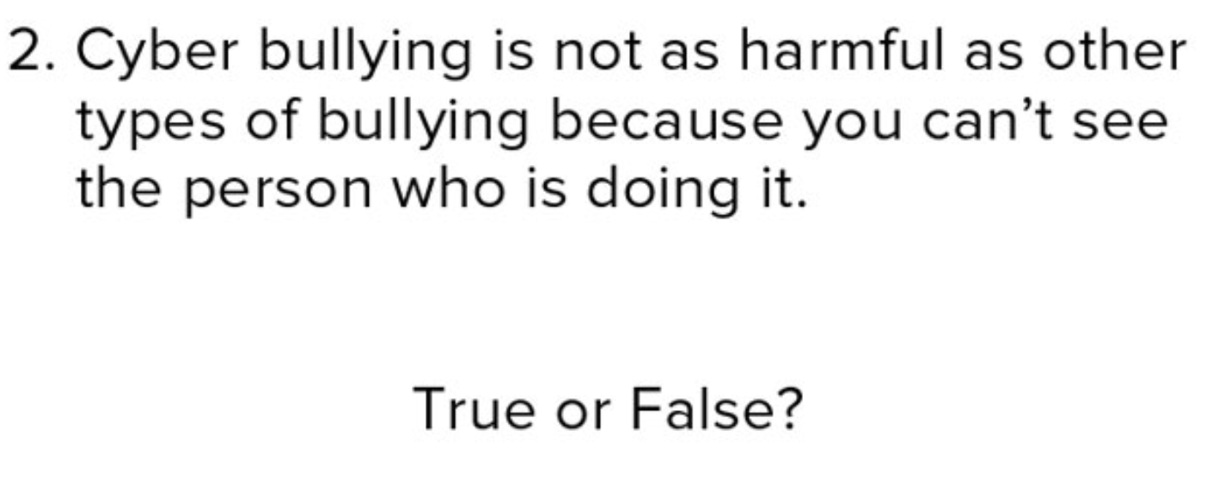

Slide 49
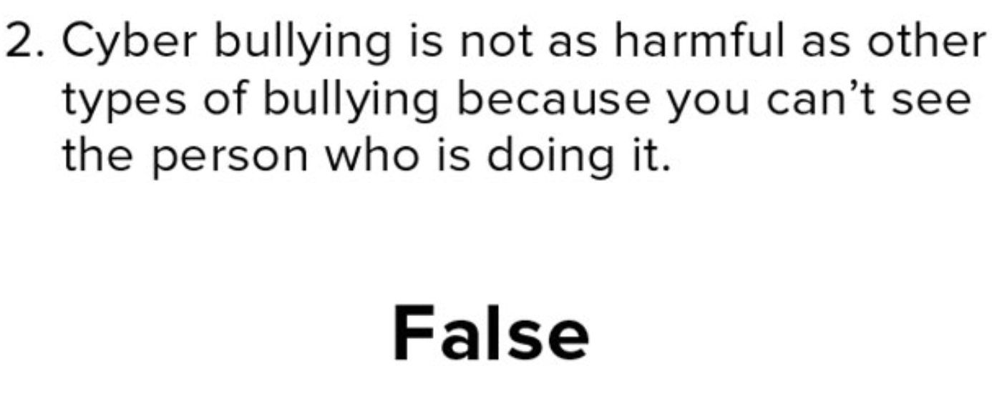

Slide 50
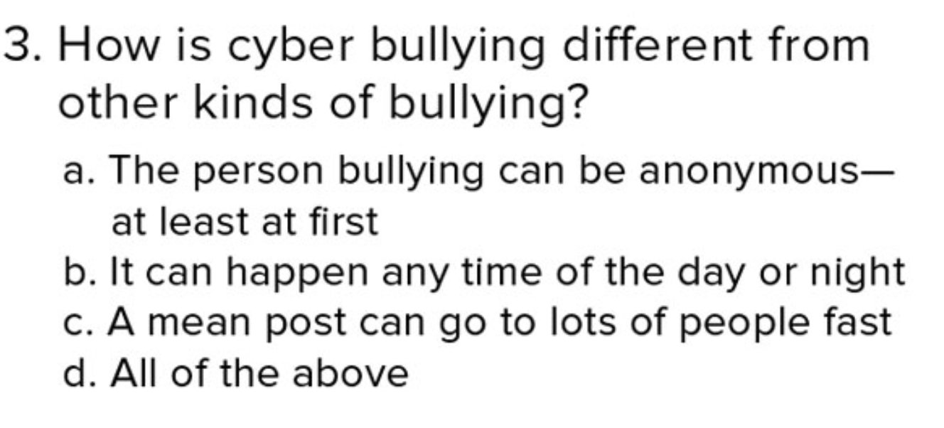

Slide 51
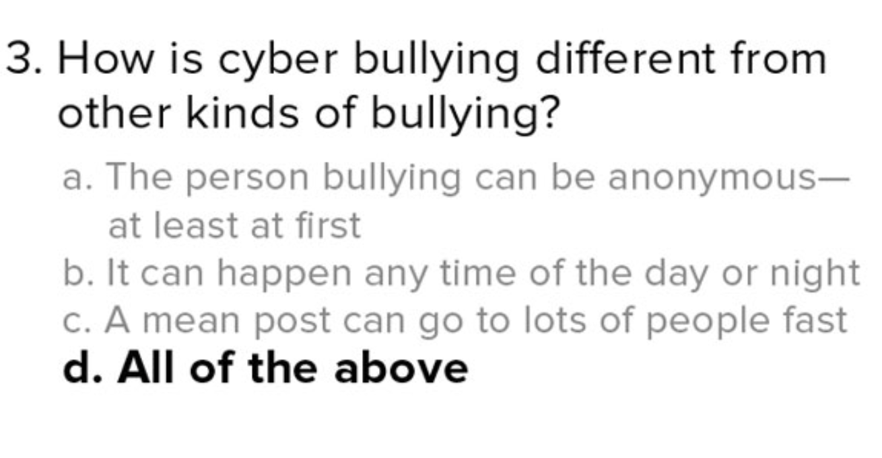

Slide 52
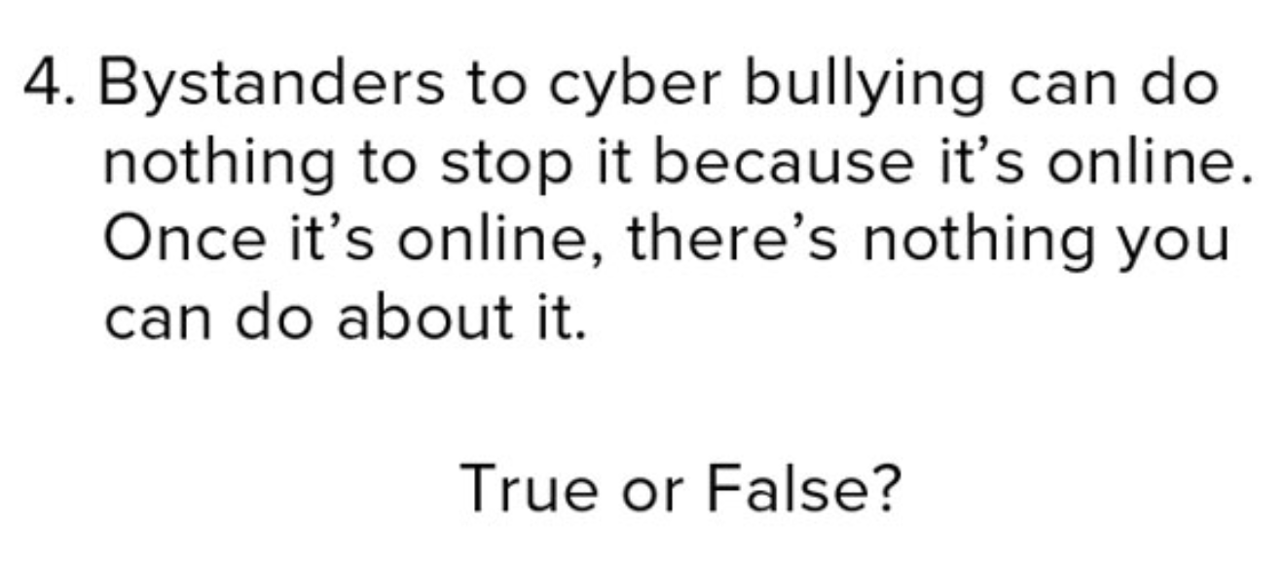

Slide 53
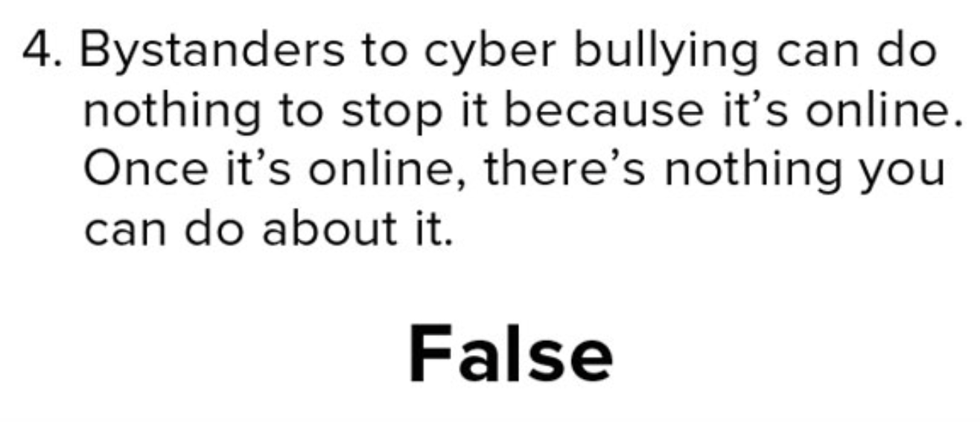

Slide 54
Video...part 1
As you watch the first part of the video, pay attention to the bystanders and what they are doing (or not doing).
https://learn.secondstep.org/product/bpu-kit/teach/grade-4/g4l04/g4l04-slm
How do you know that Tessa is being cyberbullied?
How are the bystanders part of the cyberbullying problem?

Slide 55
Video...part 2
Let's watch and see if the cyberbullying continues...
https://learn.secondstep.org/product/bpu-kit/teach/grade-4/g4l04/g4l04-slm
Sal and Kai were bystanders who did the right thing. What did they do?
If you know cyber bullying is happening, what are some things you can do to help stop it?

Slide 56
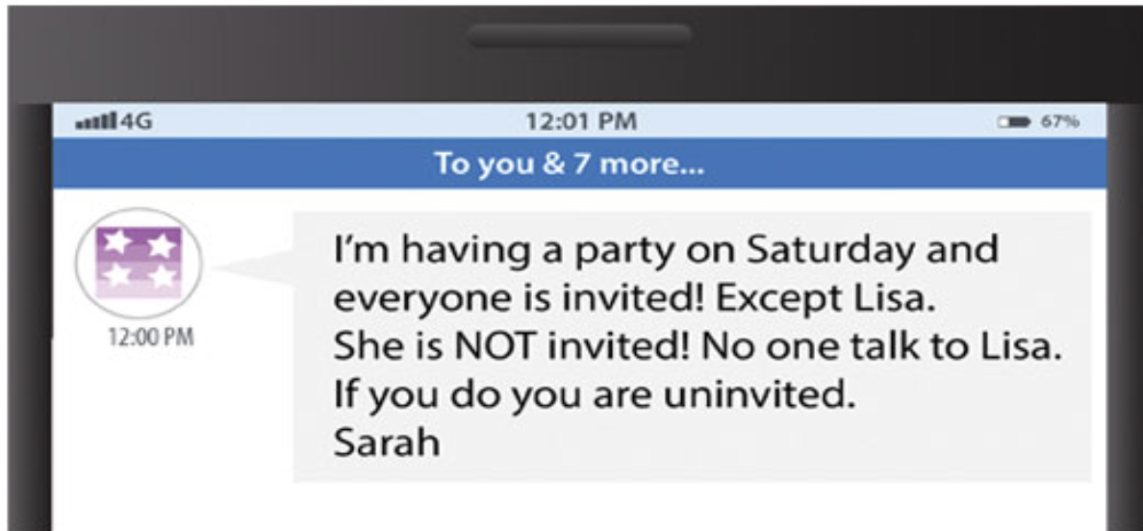
What can you do to help?

Slide 57
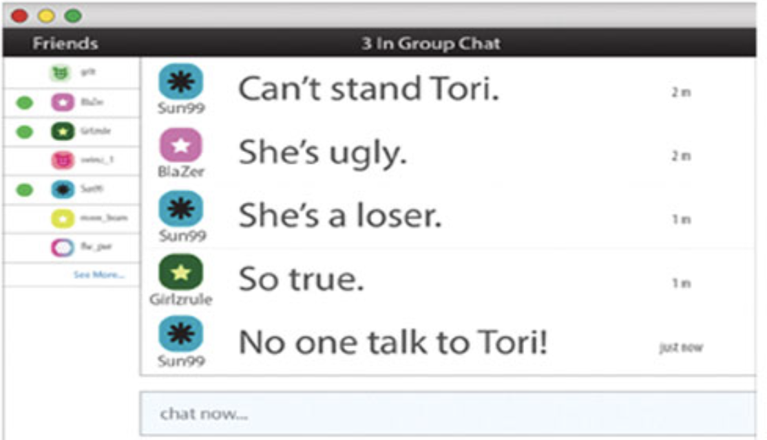
What can you do to help?

Slide 58
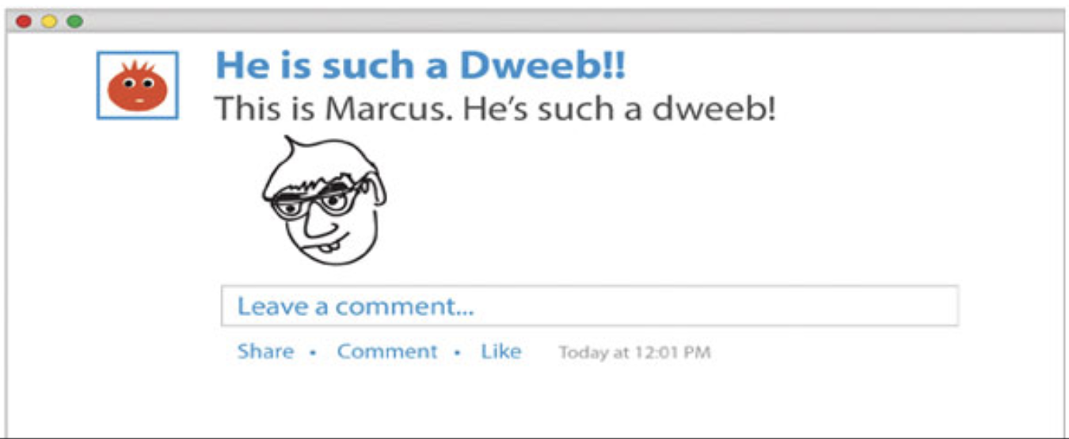
What can you do to help?

Slide 59
Let's review what we learned!
What is bullying?
What are the 3 Rs that you learned about?
What is a bystander?
How is cyberbullying similar to, and different from, bullying?

