Slide 1

Student Career Exploration: When I Grow Up…..
By: Tracey Allen-McMasters

Slide 2
Existing Data Resources
(102 Students- 5th Graders)
Student Surveys: Surveys was given to all 5th grade students to get a general idea of areas that needed to be focused on Career Day so the lesson can be meaningful, measurable, or targeted.
School Counselor’s Feedback
Academic Performance Data: Reviewed school data on grades, test scores, and core course engagement. (Research shows that students opinions about careers impacts efforts in subjects and future choices, Ellot et al, 2024).
Behavior Data: EduClimber was pulled to review behavior referrals and patterns. 27 of the 102, 5th grades has had a behavior referral.
Attendance: 12 students were identified as having attendance issues.
Notes:
Fifth grade students were survey, and I received input information from school counselor to justify my reasoning for implementing “When I Grow Up…”. I wanted to see how many students had career interests. The school district is starting an initiative of having all students who graduate a post-secondary plan, and they want to push elementary schools to start the connection of how academics, attendance, and behaviors start their futures.
All individuals should have a plan after high school whether it be some type of post-secondary
education or training to achieve economic and personal success. Receiving a college degree can lead to various employment opportunities and is considered an asset in the US economy (Hines & Owens, 2022).

Slide 3
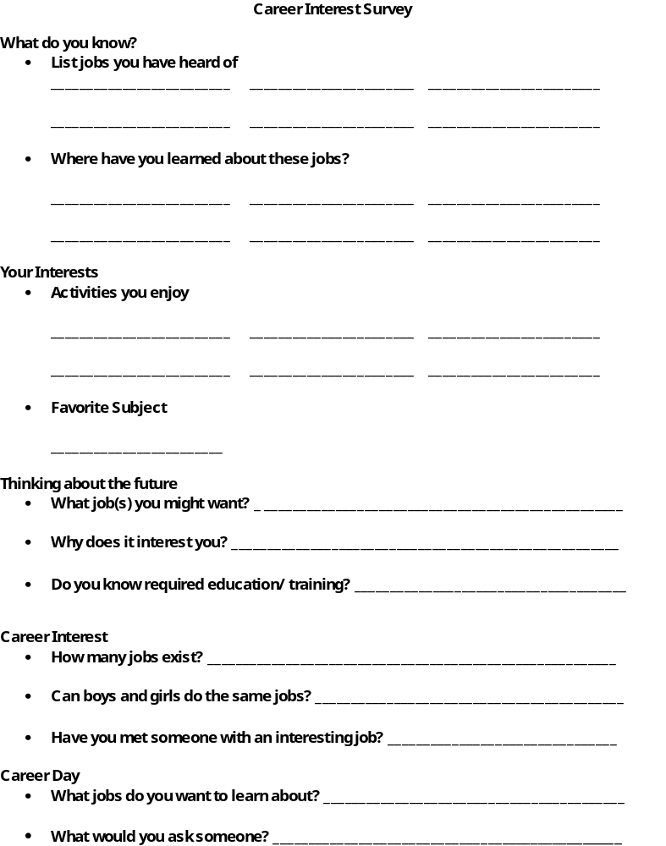
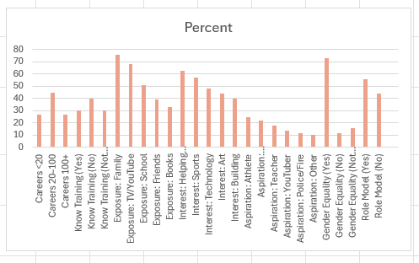
Needs Assessment:
Participants: (102,
5th grade students participated in a
Career Interest Survey)
Data showed that students were interested in learning about different careers.
All individuals should have a plan after high school whether it be some type of post secondary education or training to achieve economic and personal success. Receiving a college degree can lead to various employment opportunities and is considered an asset in the US economy (Hines & Owens, 2022).
Notes:
This is an example of the Career Interest Survey that students took. Data showed that students were interested in learning about new careers. 5th graders are naturally curious about the world and their place in it. At this stage, students are beginning to connect what they enjoy in school with career exploration and real-life possibilities. Students also see the purpose of reading, math, science, and social studies from career awareness. When they understand how different skills are used on jobs, they become more motivated about school.

Slide 4
Student Career Exploration:
When I Grow Up…
The purpose of this lesson is to help students begin to explore different careers. Early exposure can link a student’s interest to planning the starts of their future, boosts academic ambitions, and develop needed skills like problem solving and critical thinking.
Teaching 5th graders about careers corresponds with ASCA by helping them associate learning to life, develop self-understanding, build awareness, and begin planning for their future at an age-appropriate level.
This lesson also supports the three domains in the ASCA model: academics, social/ emotional, and career planning. Career exploration helps students to why learning matters and the importance of maintaining good grades. Learning about careers helps students to better understand themselves, especially in the areas of values, strengths, and interests. This builds confidence! In the 5ht grade, students are building awareness. Exploring various careers helps students to recognize options for their future and teaches them that choices and efforts matter.
Career exploration helps students to stay motivated, builds confidence, and to think
about the future in meaningful way.
Notes:
The purpose of the lesson is to help students to begin to explore different careers. Early exposures can link a student’s interest to planning the starts of their future, boosts academic ambitions, and develop needed skills like problem solving and critical thinking.

Slide 5
Student Career Exploration: When I Grow Up….
Classroom Guidance Lesson 1: When I Grow Up: The focus is to see what careers students already know about and what careers students may be interested in. This lesson is to start the thinking process of different careers.
Classroom Guidance Lesson 2: Let Me Find Out: The focus is to have students’ research into different careers and learn what is needed for that career (example: degree experience, skills) and what are the benefits of the career (example: salary).
Classroom Guidance Lesson 3: What Job Fits My Personality: The focus is to help students match different careers based on their personalities through a Career Inventory Assessment.
Classroom Guidance Lesson 4: Post Cards to the Future: The focus is for students to narrow careers they are interested in and put everything together from classroom guidance lessons 1-3. Students will make post cards and send one to themselves at the end of the school year and then one to their future self in high school. The post cards will have goals and how they will reach those goals.
Notes:
Classroom Guidance Lessons 1-4. At the end of the 4th lesson, we had a school wide Career Day.

Slide 6
AIA Standards
Counseling Prevention & Intervention
Demonstrates self-awareness, sensitivity to others, and the skills needed to relate
to diverse individuals, groups, and classrooms.
Diversity & Advocacy
Actively seeks out and develops opportunities to engage stakeholders in student development.
Demonstrates multicultural competencies in relation to diversity,
equity, and opportunity in student learning and development.
Assessment
Selects appropriate assessment strategies that can be uses
to evaluate a student’s
academic, career, and social/emotional development.
Analyazes assessment information in a manner that produces valid
inferences when evaluating the needs of individual students and assessing
the effectiveness of educational programs.
Notes:
AIA Standards that went with the lesson.

Slide 7
Continuation of AIA Standards
Academic Development
- Conduct programs designed to enhance student academic development.
Implement strategies and activities to prepare students for a full range of post-
secondary options and opportunities.
Implement differentiated instructional strategies that draw on subject matter and
pedagogical content knowledge and skills to promote student achievement.
Collaboration & Consultation
Intern is aware of and adheres to ethical standards regarding parent/ guardian
rights and confidentiality.
Locates resources in the community that can be used in the school to improve
student achievement and success.
Consults with teachers, staff, and community-based organizations to promote
student academic, career, and social/emotional development.
Leadership
Plans and presents school counseling related
educational programs for use with parents and teachers.
Notes:
Continuation of AIA Standards

Slide 8
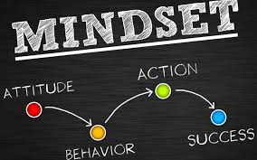
ASCA Mindsets & Behaviors
Mindset Standards
M1. Belief in development of whole self, including a healthy balance of mental, social/ emotional and physical well-being.
M2. Sense of acceptance, respect, support, and inclusion for self and others in the school environment.
M3. Positive attitude toward work and learning.
M6. Understanding that postsecondary education and lifelong learning are necessary for long term success.
Notes:
ASCA Mindsets and Behaviors that went with the lesson.

Slide 9

Behavior Standards
Learning Strategies
B-LS 1. Critical thinking skills to make informed decisions.
B-LS 3. Time management, organizational, and study skills.
B-LS 4. Self-motivation and self direction for learning.
B-LS 7. Long- and short-term academic, career, and
social/emotional goals.
Self-Management Skills
B-SMS 1. Responsibility for self and actions, B-SMS 2. Self-discipline & control,
B-SMS 3. Independent work, B-SMS 5. Perseverance to achieve long and short-term goals, B-SMS 6. Ability to identify and overcome barriers.
C. Social Skills
B-SS 1. Effective oral and written communication skills and listening skills,
B-SS2. Positive, respectful and supportive relationships with students who are
Like and different from them, B-SS 3. Positive relationships with adults to support success,
B-SS6. Effective collaboration and cooperation skills, B-SS 10. Cultural awareness, sensitivity, and responsiveness.
Notes:
Continuation of ASCA Mindsets and Behaviors that went with the lesson.

Slide 10

State Academic Standards
NC Student Success Standards
Career and Exploration
5.C.1. Understand the connection among personal interests, skills, and career choices, 5.C.2. Understand the connection between education
and career success
Goal Setting and Planning
5.P.1. Understand to create and achieve goals
English Language Arts
ELA, SL.5.1: Engage in collaborative conversations, build on others’ ideas, and communicate ideas clearly.
RD.5.2: Create readable documents through legible handwriting
W5.5: Conduct short research projects that uses several sources to build knowledge through investigation of different aspects of a topic.
Notes:
NC State Academic Standards that went with the lesson.

Slide 11
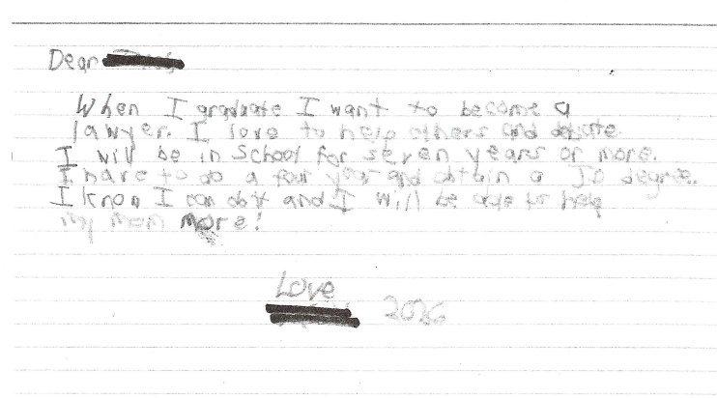
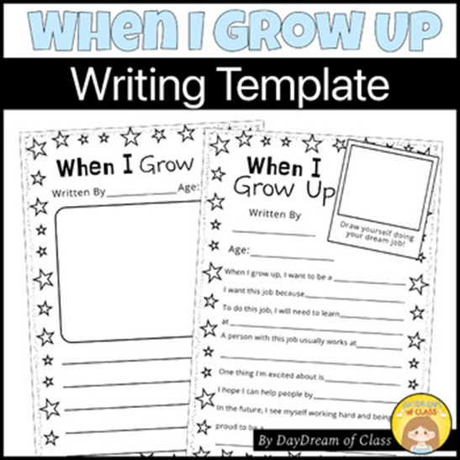
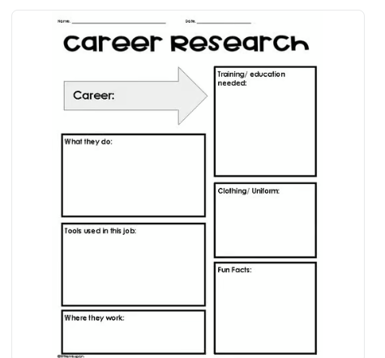
ARTIFACTS AND
WORK SAMPLES
https://www.youscience.com/
Career Inventory Assessment
Notes:
Artifacts and work samples that was used in the lesson.

Slide 12
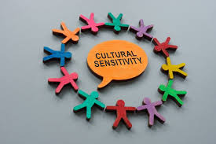
Cultural Sensitivity
The classroom guidance unit is culturally sensitive by providing lessons where all students can participate with various backgrounds. All students can learn about different careers that are available after high school. At the beginning of each lesson, we will discuss roles and the norms for each session that is developmentally appropriate for 5th graders. I will also remind students during the lessons this is a respectful and safe environment for ALL students to engage, learn, and support each other.
Notes:
Summary of how the lesson was cultural sensitivity.

Slide 13
EVALUATION
Students were given the exact same pretest to see if students had a better understanding of careers. According to data from post test students have a better understanding of various careers
(see next slide).
I also pulled data from academics, attendance, and behavior on targeted students from administration and teachers. There were 18 students at risk. There were 4 improvements on academics and 3 improvements on behavior. Attendance is still an issue.
AREAS FOR IMPROVEMENT
Incorporate more small groups in the lesson so I can engage with all students.
Incorporate more hands on/ role-based activities.
Use data collected from this lesson to improve for next time.
Notes:
Students were given the same Career Interest Survey to see if students had a better understanding of careers. Data was pulled data from academics, attendance, and behavior on targeted students from administration and teachers. There were 4 improvements in academics and 3 improvements in behavior. Attendance is still an issue.

Slide 14
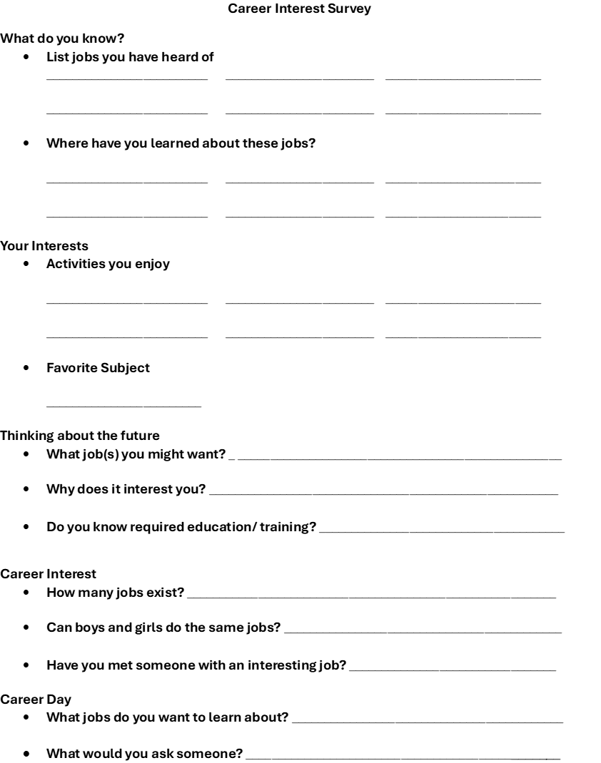
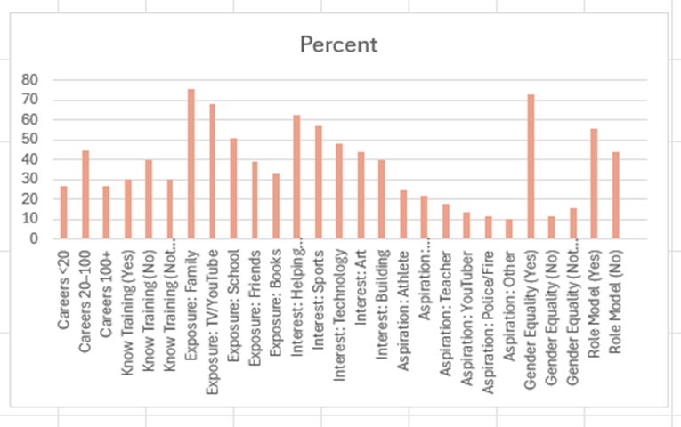
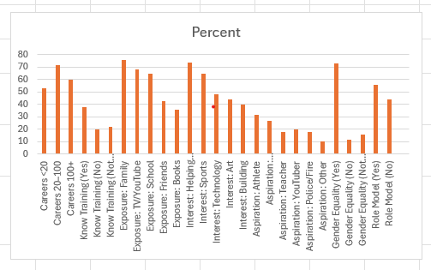
Notes:
Graphs show some growth in career interests. To better improve academics, attendance, and behavior, the lesson will need to:
Incorporate more small groups in the lesson so I can engage with all students.
Incorporate more hands on/ role-based activities.
Use data collected from this lesson to improve for next time.

Slide 15
Any Questions?
Thank you

