Slide 1
Freshmen Year Foundations
Tracey Allen-McMasters
Liberty University
COSC 693

Slide 2
Data
Sources
(Identified Data Sources)
8th Grade Final Grades/ EOC Testing
58% of students tested at basic, proficient, or advance levels in math/ reading.
(34% tested at basic level)
8th Grade Four Year Plans
72% of students had a postsecondary plan or had an idea of what interested them after high school
From these 2 data sources, Freshmen Year Foundations was created to give freshmen tools and resources to be successful during there high school journal.
An important part of a student’s learning is independent study behaviors (Walck-Shannon et al, 2021).
Studies have shown that students who completed a four-year plan were likely to pick out a career that they liked and make sound college choices compared to students who did not have a four-plan tool (Britton & Spencer, 2022).

Slide 3

Needs Assessments
Surveys were given to students and parents/ guardians about what they felt was important to be a successful student.
The surveys data provided the topics discussed in the classroom guidance lessons.

Slide 4
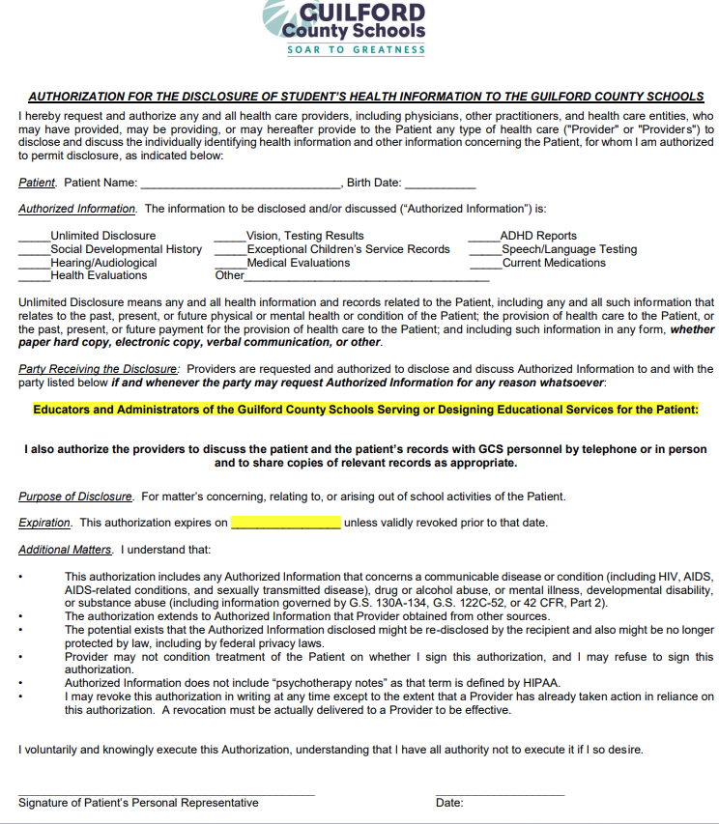
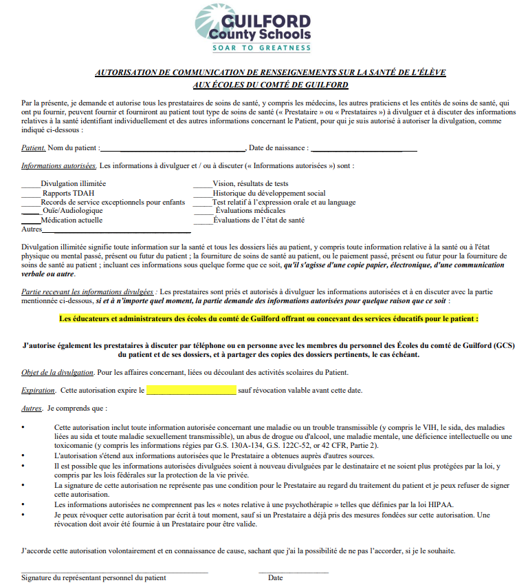
Screening Process
Example of Consent Form
The screening process was for any freshmen who struggled in middle school, did not make proficient on end of grade testing, who did not have an idea or plan after high school, or just wanted to learn new strategies for being a successful student.
**20 students were selected**

Slide 5

Advanced Internship Assessment
1.B.1: Demonstrate the ability to apply and adhere to ethical and legal standards in school counseling.
2.D.2: Counseling Prevention and Intervention- Provides individual and group counseling and classroom guidance to encourage academic, career, and social/ emotional development of students.
3.F.2: Diversity and Advocacy- Advocates for learning and academic experience necessary to promote the academic, career, and social/ emotional development of students.
4.H.1: Assess and interpret students’ strengths and needs, recognizing uniqueness in cultures, languages, backgrounds, and abilities.
5.J.3: Analyzes and uses data to enhance counseling programs.
6.L.2: Implements strategies and activities to prepare students for a full range of post-secondary options and opportunities.
7.N.1.: Works with parents, guardians, and families to act on behalf of their children to address problems that affect student success in school.

Slide 6
Continuation of AIA
The “Freshmen Year Foundations” guidance unit will follow ethical and legal guidelines. The unit will have opportunities for individual and group prevention and intervention opportunities to focus on key areas of the unit.
Smith High School is made up of a diverse population. All guidance units will support all students in the areas of academics, careers, and social/ emotional development.
Within the “Freshmen Year Foundations”, I will be assessing students’ strengths and needs as well as understanding and appreciating each student’s uniqueness.
Throughout this program, I will continue to collect data and enhance the program based on the collected data. Another area the unit will focus on is post-secondary plans.
I will be working with both students and families on the beginning stages of life after high school. We will work collaboratively on keeping students and families informed on opportunities after high school and how to take advantage of those opportunities.

Slide 7
The ASCA Mindsets and Behaviors
B-LS 3. Time Management, Organizational, and Study Skills: Students will learn these skills and turn these skills into habits. These Skills will help students in high school as well as the transition to adulthood.
B-LS 4. Self-Motivation and Self Direction for Learning: Units will help to motivate and encourage students to take control of their learning and goals.
B-LS 7. Long- and Short-Term Academic, Career, and Social/ Emotional Goals:
Units will help with goals in academics, careers, and social/ emotional.
B-SMS 1. Responsibility for Self and Actions: Units will help students take responsibility in academics, extracurricular activities, career interest and college planning.
B-SMS 5. Perseverance to Achieve Long-Short Term Goals: This will help students to find ways to persevere through challenges in reaching goals.
B-SMS 6. Ability to Overcome Barriers: Units will help students to identify barriers and find ways to get through those barriers.
B-SS 3. Positive Relationships with Adults to Support Success: Students will learn the importance of having positive relationships with adults to have support in becoming a successful student.
B-SS 10. Cultural Awareness, Sensitivity, and Responsiveness: Students will learn the importance of being responsible and supportive to all cultures.

Slide 8

North Carolina State Academic Standards
B2.1.a: Take steps that are proactive in planning fort post-secondary goals by establishing and building individual strengths and ways to handle challenges that impede goals.
I will be providing different resources such as various college materials and job websites to explore options in post-secondary planning.

Slide 9
Cultural
Sensitivity
The “Freshmen Year Foundations” is for any 9th grader who wanted to establish study habits that work for them, explore new interests, and start planning for their future.
These units allow students to reflect on themselves and explore opportunities that the school provides which allow for cultural sensitivity.
Each unit, I plan to set classroom expectations and promote an environment where everyone can be comfortable, safe, and appreciated!

Slide 10
Evaluation
The group was evaluated by looking at 8th grade final grades and comparing them to Q1 and Q2 grades freshmen year. Freshmen are also given another opportunity to complete four-year plans if they did not complete the component in 8th grade.
Out of the 20 freshmen who participated, 14 student’s grades increased
3 students joined an extracurricular activity at Smith High School
Four-year plans increased from 72% to 75% of completion of a post-secondary plan
There were areas of improvement in both reasons why Freshmen Year Foundations was created. Data showed an increase in grades and four-year planning.
The four-year plans only increased by 3%. This area needs more exposure. Students need more access to different careers, colleges, and the work-force.
The Freshmen Year Foundations classroom guidance lesson needs to be done at the beginning of each quarter so students will understand what they need to do to be successful!

Slide 11
Thank you
References
American School Counselor (2019). The ASCA national model: A framework for school counseling programs (4th ed). Alexandria, VA: American School Counselor Association.
ISBN: 9781929289592
Britton, T. & Spencer, G. (2020). Do students who fail to plan, plan to fail? Effects of individualized learning plans on transitioning. Teachers College Record, 122(5), 1-18.
https://doi.org/10.117/016146812012200509
Walck-Shannon, E. Rowell, S.,& Frey, R. (2021). To what extent do study
Habits relate to performance? CBE-Life Sciences Education, 20(1), 1-15.
https://doi.org10.1187/cbe.20-05-0091

