Slide 1


Parent- Teacher Presentation
School Counseling Benchmark
Tracey Allen-McMasters
COSC 660
Liberty University

Slide 2

Component 1: Comprehensive Program Elements
At Ben L. Smith High School, our Comprehensive Counseling Program’s goal and vision is to offer a program that correlates with the ASCA National Model. We want students to be empowered so they will do their very best in academics, college/ career readiness, and social/ emotional development. It is our hope that in return students can give back to society with compassion and gratification.
The mission of our program is to help ALL students to receive awareness, skills, and a mindset to become successful students. We want all our students to become responsible/ respectful adults, important workers, and lifelong learners by discussing areas in academics, careers, and social/ emotional development.
We believe that ALL students are important and deserve and education that is equal and develops the whole child by following the districts vision and mission. We advocate for social justice and equality by following the ASCA’s ethical standards and principals.
Notes:
A comprehensive counseling program’s goals, visions, and beliefs focuses on what the school counselors' efforts are to support and serve students.
Component 1: Comprehensive Program Elements
At Ben L. Smith High School, our Comprehensive Counseling Program’s goal and vision is to offer a program that correlates with the ASCA National Model. We want students to be empowered so they will do their very best in academics, college/ career readiness, and social/ emotional development. It is our hope that in return students can give back to society with compassion and gratification.
The mission of our program is to help ALL students to receive awareness, skills, and a mindset to become successful students. We want all our students to become responsible/ respectful adults, important workers, and lifelong learners by discussing areas in academics, careers, and social/ emotional development.
We believe that ALL students are important and deserve and education that is equal and develops the whole child by following the districts vision and mission. We advocate for social justice and equality by following the ASCA’s ethical standards and principals.

Slide 3
ACADEMICS: LEARNING TO LEARN
School counselors can help students with academic success, by working together and collaborating with students, families, and staff!
School counselors can assist students with learning new skills that will make learning more successful!
School counselors can help students set academic goals and support student in their goals!
School counselors can make sure students have access to appropriate and rigorous course
material!
School counselors can offer core curriculum and closing the gap interventions!
Notes:
Academics: We want students learn to learn. There are specific things school counselors can provide for students to be successful in learning.
School counselors can help students with academic success, by working together and collaborating with students, families, and staff!
School counselors can assist students with learning new skills that will make learning more successful!
School counselors can help students set academic goals and support student in their goals!
School counselors can make sure students have access to appropriate and rigorous course
material!
School counselors can offer core curriculum and closing the gap interventions!

Slide 4
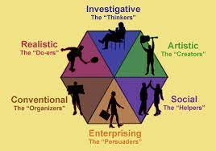

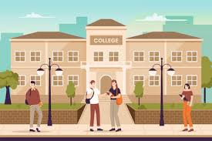
CAREER DEVELOPMENT: LEARNING TO WORK
School counselors can work with students to help them identify postsecondary plans after high school. School counselors would like ALL students to become future productive citizens.
Students can learn about different careers through:
Assessment (career and personality)
Job Fair/ Vocational Training
College Tours
Notes:
Career Development: We want students to learn how to work!
School counselors can work with students to help them identify postsecondary plans after high school. School counselors would like ALL students to become future productive citizens.
Students can learn about different careers through:
Assessment (career and personality)
Job Fair/ Vocational Training
College Tours

Slide 5
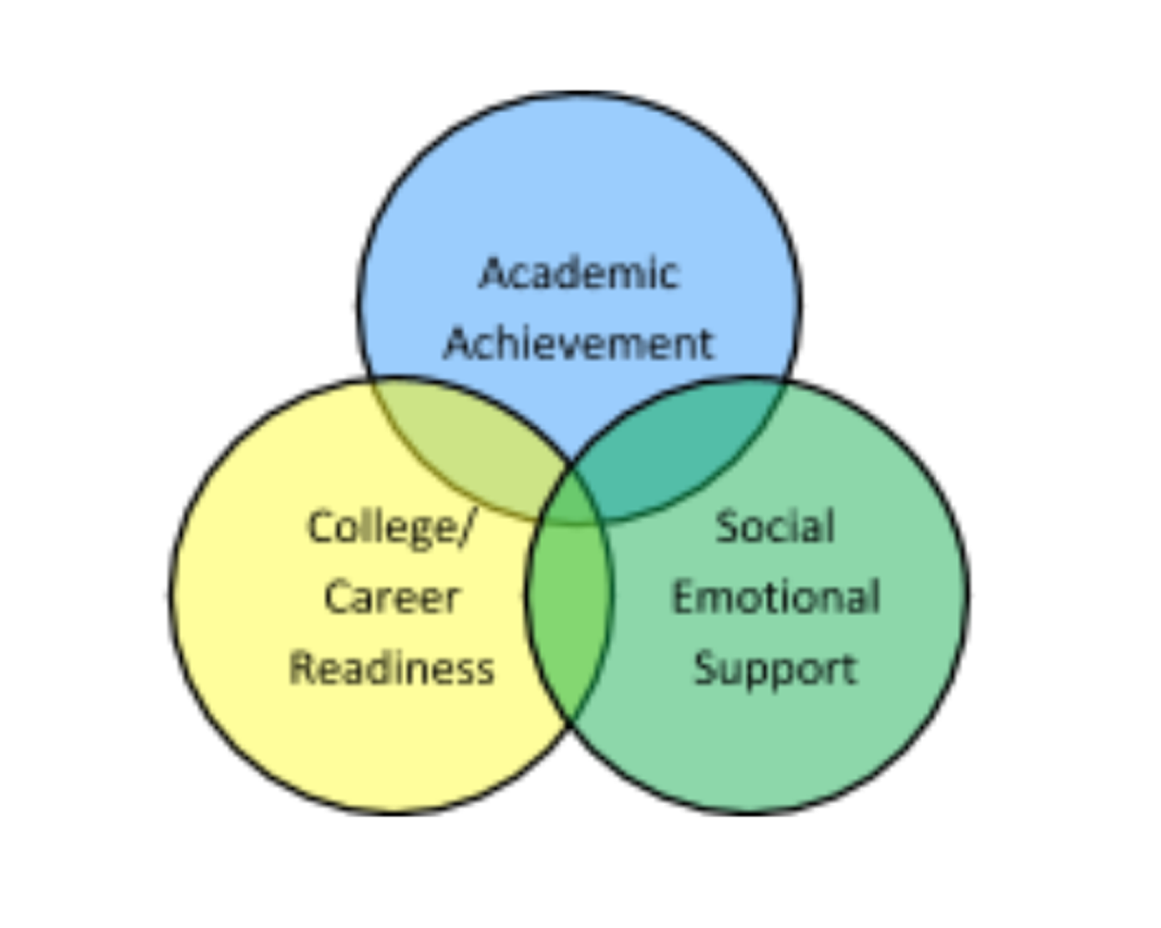
PERSONAL AND SOCIAL DEVELOPMENTS:
LEARNING TO LIVE
School counselors can help ALL students to navigate and understand social and emotional growth.
School counselors can assist in making sure ALL students have access to mental health services when dealing with personal and social needs.
School counselors can create an educational program to strengthen mental health awareness.
School counselors can help ALL students learn and practice interpersonal skills.
Notes:
Personal and Social Developments: We want students to learn how to live!
School counselors can help ALL students to navigate and understand social and emotional growth.
School counselors can assist in making sure ALL students have access to mental health services when dealing with personal and social needs.
School counselors can create an educational program to strengthen mental health awareness.
School counselors can help ALL students learn and practice interpersonal skills.

Slide 6


COMPONENT 2: ADVOCACY
Advocacy is standing up for other individuals on their behalf. Advocacy is an important part of a school counselor’s role. Advocacy is an extensive and versatile process according to ASCA (ASCA, 2019).
School counseling programs are in a critical position to lead and advocate for changes that are positive in polices and practices that encourage high levels of opportunities for all students (Erford, 2019).
School counselors, students, parents, teachers, coaches, and staff can be ADVOCATES for STUDENTS!
School counselors can advocate for students in various ways such as:
Personal conversations
Counselor’s newsletters
Meetings
Parent workshops
Curriculum planning
Community collaborations
Notes:
Component 2: Advocacy
Advocacy is standing up for other individuals on their behalf. Advocacy is an important part of a school counselor’s role. Advocacy is an extensive and versatile process according to ASCA (ASCA, 2019).
School counseling programs are in a critical position to lead and advocate for changes that are positive in polices and practices that encourage high levels of opportunities for all students (Erford, 2019).
School counselors, students, parents, teachers, coaches, and staff can be ADVOCATES for STUDENTS!
School counselors can advocate for students in various ways such as:
Personal conversations
Counselor’s newsletters
Meetings
Parent workshops
Curriculum planning
Community collaborations

Slide 7


Counselor Strategies
Collaboration
Counselors collaborate with parents, teachers, staff, and the community to offer and provide resources to all students.
Ethical Guidelines
Teachers and staff should understand and follow student confidentiality agreements, professional ethical standards, and other pertinent guidelines.
Data Collection
School counselors can collect data on underserved students by working with the appropriate staff. This data can help school counselors produce a plan to target this special population, make referrals, and minimize barriers to help all students achieve.
Notes:
Counselors can advocate for students through collaboration, ethical guidelines, and collection of data.
1. Collaboration
Counselors collaborate with parents, teachers, staff, and the community to offer and provide resources to all students.
2. Ethical Guidelines
Teachers and staff should understand and follow student confidentiality agreements, professional ethical standards, and other pertinent guidelines.
3. Data Collection
School counselors can collect data on underserved students by working with the appropriate staff. This data can help school counselors produce a plan to target this special population, make referrals, and minimize barriers to help all students achieve.

Slide 8
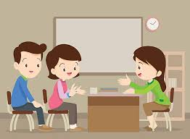

Parent Strategies
Communication
Parents can communicate by contacting teachers and attending meetings. During communication, express concerns if any about your child’s education. It is best practice to take notes so you can have what was discussed.
Record Safekeeping
Parents need to keep student records such as progress reports, report cards, standardized test results, and meeting notes.
Know Your Rights and the Rules
Parents should be familiar with their rights and the school/ district/ state’s rules, procedures, and policies.
Notes:
Parents can advocate through communication, keeping records, and knowing their rights and the rules.
1. Communication
Parents can communicate by contacting teachers and attending meetings. During communication, express concerns if any about your child’s education. It is best practice to take notes so you can have what was discussed.
2.. Record Safekeeping
Parents need to keep student records such as progress reports, report cards, standardized test results, and meeting notes.
3. Know Your Rights and the Rules
Parents should be familiar with their rights and the school/ district/ state’s rules, procedures, and policies.

Slide 9

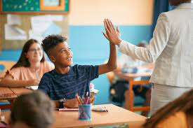
Teacher Strategies
Perspective of Student
Teachers can look at situations through a student’s viewpoint instead of their own.
What is Best for the Students
Teachers can take the time to get to know their students and their backgrounds! Teachers should always make decisions that are best for their students and classroom.
Advocate
Teachers should always stand up for their student’s rights.
Notes:
Teachers can advocate by taking into consideration a student’s perspective, doing what is best for the student, and continuing advocating.
1. Perspective of Student
Teachers can look at situations through a student’s viewpoint instead of their own.
2. What is Best for the Students
Teachers can take the time to get to know their students and their backgrounds! Teachers should always make decisions that are best for their students and classroom.
3. Advocate
Teachers should always stand up for their student’s rights.

Slide 10

ADVOCACY APPROACHES AND STRATEGIES
Approaches and strategies for promoting equitable educational practices and responsive climates in pluralistic schools include:
Promoting acceptance and support for ALL students
Developing, promoting, and advocating awareness
Assisting in the development of ALL students in social and emotional skills
Counselors can also help and encourage schools by:
Strengthening development in social skills and problem solving to match classroom guidance to cultural norms for social interaction
Accommodating wait time for students from various cultures to increase participation in classrooms and enhance development in skills of critical thinking
Engaging in respectful approaches and strategies as well as culturally responsive character education, discipline, and social skills education
Notes:
There are approaches and strategies that can be used when looking advocacy.
1. Approaches and strategies for promoting equitable educational practices and responsive climates in pluralistic schools include:
Promoting acceptance and support for ALL students
Developing, promoting, and advocating awareness
Assisting in the development of ALL students in social and emotional skills.
2. Counselors can also help and encourage schools by:
Strengthening development in social skills and problem solving to match classroom guidance to cultural norms for social interaction
Accommodating wait time for students from various cultures to increase participation in classrooms and enhance development in skills of critical thinking
Engaging in respectful approaches and strategies as well as culturally responsive character education, discipline, and social skills education

Slide 11
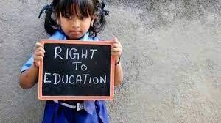
COMPONENT 3: ACCESS
To have results in equitable outcomes, individuals must have access to available pathways that provide equitable engagement in the educational system (Erford, 2018).
Cultural: ALL students need to be able to have access and engage with cultures that are different in classrooms and outside of classroom instruction (ex. Clubs).
Ethical: ALL students need to know how to use ethical standards in schools, homes, and communities (ex. Volunteering).
Economic: Students need to learn and know about the working world (ex. College Information, Job Training).
Legal: Students need to learn about their rights and what is legal in the educational system.
Political: Students need to learn about political events and issues around the word. This can be done by watching/ reading the news.
Notes:
Component 3: Access
To have results in equitable outcomes, individuals must have access to available pathways that provide equitable engagement in the educational system (Erford, 2018).
Cultural: ALL students need to be able to have access and engage with cultures that are different in classrooms and outside of classroom instruction (ex. Clubs).
Ethical: ALL students need to know how to use ethical standards in schools, homes, and communities (ex. Volunteering).
Economic: Students need to learn and know about the working world (ex. College Information, Job Training).
Legal: Students need to learn about their rights and what is legal in the educational system.
Political: Students need to learn about political events and issues around the word. This can be done by watching/ reading the news.

Slide 12

ATTAINMENT
Achieving a specific goal, event, behavior, or milestone that an individual has set for themselves (Erford, 2018).
Cultural: Set goals for students to learn
about a different culture.
Ethical: Set goals for students to volunteer
and participate in their communities and
various charity groups.
Economic: Set goals for students to learn
how to budget and save money.
Legal: Set goals for students to learn about different avenues after high school and what they have access to help them reach those goals.
Political: Set goals for students to learn about relevant political events and how they can get involved.
Notes:
Within access you will see attainment and what that means is achieving a specific goal, event, behavior, or milestone that an individual has set for themselves (Erford, 2018).
Cultural: Set goals for students to learn
about a different culture.
Ethical: Set goals for students to volunteer
and participate in their communities and
various charity groups.
Economic: Set goals for students to learn
how to budget and save money.
Legal: Set goals for students to learn about different avenues after high school and what they have access to help them reach those goals.
Political: Set goals for students to learn about relevant political events and how they can get involved.

Slide 13

ACHEIVEMENT
Completing a goal or task by effort successfully (Erford, 2018).
Cultural: Students learned about different cultures.
Ethical: Students completed volunteer and charity work successfully.
Economic: Students learned how to budget and save. Students opened a checking and/ or savings account.
Legal: Students applied for loans and scholarships for college or a career.
Political: Students remained up to date on politics.
Notes:
Within access you will also have achievement. ACHEIVEMENT is Completing a goal or task by effort successfully (Erford, 2018).
Cultural: Students learned about different cultures.
Ethical: Students completed volunteer and charity work successfully.
Economic: Students learned how to budget and save. Students opened a checking and/ or savings account.
Legal: Students applied for loans and scholarships for college or a career.
Political: Students remained up to date on politics.

Slide 14
COMPONENT 4: BARRIERS TO
STUDENT DEVELOPMENT
Identifying barriers is very important when it comes to student’s meeting goals!
Barriers can impact a student from meeting their desired goals.
When a barrier is identified, it is important for school counselors to produce a plan of action with student so they can overcome identified barriers.
EXAMPLES OF BARRIERS
Poverty
Stereotypes/ Biases
Engagement and Involvement from Students and Parents
Gaps in Achievement
Equal Access to Opportunities and Programs
Underdeveloped Skills
Behavioral Issues
Media Distractions
Notes:
Component 4: Barriers to Student Development
Identifying barriers is very important when it comes to student’s meeting goals!
Barriers can impact a student from meeting their desired goals.
When a barrier is identified, it is important for school counselors to produce a plan of action with student so they can overcome identified barriers.
EXAMPLES OF BARRIERS
Poverty
Stereotypes/ Biases
Engagement and Involvement from Students and Parents
Gaps in Achievement
Equal Access to Opportunities and Programs
Underdeveloped Skills
Behavioral Issues
Media Distractions

Slide 15


CONTINUATION OF BARRIERS TO
STUDENT DEVELOPMENT
ACADEMIC ACHEIVEMENT
Gaps in Achievement and Opportunities
(ex. Admission to colleges- low graduation rates)
Multicultural and Diversity Issues
(ex. Beliefs, stereotypes, actions, and opinions towards certain groups)
STUDENT WELL-BEING
Family Problems
Mental Health Issues
Substance Abuse
Bullying and Harassment
Notes:
Barriers in academic achievement- ACADEMIC ACHEIVEMENT: Gaps in Achievement and Opportunities (ex. Admission to colleges- low graduation rates)
Multicultural and Diversity Issues (ex. Beliefs, stereotypes, actions, and opinions towards certain groups)
Barriers in Students Well- being- STUDENT WELL-BEING
Family Problems
Mental Health Issues
Substance Abuse
Bullying and Harassment

Slide 16


STRATEGIES TO REMOVE BARRIERS
Provide students with opportunities to develop individual and attainable goals.
Provide trainings and seminars for students and families about making goals, future planning, decision making, and time/ self management.
Provide weekly or monthly meetings with students/ families/ staff about updates on opportunities that are available to students.
Review data on percentage of class passing rates, graduation rates, and school drop out rates. Data can help to determine the effectiveness of courses offered and the validity of student access.
Notes:
STRATEGIES TO REMOVE BARRIERS
Provide students with opportunities to develop individual and attainable goals.
Provide trainings and seminars for students and families about making goals, future planning, decision making, and time/ self management.
Provide weekly or monthly meetings with students/ families/ staff about updates on opportunities that are available to students.
Review data on percentage of class passing rates, graduation rates, and school drop out rates. Data can help to determine the effectiveness of courses offered and the validity of student access.

Slide 17
References
American School Counselor Association (2019). ASCA national model: A framework for school
counseling programs (4th ed.). Alexandria, VA: Author. ISBN: 9781929289592.
American School Counselor Association (2019). ASCA national model implementation guide:
Manage and Assess (2nd ed). Alexandria, VA: Author. ISBN: 9781929289608.
Erford, B. T. ( 2019). Transforming the school counseling profession (5th ed). Boston, MA:
Pearson.

