Slide 1
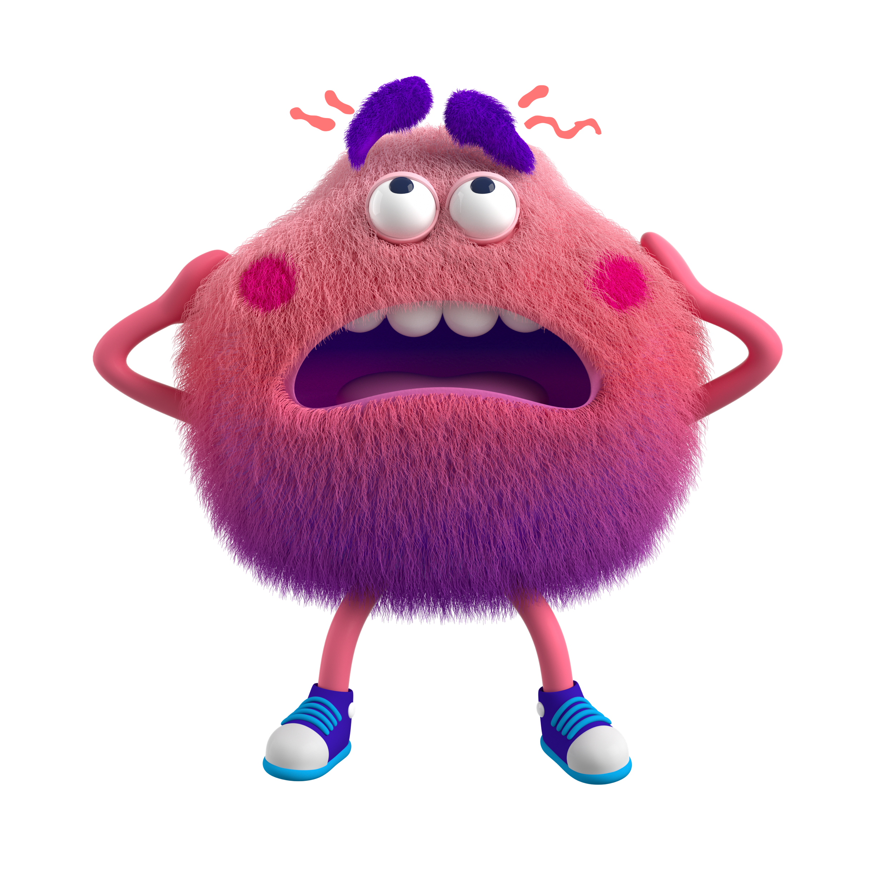
ACADEMIC
SUCCESS
It is not too late to learn how to be successful in school!
Tracey Allen-McMasters
Liberty University
COSC 698

Slide 2

Are you struggling to achieve academic success?
The Academic Success Small Group is to help students who are in the 11th and 12th grade be successful in academics, studying, completing assignments, organizing, attendance, and reducing stress of school!
You only have 24 hours in a day! How can you make your time count!
2

Slide 3

Why is there a need for this group?
(Identified Data Sources)
Tweeners (students who are off grade cohort.
Attendance
2023-2024 academic school year, 23% of students were not in the correct grade based on credits.
2023, NC Public Schools chronic % absenteeism rate was 27% up from 15% in 2018.
3

Slide 4

NEEDS ASSESSMENT
Surveys were given to students to support the needs of the group. The surveys gave school counselors an opportunity to collect, analyze data, and to look at if the effectiveness of the group will yield academic improvements in the areas of tweeners being on correct grade level cohort, increase in attendance, and ways to decrease stress.
4

Slide 5


SCREENING PROCESS
The screening process for this group was students who were in the 11th and 12th grade, off grade level cohort, and wanting to get back on their grade level and graduate on time.
Feeling overwhelmed
5

Slide 6
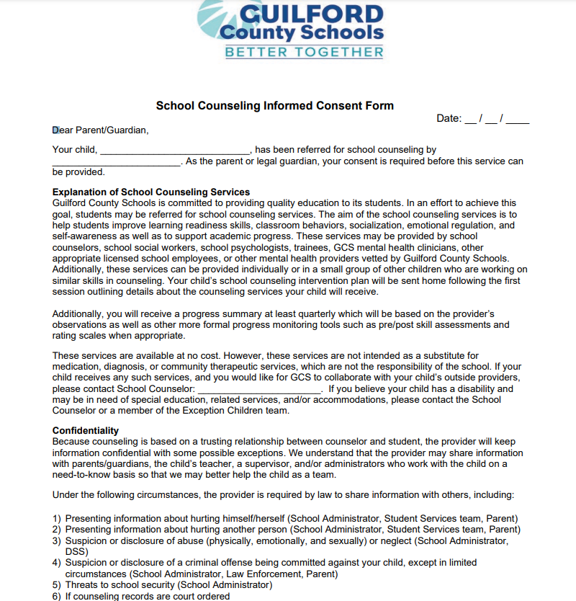
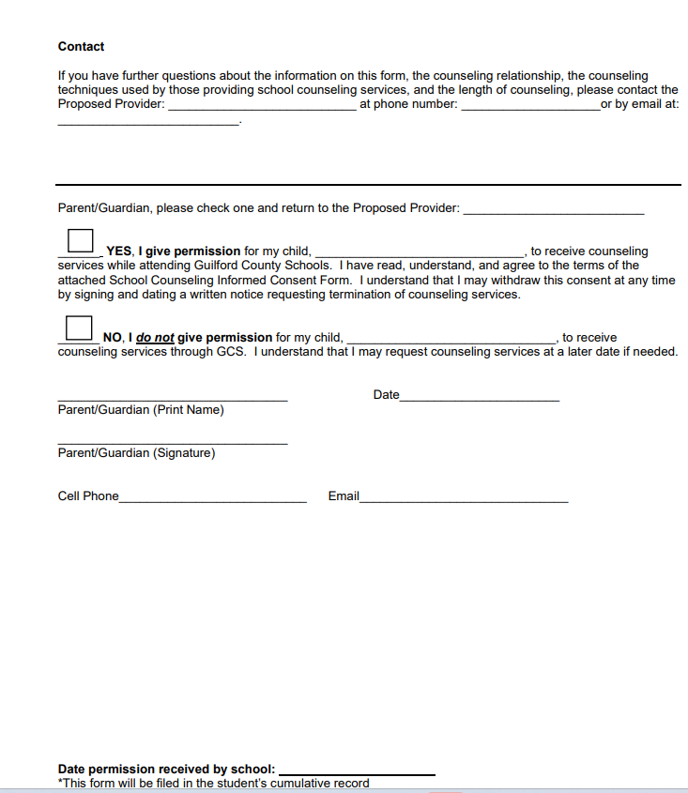
EXAMPLE OF CONSENT FORM...

Slide 7



Pre-AIA Specialty Standard(s)
The PRE-AIA Specialty Standard that aligns with this group and provides rationale for the identified alignment is Academic Development. The purpose of the small group is to enhance performance in academic success, which will help students graduate on time and prepare for the future. This will also help students in preparing for a full range of postsecondary options and opportunities as well as accomplish differentiated instructional techniques that draw on subject matter, content knowledge, and skills to promote student achievement.

Slide 8
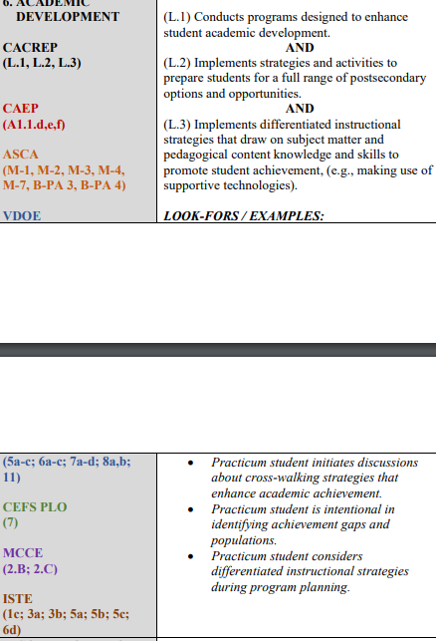
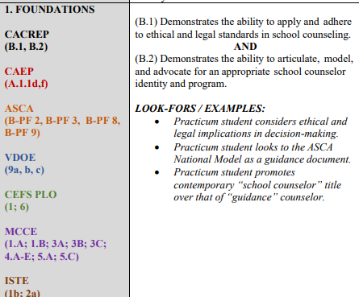
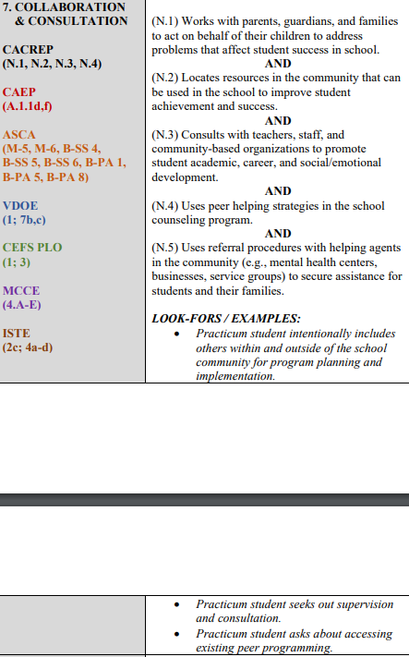
PRE-AIA Practicum Competencies

Slide 9

STRATEGIES TO PROMOTE A SAFE ENVIRONMENT
As the facilitator of the group, I established that each member of the group understood that everyone is responsible for showing respect and cultural sensitivity to all backgrounds, beliefs, and values. As the facilitator, I also must be aware of my own biases. The American School Counselor Association (ASCA) tells us in the ethical standards that school counselors have an obligation to make sure all students are treated with respect and dignity as unique individuals (ASCA, 2019). When issues of conflict, bias, prejudice, oppression, and discrimination arise, these issues will be discussed and addressed at the beginning of each group to foster an environment that is safe, supportive, caring, respectful, positive, and comfortable. If the group has a conflict, it is my job as the facilitator to acknowledge and deal with those conflicts immediately so there can be an establishment of integrity and trust. As my role as the facilitator, I will be using various approaches in helping students. Petko and Kendrick (2016) state that school counselors should have a thorough knowledge of counseling theories and techniques to be effective. Counselors should not force the same counseling approach on all students (Petko and Kendrick, 2016). It is my job as the facilitator to make sure I am culturally bound in the groups that I hold.
9

Slide 10

EVALUATION AND DATA FOR SUCCESS
The group was evaluated by looking at previous data (grades and attendance) of each student. Each student received a graduation status report and transcript. Each student filled out which classes they had completed and highlighted classes they still needed to graduate. Each student participated in different activities within the group. These activities promoted awareness and growth in academics and attendance. At the end of Q1 students looked at their report card that tells grades and attendance. Out of 8 students, 6 students made growth in academics and attendance. A post survey was given to students to evaluate student’s stress level after learning different techniques and strategies for improving academics, attendance, and organization. After reviewing the data, it would be best to start this group in the 9th grade to teach students better habits for student success.

Slide 11
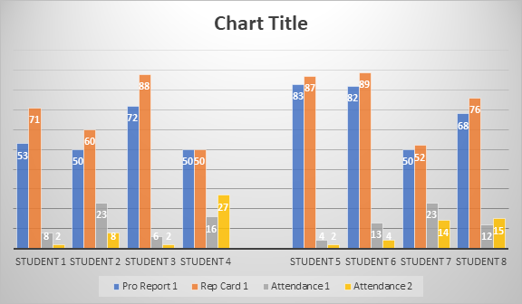
 | Pro Report 1 | Rep Card 1 | Attendance 1 | Attendance 2
Student 1 | 53 | 71 | 8 | 2
Student 2 | 50 | 60 | 23 | 8
Student 3 | 72 | 88 | 6 | 2
Student 4 | 50 | 50 | 16 | 27
Student 5 | 83 | 87 | 4 | 2
Student 6 | 82 | 89 | 13 | 4
Student 7 | 50 | 52 | 23 | 14
Student 8 | 68 | 76 | 12 | 15

Slide 12
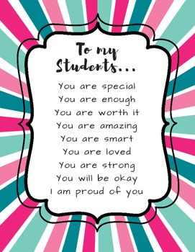
CONCLUSION
As I reflect on the small group, I am very proud of the students who put in the work! Throughout the different sessions, we worked on activities that could be used in high school but also in everyday life. The group gave students the opportunity to engage with other students who have some of the same issues and struggles. In high school students still need assurance, motivation, and praise for the small wins. This group was meaningful for me because it is the 1st group that I ran as the facilitator and for the most part it was successful. I enjoy seeing students grow no matter the obstacles and being proud of themselves!

Slide 13
References
American School Counselor Association. (2019). ASCA National Model: A Framework for School Counseling Programs (4th ed.). Author. ISBN: 9781929289592.
myFutureNC (2024). https://www.myfuturenc.org/
Petko, John & Kendrick, Emma (2016). Selecting a Theory of Counseling: What Influences a counseling student to choose? Universal Journal of Psychology, 4(6), 285-291.
10.13189/ujp.2016.040606.

