Slide 1


Zone of Proximal Development
This Photo by Unknown Author is licensed under CC BY-NC

Slide 2
By Hannah Overstreet
Course: EDUC 205
Spring
2024

Slide 3
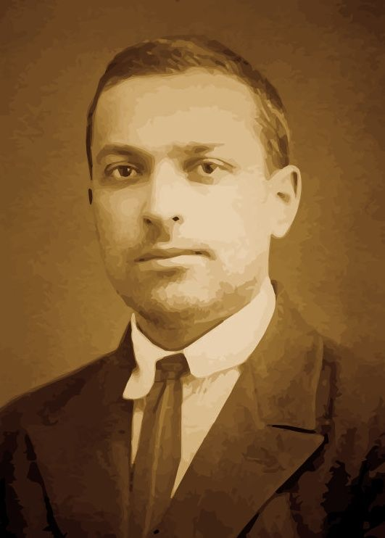
Lev Vygotsky
Lev Vygotsky was a Russian teacher who is considered a pioneer in learning in social contexts.(Kurt, 2020) He was a man who was one of the first to realize how much social interaction how a deal on cognitive growth. .(Kurt, 2020) Which means he looked at how interacting with one another had a great deal on how our brain develops.
This Photo by Unknown Author is licensed under CC BY

Slide 4
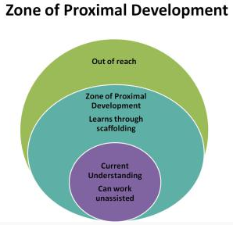
Zone of Proximal Development (ZPD)
Lev is responsible for the theory called Zone of Proximal Development. Which means the difference between what a learner can do without help and what he or she can achieve with guidance and encouragement from a skilled partner.(Vygotsky's zone of Proximal Development & Scaffolding Theory in Psychology 2024) Looking at what a student can learn on its own compared to what it can do with other peers.
This Photo by Unknown Author is licensed under CC BY-NC

Slide 5
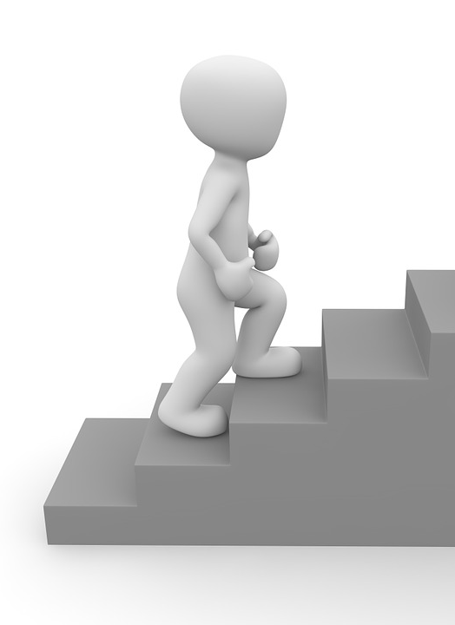
Zone of Proximal Development
There are crucial steps to following zpd. First you must perform what you want your students to know. Then you must give them time to execute with their peers. While you observe. Finally, you will provide time for the student to perform on their own.

Slide 6
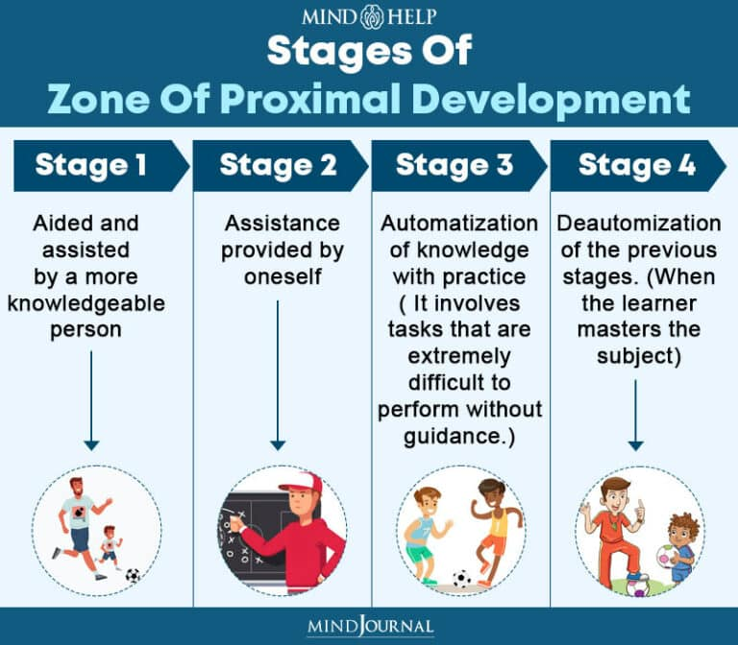
Step by step

Slide 7
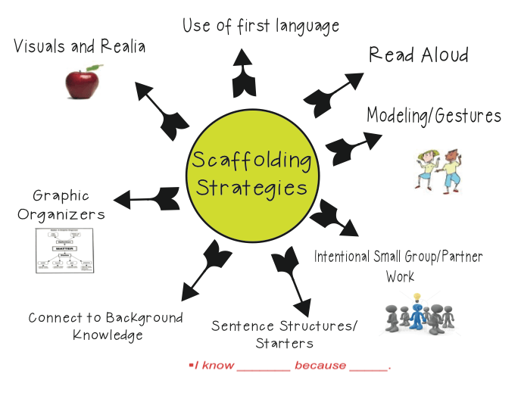
When to use ZPD!
In a classroom setting there are many ways you can use ZPD to help enhance the learning process. But 3 subjects do come to mind when I am wanting to use ZPD.
1. Math Class
2. Science
3. English

Slide 8
Scaffolding: Important when performing ZPD
Control the student's frustration
Making the task simple
Gaining and Marinating their interest
Demonstrate the Task
Emphasizing certain aspects that will help with the solution

Slide 9



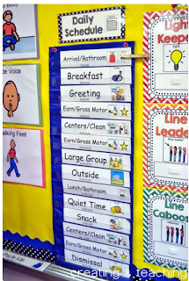
Activities: helpful with ZPD
Group work
Lecture
Visuals/Graphic Organizers
Independent work

Slide 10

Math Class
During a lesson, I would explain to all the students the problem that is written on the board. Going over each step and explaining it to them all. Then I would copy a similar problem beside it and allow the students to perform the problem alone. Giving them time to complete the problem. I would be walking around answering any questions that the students may have. Then we would come back together as a whole and discuss the problem and find the answer.

Slide 11
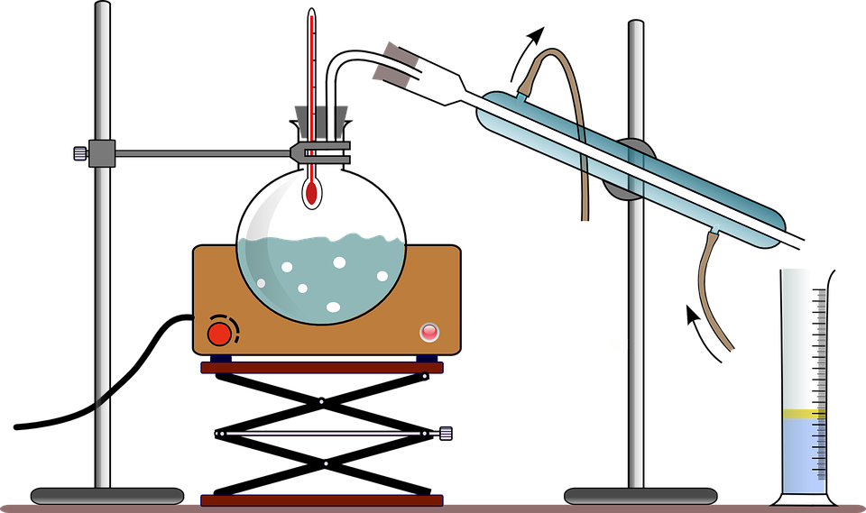
Science
To begin, I would perform a fun science experiment in front of the room. Going oversteps slowly and carefully
To which then I would have the same materials set up for the students to get into groups to perform a similar experiment. As I walked around the room to assist
Next, I would ask my students to then on their own perform this experiment and take data to present to the entire class.

Slide 12

English
In class, we all will be reading a book. As I read the book, we will be answering questions about the book.
As we continue into the next chapter, I will then have students break off into partners around the room. They will be asked to read one chapter and answer the questions together.
Once everyone has finished the chapter. They will return to their seats and then be asked to read alone. While they are reading, they must come up with questions on their own that we all can answer as a class.

Slide 13
Classroom management
Classroom management is always key to a well-rounded classroom. Therefore, I believe the Zone of Proximal Development will have a great affect on the class itself.

Slide 14

Explain?
By following the steps of ZPD will allow room for great development. Moreover, using the steps will allow students equal opportunity. For the students who do well with learning independently will strive. As well as the students who strive better with group work. Not to mention the students who do best when the teacher is in the front of the room teaching while the students are absorbing. In many ways I feel that the classroom will begin to run more smoothly.
This Photo by Unknown Author is licensed under CC BY-NC

Slide 15
References:
By, Mcleod, S., on, U., & 1, F. (2024, February 1). Vygotsky’s zone of Proximal Development & Scaffolding Theory in Psychology. Simply Psychology. https://www.simplypsychology.org/zone-of-proximal-development.html
Kurt, Dr. S. (2020, July 11). Lev Vygotsky - Sociocultural theory of cognitive development. Educational Technology. https://educationaltechnology.net/lev-vygotsky-sociocultural-theory-of-cognitive-development/

