Slide 1

Internship II Culminating Project
School Counselor Intern
Alden J. May

Slide 2
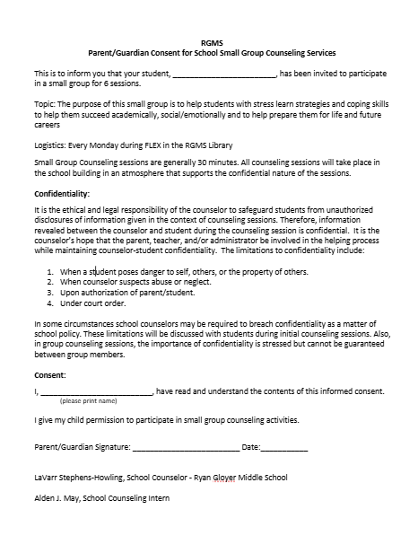
Permission form that was sent home

Slide 3
Data SOURCES Used
Pennsylvania and Seneca Valley School District require students maintain a 90% attendance rate. (Commonwealth of Pennsylvania, 2024).
Notes:
At my internship site the school counselors monitor student attendance and look for patterns. This is especially true when students miss 10 days of school. When this happens, the students must meet with the school counselor. My site supervisor and I looked over attendance data and looked at students that were missing a lot of days.

Slide 4
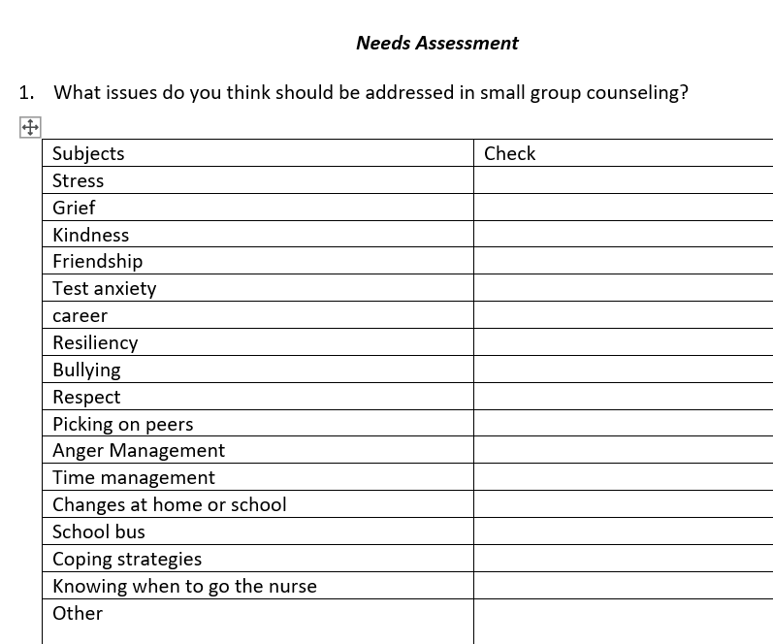
Needs Assessment
The stakeholders given the needs assessment were teachers, parents and students.
The topics of stress, resiliency, and coping strategies made up close to 60%.
Administration also wanted me to run a group for students with stress because they have talked to some of the students in my small group.

Slide 5
Recruitment and goals
I consulted with the school counselors at the school to ask if they had recommendations of any students that met the data that they thought would benefit from this group.
I talked one on one with the students to see if they would be interested in joining the group.
The students were all in 7th or 8th grade.
The goal was to help students that have stress at school learn ways to deal with it better, so it stops effecting their attendance and health office visits at school.

Slide 6

Group Description
Confidentiality, intro to group, group rules, getting to know each other
Confidentiality, good stress vs bad stress,
Confidentiality, coping strategies, who can you talk to
Confidentiality, self confidence, positive vs negative self talk
Confidentiality, resiliency, goal setting, preparing students that next week is the last meeting
Confidentiality, terminating group, celebration

Slide 7
AIA Specialty Standard(s) and Rationale
Counseling Prevention and Intervention- The small group will align with this standard because I will be running this small group to promote the academic, career and social/emotional development of the students. Helping these students that are stressed out because of school will hopefully help them achieve their goals in school and outside of school.
Diversity and Advocacy- The small group will align with this standard because I will be implementing cultural sensitivity into the group lessons. Also, I will be advocating for the needs of the students. As well as involving stakeholders in the planning process of the small group. This will involve asking parents, teachers, students, and administrators’ ideas of what they would like to see addressed in this psychoeducational small group.
Collaboration and Consultation - I will be collaborating with stakeholders in the planning process of this small group. Also, I will be following ethical standards. I will make confidentiality a priority in this small group.
(Advanced Internship Assessment, 2023)

Slide 8
ASCA Mindsets & Behaviors and Rationale
M 1. Belief in development of whole self, including a healthy balance of mental, social/emotional and physical well-being- Student will learn how to maintain a healthy academic, mental, social emotional, and physical balance in life. The student group members will learn these ideas throughout the six lessons in the group. They will learn from the school counselor and from each other.
B-SMS 7. Effective coping skills- Students will learn multiple coping skills that will help them manage their stress on their own. The students will learn various strategies such as breathing exercises, positive self-talk and mindfulness techniques.
B-SMS 6. Ability to identify and overcome- Participation in the group will teach the students multiple coping strategies that they will be able to utilize when they are feeling stressed.
(American School Counselor Association, 2021)

Slide 9
Pennsylvania State standards
Standard 11.2.8.B: Analyze the responsibilities of the family, workplace, and community roles and their impact on relationships and lifestyle. (Pennsylvania Department of Education, n.d.)
Standard CC.1.5.8.A: Engage effectively in a range of collaborative discussions (one-on-one, in groups, and teacher-led) with diverse partners on grade 8 topics, texts, and issues, building on others' ideas and expressing their own clearly. (Pennsylvania Department of Education, n.d.)

Slide 10
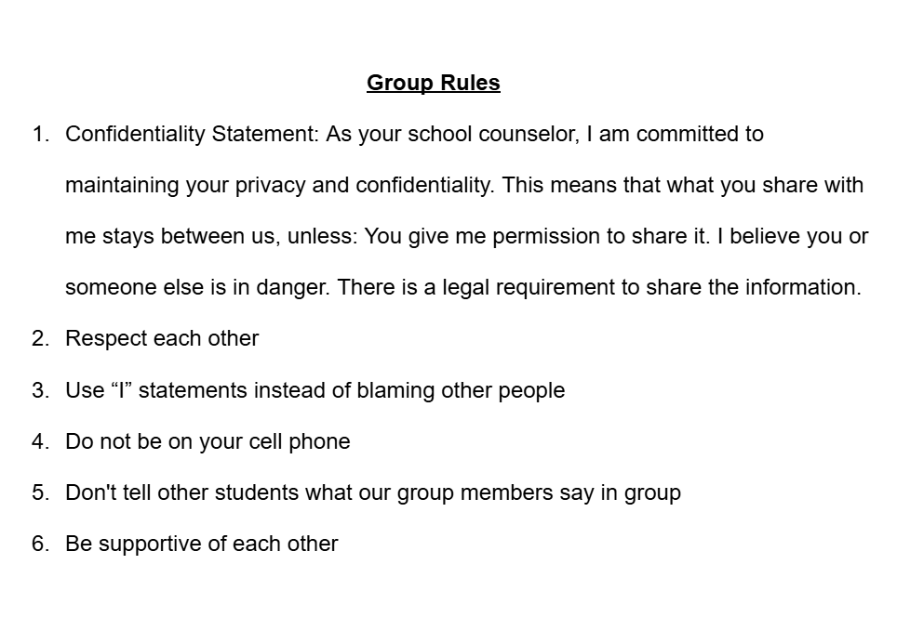
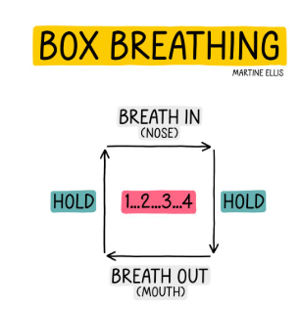
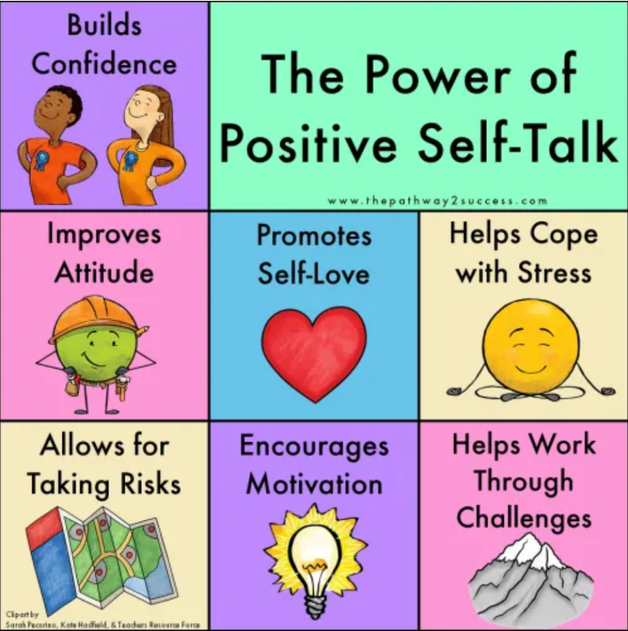
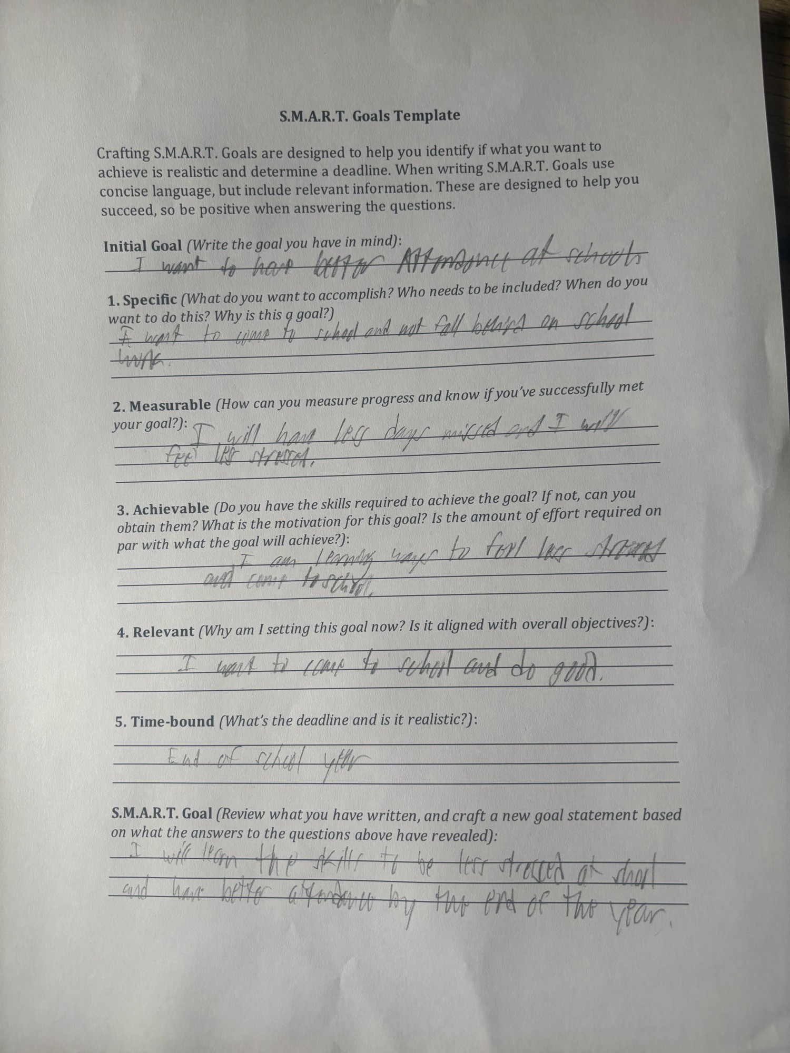
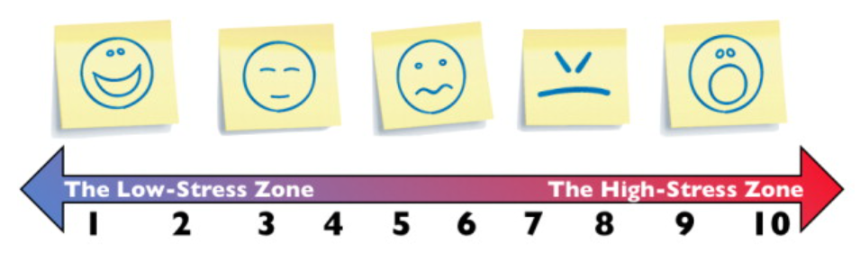
Artifacts/Pictures/Examples
Notes:
When I started my internship

Slide 11
Cultural Sensitivity
I recognized cultural biases that I might have and did not let that effect how I counseled the group members.
The learning materials that were used had pictures to make all group members feel welcome. (Abacioglu, 2020)
I encouraged students to use their different cultural backgrounds as a strength. (Rutledge, 2019)

Slide 12
Evaluation
The group consisted of 6 meetings but that was over an 8-week time frame because of school scheduling conflicts.
Success is if the student's improved attendance and if it went up to the state recommended 90%. Also, if the students were learning that they don’t always have to go to the school health office. They can talk to their school counselor too.
 | Pre-Group Attendance % | Post Group Attendance % | Pre-Group Health Office | Post Group Health Office
Student 1 | 82% | 88% | 5 | 2
Student 2 | 87% | 93% | 4 | 1
Student 3 | 86% | 85% | 6 | 1
Student 4 | 82% | 95% | 4 | 0

Slide 13
improvement
I would do the needs assessment electronically so I could easily collect the data.
I would like to use the perceived stress scale as a pre/post assessment with students. (Harris et al., 2023)
Dig deeper into the school data to look for more factors and ways to make the group more diverse.

Slide 14
References
Abacioglu, C. S., Volman, M., & Fischer, A. H. (2020). Teachers’ multicultural attitudes and perspective taking abilities as factors in culturally
responsive teaching. British Journal of Educational Psychology, 90(3), 736-752.
Advanced Internship Assessment (2023). Liberty University.
American School Counselor Association (2021). ASCA Student Standards; Mindsets and Behaviors for Student Success. Alexandria, VA: Author.
Commonwealth of Pennsylvania. (2024). Compulsory school attendance, unlawful absences, and school attendance improvement conferences.
Pennsylvania Department of Education. https://www.pa.gov/agencies/education/resources/policies-acts-and-laws/basic- education-circulars-becs/purdons- statutes/compulsory-school-attendance-unlawful-absences-and-school-attendance-improvement-conferences.html
Harris, K. M., Gaffey, A. E., Schwartz, J. E., Krantz, D. S., & Burg, M. M. (2023). The Perceived Stress Scale as a measure of stress: Decomposing
score variance in longitudinal behavioral medicine studies. Annals of Behavioral Medicine, 57(10), 846-854. https://doi.org/10.1093/abm/kaad015
Pennsylvania Department of Education. (n.d.). PA Core ELA Standards. Retrieved from https://www.pa.gov/content/dam/copapwp
-pagov/en/stateboard/documents/regulations-and-statements/state-academic-standards/pa%20core%20ela%20standards.pdf
Rutlidge, Marsha (2019). Cultivating Cultural Responsiveness. American School Counselor Association.

