Slide 1
Parent-Teacher Presentation
Alden J. May

Slide 2
Comprehensive Program Elements
Academic
Career
Social Emotional Development
These all contribute to the students overall academic achievement

Slide 3
Comprehensive Program Elements: Beliefs
At our school we take our beliefs from the American School Counseling Association. These beliefs are that students have basic rights. These are to be treated with dignity, have a safe school environment, have equitable access to all school counseling resources, support in self development, and to have privacy. (Association, A.S. C.2019)
Notes:
It is important for school counselors to have a set of beliefs that align with the ASCA. This is important so school counseling programs across the country have similar approaches to how they are going to help students reach their full academic potential.

Slide 4
Comprehensive Program Elements: Mission
Our mission as school counselors is to advocate for the success of every student. We will make sure students get respect and have the tools they need to succeed. We will involve the students, staff and members of the community to make sure we are providing the best learning environment for the students. (Association, A.S. C. 2019)

Slide 5
Comprehensive Program Elements: Vision
Our schools' vision is for every student to have the skills and support they need to achieve any goal that they set for themselves. We as school counselors will be there to support them in every step of the process.

Slide 6

Comprehensive Program Elements: Academic
School Counselors work in collaboration with teachers.
Students may need a counseling intervention to help reach full academic potential.
ASCA standard B-LS 8. Engagement in challenging coursework
Notes:
It is important for school counselors to work closely with teachers because teachers are with the students the most. If a student is struggling academically, the school counselor can work in collaboration with the teacher to figure out a good academic intervention for the student. ASCA standard B-LS 8 says that the school counselor should help students that are engaging in challenging schoolwork. (ASCA, 2019) The goal of our comprehensive school counseling program is to help students find their full potential in school.

Slide 7
Comprehensive Program Element: Career
Help students succeed
Community members will talk with students about different career opportunities
Create a career fair with the help of students, staff, parents and community members
Talk with students when they have questions about their future career paths.
Notes:
An important aspect of a students education is career preparation. School counselors have a major role in helping a student plan for their future. A great activity that we will do for the students is create a career fair with the help of students, staff, parents and other members of the community. We want community members to be a big part of the career aspect of our comprehensive school counseling program because we want our students to know all of the different opportunities that are waiting for them after they graduate from our school. Our major overall goal of all these activities is to help students succeed.

Slide 8
Comprehensive Program Element: Social/Emotional Development
We help students work through issues
One on one counseling, group counseling, classroom lessons and outside the school resources are utilized when needed (Martinez et al. 2019)
Work with the teachers to help identify students having issues
We use evidence based strategies that are inclusive for all students (ASCA, 2019)
Trauma informed care (ASCA, 2019)
Notes:
In our comprehensive school counseling program, we help students with their social/emotional development. One of the ways we do this is by using trauma informed care. Using trauma informed care, we utilize tier 1, 2, and 3 supports for students depending on their level of need. Tier 1 supports for students is making sure they have a safe environment to learn. Tier 2 support is identifying students in need and at risk of trauma. Tier 3 is more intensive supports such as outside therapy and trauma treatment. (Martinez et al. 2019) The school counselor will implement the knowledge of trauma and the effects it has on students into the school system. (Martinez et al. 2019) We help students work through their trauma, but it is also critical to help create awareness in the school for how to recognize the signs and symptoms of trauma.
Martinez, R. R., Gavin Williams, R., & Green, J. (2019). The Role of School Counselors Delivering a Trauma-Informed Care Approach to Supporting Youth in Foster Care. Professional School Counseling, 23(1). https://doi.org/10.1177/2156759X20947747

Slide 9
Advocacy
Teamwork is required between students, teachers, school counselors, administration, parent, and the whole community.
Everyone in the school community has the student's best interest in mind
Notes:
Parents are an important part of our approach to advocacy because they know their child and the needs that they have the best. The school counselor will meet with parents to find out the best way we can advocate for that student in the school. After we learn about the student, we can then implement 1 on 1 counseling and group counseling. These approaches will help the students learn the skills they need to advocate for themselves. In group counseling students can learn from each other and have a better understanding of how to advocate for themselves and others. (Darling-Hammond and Cook-Harvey, 2018)

Slide 10
Advocacy: ASCA National Model
Help students learn how to advocate for themselves (ASCA, 2019)
With the students/family's permission collaborate with outside resources. (ASCA, 2019)
Following up with a students to see how they are making progress (ASCA, 2019)
Notes:
B-PA 4. Develop and implement action plans
aligned with annual student outcome goals and
student data (ASCA, 2019)

Slide 11

Advocacy: Student Centered Teaching
Students do more than just listen to a teacher talk
Students are challenged
Students create
Topics should be taught in multiple different ways for students that learn differently
(Darling-Hammond and Cook-Harvey, 2018)
Notes:
Student centered teaching is a strategy that we use to help students advocate for themselves. It also helps to create an equitable environment for learning. Student centered teaching helps teachers create lessons for students based on there unique individual background. (Darling-Hammond and Cook-Harvey, 2018) The school counselor works with the teachers and students to learn how students learn best.

Slide 12


Advocacy Approach: Cultural Training
School counselors and staff receive cultural training
ASCA standard M 2. Sense of acceptance, respect, support and inclusion for self and others in the school environment
Accept all student for who they are
No student should feel unwelcomed
Notes:
The school counselors and teachers receive cultural training so they can learn how to be accepting of all students that are in the school. Students will also be encouraged to learn about their own culture and the culture of other students in the school. We do not want students to be color blind to each other. This can have negative results because it encourages people to ignore real issues that have to do with race and ethnicity. (Chao et al., 2011) We want students to be able to learn about all the great things that make them unique as individuals. We will host cultural events at the school that students can show the many unique things that their cultural backgrounds can teach other.

Slide 13

Access, Attainments & Achievement
Access- the ways in which educational institutions and policies ensure—or at least strive to ensure—that students have equal and equitable opportunities to take full advantage of their education. (Glossary of Educational Reform, 2014)
cultural, ethical, economic, legal, and political issues
Notes:
We address cultural issues in relation to access by making sure no students are discriminated against based on their cultural background. We will teach students about ethical issues surrounding access. For example, we teach students that it is not ethical to deny people access to opportunities based on race or gender. In our program we will make sure that students have equal access to all school resources and does not matter the amount of money that the student's family has. Also, we want to teach students the importance of how the economy works and show them in the career fair the many different jobs and opportunities that they have access to. We will give students access to information about how the legal system works. Also, students need to have access to information about the different political issues that are happening all over the world. This is important to help them better understand the world around them.

Slide 14

Access, Attainment and Achievement
Attainment- the action or fact of achieving a goal toward which one has worked. (Oxford dictionary, 2017)
cultural, ethical, economic, legal, and political issues
Notes:
Attainment is all about helping students set goals and then helping them to achieve those goals. The cultural goals we help students set is for them to learn more about their own culture and the culture of other students in the school. We will help students set ethical goals of being kind to each other. Economic goals that we will help the students set are related to helping them save money for college or saving to buy car. We will help students set goals to stay away from drugs and other things that are not legal. We will help students set goals to learn more about political issues so they can be well informed voters when they turn 18.

Slide 15

Access, Attainment, and Achievement
Achievement- a thing done successfully, typically by effort, courage, or skill. (Oxford Dictionary, 2017)
cultural, ethical, economic, legal, and political issues
B-SS 6. Collaborate with families, teachers, administrators, other school staff and education stakeholders for student achievement and success (ASCA, 2019)
Notes:
We will help students learn about the different achievement that have been accomplished by others that share their culture. We will help students achieve their goals by ethical means and teach them that it not good to cheat to achieve a goal. We will help the students learn about how to achieve economic freedom by saving their money and getting a good job. We will show students how to achieve different goals by learning the process of running for a political office.

Slide 16

Barriers to Student Development
Academic achievement
Collaboration is key to student success
Teachers help the school counselors identify students that might need academic intervention
Promote Equity
Notes:
Unfortunately, their can be barriers to a student's academic achievement. The social and economic background that a student comes from can influence their academic achievement. For example, the cost of college can be very expensive for some families and that can discourage students from wanting to go to college. This can be a major barrier students from low-income families. (Spica and Biddix, 2021) In our comprehensive school counseling program we teach students about options to help get rid of this barrier. We can show students options with where they apply to go to college. There are community colleges and state colleges that are cheaper than private universities. Also, another barrier to academic achievement is a student's family. Some students come from a very supportive family that will help them achieve academically. Unfortunately, we have some students that have a harder family life and have more stresses at home that can affect their academic achievement. This is where the school counselors, teachers and family can collaborate to help a student find resources like study groups or tutoring that can help bridge the gap between them and other students. This is also important to help promote equity in education.

Slide 17
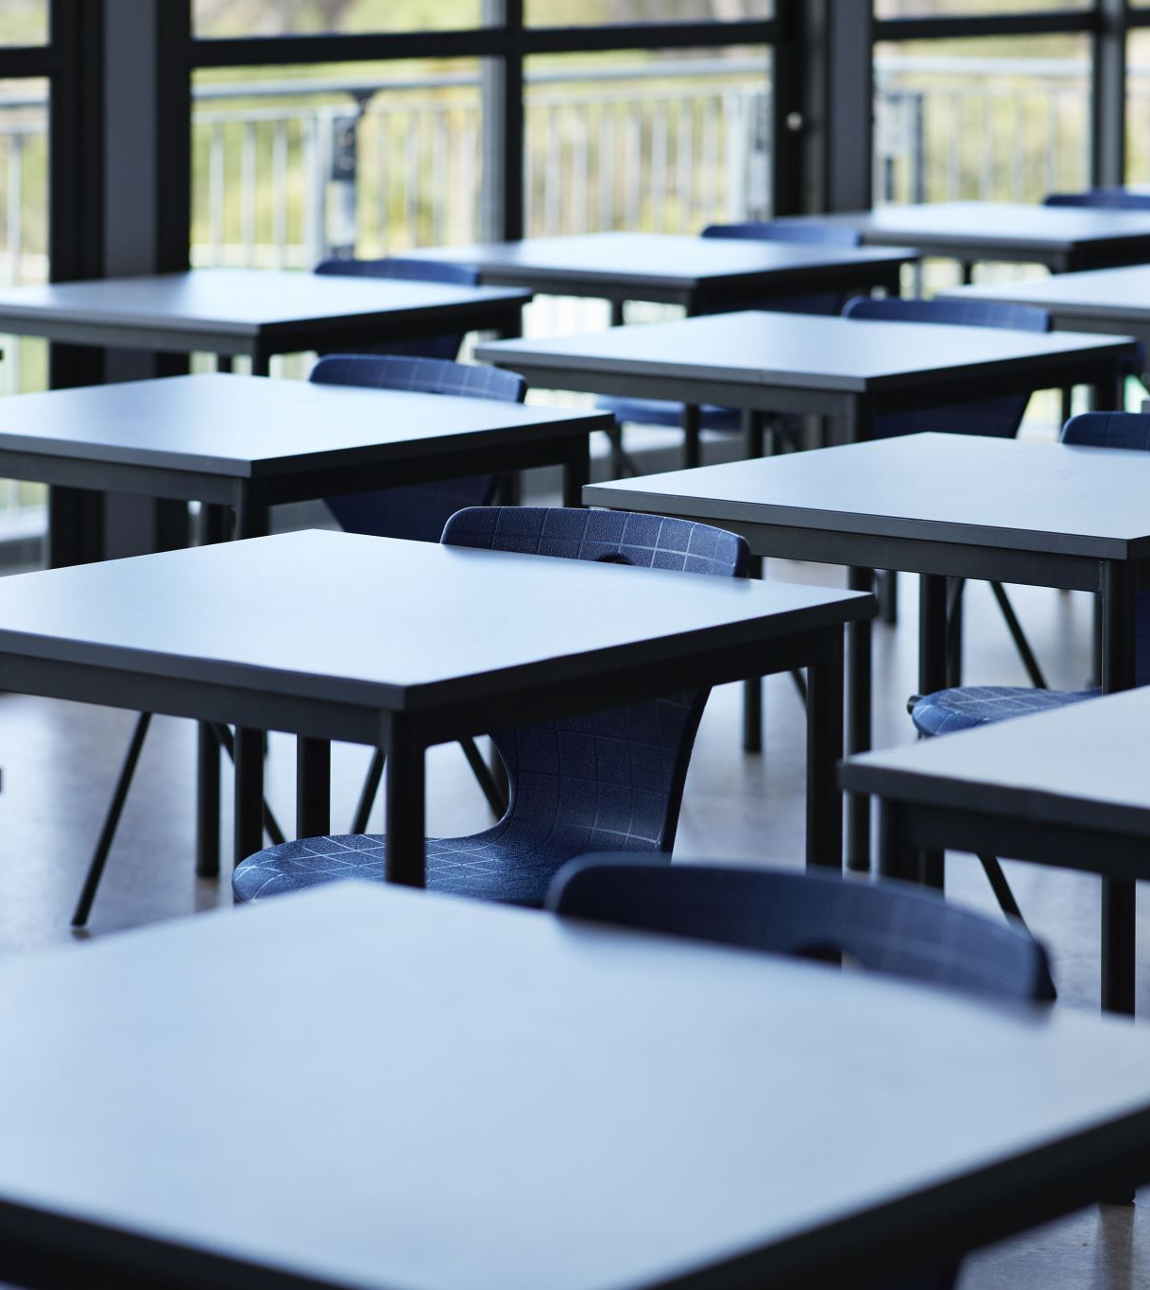
Barriers to Student Development
Student well-being
Anxiety and depression
drugs
Notes:
The well being of the students is one of our biggest priorities. We want to help students feel safe and welcome when they are at our school. The teachers and school counselors will collaborate to make sure no student is being bullied or suffering in silence from anxiety or depression. The school counselors will meet with students to talk about how they are feeling and to make sure they feel safe at school. Also, it will be important for the school counselors to have meetings with the families of students to make sure all the students needs are being met. Also, today drugs have become a major issue for some people. To counter this, we will teach students about the dangers of drugs and alcohol by having group lessons about the dangers.

Slide 18
References
Martinez, R. R., Gavin Williams, R., & Green, J. (2019). The Role of School Counselors Delivering a Trauma- Informed Care Approach to Supporting Youth in Foster Care. Professional School Counseling, 23(1). https://doi.org/10.1177/2156759X20947747
American School Counselor Association. (2019). The ASCA National Model: A Framework for School Counseling Programs, Fourth Edition, Alexandria, VA: Author.
Darling-Hammond and Cook-Harvey (2018) Educating the Whole Child: Improving School Climate to Support Student Success.

Slide 19
References
Chao, Wei, M., Good, G. E., & Flores, L. Y. (2011). Race/ethnicity, color-blind racial attitudes, and multicultural counseling competence: The moderating effects of multicultural counseling training. Journal of Counseling Psychology, 58(1), 72–82. https://doi.org/10.1037/a0022091
Spica, E., & Biddix, J. P. (2021). Prices They Pay: Academic Achievement and Progress to Graduation Barriers Experienced by Community College Students Due to the Cost of Course Materials. Innovative Higher Education, 46(6), 643-662. https://doi.org/10.1007/s10755-021-09557-7

Slide 20
References
Oxford Dictionary. (n.d.) Achievement and Attainment. https://languages.oup.com/google-dictionary-en/
The Glossary of Education Reform. (2014) Access https://www.edglossary.org/access/

