Slide 1
School Counseling Needs Assessment for 8th graders – Sharing the Data
Mrs. Langberg

Slide 2
Explanation of Survey
The purpose of our survey was to gather information from 8th teachers concerning their students’ academic, career, and social/emotional mindsets.
We asked all 8th grade teachers to fill out an online google form survey consisting of 10 questions. The survey was completely anonymous.
We decided to ask the teachers for their valuable input as we value their feedback in the development of our comprehensive school counseling program.
Important consideration – we are going to give our 8th grade students a similar survey so we may have a more complete and accurate assessment of the needs of our 8th grade students.

Slide 3
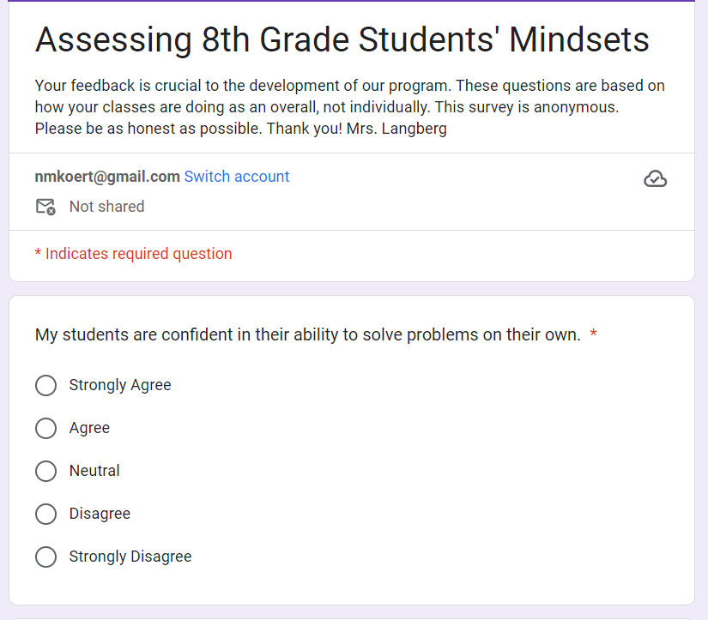
Survey

Slide 4
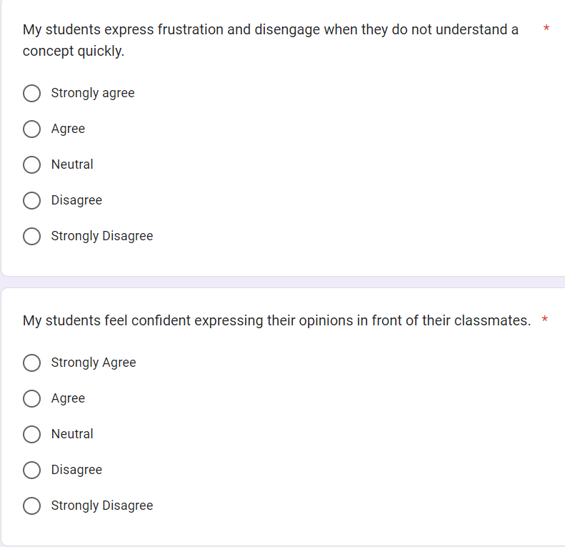
Survey

Slide 5
Survey results – what teachers said
Academic Analysis –
Only 50% of students are confident in ability to solve problems
50% of students feel frustrated when they do not understand their work
Social/Emotional Analysis –
50% do not feel confident expressing opinions in front of classmates
50% supportive of their peers
33% students are anxious to participate
Career Analysis –
50% of students do not believe they can achieve their postsecondary goals through hard work.
Only 33% of teachers believe their students understand the importance of education in achieving their postsecondary goals.
33% of teachers do not believe their students understand the importance of postsecondary attainment

Slide 6
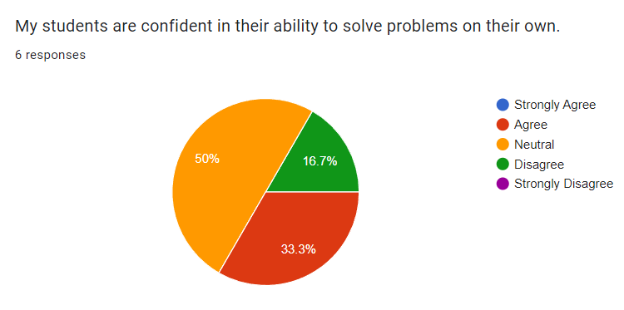

Slide 7
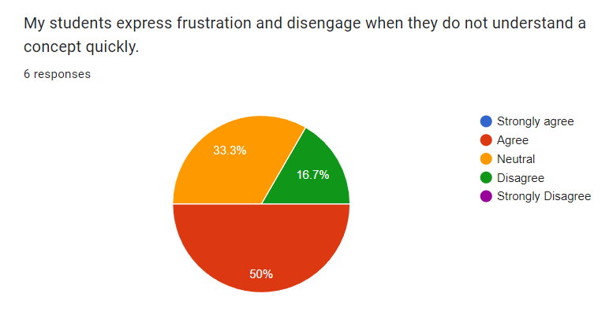

Slide 8
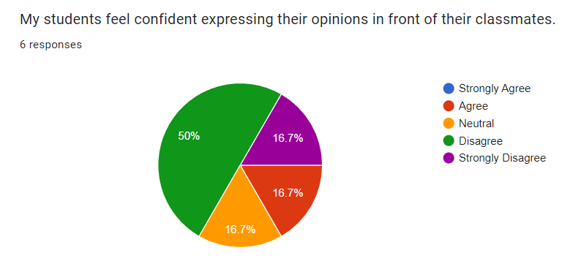

Slide 9
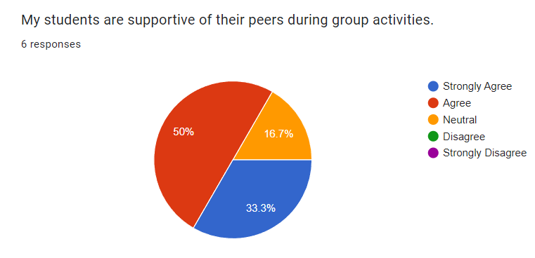

Slide 10
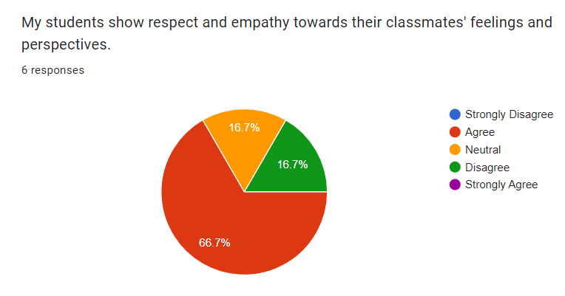

Slide 11
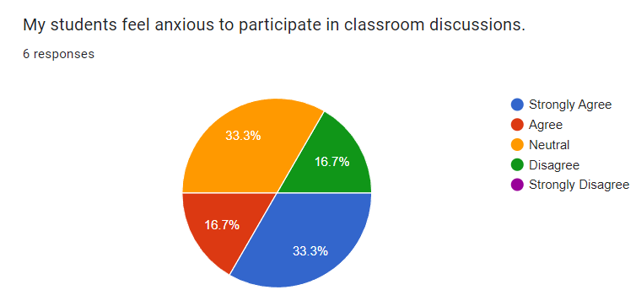

Slide 12
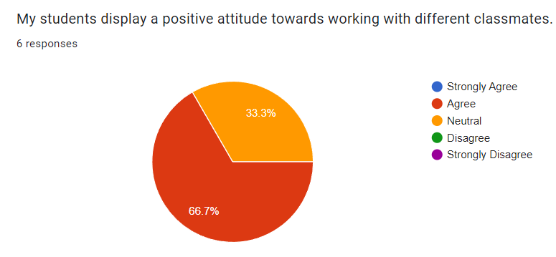

Slide 13
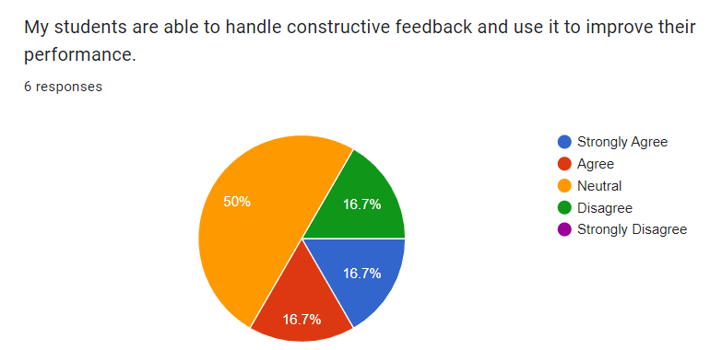

Slide 14
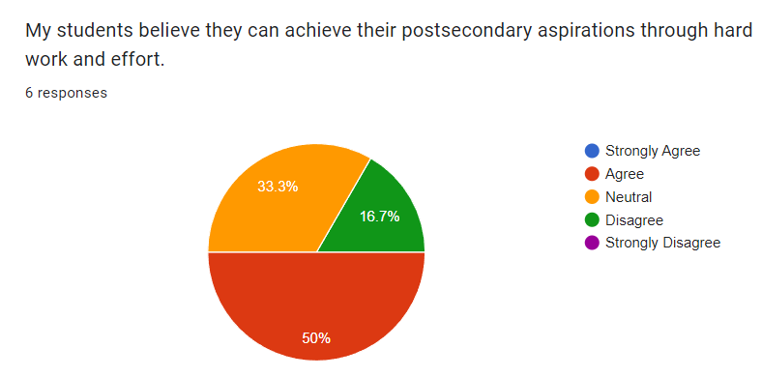

Slide 15
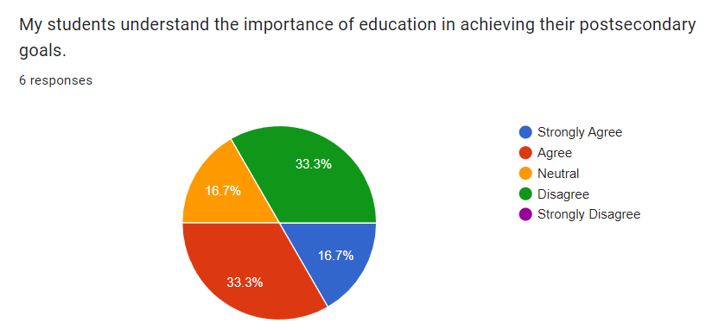

Slide 16

Interpretation of results
3 major takeaways -
Career/Postsecondary counseling
Growth mindset
Self-confidence/self-esteem
Recommendations –
Share data with teachers so they can see overall how 8th graders are doing. (50% of teachers said students disengage) Is the content too hard? Are they receiving supplemental instruction when needed? Enough time to master a skill?
Improve/modify the career counseling program. Do our students understand the importance and implications of staying in school and or working hard to achieve postsecondary goals?
Improve/modify the guidance lessons to include a more growth mindset and self-confidence focus. Increase small-group counseling. Are our students giving up when things get tough? Are they not believing in their abilities? Do they know they have many abilities and talents?
Notes:
According to our teachers, our students are displaying a positive attitude towards working with classmates and also showing respect and empathy towards each other. Where I see the challenge is from students’ own self-confidence. 50% of teachers feel their students don’t feel confident expressing their opinion even though about 68% of teachers expressed that their students show empathy and respect towards one another. So the need may be in helping our students see their own strengths and worth, build self-confidence.
50% of students will get frustrated and disengage if content is too hard – growth mindset, adjust curriculum and teaching?
Another takeaway is that only 50% of teachers felt their students understood that they have to work hard in order to achieve postsecondary success. What are they thinking then? And there is an even divide between agreeing and disagreeing that their students understand the importance and connection of education and achieving postsecondary goals. If the majority of our students don’t see a connection between education and postsecondary success than we aren’t emphasizing this enough. – improve our career counseling program

Slide 17
Interventions for addressing growth mindset
Direct student services
Indirect student services
Whole class growth mindset workshops. Explicit teaching of the brain’s ability to form new connections and grow - Carol Dweck’s theory (Dweck & Yeager, 2019) “I can’t” to “I can’t yet”
2. Specific teacher feedback emphasizing specific progress and hard work (Gan & Liu, 2021).
3. Assisting and monitoring of Goal setting (academic, social/emotional, and career) Proven to improve growth and performance (Dotson, 2015).
1. Create a supportive classroom environment
2. Growth Mindset Role Models
3. Parent education and involvement
Notes:
Whole class growth mindset workshops. Explicit teaching of the brains ability. Teach from the Brainology curriculum – helping students to understand that their intelligence and abilities are not fixed and can be developed through effort. (Carol Dweck’s theory)
2. Teachers will provide specific feedback emphasizing specific progress and hard work –
3. School Counselors will have ongoing goal setting workshops to assist students in goal setting and monitoring of Goal setting (academic, social/emotional, and career)
1. Our classrooms will value learning from mistakes, a culture of kindness and support so students will feel free to take risks in front of peers, participate without fear and make mistakes.
2. Growth Mindset Role Models – I always love showcasing people, famous or not who exemplify resilience and perseverance. Students will be exposed to numerous role models throughout the year who have growth mindsets especially when faced with adversities.
3. Parent education and involvement – parent education and involvement is extremely important. Parents will have the same opportunities to learn about Carol Dweck’s theory and how they can help their student at home engage in a more growth mindset mentality.

Slide 18
Interventions for addressing self-confidence/self-esteem
Direct student services
Indirect student services
1. Skill-building Workshops – showcase strengths, talents etc. Proven to increase confidence and well-being (Zhang & Chen, 2018).
2. Individual/small group counseling – tailored to help students really struggling to think positively (Zyromski & Joseph, nd).
3. Positive Talk Moments – beginning of SEL lessons. Learn and practice saying positive affirmations to self, make this habit. Creates a protective barrier ands builds resilience (Cascio et at., 2016).
1. Creating a supportive and inclusive classroom environment
2. Peer/Adult support network
3. Parent education and involvement
Notes:
1. Skill-building Workshops – showcase strengths, talents through the creative arts, music, writing etc. – I love showcasing our strengths and talents. It brings the class community together in a fun way.
2. Individual/small group counseling – this will be done on an as-needed basis which will be tailored to help students really struggling to think positively about themselves. Use Cognitive Behavioral Therapy as this can teach a student to change their mindset from faulty to more positive thinking
3. Positive Talk Moments – beginning of SEL lessons. Learn and practice saying positive affirmations to self, learning to make this habit. Creates a protective barrier ands builds resilience (Cascio et at., 2016).
1. Creating a supportive and inclusive classroom environment again where students feel free of judgement so they want to participate more and feel confident doing so
2. Peer/Adult support network – offering students the opportunity to have a peer or adult mentor as a system of support.
3. Parent education and involvement - again parent involvement is key to any successful program and this is no exception. Parents are an integral part of helping their child see their value. We can hold information sessions and coffee mornings to help give parents tools and strategies to help build their child’s confidence at home.

Slide 19
Interventions for addressing postsecondary/career importance
Direct student services
Indirect student services
1. Interest inventory/goal-setting workshops (Dotson, 2015).
2. Career exploration program. Perfect age to start exploring future goals due to increased self-awareness (Godbey & Gordan, 2019).
3. Mentorship program – can have a positive impact on a students academic, social-emotional and career readiness with overall connection to school (Lyons & Chan, 2021).
1. Career/real-world curriculum design
2. College/career showcasing climate
3. Parent education and involvement
Notes:
Interest inventory/Goal-setting workshops – teach students how to do interest inventories (O*Net, Holland Code, True Colors). Assist in making and achieving goals (short and long-term). Teach the steps needed and the role of hard work in achieving a goal
Career exploration days – explore careers through attending career fairs at other schools, host our own, invite guest speakers, field trips to universities and postsecondary trades schools. Students in middle school are at the perfect age for these types of career explorations as they have an increased sense of self-awareness.
Mentorship Program – connect students with an adult in the school as their mentor (teacher, previous teacher, coach, admin) these mentors provide guidance and share experiences while emphasizing the importance of hard work and postsecondary and career opportunities. Mentorships will be ongoing and allow our students to feel more connected to their learning, and to the school. These mentorships have a positive impact on our students academic, SEL and career readiness .
Career/real-world curriculum design – work to connect the existing curriculum to real-world applications showing the connection between subjects taught and the real-world. The why behind why students are learning what they’re learning.
College/career showcasing – because it seems our students are disconnected with understanding the value education and working hard has on their future, and the implications of this. I would like to have an alumni featured each month on a bulletin board. This will help students understand that they too can accomplish greatness and success. (feature their college swag, pictures of their certificates/awards/degrees etc. maybe even get them in as guest speakers.
Parent involvement – Involve parents in the planning and provide them with resources and information to help their student achieve their aspirations and goals.

Slide 20

Systemic Focus – Potential Inequities to proposed interventions
Parent Involvement and Engagement – language barriers, work schedules, lack of access to information (Godbey & Gordan, 2019).
Curriculum Inclusivity – curriculum might alienate underrepresented groups affecting their self-esteem
Bias in Teaching and Disciplining – teachers might bring personal bias and frustrations to their teaching and disciplining, potentially disproportionately affecting students of color and lower socioeconomic status
Solutions:
Offer flexible meeting times for parents, multilingual resources and communication
Adopt a culturally responsive curriculum that celebrates diversity and values equity.
Cultural sensitivity training to all staff once beginning of year and once mid-term
Notes:
Parent Involvement and Engagement – language barriers, work schedules, lack of access to information
Curriculum Inclusivity – curriculum might alienate underrepresented groups affecting their self-esteem
Bias in Teaching and Disciplining – teachers might bring personal bias and frustrations to their teaching and disciplining, potentially disproportionately affecting students of color and lower socioeconomic status
We can offer flexible meeting times for parents, multilingual resources and communication
We can work to adopt a culturally responsive curriculum that celebrates diversity and values equity.
We will provide cultural sensitivity training to all staff once beginning of year and once mid-term so we can continue to foster supportive, inclusive classroom environments

Slide 21

Implementation plan and assessment for effectiveness
Participation data – 100% of our 8th grade students will participate in activities mentioned in previous intervention slides with the exception of individual/small group counseling which will be on a needs basis and targeted towards more individual interventions.
Track - Attendance at all classes, workshops, field trips, mentoring sessions etc. through our Pheonix digital attendance tracking system.
ASCA Mindsets ad Behavior data – from 50% to 80% of 8th graders improving their growth mindsets and improved attitudes around the hard work and dedication needed to achieve future career/postsecondary success. Collect data before and after certain activities.
Track - ASCA-aligned pre-post surveys and questionnaires.
Outcome data – Collect data three times throughout the year to demonstrate growth and future needs. (beg-year, mid-year, end-year) We are looking for academic performance, behavior records, teacher/mentor/admin/counselor feedback.
Track - report cards, school behavior records, and stakeholders anecdotal records.
Notes:
1. Participation data – 100% of our 8th grade students will participate in activities mentioned in previous intervention slides with the exception of individual/small group counseling which will be on a needs basis and targeted towards more individual interventions. Teachers and school counselors will track participation data by taking attendance at all classes, workshops, field trips, mentoring sessions etc. through our Pheonix digital attendance tracking system.
2. ASCA Mindsets ad Behavior data – our “what” did students learn through participating in all of our activities (ASCA, 2019). Collect data before and after certain activities to demonstrate knowledge, growth, attitudes towards learned skill. So, our hope is that we can get from 50% to 80% of 8th graders improving their growth mindsets and improved attitudes around the hard work and dedication needed to achieve future career/postsecondary success. We will use ASCA-aligned pre-post surveys and questionnaires.
3. Outcome data – Our “how” did the learning affect their achievement, attendance, and discipline? (ASCA, 2019). We will collect data three times throughout the year to demonstrate growth and future needs. (beg-year, mid-year, end-year) We are looking for academic performance, behavior records, teacher/mentor/admin/counselor feedback.
We will look at report cards, school behavior records, and stakeholders anecdotal records.

Slide 22
ASCA Mindsets and Behaviors
M 2. Self-confidence in ability to succeed (ASCA, 2019).
Our workshops, mentoring, showcasing strengths and talents in guidance classes, will improve our students’ self-esteem and self-confidence.
M 4. Understanding that postsecondary education and life-long learning are necessary for long-term career success (ASCA, 2019).
We will improve our students’ attitudes towards postsecondary education. Recognize the importance and role college has in their future success. Career exploration workshops, mentorships, will help our students see the value of hard work and lifelong learning.
B-LS 7. Identify long- and short-term academic, career and social/emotional goals (ASCA, 2019).
Our plan includes workshop activities and mentorship that will help our students set and achieve personal and academic goals.
B-SMS 5. – Demonstrate perseverance to achieve long- and short-term goals (ASCA, 2019).
Through growth mindset education and workshops our students will learn strategies to improve their ability to persist through challenges, struggles, or barriers they may face.
B-SS 9. – Demonstrate social maturity and behaviors appropriate to the situation and environment (ASCA, 2019).
Our students will learn to take their future more seriously and that the planning starts now. All workshops and instruction will help our students learn to navigate postsecondary decision-making with maturity.
Notes:
M 2. Self-confidence in ability to succeed (ASCA, 2019).
Relevance – our interventions listed in previous slides (workshops, mentoring, showcasing strengths and talents in guidance classes) will improve our students’ self-esteem and self-confidence which is our main goal and where we have seen the most need
M 4. Understanding that postsecondary education and life-long learning are necessary for long-term career success (ASCA, 2019).
Relevance – we will work to improve our students’ attitudes towards postsecondary education. We will help our students see the importance and role college has in their future success. All of our career exploration workshops planned throughout the year will help our students see the value of hard work and lifelong learning.
B-LS 7. Identify long- and short-term academic, career and social/emotional goals (ASCA, 2019).
Relevance – Our plan includes workshop activities and mentorship that will help our students set and achieve personal and academic goals.
B-SMS 5. – Demonstrate perseverance to achieve long- and short-term goals (ASCA, 2019).
Relevance – through our growth mindset education and workshops our students will learn strategies to improve their abitlity to persist through challenges, struggles, or barriers they may face.
B-SS 9. – Demonstrate social maturity and behaviors appropriate to the situation and environment (ASCA, 2019).
Relevance – Our students will learn to take their future more seriously and that the planning starts now. Through all of our workshops and instruction our students will learn to navigate these post-secondary decision-making with maturity.

Slide 23
Announce
Teachers/ administration – staff meetings, emails, professional development sessions
Parents/ community members – parent/teacher/counselor conferences, school newsletters/school social media, community meetings
Students – classroom/school announcements, morning meeting messages, school assemblies, student emails
Notes:
Teachers/ administration – we can present progress/updates and results at staff meetings, emails, professional development sessions.
Parents/ community members – we can share progress and results during individual parent/teacher/counselor conferences, school newsletters/school social media, community meetings
Students – teachers can share progress and results in classroom/school announcements, morning meeting messages, school assemblies, student emails

Slide 24
Advocating for Program
Design | We surveyed teachers to help us gain an understanding of 8th grade students’ mindsets, beliefs, and attitudes towards their academics, their social emotional health, and their career readiness
Ask | We conducted an anonymous online google forms survey consisting of 10 questions
Track | Results showed that we need to help our students build self-confidence. 50% of our teachers reported that their students don’t feel confident expressing their opinion even though about 68% of teachers expressed that their students show empathy and respect towards one another. 50% of students will get frustrated and disengage if content is too hard. Only 50% of our teachers felt their students understood that they need to work hard in order to achieve postsecondary success.
Announce | Please note: further data needs to be collected. We understand our program’s needs are not complete without our students’ input. We are in the process of surveying our students themselves as this will then complete our data collection and allow for a more accurate program. Our students need help in recognizing their strengths and worth. Our students need explicit teaching of acquiring a growth mindset and classroom instruction and feedback needs to be adjusted to allow for a more supportive and positive classroom environment. We need to improve our career counseling program with numerous workshops, field trips, interest inventories, and mentorships, if we are going to help our students understand the importance and connection of education and achieving postsecondary goals.

Slide 25
References
American School Counselor Association (2019). ASCA national model: A framework for school counseling programs (4th ed.). Alexandria, VA: Author. ISBN: 9781929289592.
Cascio, C. N., O'Donnell, M. B., Tinney, F. J., Lieberman, M. D., Taylor, S. E., Strecher, V. J., & Falk, E. B. (2016). Self-affirmation activates brain systems associated with self-related processing and reward and is reinforced by future orientation. Social cognitive and affective neuroscience, 11(4), 621–629. https://doi.org/10.1093/scan/nsv136
Dotson, R., (2015). Goal Setting to Increase Student Academic Performance. Retrieved from, https://files.eric.ed.gov/fulltext/EJ1158116.pdf
Dweck, C. S., & Yeager, D. S. (2019). Mindsets: A View From Two Eras. Perspectives on psychological science : a journal of the Association for Psychological Science, 14(3), 481–496. https://doi.org/10.1177/1745691618804166
Gan Z, An Z and Liu F., (2021).Teacher Feedback Practices, Student Feedback Motivation, and Feedback Behavior: How Are They Associated With Learning Outcomes? Front. Psychol. 12:697045. doi: 10.3389/fpsyg.2021.697045
Godbey, Samantha and Gordon, Howard R. D. (2019) "Career Exploration at the Middle School Level: Barriers and Opportunities," Middle Grades Review: Vol. 5 : Iss. 2 , Article 2. Available at: https://scholarworks.uvm.edu/mgreview/vol5/iss2/2
Lyons, M. D., & Chan, W. Y. (2021). Mentoring and Academic Outcomes: A Review of the Literature. National Mentoring Resource Center Research Review. Retrieved from, https://nationalmentoringresourcecenter.org/index.php/component/k2/item/572-mentoring-and-academic-outcomes-a-review-of-the-literature.html
Zhang, Y., & Chen, M. (2018). Character Strengths, Strengths Use, Future Self-Continuity and Subjective Well-Being Among Chinese University Students. Frontiers in psychology, 9, 1040. https://doi.org/10.3389/fpsyg.2018.01040
Zyromski, B., & Joseph, A. E. (nd). Utilizing Cognitive Behavioral Interventions to Positively Impact Academic Achievement in Middle School Students. Retrieved from, https://files.eric.ed.gov/fulltext/EJ894786.pdf

Slide 26
Kaltura Presentation Link
https://watch.liberty.edu/media/t/1_aan3eave

