Slide 1

The impact of having a positive mindset
Notes:
Good morning, 6th grade friends!

Slide 2

Entrance ticket
Notes:
I’m going to pass around an entrance ticket like I normally do that the beginning of my lessons. After you answer please put those in my inbox right here and then have a seat and we will get started!
**this is when I walk to my EL students, or Sped students to help them read if necessary. (4 students).

Slide 3
Pre-/Post-Assessment:
1. Which of the following is a result of having a positive mindset?
  Less friends
  Low achievement in school
  Negative feelings of self
  Better relationships
2. Which of the following is a result of having a negative mindset?
  More friends
  High achievement in school
  Relationship struggles with peers
  Live longer
Notes:
This pre/post assessment is a result of the feedback I received from Dr. Ricks. (multiple choice, not Likert scale).
** I walk around and help my EL and Sped students read the questions and answers

Slide 4

Targets and Objectives
TARGETS:
B-SS 2. – Create positive and supportive relationships with other students
CCSS. ELA-LITERACY.SL.6.1 – Engage effectively in discussions with peers building on others’ ideas and expressing your own clearly
OBJECTIVES:
You will learn to reframe viewpoints from negative responses to positive responses and be able to identify the differences
You will practice interacting with peers using a positive mindset
Notes:
Alright, friends today we have some very important, lifelong learning targets to learn about and practice. You will learn how to reframe negative thoughts to be more positive in your interactions. And then you will get a chance to role play and practice what this sounds like looks like and how it feels to be more positive.

Slide 5
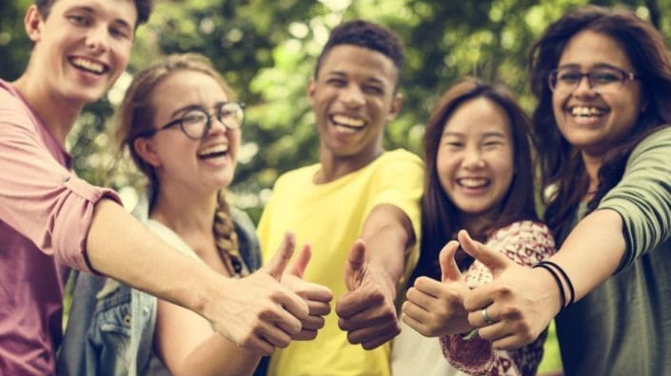
Review:
-recognizing our strengths
-when we are positive and happy with ourselves, we can be positive and happy for others
This Photo by Unknown Author is licensed under CC BY-ND
Notes:
Before we begin today’s lesson who would like to tell me what we learned last week as the 1st lesson in our positive mindset unit. I believe we have one friends who was absent. Let’s tell our friends what we learned!
A discussion on personality traits
Word art to creatively share our traits
Shared our word art and what personality traits we identify with the most
Lesson – only when we are happy and accepting of ourselves, can we be happy and accepting of others

Slide 6
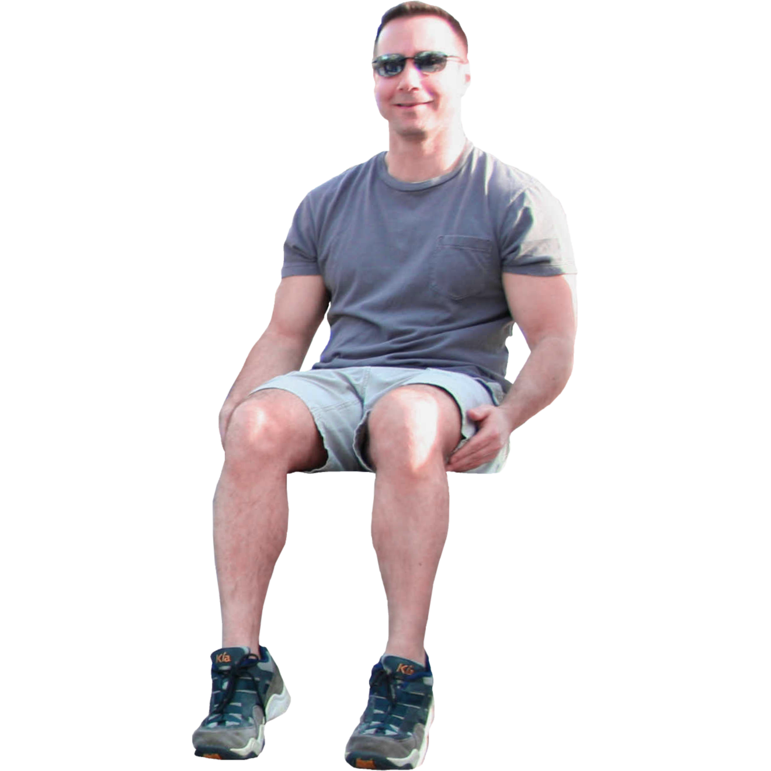
Warm up
Stand up/Sit down
Notes:
For today’s warm up – let’s play stand up/sit down
I’m going to be quick so think fast ☺
Stand up if what you hear is a positive response, sit down if what you hear is a negative response.
Let’s start by standing up

Slide 7
1. I hate this job. I’m only here because my parents are making me work to help pay for college.

Slide 8
2. You are very smart. I am inspired by your hard work.

Slide 9
3. You are so full of yourself. You think you’re so great.

Slide 10
4. Who would ever want truck driving as a career?

Slide 11
5. You are really pretty. I am too, in my own unique way.

Slide 12
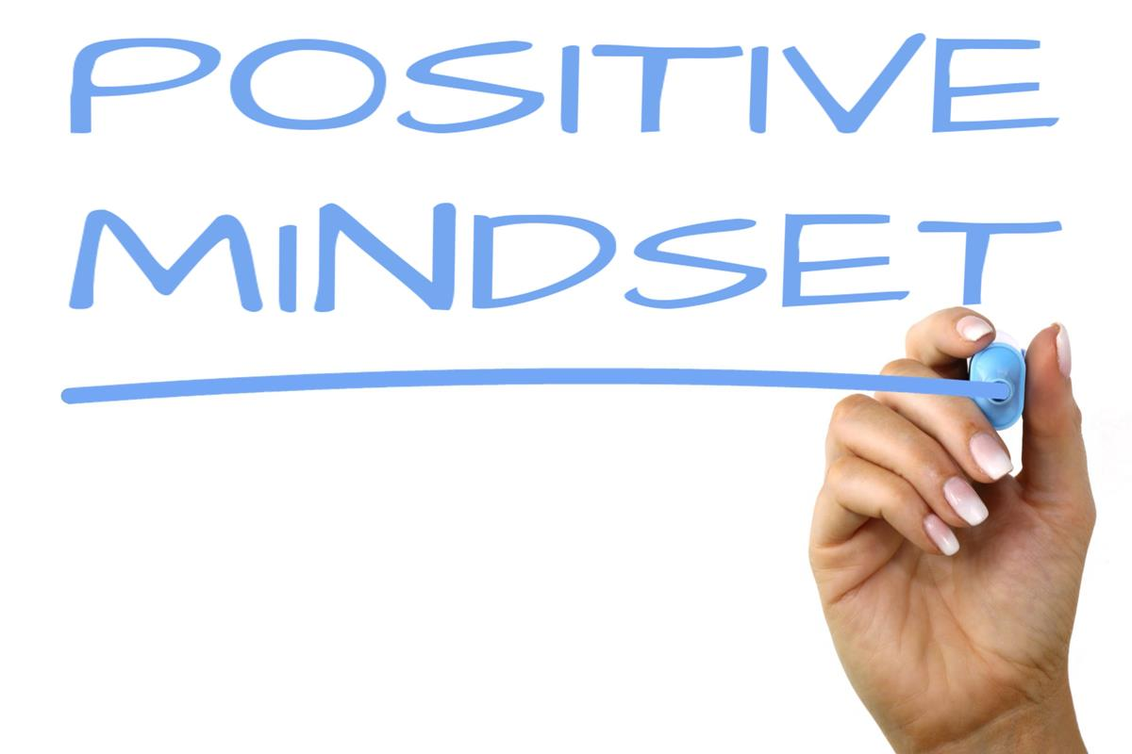
Lesson Objectives:
Reframe our negative thinking into positive thinking
2. Understand the impact this mindset has on our happiness and our relationships with our peers
Notes:
Alright, now that we have our blood flowing a little bit, go ahead and have a seat..
Those responses will be the focus of our lesson today
We are going to reframe this negative thinking and together come up with positive ways to respond and see how this changes how we feel and anything else you notice being impacted.
Let’s go back to response #1

Slide 13
I hate this job. I’m only here because my parents are making me work to help pay for college.
Negative Response:
Positive Response:
Notes:
Who would like to read this for me?
Negative:
- feel resentful towards your parents
You feel angry
You feel embarrassed
You think you are better than this job
Positive:
I’m grateful for this job even if I don’t love it
I like that I’m making friends here and that others are in the same boat as me
I feel good about helping my parents pay for my college
Maybe this job will lead to a better job down the road
I like making extra money
I feel independent and responsible
This isn’t easy but I know this is what is needed to help me with my future

Slide 14
You are very smart. I am inspired by your hard work.
Negative Response:
Positive Response:
Notes:
Another check in. Are you noticing a difference? Tell me about it
What response would make you have a better day?
Positive:
Happy for her
Inspired to do well myself
Motivated by her
Negative:
You think you’re so smart
I’m ignoring you
I hate when you answer
I feel dumb around her

Slide 15
You are so full of yourself. You think you’re so great.
Negative Response:
Positive Response:
Notes:
Negative:
I don’t like him at all
I feel inadequate around him
I don’t want to be around him
I feel little
Positive:
You’re really good at that, maybe you could teach me
I’m impressed by your abilities
Just silence! Or nod, or mhhmmm (talk about this for a minute)

Slide 16
Who would ever want truck driving as a career.
Negative Response:
Positive Response:
Notes:
Negative:
it’s an inferior job
Look down on anyone who is a truck driver
That person must not be happy
Reframe this:
Truck driving seems like an interesting job
You get to be by yourself and put whatever music or podcasts you want on all the time
I think the pay is really good
I bet you would see some really cool things on your travels
So even though the friend you are talking to isn’t the truck driver, you still give off a judgmental, negative energy that makes people question you and not trust you

Slide 17
You are really pretty. I am too, in my own unique way
Negative Response:
Positive Response:
Notes:
Positive:
I look up to her
I’m impressed by her
I’m happy for her
I’m feeling confident in myself too
Negative:
You aren’t even pretty
I’m prettier than you.. Or she’s prettier than you
Why is she pretty and I’m not
I hate the way I look
Pause here to reflect on how the different thinking changes how we feel and changes our relationships

Slide 18

Your Turn!
Practice reframing your thinking. Try both positive and negative responses
Take turns
I’m here if you need help
Remember group work etiquette
Notes:
You’re turn to practice!
You don’t have to have the same responses, but practice being positive and see how you feel!
Take turns
I’m here if you need help (I will help my EL students)
Remember group work etiquette? Quickly how do we work together in a group?
One person talking at a time
Level 2 voices
Give everyone a chance to participate
**go over to EL student: “Juan, may I assist you in reading the responses?” , “Veronica, how are you doing over here, can I assist you in anyway?”

Slide 19
Reflection
How did you feel when you responded negatively?
How does responding positively change how you feel?
How do you think this changes your relationships?
How does this change your day?
Notes:
Let’s have a discussion:
Really reflect here how having a positive or negative mindset really effects your day
Negative feelings: Positive feelings: happier, light, mature, great Relationships: people will want to talk to you, be around you when you are happy and positive
Bitter
Low Day: you have a better day, can concentrate on school work because nothing is bothering you,
Down healthy relationships make you feel good, so you exude positivity and that attracts people so you will
Sad have a social life at school that is fullfilling
Angry
heavy

Slide 20
Reflection and Closing
Question: How do you think having a positive mindset would affect you long-term, when you get older?
**Share Harvard Study next week!
Share your experiences with being positive next week
Notes:
HAND OUT EXIT TICKET. Same as your entrance ticket. And there are optional questions on the back
Question to leave you with this week (get a good job, a lot of friends, sleep well,
You will live longer!! I will share this Harvard Study with you in our next lesson
Try being positive this week when you respond to uncomfortable, or bad situations.. Practice being positive. I want you to share next week if you notice how powerful having a positive mindset can be, what you notice.

Slide 21
Exit ticket
Notes:
Here is the post survey exit ticket.
We have a few extra minutes, I would love if you have time, on the back to fill in those two short answer. I want to see what you are taking away from today.
Great lesson, friends!
Can’t wait to share the study with you and hear all about your positive interactions, next week!

Slide 22
Pre-/Post-Assessment:
1. Which of the following results from having a positive mindset?
  Less friends
  Low achievement in school
  Negative feelings of self
  Better relationships
2. Which of the following is a result of having a negative mindset?
  More friends
  High achievement in school
  Relationship struggles with peers
  Live longer
Notes:
**help friends read if needed

Slide 23
THANK YOU, Friends!
Nancy Langberg
502-555-0152
Nancy.Langberg@lcps.org
nlangberg@liberty.edu

Slide 24
References
American School Counselor Association (2019). ASCA national model: A framework for school counseling programs (4th ed.). Alexandria, VA: Author. ISBN: 9781929289592.
Council Of Chief State School Officers & National Governors' Association. (2022) Common Core State Standards Initiative. United States. [Web Archive] Retrieved from the Library of Congress, https://www.loc.gov/item/lcwaN0010852/.
**Topor, D. (2019) If you are happy and you know it… you may live longer, Harvard Health Blog. Harvard Health Publishing. https://www.health.harvard.edu/blog/if-you-are-happy-and-you-know-it-you-may-live-longer-2019101618020

