Slide 1

Kindergarten Small Group
Building Relationships

Slide 2
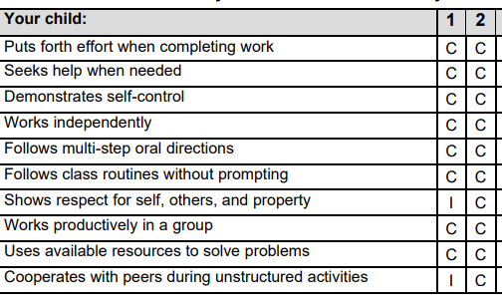
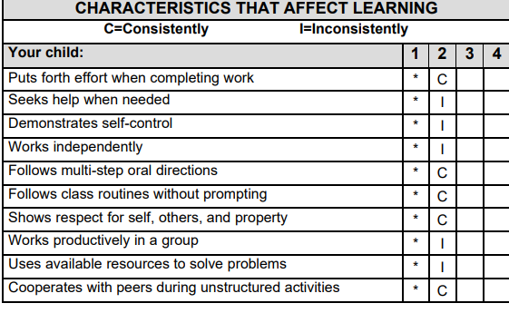
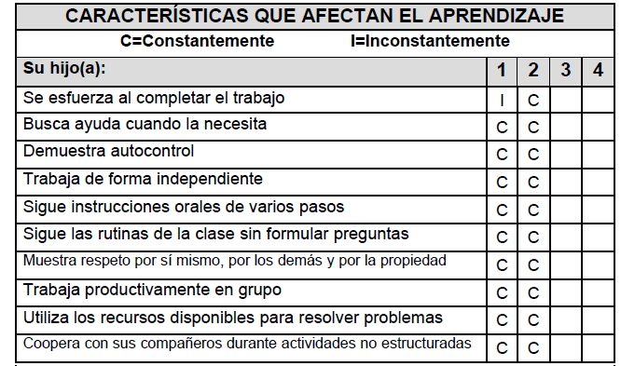
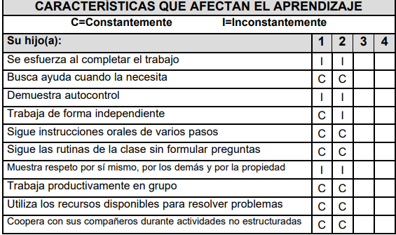
Existing Data Sources
Report Card Data for Q.1 and Q.2

Slide 3
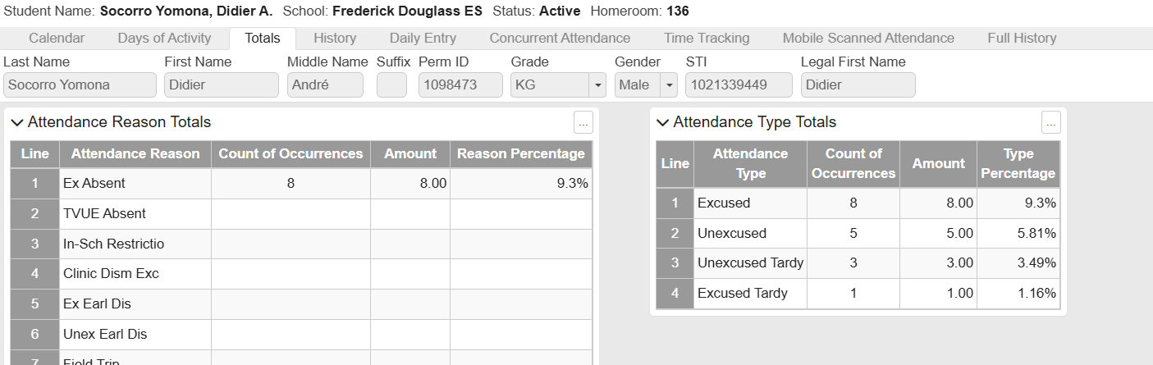
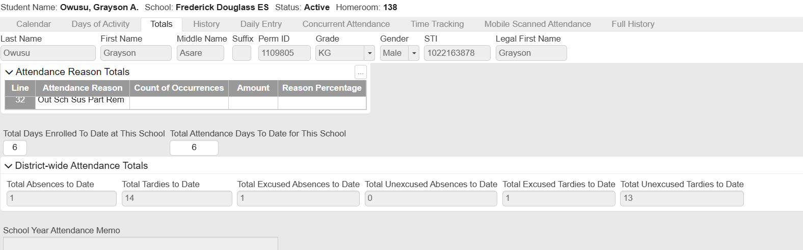
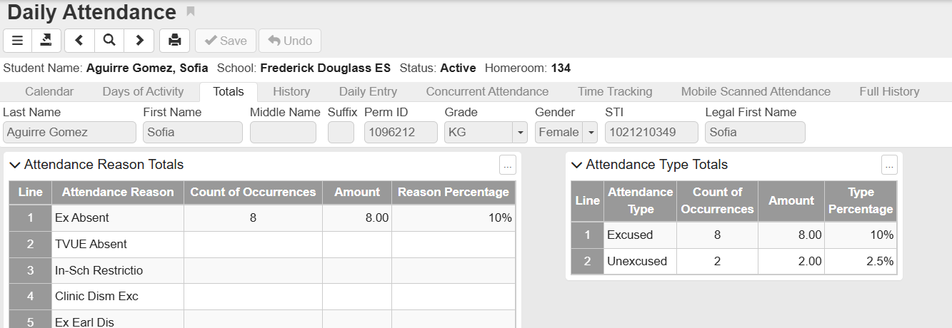
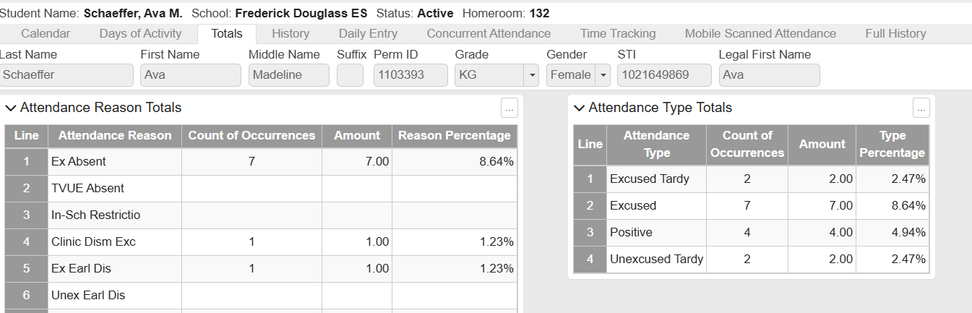
Existing Data Sources
UMHT (United Mental Health Team) Data

Slide 4
Existing Data Sources
UMHT (United Mental Health Team) Data

Slide 5
Kindergarten Small Group
Building Relationships

Slide 6
Kindergarten Small Group
Building Relationships

Slide 7
Kindergarten Small Group
Building Relationships

