Slide 1
Benchmark Culminating Project:
Bullying Prevention Classroom Guidance unit

Slide 2


Bullying Prevention
Grade Level:
KG – 6 classes

Slide 3
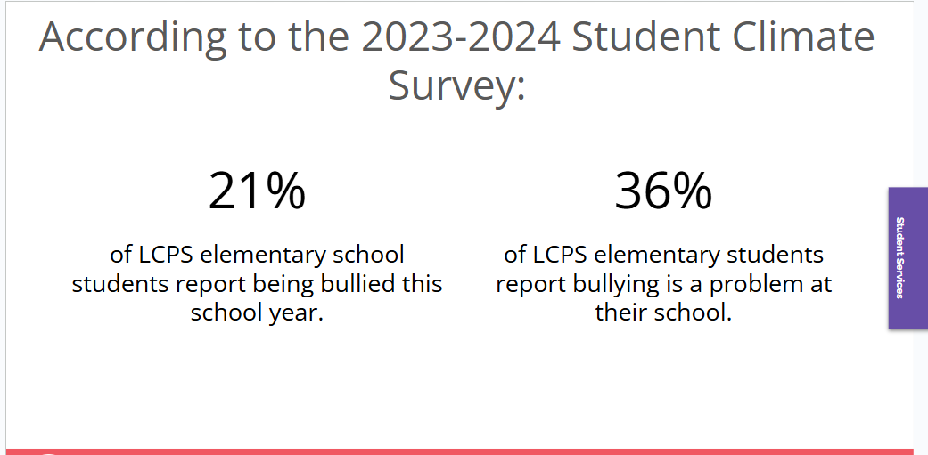
Existing Data Sources

Slide 4
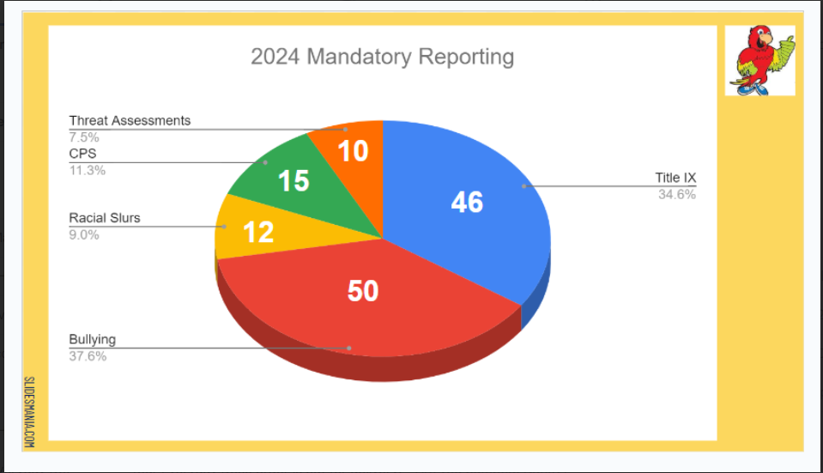
Our School’s 23/24 Data:
Bullying reported the most – 38%
Uptick in reporting once bullying unit started.
Notes:
Data from the end of the 2023/2024 school year showed that out of all of the mandatory reporting we had to do at the school, bullying was the most at 38%.
My co-counselors shared that there is always an uptick in reporting once bullying unit starts each year and that is because when you start talking about it, students realize it my be happening to them, or they knew it was happening to them and now feel empowered to share.

Slide 5
Needs Assessment
Teachers were asked to provide observable data on behaviors related to bullying. They did this through Phoenix the district online student information and reporting system.
Parents shared concerns with teacher and or counselors about child’s behavior through BOY questionnaire sent out
Beyond the data meeting – teachers share information about how students are socializing and adjusting in class. Specific social dynamics/needs of their classroom are discussed.
Notes:
Teachers were asked to provide observable data on behaviors related to bullying. They did this through Phoenix the district online student information and reporting system -
Parents shared concerns with teachers about child’s behavior through a “get to know you questionaire” completed at beginning of year.
Beyond the data meeting – teachers share information about how students are socializing and adjusting in class and any concerns they have. This is a time where teachers shared with counselors and admin any concerns worth noting from parent’s questionnaire. Specific social dynamics/needs of their classroom are discussed.

Slide 6
Description of project
4 different bullying prevention lessons are taught in October
Based on 3 R’s – recognize, report, refuse
Lessons are taught through stories that encourage discussion.
Focus on building empathy, teaching conflict resolution, and promoting positive social interactions.
Early and repeated foundation can help prevent bullying behaviors from developing or escalating as students grow older.
Notes:
The bullying prevention unit is always completed each year in October so actually this is what I was tasked with doing. It is based on the Second Step program and the 3 R’s recognize, report, and refuse. Lessons are taught through stories that encourage discussion and the ability to tweak the lesson and conversation based on the students’ questions and our observations as to what the might need more teaching of. I did make sure that I was cognizant of this and allowed the lesson to flow as needed while making sure to still get the objective across.
Focus of these lessons is on building empathy, teaching conflict resolution, and promoting positive social interactions.
Early and repeated foundation can help prevent bullying behaviors from developing or escalating as students grow older. Every year the KG students will receive a bullying prevention unit but with different social stories that are relatable and developmental appropriate for the grade level.

Slide 7
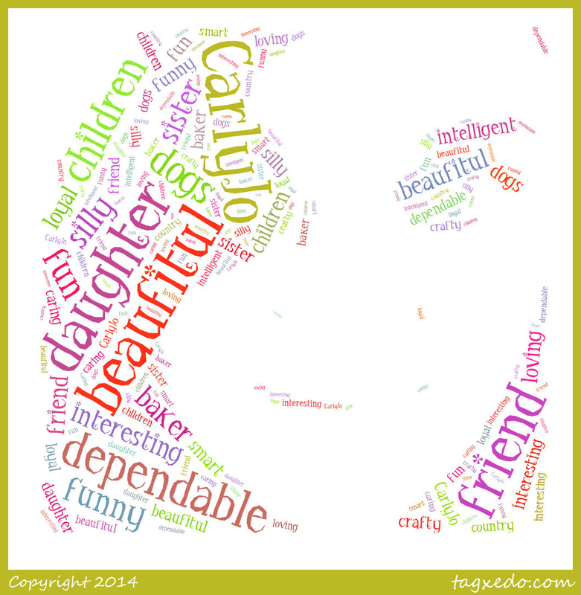
PRE-AIA Specialty Standards in Alignment
Counseling prevention and intervention
Diversity and Advocacy
Assessment
Notes:
Counseling prevention and intervention
For KG this is an introduction to the concepts of bullying, helping students recognize, report, and refuse bullying. Students learn and practice self-empowerment and to stand up for themselves. This proactive approach can prevent and disempower bullying. M-7 (ASCA, 2019).
Diversity and advocacy
Materials and examples represented a variety of cultural and social backgrounds. This object of this was to reduce the likelihood of bullying based on differences.
Unit taught students to recognize bullying and encouraged them to stand up for themselves and for their peers. This promoted a culture of advocacy and support for each other.
Lessons helped students develop empathy by encouraging students to put themselves in others’ shoes and understand the impact of bullying. B-PF 6 (ASCA, 2019).
Assessment
Identification of student needs when unit began through a verbal assessment to gauge students understanding of bullying.
Informal assessments throughout, such as observations, discussions, thumbs up thumbs down if our objectives were learned and student reflections. Continuous feedback from teachers on students and overall class behaviors in our “beyond the data” meetings which provides continuous feedback to the counselors on how well students are showing kindness and overall social abilities.
We conducted a post verbal assessment for KG to evaluate students understanding and if objectives were met. B-PE 2, B-PE 4, B-PE 5 (ASCA, 2019).

Slide 8
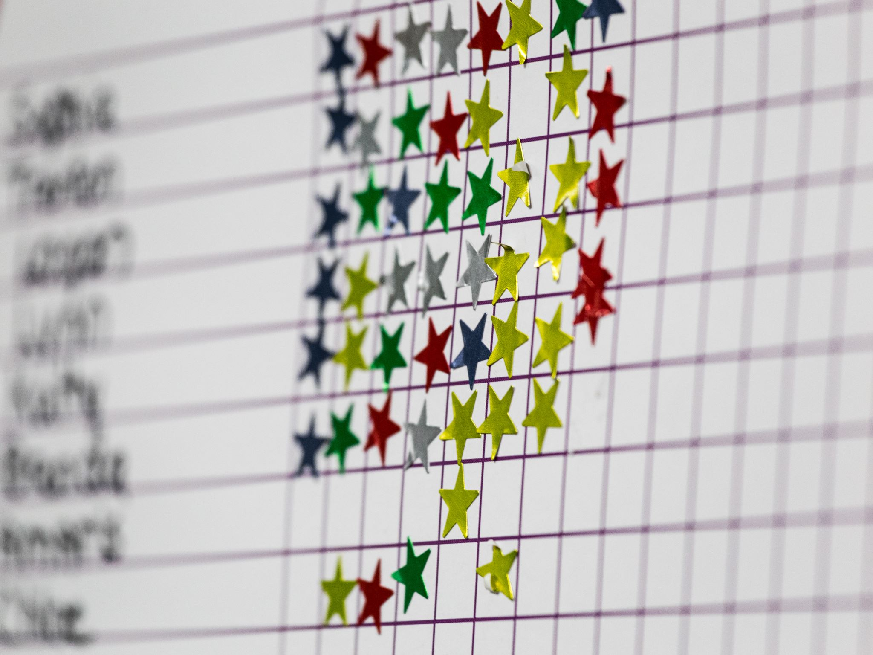
Asca mindsets and behaviors
M.1. Belief in development of whole self, including a healthy balance of mental, social/emotional and physical well-being (ASCA, 2021).
M 2. Sense of acceptance, respect, support and inclusion for self and others in the school environment (ASCA, 2021).
B-SS 2. Positive, respectful and supportive relationships with students who are similar to and different from them (ASCA, 2021).
B-SS 8. Advocacy skills for self and others and ability to assert self, when necessary (ASCA, 2021).
Notes:
M.1. Belief in development of whole self, including a healthy balance of mental, social/emotional and physical well-being (ASCA, 2021).
M 2. Sense of acceptance, respect, support and inclusion for self and others in the school environment (ASCA, 2021).
B-SS 2. Positive, respectful and supportive relationships with students who are similar to and different from them (ASCA, 2021).
B-SS 8. Advocacy skills for self and others and ability to assert self, when necessary (ASCA, 2021).

Slide 9

State academic standards
K.1. Essential Health Concepts:
Mental Wellness/Social and Emotional Skills
Identify a variety of feelings (e.g., happiness, sadness, anger, fear, frustration, calmness).
Describe what it means to be a friend and how to show kindness, consideration, and concern for others (i.e., self-awareness, social awareness, and relationship skills).
Describe personal space.
Notes:
K.1. Essential Health Concepts:
Mental Wellness/Social and Emotional Skills
Identify a variety of feelings (e.g., happiness, sadness, anger, fear, frustration, calmness).
Describe what it means to be a friend and how to show kindness, consideration, and concern for others (i.e., self-awareness, social awareness, and relationship skills).
Describe personal space.
These are especially important skills to teach at the Kindergarten level because so many of the students don’t have a sense of personal space yet and it makes others feel very uncomfortable and nervous and scared to be around that person.
Our students are learning how to identify their feelings and that it’s ok to have all of these feelings but its how we manage them that is really important to learn at a young age so we’re managing them appropriately and not in an aggressive way that might hurt others around us.

Slide 10
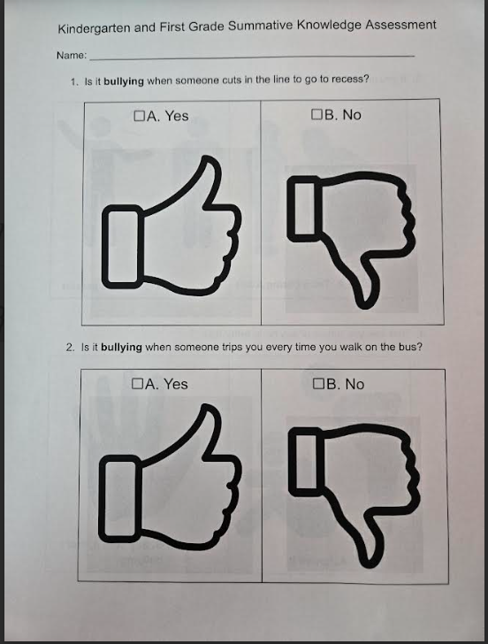
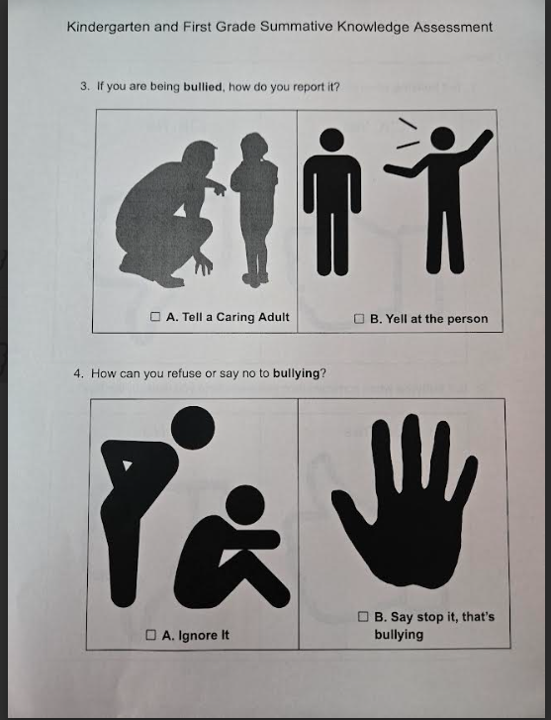
kg pre/post ASSessment
Notes:
It’s really important to note that we kept our assessment and our activities writing free on purpose. We only have 25minute lessons for Kindergarten and we find when we have an activity that requires coloring or writing it takes up so much of our lesson time. Especially in the beginning of the year where they are still learning how to use their writing tools.
So to save on time, and confusion we thought it best to perform a verbal pre/post. We put the question on the board as a visual and then taught them how this would work. We gave them each a popsicle stick with one side A and one side B. They put the stick showing what answer they thought A side or B side. This was modeled with a practice question (what activity do you like at school better A – PE, or B – recess, What food do you like better A – pizza, or B – Hot Dogs) once students understood how to “play this game” we started our assessment. We took a tally and put on board for them to see as a visual.

Slide 11
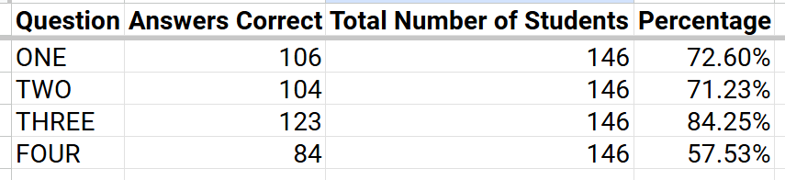
PRE Results
Notes:
Something we noted was that question 4 – How can you refuse or say no to bullying? We realized that our results may be this way because kids are taught by their parents to ignore mean behavior.
This was good information to us as when we came to the lessons of refusing, we made sure to reiterate what bullying is and that if it’s one time, you could potentially ignore it but if it continues and you have asked them to stop and they don’t then this is bullying.
Also, with KG you just aren’t sure if they truly understand the questions so is a pre test even reliable?

Slide 12
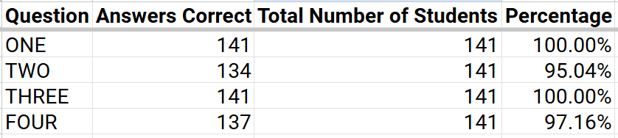
Post Results
Notes:
We were excited to see so much growth. We felt good about our lessons and that the objectives were clearly taught and understood and this showed in our post results.
There were a few friends who we still weren’t sure understood the questions and were putting up A or B not based on knowledge learned but by looking around at their friends, we also had a few not able to follow the instructions accurately by not being able to put a definitive A or B.

Slide 13

Example Bullying Detective questions
Recognize Bullying Lesson –
Someone is pushing you in line every day
Someone took your pencil one time
Report –
Someone called you mean names at recess and you asked them to stop but they keep doing it what do you do?
Refuse –
Someone excludes you and tells others not to play with you, what do you do?
Notes:
At the end of the lesson we had our students be bullying detectives to get them actively engaged and apply what they had learned
Recognize Bullying Lesson – Stand up if that is bullying or sit down if it is not.
Someone is pushing you in line every day
Someone took your pencil one time
Report – “I need to report bullying”
Someone called you mean names at recess and you asked them to stop but they keep doing it what do you do?
Refuse – “please stop, that’s bullying”
Someone excludes you and tells others not to play with you, what do you do?
Depending on time, we did a few scenarios like this or more. Some of the scenarios were not considered bullying and so the students had to be able to identify that and explain why.

Slide 14

Cultural Sensitivity
Diverse Materials: Books, materials, and examples included characters and scenarios from a variety of cultural backgrounds. Helped with connection and that bullying can affect everyone, regardless of their background.
Inclusive Language: Language was inclusive and understandable to all students. Avoided stereotypes or assumptions about family or personal experiences.
Open Dialogue: Opportunities for students to express their concerns or experiences with bullying in a non-judgmental environment.
Involvement of Families: Lessons were shared via letters home. Letters discussed how parents can have discussions about bullying using the same language taught at school.
Notes:
Diverse Materials: Books, materials, and examples included characters and scenarios from a variety of cultural backgrounds. Helped with connection and that bullying can affect everyone, regardless of their background.
Inclusive Language: Language was inclusive and understandable to all students. Avoided stereotypes or assumptions about family or personal experiences.
Open Dialogue: Opportunities for students to express their concerns or experiences with bullying in a non-judgmental environment.
Involvement of Families: Lessons were shared via letters home. Letters discussed how parents can have discussions about bullying using the same language taught at school.

Slide 15
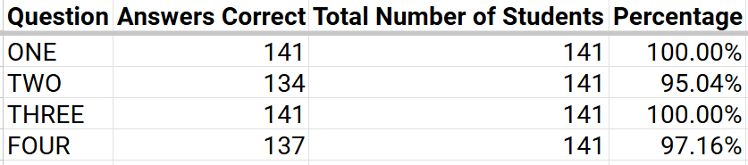
Evaluation of unit
How effective was your intervention?
Verbal vs. written and reliability
Social stories were very engaging and easy to understand message
Notes:
How effective was your intervention?
I believe the lessons were simple and straight forward and focused on one skill for them to comprehend well. The social stories we watched were very engaging and easy to understand the meaning and objective.
We had 4 main objectives to teach and we really feel they comprehended them well based on our post summative data.
The assessment is tough with KG. If we gave a written assessment, there would have been lots of confusion and it would have taken up a lot of time (this is based on experience). The reliability of their answers would have been questionable. But, similarly I found that with the verbal assessment, some students were facing the A or the B because their friend beside them was, even when we explained to be careful not to do this, and we can’t be 100% sure that they understood the question even with visuals. I feel confident that for the post, most if not all of the students did comprehend the questions and answers based on their new knowledge learned from the lessons. I felt good that it was a reliable assessment.
Ofano’s class which scored low in the pre is questionable because students in there are going through child studies and are being slowly but surely identified as needing interventions. so they may have been putting up A or B without knowledge of why.
Overall, super happy with the execution and results of this unit. Our students were thoroughly engaged and learned valuable anti-bullying skills and new knowledge.

Slide 16
References
American School Counselor Association (2021). ASCA Student Standards; Mindsets and Behaviors for Student Success. Alexandria, VA: Author.
Council for Accreditation of Counseling and Related Educational Programs. (2024). 2024 CACREP standards. https://www.cacrep.org/section-2-professional-counseling-identity/
Virginia. (2022) Virginia Department of Education. United States. Retrieved from the Library of Congress, https://www.doe.virginia.gov/teaching-learning-assessment/instruction

Slide 17
Thank You
Nancy Langberg
571-315-6912
  nlangberg@liberty.edu
  nancy.langberg@lcps.org

