Slide 1
Culminating Project- Small Group
Ally Rogalski

Slide 2
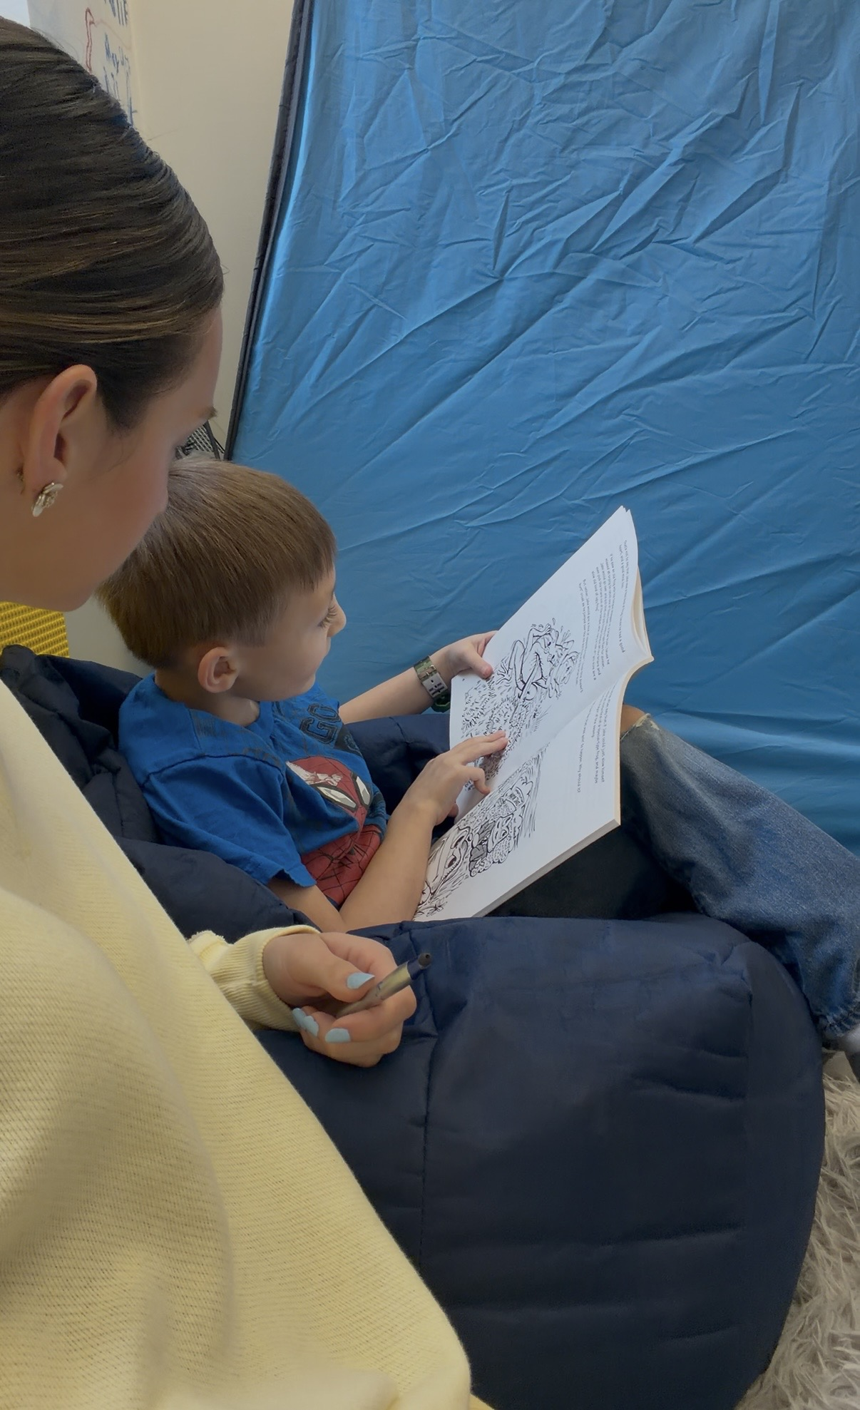
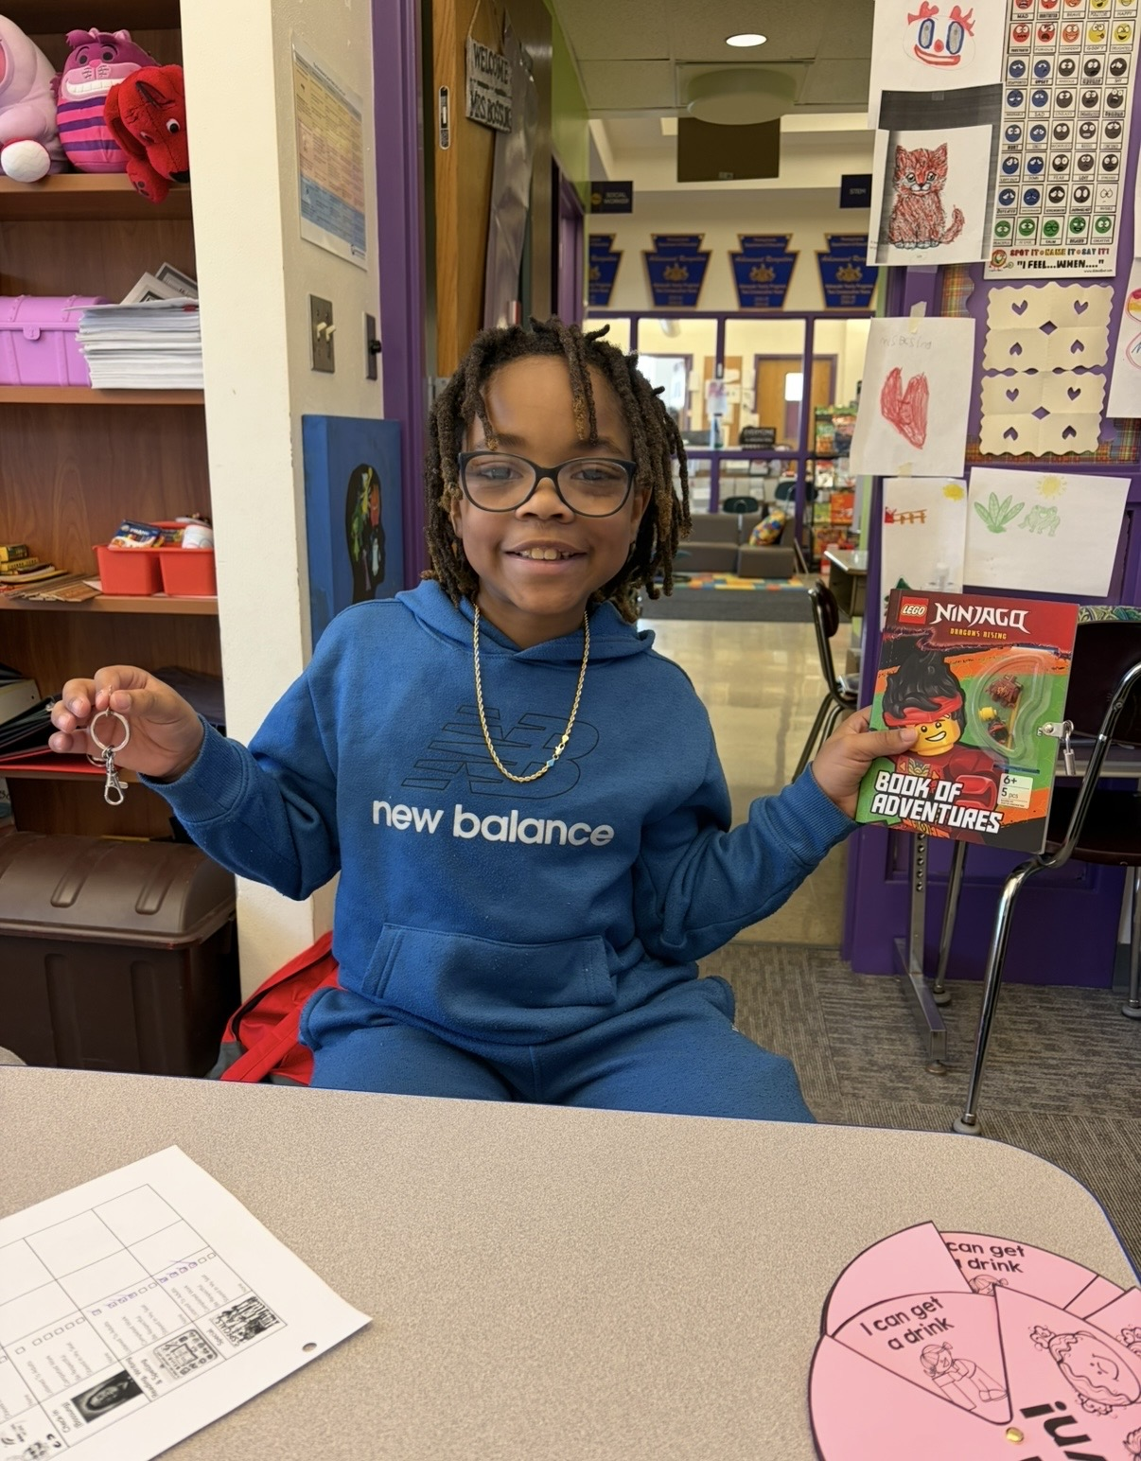
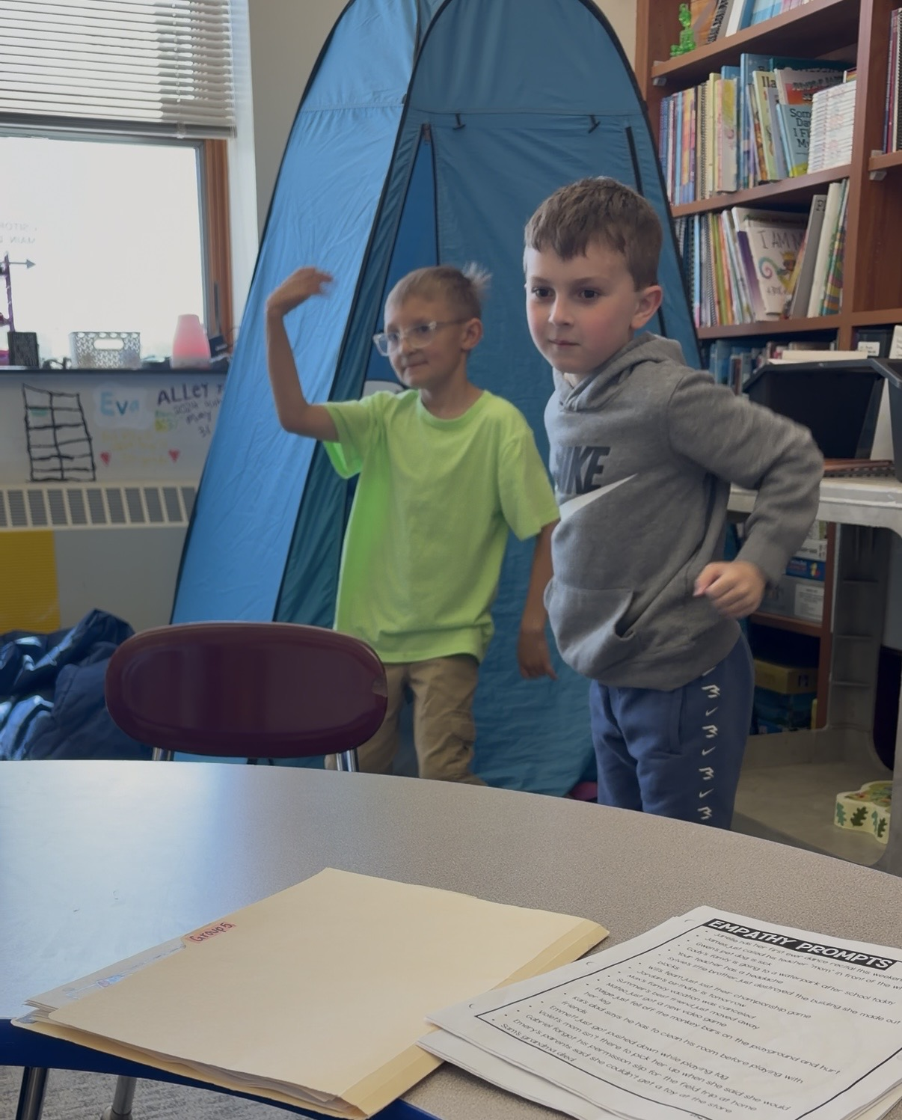
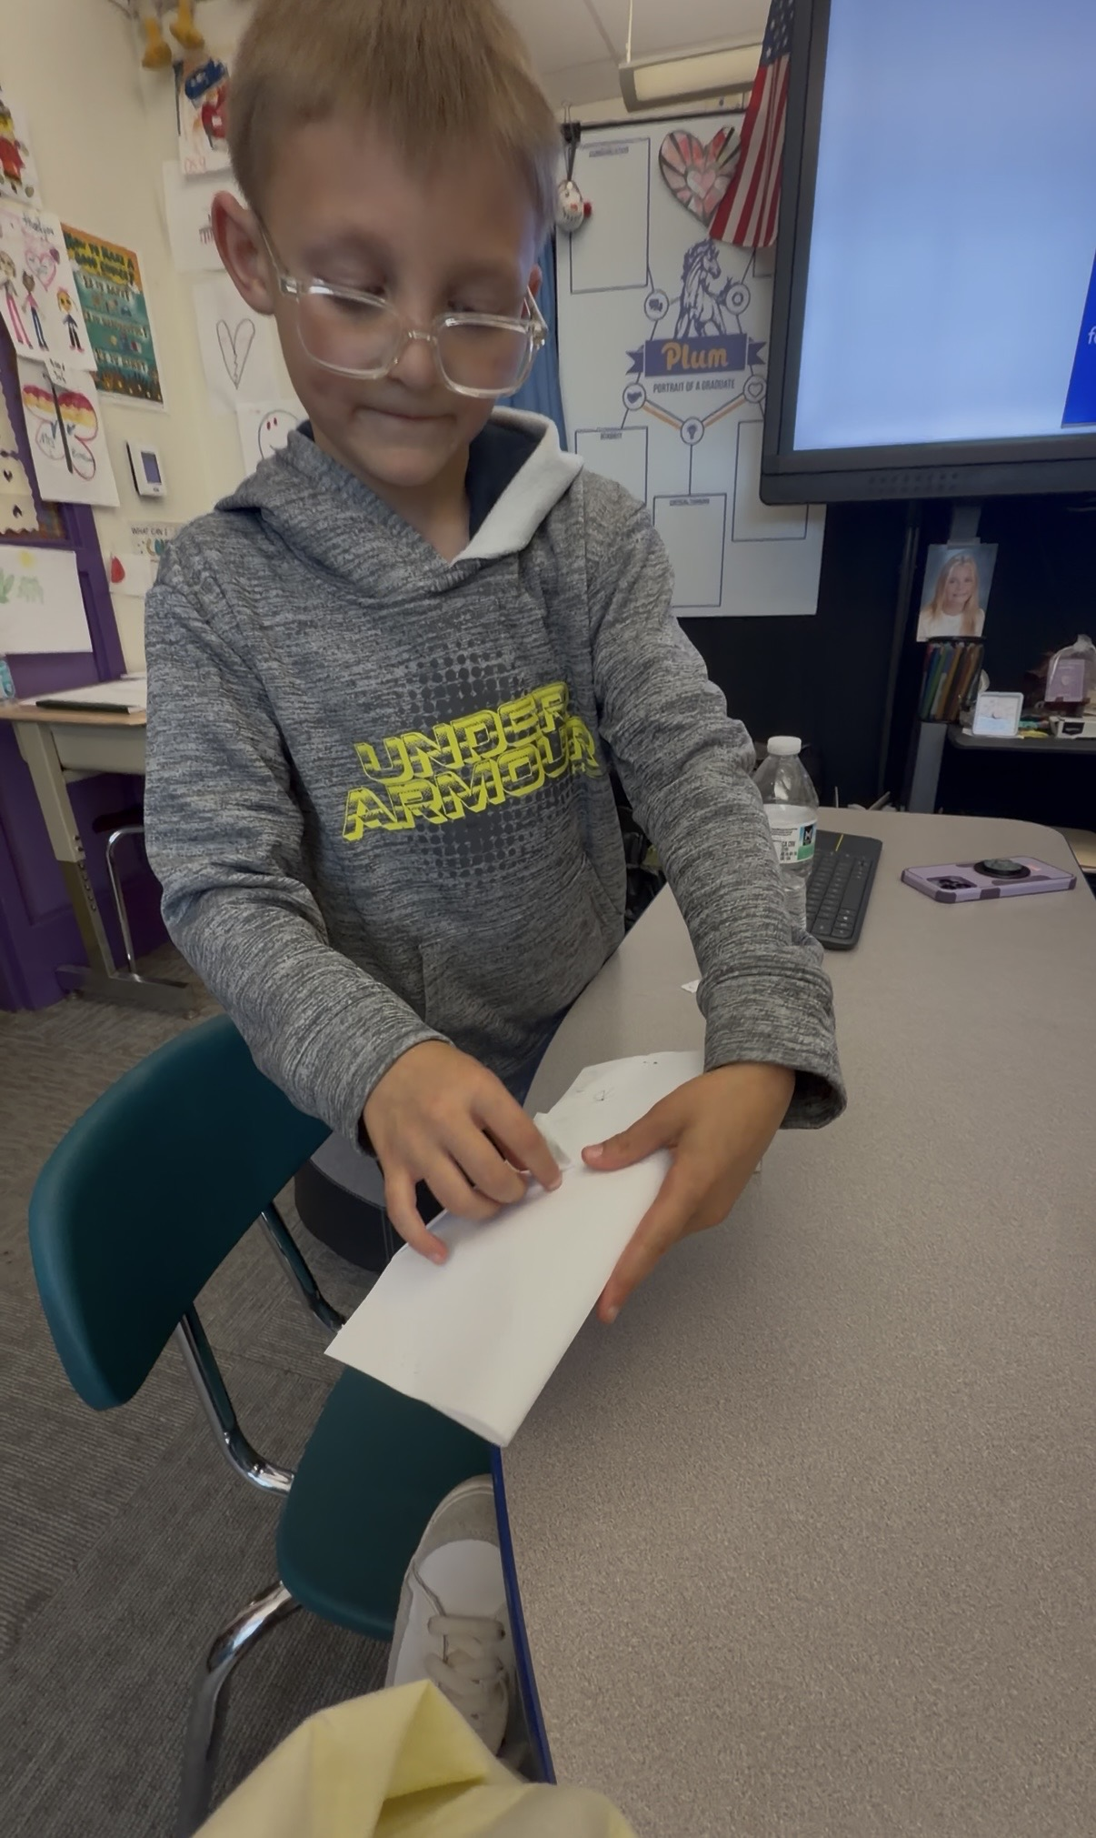
Building Healthy Friendships

Slide 3
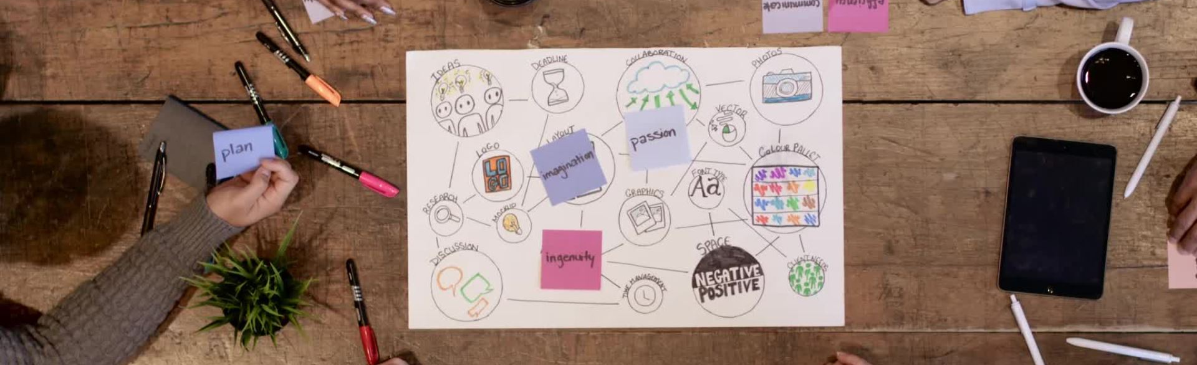
Data Sources
Teacher ratings on the pre/post tests
Supervisor verbal need for this group
Parents need for this group
Pre/port test
Peer relations observed

Slide 4
Needs Assessment
My supervisor noticed students having peer relationship struggles across the board in second grade as I was arriving for my internship. We sent permission slips home to see if the parents also felt this need, and the outcome was huge.
Parents and staff now noticed this need.
We got a pre/post test together and also had the teacher fill them out about the designated students. We noticed they also felt a noticeable need in their pre test results, so we moved forward with our group session plan and topic.

Slide 5
Sessions
Over 6 sessions we talked about noticing how people are feeling by reading a story every week that had a different character acting a different way. We evaluated if the character was being a good friend and if we would be good friends with them.
We then answered comprehension questions that further showed us what it means to be a good friend to others and what a good friend looks like.
At the end of every session, we had a fun activity /craft that we worked together to complete, by sharing scissors, taking turns answering questions, and helping each other complete the activity. All topped with a scented sticker if they were being kind and a good friend to others while in group. This incentive helped greatly and formed real connections.

Slide 6
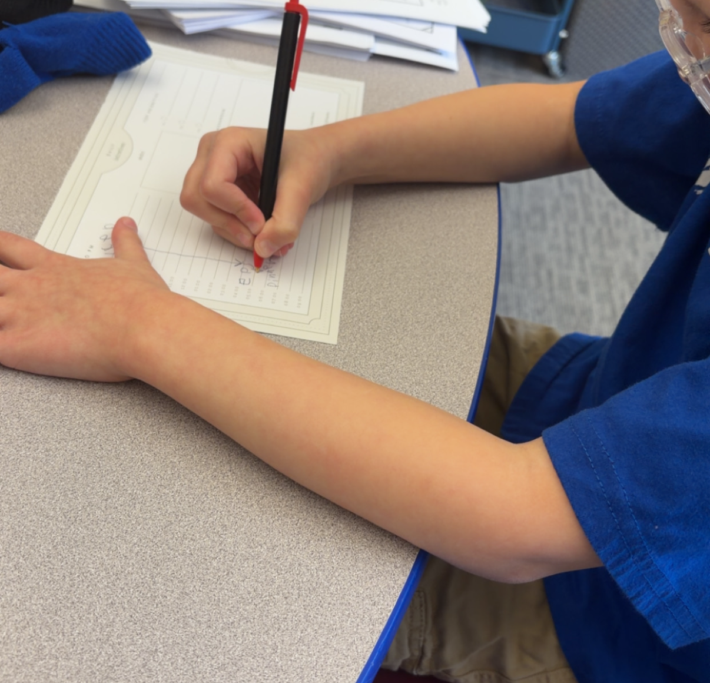

AIA Alignment/ASCA:
AIA - 7. COLLABORATION & CONSULTATION CACREP (G.1.d; G.2.a; G.2.b; G.2.d; G.2.k; G.2.n; G.3.h; G.3.i; G.3.j; G.3.l; G.3.m) - Intern collaborates and consults in a professional manner with stakeholders within and outside of the school/community to improve policy/ practices to promote the students success and holistic development
ASCA - B-SS 3. Positive relationships with adults to support success
- B-SS 7. Leadership and teamwork skills to work effectively in diverse groups
-B-SS 10. Cultural awareness, sensitivity and responsiveness

Slide 7
Cultural Sensitivity
Took time to get to know each student individually and where they came from
Curriculum was all inclusive
No cultural biases were in place in this plan
Each activity had children of every cultural ethnicity

Slide 8
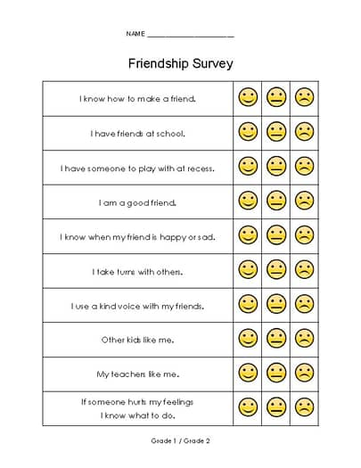

Evaluation
This was the pre/post test.
After the completion of 6 sessions over 6 weeks, students went from a 66% to an average of 75%. Although small growth, progress was still noted on the evaluation and also in person.

Slide 9
Summary
Overall, although focusing on a single group for this presentation, we did 8 groups of 6 children, and each group saw improvement.
Talk of second grade friendship group is already happening for next year.
New peer friendships have been formed because of these groups.
Teachers and parents notice shifts in their children's confidence.

Slide 10
References
ASCA student standards: Mindsets & Behaviors for student success. (2026). https://www.schoolcounselor.org/getmedia/7428a787-a452-4abb-afec-d78ec77870cd/mindsets-behaviors.pdf
Spring 2023 Advanced Internship Assessment (AIA). (n.d.-b). https://www.liberty.edu/behavioral-sciences/counselor-ed/wp-content/uploads/sites/43/2021/02/ADVANCED-INTERNSHIP-ASSESSMENT_ASCA-1.pdf

