Slide 1
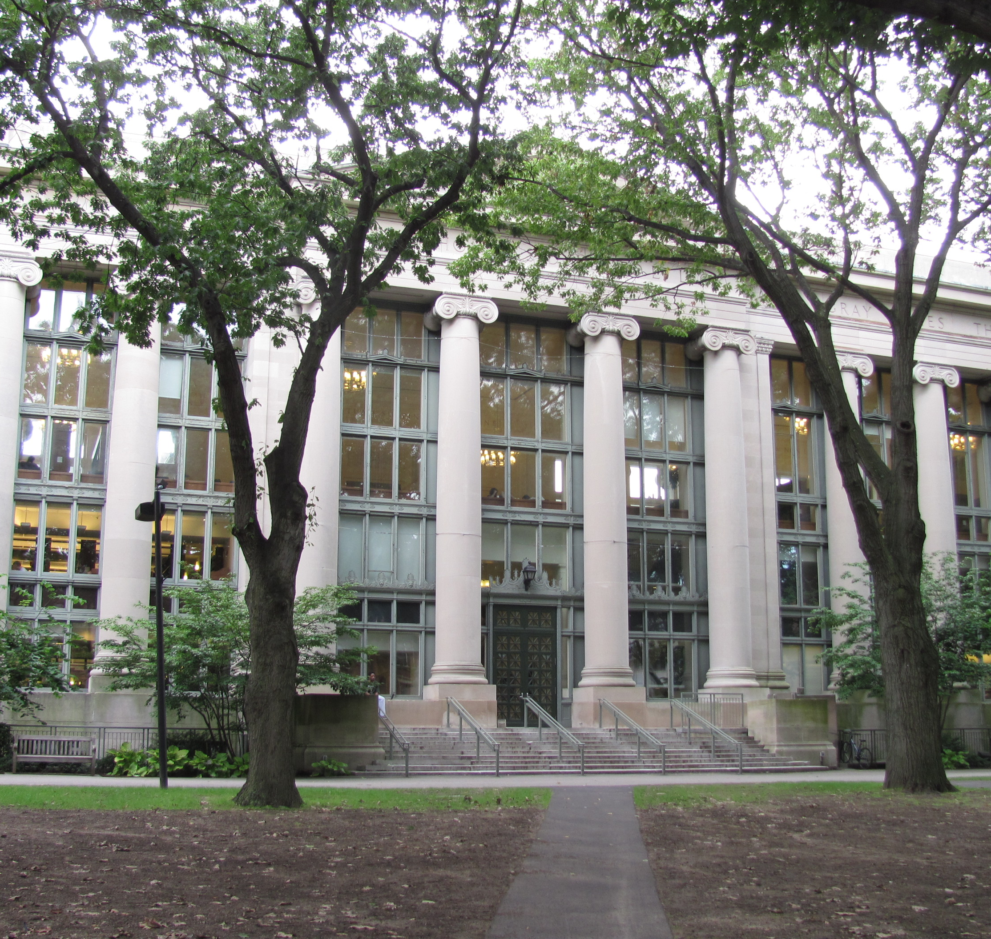
Tier system overview
Ally Rogalski

Slide 2

Overview on the school
Grade- 9
All boy's Catholic school. College-prep school with high performing sports
All three tiers needed
Notes:
Pittsburgh, Pennsylvania. Part of the Catholic Diocese

Slide 3

Needs
    Transitioning to new school smoothly
Notes:
This is a college prep school and many of the students came from public schools with entirely different curriculums. Students get too stress with academics, social life, and sports pressure and leave to alleviate that. Retention rate falls their freshmen year and the administrators asked if I could help gather information and help combat this.

Slide 4
Tier one interventions (classroom GL)
Initial transition/
Getting involved
Academics/attendance
Description- advocated for the importance of clubs/sports in academic, social-emotional/ mental health wellness
Research- benefits? Higher GPA, better attendance, lower dropout rates (NFHS, 2025).
Why?- build relationships and a sense of home, show the benefit and educate students on what and how to get involved.
When?- September- Every Monday
Description- Explain how GPA, Eligibility, attendance points and limits work
Research- 2021-2022, 14 million students missed >10% of school year. Result? Struggles in grade retention and academic achievement (AAP, 2025).
Why?- Our school data correlates lack of attendance to lack of knowledge which=lack of success
When?- Tuesdays of first quarter
Notes:
Involvement- "Students who participate in activity programs tend to have higher grade-point averages, better attendance records, lower dropout rates and fewer discipline problems than students generally." (NFHS, 2025).
Academics/attendance- It Is very hard to have one without the other. The more students are in class, the more discipline gets built, a routine gets built, and the more knowledge they are exposed to.

Slide 5

Biblical correlation
Pressure is a privilege, do not run from it.
James 1:2 says," ² Consider it pure joy, my brothers and sisters,^{[a]} whenever you face trials of many kinds, (Holy Bible, 2011).
This school is hard, but trials build you, rely on God
Notes:
Success is not an easy road. Jesus had many hard times and He relied on the Lord through them. Just because something is hard, does not mean it is impossible.

Slide 6
Tier two interventions (Small groups)
New clubs
Social-emotional struggles
Description- Survey conducted to see if there was interest in clubs we did not already provide. Real estate club.
Why?- Giving the students a voice helps them feel accepted.
When?- Wednesdays during study hall
Description- 6-10 people, build confidence, build community, expect greatness
Research- Studies show- most important thing is to expect students to be great. And that you will help them get there. (Breiseth, 2024).
Why?- One of the major reasons to transferring. Should help with retention rate
When?- Thursdays during lunch
Notes:
To help students adjust, I sent out a survey to all the freshmen to give them an opportunity to write down any club they would be interested in starting that was not already going. There was a big response about a real estate/growth mindset/entrepreneurial based club. So one of our small groups was this.
SEL- Students need people to believe in them. Expect them to be great and they will be more apt to. Help them learn self-regulate skills, confidence and friendships(common ground with people).

Slide 7

Biblical correlation
We will build confidence through God, not through our own flesh and blood. We are His sheep and are loved endlessly. We should live as such.

Slide 8
Tier three interventions (one-on-One)
Write the Counselor
One-on-Ones
Description- Students can journal their thoughts and drop it in a box outside my office
Why?- When they are not comfortable speaking them to me but need to get something off their chest.
When?- All school hours
Description- Building strength in self-awareness, social acceptance, personal growth, mental health, academic needs etc..
Research- academics improve, behavior is better, mental well-being increases in all domains. (Carson-Newman (2024).
Why?- Help with happiness, and success and school experience.
When?- Twice a week for 8 weeks, different for each student
Notes:
Write the Counselor- I will follow up with students in person in a one-on-one and see if they want to elaborate on what they wrote to me. If not, they know I am only a door knock away.

Slide 9

Biblical correlation
The Bible tells us to seek and give wise counsel. As a school counselor, I need to gain wisdom from others and education to be able to counsel the youth.
Showing compassion for others
Notes:
Jesus was and is our ultimate counselor, so I can use His guidance and teachings to help me teach and be there for others.

Slide 10
References
NFHS. (June 19th, 2025). The case for high school activities. https://nfhs.org/stories/the-case-for-high-school-activities
AAP. (February 11th, 2025). American Academy of Pediatrics. School Attendance. https://www.aap.org/en/patient-care/school-health/school-attendance/?srsltid=AfmBOoq0eG2JHnrPqULx9_n-OBQgnk7krKRoIg0poZNH9yxuXGtFPqTm
Holy Bible, New International Version®, NIV® Copyright ©1973, 1978, 1984, 2011 by Biblica, Inc.®
Breiseth, L. (March 24th, 2024). 10 ways to support social and emotional learning for students with LD and ADHD. NEA. https://www.nea.org/professional-excellence/student-engagement/tools-tips/10-ways-support-social-and-emotional-learning-students-ld-and-adhd
Carson-Newman. (2024, July 25). School counseling in developing social emotional skills. Carson-Newman University. https://www.cn.edu/cps-blog/the-importance-of-school-counseling-in-developing-social-emotional-skills/
School Attendance
School Attendance

