Slide 1
Internship Culminating Project: Becoming Well Balanced Students
By: Marshall Beachboard
Notes:
Introduction slide to what it means to become well balanced as a student and person.

Slide 2
What is a well balanced student?
Use of character strong to identify with students what a well balanced student looks like.
Character Strong activities to ask questions and provide examples to students about feeling connected; “turn and talk”, “what would you be doing/thinking/feeling”
Character Strong DARE of the week implemented school wide: Each week a new “DARE” is given to promote a healthier school environment.
Students answers to what a well balanced student looks like were:
  Happy, healthy, good grades, friends, talks to others, happy with family, kind to others.
Notes:
This question was the very first question I asked each class before we started a series of Character Strong lessons. This question was used to get students thinking about what it means to be “well-balanced”. I received great feedback from students about this and learned they already had some ideas about how to have a healthy lifestyle outside of physical health. This question really helped me to understand the need for this lesson but to also show students the importance of being well-balanced in their lives to be successful and give their all each and every day Webb, R. L. (2024).

Slide 3
Data Sources: The Why..
Attendance concerns within the 7th and 8th Grade.
Behavioral referrals increasing (disrespect to staff/inappropriate language).
Social, Emotional, Academic struggles certain groups of students (7th Grade).
Creating a sense of school connectedness.
Notes:
The why for this project was developed by needs assessments sent to the Administration and the teacher leads for 7th and 8th grade. The teachers responded to a google form about some concerns they have seen within the students they see daily and these are the main topics that came up from that assessment. These teachers and admin showed the main places they wanted to see improvement in our students. By looking at my idea for a well balanced student, being able to address social, emotional, mental tools these students can use, they will be able to improve each of these areas of their lives.

Slide 4
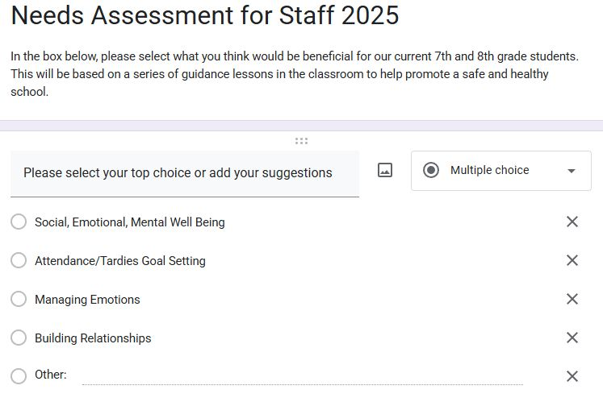
Data Sources: The Why..
Notes:
This slide shows the brief assessment shared with teachers that gave me the feedback I needed to look into what lessons they felt I should share with our students. Overwhelming it came back that Social, Emotional and Mental lessons were the most requested. I felt this was due to that being such a wide umbrella it would cover many areas of the students lives.

Slide 5
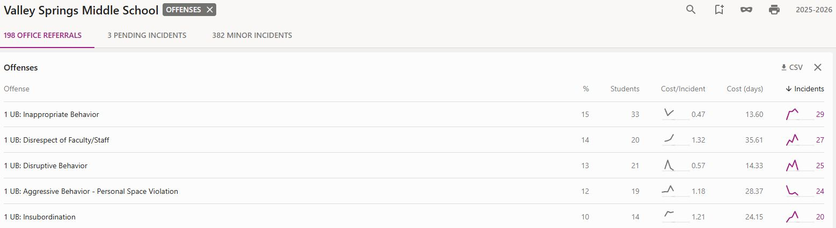
Data Sources: The Why..
Notes:
In this slide you can see that the categories listed are what I looked into when deciding on lessons. These are the top 5 referral incidents as recorded by our system. When looking at this, I saw the necessity of using social and emotional learning to increase student awareness, equip them with tools and help them understand the actions listed above. When students can show remorse, learn from their actions, and feel connected to a group they are less likely to exhibit these behaviors (Green, Ferrante, Boaz, Kutash, & Wheeldon‐Reece, 2021).

Slide 6
Data Sources: The Goal
Use referral numbers based on behaviors over a 3 month span (Sept., Oct., Nov.)
See if needs assessment and specialized lessons help to bring down numbers in the top 5 behavioral categories.
Work to create a happier and healthier school environment
Cut down missed seat time for students receiving referrals
Notes:
The why for this project was developed by needs assessments sent to the Administration and the teacher leads for 7th and 8th grade. The teachers responded to a google form about some concerns they have seen within the students they see daily and these are the main topics that came up from that assessment. These teachers and admin showed the main places they wanted to see improvement in our students. By looking at my idea for a well balanced student, being able to address social, emotional, mental tools these students can use, they will be able to improve each of these areas of their lives.

Slide 7
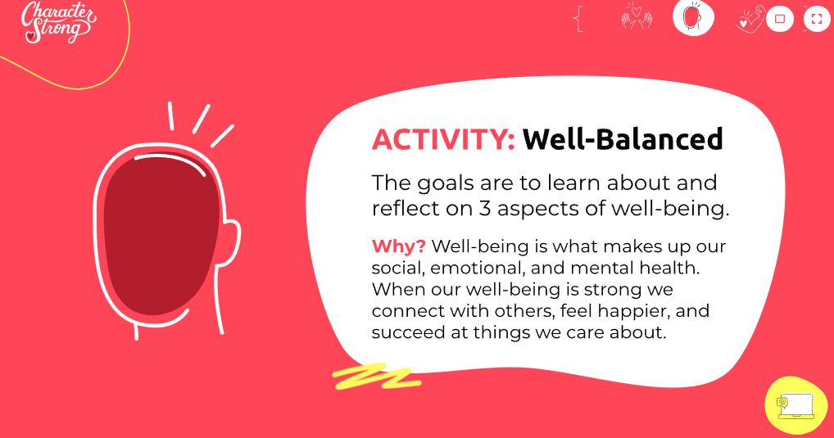
Character Strong Examples
Notes:
When students are given goals and are given responsibilities it is shown to have better results (O’Grady & Nag, 2024). The students read this prompt as we began a lesson on being a “well balanced student” they were asked at this time to describe the difference in social, emotional and mental health. This slide was used to start conversation about what students felt like they already know versus what they were going to learn in this lesson.

Slide 8
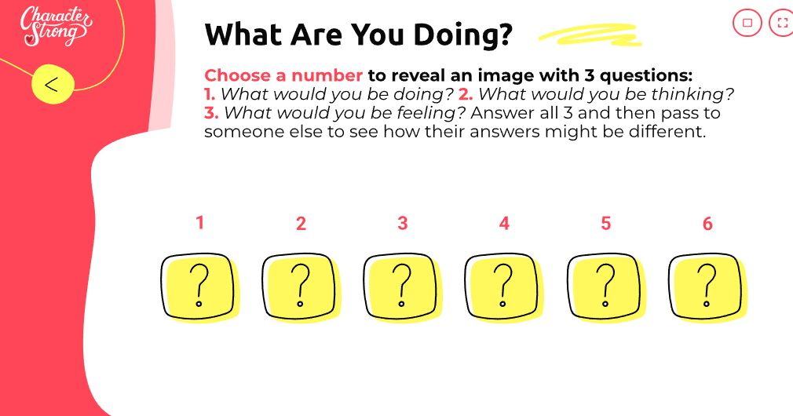
Character Strong Examples
Notes:
This is an example of an activity I did with the students in a 7th grade class. This activity had students pick a number 1-6 and then it would show a picture. During this time I asked them to talk to a partner and answer the 3 questions that are listed on the next slide. This activity is great to help the room feel connected and after each number we switched partners to try and get to meet someone new. This was used to show each person can have both similar and also different feelings but yet the students viewed the same picture together.

Slide 9
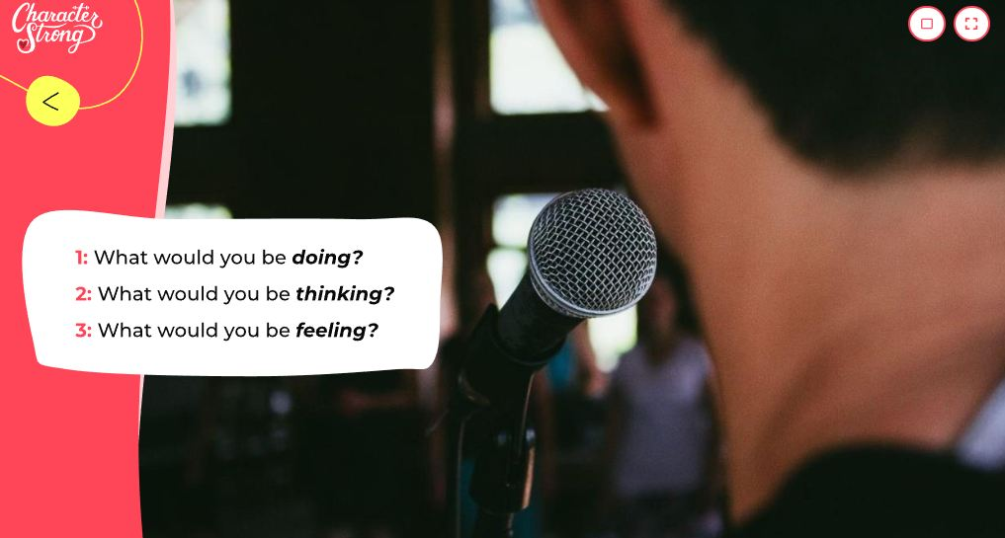
Character Strong Examples
Notes:
As listed in the previous slide, students would use a photo like this to describe the three questions above with a partner. After a few minutes, I asked a few students to share with the class their feelings about the photo. This really helped in starting communication in the classroom and helped students be comfortable with one another while addressing emotions.

Slide 10
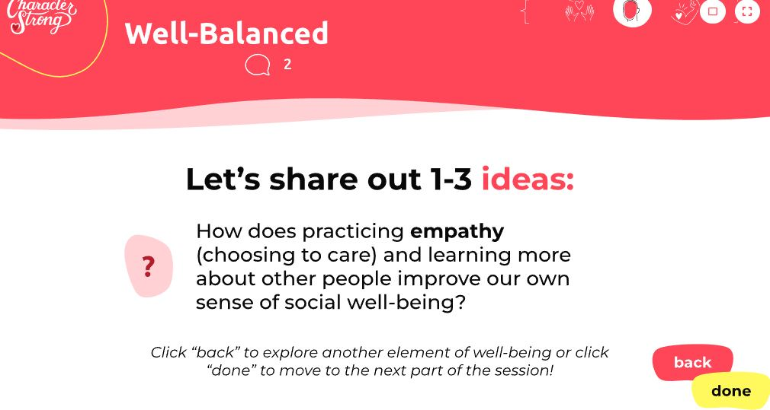
Character Strong Examples
Notes:
As a series of questions, students would either write down, or share out their thoughts about different prompts that fell under the social emotional, or mental well being. These various prompts all tie into one of those categories and help students visualize and verbalize what they have just learned. This overall creates a classroom atmosphere that helped to make others comfortable.

Slide 11
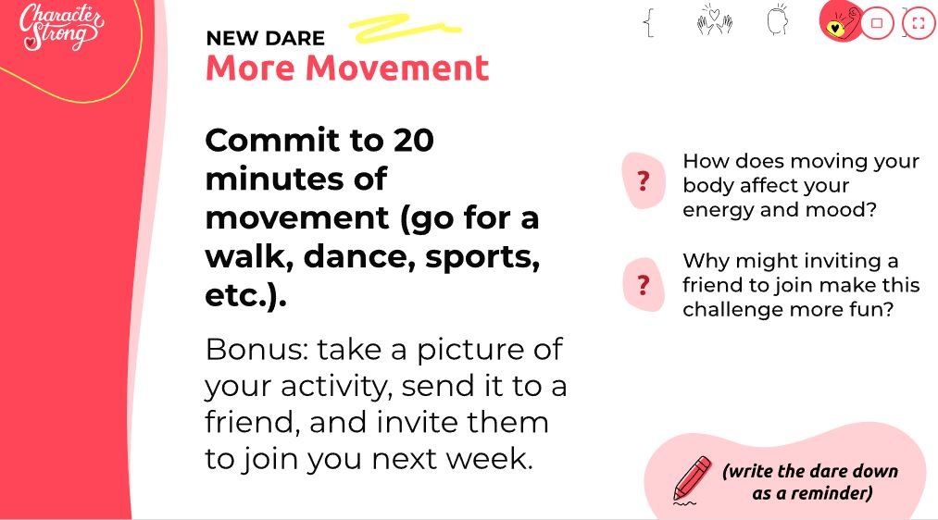
Character Strong Examples
Notes:
Each Character Strong lesson has a “DARE” that helps students put what they learn into action. This dare was one that was shared with our students to show how they could commit to things (setting goals) but to also have them incorporate their friends. The questions on the right side help to link in the lesson and have students think about how all this ties into being well-balanced.

Slide 12
Character Strong Link for Presentation
https://curriculum.characterstrong.com/content/ms-grade-08-session-11-11-11?scope=25_SESSIONS&lang=en
Notes:
This slide is used in presentation to give my classmates a better look into the Character Strong program as it cost to use these slides.

Slide 13
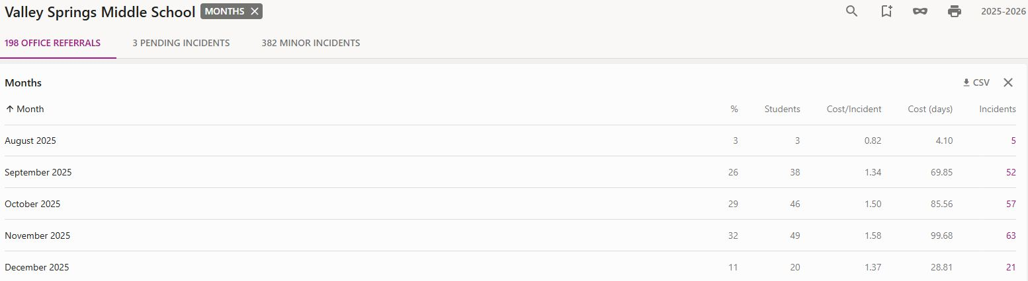
Evaluation
Notes:
The above shows how I evaluated this program. Though in the smaller areas that I deal with every day and the interactions I have with students have shown some progression, overall the referral amounts still increased. In sub-areas there was some slight differences on the types of referrals that were happening. There was a major incident that happen causing multiple referrals so these numbers may be skewed. I would like to be able to see this program implemented throughout the full year to see if it would actually change the amount or the behavior types in general instead of this small amount of time.

Slide 14
Things to Change:
I would like to have a smaller sample size, use that to see if the program is actually working
Work with teachers to tailor lessons about things they can extend on in their own classrooms.
Train teachers on interventions to see if that helps limit the need for this broad of a lesson.
Involve students on what they would like to talk about or gain input on what they would like for the school.
Notes:
When looking back over this project, I wish that i could change a few things about how I set it up. I would love to change the sample size and see if it is effective in a smaller scale before introducing it to a larger group, I also would like to have more specific teacher input on what they would like to see change within their classrooms. Working to train teachers on using this platform before introducing it in small doses may help familiarize students with the platform and help gain a sense of “buy-in” from them as a whole.

Slide 15
AIA Standards
Counseling Prevention and Intervention - Using/Teaching Techniques to enhance school climate and help with preventative measures to limit behaviors. Using a program designed with tools to introduce interventions to students and staff that will promote better behavior/connectedness.
Collaboration and Consultation - Working with teachers and admin to come up with a plan for a specific need they see in our school.
Notes:
The listed above are the AIA Standards in which I felt I was able to display in this project.

Slide 16
References
CharacterStrong. (n.d.). Homepage. Retrieved from https://characterstrong.com/.
Green, A. L., Ferrante, S., Boaz, T. L., Kutash, K., & Wheeldon‐Reece, B. (2021). Social and emotional learning during early adolescence: Effectiveness of a classroom‐based SEL program for middle school students. Psychology in the Schools, 58(6), 1056-1069.
O’Grady, A. M., & Nag, S. (2024). Promoting emotion understanding in middle childhood: A systematic review of school-based SEL programs. Social and Emotional Learning: Research, Practice, and Policy, 4, 100068.
Webb, R. L. (2024). The effects of positive action, a character curriculum, on the social and emotional development of elementary children (Master's thesis, Texas Christian University).
Notes:
References.

