Slide 1
Conflict Management
By: David Marshall Beachboard

Slide 2
Participants and Goal
Students are 9th-12th Grade. Ages 15 to 18.
  This was a group of 4 students.
The goal of this group is to work on skills that will help students resolve conflicts that arise with peers as well as their teachers. The students selected had referrals that were non violent and for things such as disrespect or verbal altercations.
Notes:
The students in this group are high school students that have been identified as students that do not manage conflict well based on the office referrals for disrespect, insubordination and non violent referrals.

Slide 3
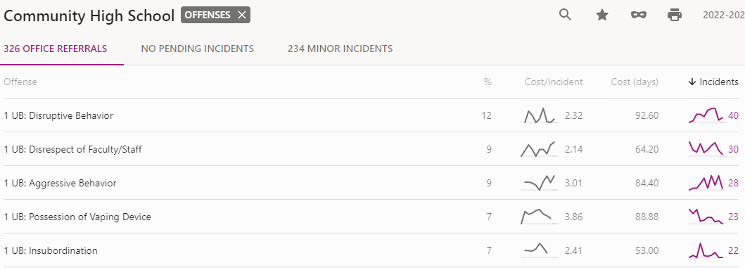
Need for Group
Increase in drama and conflict between students that end in referrals.
Students having conflicts with teachers resulting in changing classes increasing.
Notes:
If you look at the top 3 referral reasons all have to do with disrespect as result of not being able to manage conflict. These students had been confronted by others or by staff and when conflict was brought up they each did not use appropriate ways to handle it. These students showed the need for this group in order to help them manage emotions and learn healthy ways to deal with conflicts.

Slide 4
Needs Assessment/Permission Form
This link provides the needs assessment that was sent out to the students to take.
  https://forms.gle/AVxRecWk7ujY3XJCA
The link here is for the permission slip sent home with the identified students that had referrals involving conflicts.
  https://docs.google.com/document/d/1Yl1wylohvtt8nYNuQSMmCL5QZlgwoAI4FmRGP3GQa4s/edit?usp=sharing
Notes:
This was sent out to the students to take during their homerooms. The student responses showed that 40% of the students the students had trouble with conflict management among teachers. The other statistics showed that 48% of students have conflicts with other peers and do not know how to resolve these conflicts.

Slide 5
Screening Process
In order to screen these students I wanted to take the top responses as well as the students in the top 5 with the most non violent referrals and use that to ensure we had diversity represented in the group.
In a small group I also wanted to make sure that both male and female was represented in hopes that these students could learn skills to take back to both groups of friends.
Notes:
To screen the students, I printed a list of all our referrals that involved conflicts with others or with teachers and made sure that there was not an violent referrals included. These students were then identified from having the most answers in the form sent out as not understanding how to deal with conflict. I then took out of the 100 students surveyed the top 20 and split them into 4 groups of 5 based on referral amount. The group with the highest amount of conflict referrals was then selected.

Slide 6
Pre Test/Post Test Results and Referral Results
Students were given a test in the first group meeting to rate how they feel about different situations involving conflicts. This test was then given to the students in the last group meeting to compare results. Each of the students scores increased on how they felt about conflict management skills.
The link below has the test that was given:
  https://forms.gle/BSqiH9kj6ASY88vi6
Notes:
I wanted to test the students on how they felt they managed conflict now and then test them after they learned some skills. I believe that each student benefits from this group by the numbers showing the increase in scores being that they were “more confident” in handling conflict than before.

Slide 7
Pre AIA Standards
This group met the following standards within the pre AIA: (ASCA 2019)
(D.1) Counseling Prevention and Intervention: Self awareness and sensitivity to others
(D.2) Social and Emotional development
(N.4) Collaboration and Consultation: working with peers on strategies to help each other.
Notes:
The listed standards are what this group was able to achieve in the weeks spent together. We worked on promoting the students self awareness and sensitivity to others as we looked at how our actions affect other people. We also worked to emotionally and socially develop by learning to control our emotions in situations and be able to address conflict in a calm manner. Lastly, we worked to promote a safe school by having this group work with each other and agree that if one of them was dealing with conflict they could come to the other members for help.

Slide 8
Diversity and Bias
Our group of 6 students came together to create group norms that we all agreed on.
  This helped with inclusion of all participants.
  We agreed to keep our discussions confidential and to respect others opinions.
  This enabled the group to see each other as equals and promoted a safe environment for discussion.
Notes:
The school that I am working in is very diverse so I did not worry about having diversity within my small group. I did want to avoid any bias as well as make sure that all members of the group were participating so we set group norms on day one that involved input from all members.

Slide 9
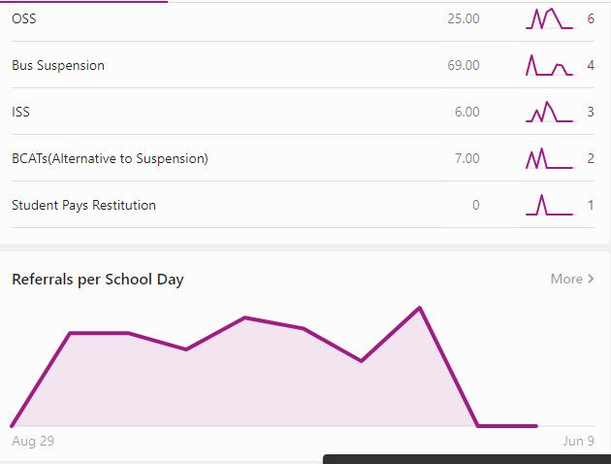
Evaluation
Student responses on the post test were increased toward the positive end of the scale by 60 percent. Four of the Six students all had negative responses that changed after the end of the small group.
Pictured is the student with the most referrals and what is shown is his decrease in referrals over the last month. He went from having multiple referrals for disruptions and anger, to having no referrals the last month while in the small group. The other students involved each decreased in write ups as well. (You see the decline in referrals as the graph takes a drastic drop).
Changes:
  I would like to see if this group would work if introduced to a larger population because the write ups in the students not involved still stayed in the higher amounts and my hopes were this group would lead as examples to their peers. This could just be timing as well, due to it being close to the end of the year.
Notes:
Each of the students involved in the small group decreased referrals over the month they were involved and the post test came back with higher positive responses on dealing with conflict and knowing what to do. This showed that though it may not have dealt directly with the group techniques we practiced, but something about this group changed over the time we spent together to decrease the conflicts within these students lives.

Slide 10
References
ASCA ethical Standards for School Counselors. ASCA Ethical Standards for School Counselors - American School Counselor Association (ASCA). (n.d.). https://www.schoolcounselor.org/About-School-Counseling/Ethical-Responsibilities/ASCA-Ethical-Standards-for-School-Counselors-(1)
Saputra, W. N. E., Supriyanto, A., Astuti, B., Ayriza, Y., Adiputra, S., & Da Costa, A. (2020). Peace counseling approach (PCA) to reduce negative aggressive behavior of students. Universal Journal of Educational Research, 8(2), 631-637.

