Slide 1
Dosis: A Manchac Product
Notes:
1

Slide 2
What is Dosis?
Dosis is an automated single-medication blister card packaging machine.
Target Population: Long-term care, hospitals, and correctional facilities.
There are three different models:
  L60
  C60
  U60
Possible add-on options:
  Pre-Pack Manager
  Time-Pass Prescription Labels
Jeff Mazzamurro | Pharmacist Intern | WNE College of Pharmacy | 2/6/17

Slide 3
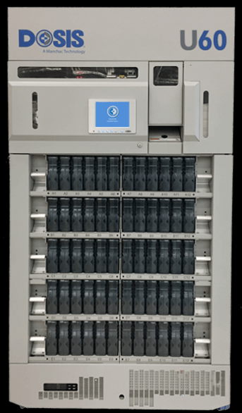
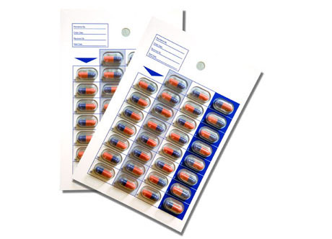
Models
Jeff Mazzamurro | Pharmacist Intern | WNE College of Pharmacy | 2/6/17

Slide 4
L60
It fills, seals, and puts patient labels on 28/30/31 day blister cards without user interaction.
First 60 drugs relieve 33% of workload.
Has skip-dose and calendar filling option.
Dispenses into correct blister card to match the correct dates to be taken.
Has a user friendly software.
Uses bar coding to track replenishments.
Has machine medication counting technology.
Can hold up to 60 canisters and 400 blister cards.
Jeff Mazzamurro | Pharmacist Intern | WNE College of Pharmacy | 2/6/17

Slide 5
C60
It fills, seals, and puts patient labels on 15/16 day blister cards for narcotics without user interaction.
First 60 drugs relieve 80% of workload.
Inventory report shows current stock level of each medication.
Has a user friendly software.
Uses bar coding to track replenishments.
Has machine medication counting technology.
Can hold up to 60 canisters and 400 blister cards.
Jeff Mazzamurro | Pharmacist Intern | WNE College of Pharmacy | 2/6/17

Slide 6
U60
Has the same filling capabilities as the L60 plus has the capability of printing on each blister cup.
Easier to reclaim unused medications.
Blister cups come in two different sizes: 3/8” and ½” depths.
Jeff Mazzamurro | Pharmacist Intern | WNE College of Pharmacy | 2/6/17

Slide 7
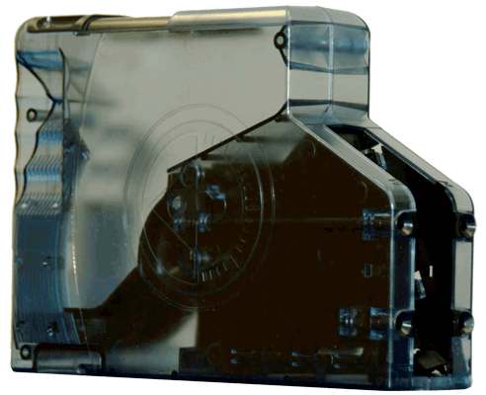
Canisters
Holds 1000 cc of each medication.
One size fits all and can be moved to any location.
Allows for brand-generic changes.
No canister calibration needed.
Can easily add or empty pills.
Jeff Mazzamurro | Pharmacist Intern | WNE College of Pharmacy | 2/6/17

Slide 8
Add-ons
Pre-Pack Manager
  Easily allows pharmacies to keep the right amount of pre-packed medications on hand. Once a medication quantity drops below an entered amount, the system will automatically restock the medication back to its entered quantity. Thus, lowering the amount of stock on hand.
Time-Pass Prescription Labels
  The system allows you to put the time the medication should be taken and any other labels needed for each prescription. It allows each of the cards look the same.
Jeff Mazzamurro | Pharmacist Intern | WNE College of Pharmacy | 2/6/17

Slide 9
Benefits Drawbacks
Increases efficiency, safety, accuracy, and productivity.
Takes up space in pharmacy.
Requires extra training.
Has certain internet, network, and power requirements.
Only compatible with single medication blister cards.
Jeff Mazzamurro | Pharmacist Intern | WNE College of Pharmacy | 2/6/17

Slide 10
Place in the Practice
Doris automated dispensing machines will greatly decrease the pharmacies dispensing workload. Once prescriptions are entered into the system Doris automatically dispenses each medication into blister cards sealing and labeling them, making them ready to be dispensed to the patient.
The L60 and the U60 can be used for all capsule or tablet medication that is not a narcotic. The U60 has an added feature that prints the medication information such as the drug name, the dose, manufacturer, and lot number on each blister cup which makes reclaiming the medication a much quicker and simpler process.
The C60 is used for narcotic medications. The system continuously keeps track of the inventory amounts.
Jeff Mazzamurro | Pharmacist Intern | WNE College of Pharmacy | 2/6/17

Slide 11
Experience
Can be used in ambulatory setting as well.
I worked at a 340B pharmacy. Blister cards were used a lot. It helped with adherence for the patient population with a low health literacy.
Dosis would have decreased workload, increased productivity, and increased efficiency which would have given more time to be dedicated to patient counseling.
Thus leading to better patient outcomes.
Jeff Mazzamurro | Pharmacist Intern | WNE College of Pharmacy | 2/6/17

