Slide 1
PharmaJet

Slide 2
What is PharmaJet?
PharmaJet is a company that has developed needle-free injection devices for vaccines.
Currently have two devices:
  Stratis- for intramuscular and subcutaneous injections
  Tropis- for intradermal injections
Being used in 37 states and the District of Columbia.

Slide 3
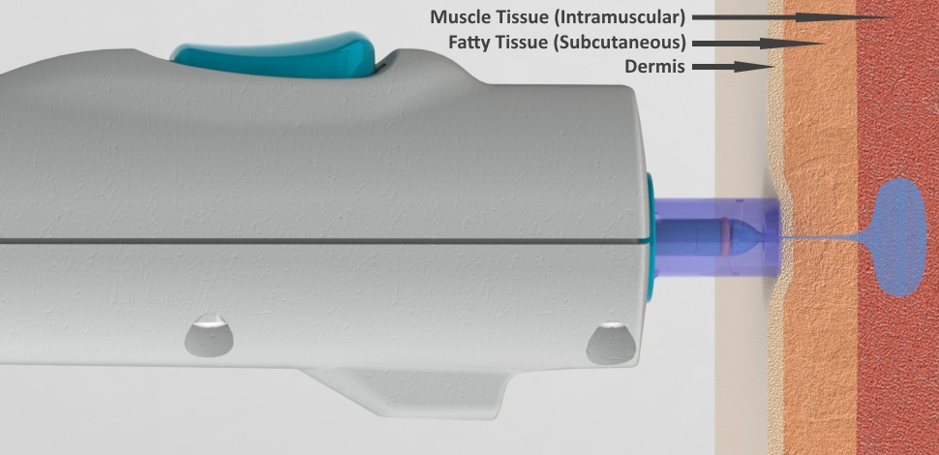
How does it work?
The injector delivers the vaccine as a fine stream of fluid that punctures the skin to the desired tissue depth.
Takes about 1/10 of a second to deliver the vaccine.

Slide 4
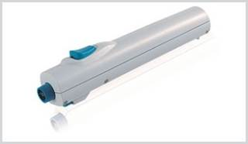
Stratis
For 0.5 mL intramuscular and subcutaneous vaccine injections
Delivered on a 90 degree angle
For subcutaneous injections, pinch the skin around injection site
For ages 18-64

Slide 5
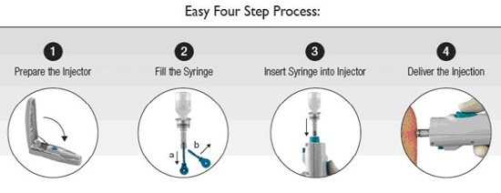

Slide 6
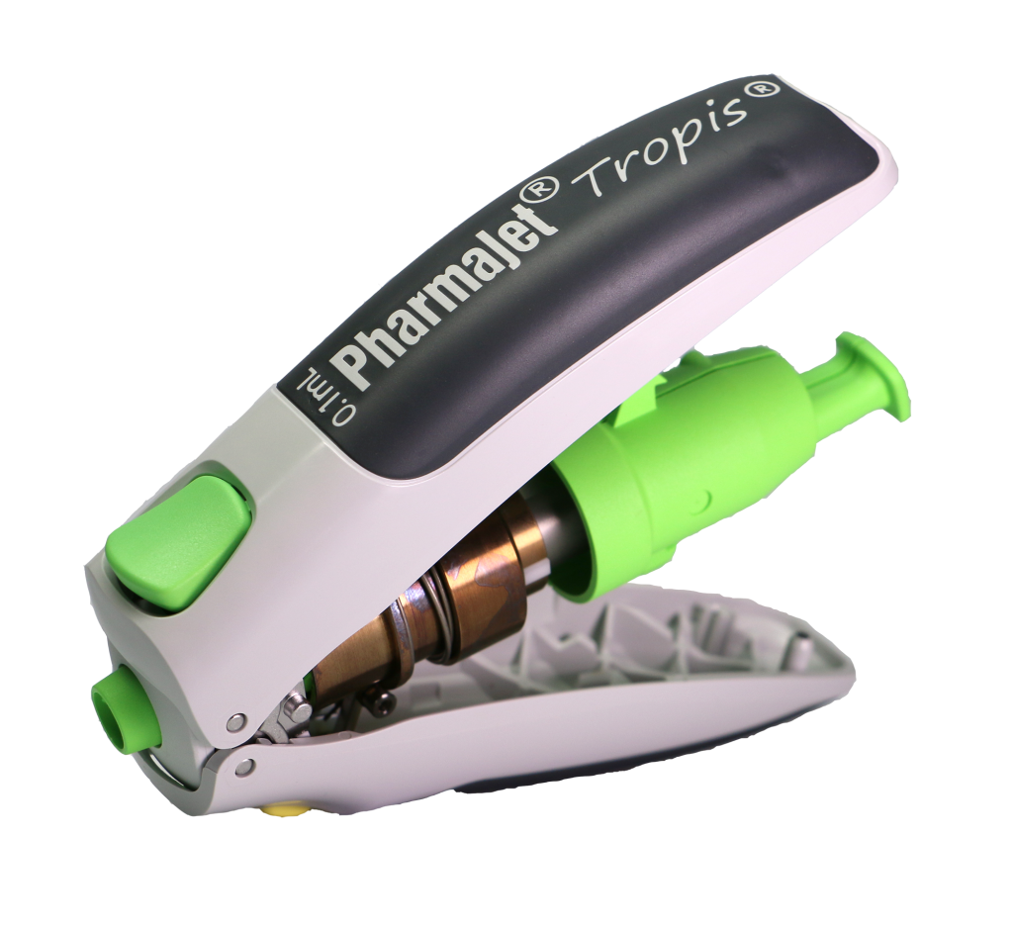
Tropis
For 0.1 mL intradermal injections
Delivered on a 90 degree angle
Currently not approved, undergoing clinical trials.
For ages 18-64

Slide 7
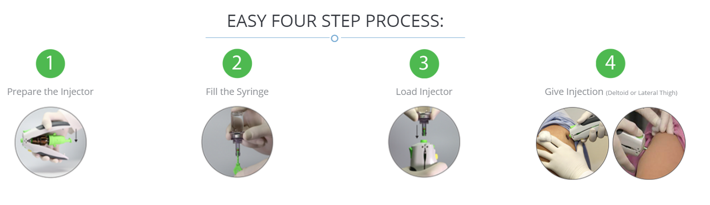

Slide 8
Legal Aspect
Stratis
  Currently is FDA cleared, is CE marked, and is pre-qualified by the World Health Organization.
  FDA approved for Afluria and Afluria QIV
Tropis
  Currently is only CE marked.
Federal law restricts these devices to be only sold to or by an order from a physician.

Slide 9
Benefits Drawbacks
Faster and easier administration compared to traditional vaccination methods.
Can save costs through decreased needle sticks, and use of sharps containers.
Safer
Can increase immunization rates in population that fears needles.
Additional training on devices and proper disposal of waste.
Stratis is only approved for Afluria and Afluria QIV.
Fairly new product

