Slide 1
RIVA

Slide 2
What is RIVA?
RIVA accurately prepares syringes and IV bags in a sterile environment and labels each dispensed dose.
It is made by the company Arxium.
RIVA is the only fully automated compounding system on the market today.
Used for the hospital setting.
Types of IV prescriptions:
  General/Adult
  Pediatric
  Chemo

Slide 3
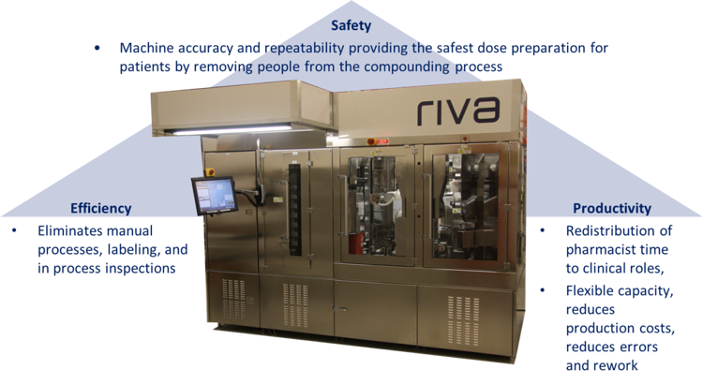

Slide 4
What does RIVA have to offer?
Safety- enhances patient care and health of the pharmacy team
Efficiency and Effectiveness- redirects workflow and decreases medication wasting
Meets Regulatory Compliances- USP 797, USP 800, Current Good Manufacturing Practice, NIOSH, and OSHA
Customizable- has more than 100 different features and updates, and is compatible with Codonics safe label system which is used for operating room medications

Slide 5
General/Adult
RIVA General helps maximize production while ensuring safety.
Ability to extend beyond use date
Handles liquid or powder vials
Handles syringes 1-60 mLs and bags 25-1000 mLs
Completes product labels
Prepares defined-concentration and defined-volume IV bags

Slide 6
Pediatric
RIVA Pediatric makes precise pediatric dosing specialized to each patient.
Has multiple technologies to ensure dose safety for vulnerable patients
High accuracy and dose repeatability
Can make syringe dose volumes down to 0.3 mL
Prepares low concentration intermediary bags which RIVA can be used as a drug source.

Slide 7
Chemo
RIVA Chemo increases efficiency and ensures the safety of patients and staff.
USP 800 compliant negative pressure helps protect pharmacy staff from cytotoxic preparations.
Multiple technologies to reduce surface contamination
Ability to pre-install ChemoClave bag spikes.
Fill queues allow loading of inventory in anticipation of preparing patient doses.

Slide 8
Benefits Drawbacks
One of a kind
Increases safety
Can save money in the long run
Increases efficiency
Decreases staff workload
Flexible technology platform
Very expensive
Extra training needed
Won't work for non-traditional medications and doses

