Slide 1
Power Pak CE

Slide 2
What is Power Pak CE?
Power Pak CE is run by Postgraduate Healthcare Education, LLC
It offers a wide range of continuing education classes for various professions in healthcare such as:
  Pharmacists
  Pharmacist technicians
  Physicians
  Nurses

Slide 3
What it has to Offer
CE's
  Articles
  Webinars
Certificate Programs
Job listings

Slide 4
CE Topics
Addiction
Allergy
Anesthesia
Biosimilars
Cardiology
Community pharmacy
Compounding
Critical care
Dermatology
Devices
Diabetes
Emergency Contraception
Emergency Medicine
Endocrinology
Gastroenterology
Geriatrics
Gynecology
Hematology
Hemophilia
Hepatic/Billiard Disorders

Slide 5
CE Topics
Hepatology
HIV/AIDS
Homeopathy
Hospital/Health Systems
Immunizations
Immunology
Infectious Disease
Insomnia
Internal Medicine
Law
Long Term Care
Managed Care
Medical Marijuana
Medication Errors
Medication Management
Medication Therapy Management
Multiple Sclerosis
Nephrology
Neurology
Nutrition/Diet
ETC….

Slide 6
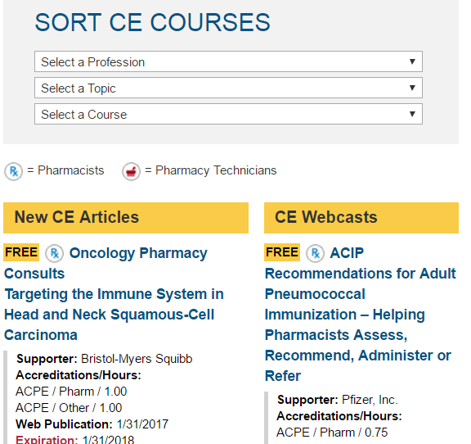
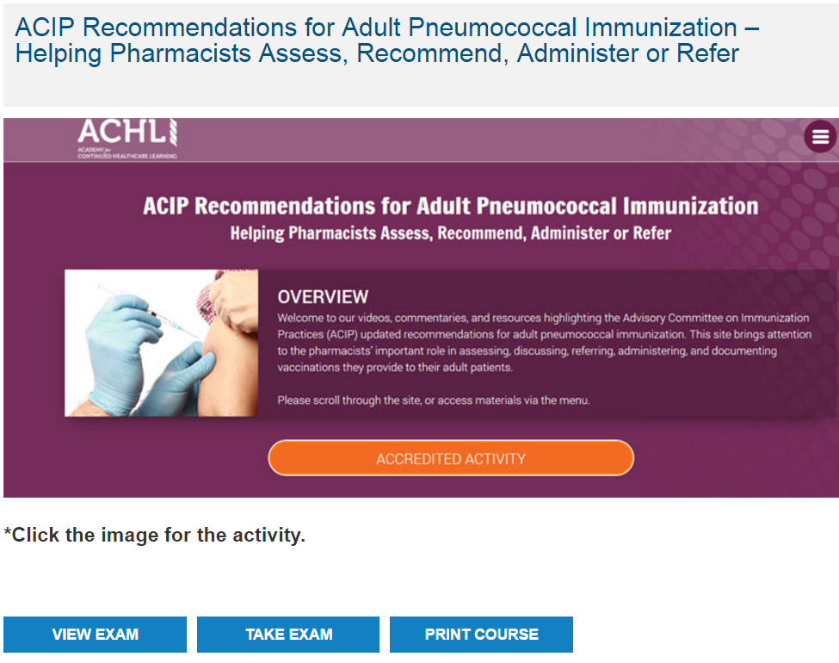

Slide 7
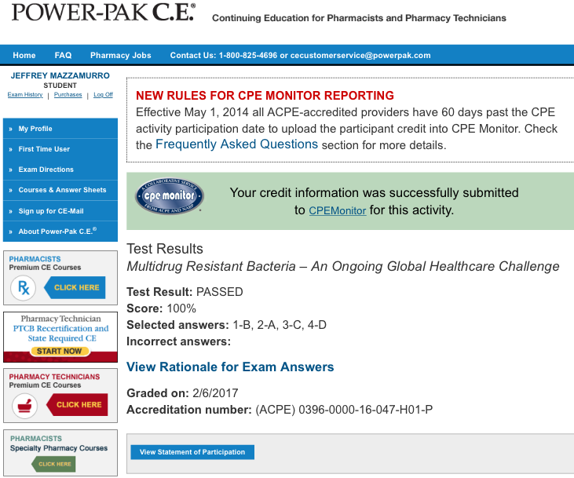
Take quick test after CE.
If passed you receive an accreditation number specific to your accrediting body.
Can be automatically submitted.

Slide 8
Benefits Drawbacks
User and mobile friendly
Uses accredited CE's
Automatic submissions
Free CE's
More than just for CE's
Majority cost money
Each CE's there for limited time
Majority are article based
Lots of competition

