Slide 1
Halo

Slide 2
What is Halo?
Halo is a complete closed system transfer device for chemotherapy.
Developed by Cordova Medical
Used in an institution setting
Made up of four components:
  Closed vial adapter
  Closed syringe adapter
  Closed line adapter
  Closed bag adapter

Slide 3
Why use Halo?
Complies with USP 800
Makes an air tight and leak proof connection between containers.
Provides a physical barrier that prevents the transfer of contaminants into the system and the escape of drug or vapor concentrations protecting the worker from exposure.
Simplistic in nature

Slide 4
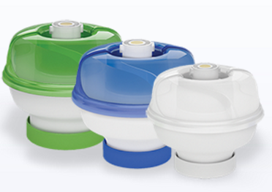
Closed vial adapter
Compatible with standard vials with 13mm, 20mm, and 28mm OD necks
Strong and secure attachment to vial
Minimal touch points for less risk of contamination
Easy-to-swab raised seal
Up to 168 hours of microbial ingress prevention
No contraindication

Slide 5
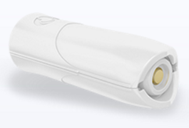
Closed syringe adapter
Designed to prevent inadvertent removal from syringe
Ability to see syringe gradations during administration without manipulating patient lines
Single motion connection to vial adaptor, bag adaptor and line adaptor
Needle safe design
Easy-to-swab raised seal
Works with standard Luer-lock connection

Slide 6
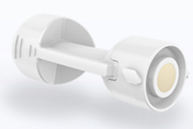
Closed line adapter
Easy-to-swab raised seal
Luer Lock to patient administration site
Simple connection with syringe adaptor
Compatible with existing administration components

Slide 7
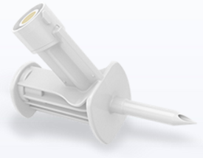
Closed bag adapter
Easy-to-swab raised seal
Simple connection with syringe adaptor
Compatible with existing preparation and administration components
No contraindication

Slide 8
Video
https://www.youtube.com/watch?v=n8tx-NnARkI

Slide 9
Benefits Drawbacks
Increased safety
Easy to use
Compatible
Efficient
Different than competition
Increased costs
More training

