Slide 1
ScriptCenter MX

Slide 2
What is ScriptCenter MX?
ScriptCenter MX is a 24/7 automated pickup and payment solutions kiosk to provide convenient and secure access to prescriptions and OTC items.
Developed by Asteres
The pharmacy staff maintains the control of filling and checking prescriptions, while the kiosk takes care of tasks associated with payment and pickup.
Used in hospital or community pharmacy settings.

Slide 3
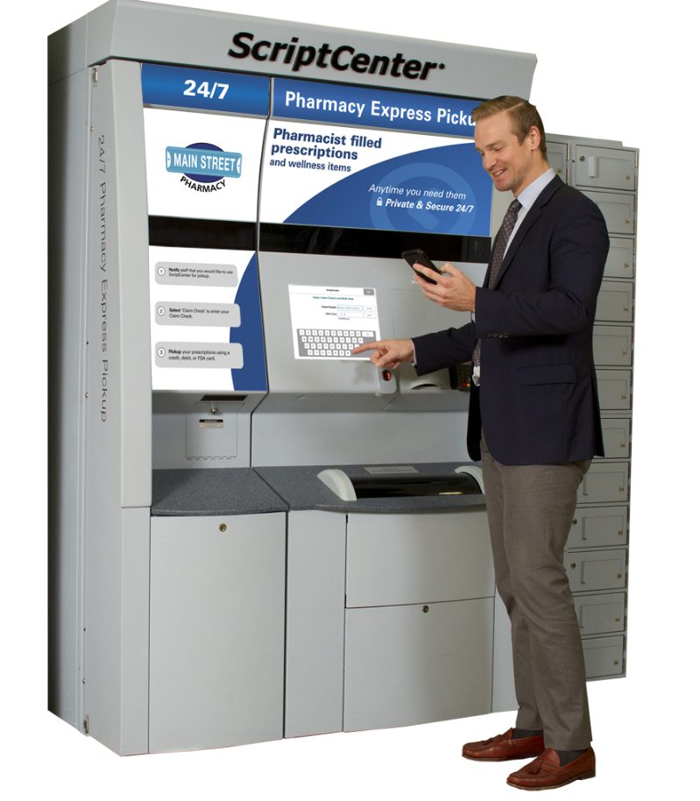

Slide 4
How does it work?
Pharmacist verified prescriptions are placed in the small, medium, or large bins. Bulky items are placed in locker compartments.
Placement doesn't matter, barcoding finds the prescription in any location.
Patient uses touch screen. Either uses fingerprint and pin code or ID options. Once signed and paid for, prescription(s) you wanted drop into collection bin.
Full video link: https://vimeo.com/203203050

Slide 5
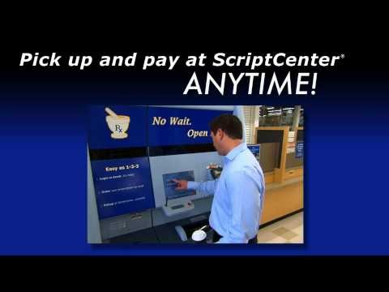

Slide 6
General Features
  Maximum capacity 560 slots
  Multiple prescriptions per container capabilities
  Front and rear staff access for item load/unload
  Individual and batch random load of items
  Biometric identification
  Photo & signature capture
  Detailed reporting for 100% audit trail
  Language options: English/Spanish

Slide 7
Pharmacy Related Features
Automated return to stock
Integrated prescription drop-off slot
Video consult & ID verification capabilities
Ability to place items ‘on hold’ for pharmacy consultation
Integrates to pharmacy management system

Slide 8
Benefits Drawbacks
24/7 access to prescriptions
Frees up workload for pharmacy staff
Easy to use
Marketing opportunities
Quicker
Can't pay with cash
May need counseling prior to getting prescription
If using ID needs to be verified by staff first
Increased costs (100k)
Additional training needed

Slide 9
References
"Home." Asteres.com. Web. 13 Mar. 2017. < http://www.asteres.com/>.
"ScriptCenter MX®." Asteres.com. Web. 13 Mar. 2017. <http://www.asteres.com/scriptcenter-mx/>.
"ScriptCenter Demonstration." Vimeo. N.p., 11 Mar. 2017. Web. 13 Mar. 2017. <https://vimeo.com/203203050>.

