Slide 1
zipdose®

Slide 2
What is zipdose?
ZipDose utilizes 3D printing to make rapidly disintegrating tablets.
Only platform to date to deliver high dosages in rapid disintegrating form.
Developed by Aprecia
Powder-liquid three-dimensional printing technology was developed at the Massachusetts Institute of Technology in the late 1980s as a rapid-prototyping technique.

Slide 3
How does it work?
Zipdose uses a process that binds multiple layers of powder blend using an aqueous fluid to produce a porous, water-soluble matrix.
Their process does not rely on compression forces, punches, or dies. As a result, it can achieve high doses up to 1,000 mg that disintegrate rapidly.

Slide 4
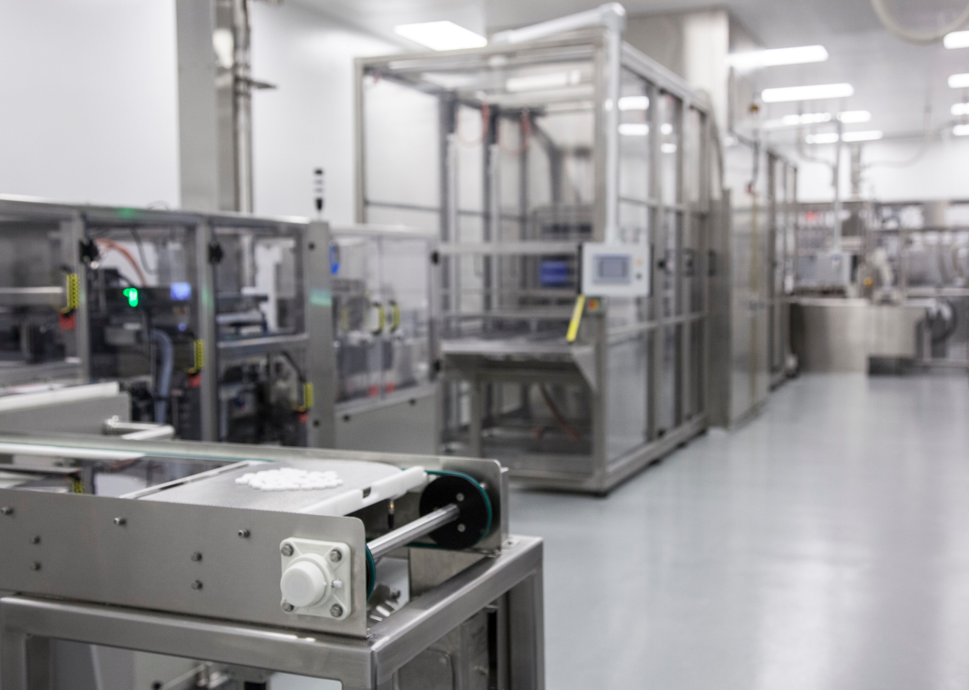
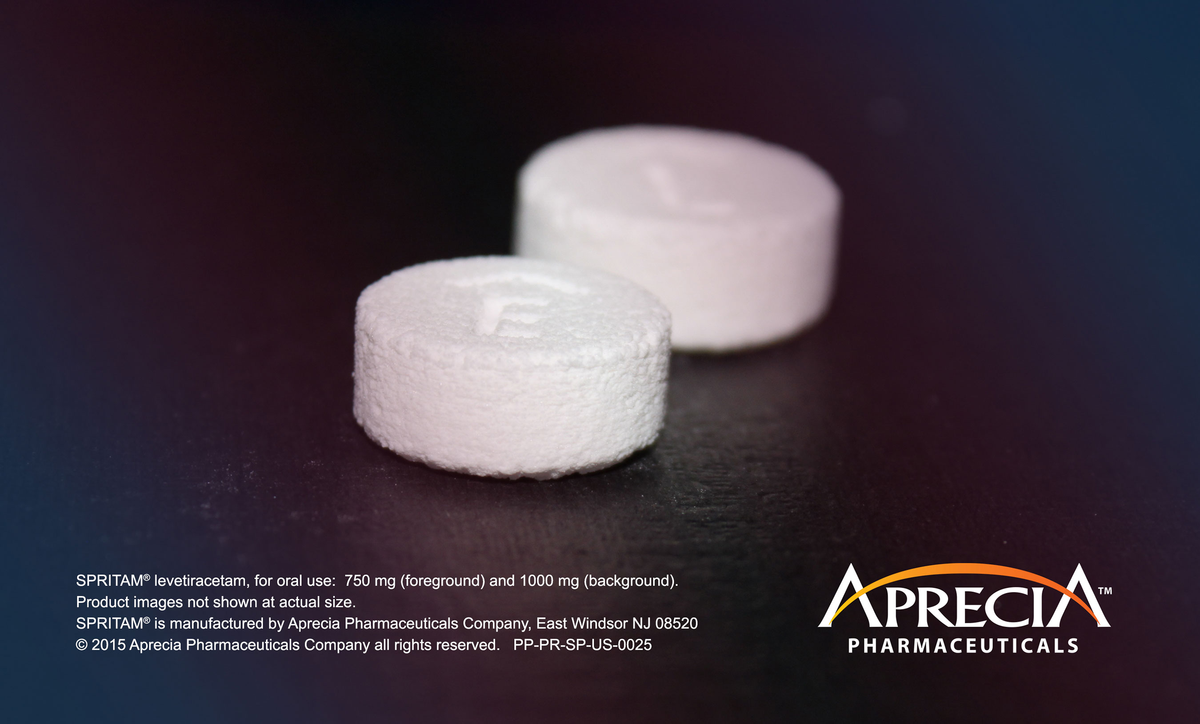

Slide 5


Slide 6
Products
ZipDose product candidates are intended to improve the patient experience and help increase adherence by being designed to:
  Rapidly disintegrate in seconds
  Offer a wide range of taste-masking capabilities
  Deliver unit-doses for precise and convenient administration
Currently, only has FDA approval for levetiracetam for seizures.
  https://www.aprecia.com/pdf/ApreciaSPRITAMLaunchPressRelease__FINAL.PDF

Slide 7
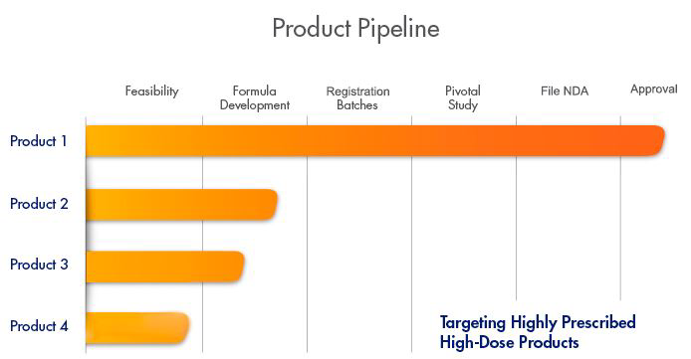
Near future
Aprecia has conducted an analysis of market performance for select ODT formulations which show lots of promise.
Has two products in formulation development and one being determined if it's feasible.

Slide 8
Legal aspect
Aprecia has the rights to more than 50 patents related to pharmaceutical applications of 3D printing,.
They have filed patent applications to protect their proprietary manufacturing system through 2033.
With several patent applications pending and plans to file additional applications.

Slide 9
Benefits drawbacks
Can reach higher doses than usual ODTs
Dissolves faster than usual with a little water
Has good palatability
One of a kind
Expensive
New
Only for ODTs

Slide 10
References
“ZipDose® Technology." ZipDose Technology | Aprecia. Web. 14 Mar. 2017. <https://www.aprecia.com/zipdose-platform/zipdose-technology.php>.
"3D Printing." 3D Printing | Aprecia. Web. 14 Mar. 2017. <https://www.aprecia.com/zipdose-platform/3d-printing.php>.
"Current Pipeline." Current Pipeline | Aprecia. Web. 14 Mar. 2017. <https://www.aprecia.com/zipdose-platform/current-pipeline.php>.

