Slide 1
Nanopatch™

Slide 2
What is the Nanopatch?
It is a 1 cm² silicon vaccine patch
Contains about 20,000 microprojections that are invisible to the naked eye
Each microprojection is coated uniformly and consistently with a dried vaccine material
The vaccine material is stabile in abient temperatures and strong so they stay intact until entered in the skin
Developed by Vaxxas

Slide 3
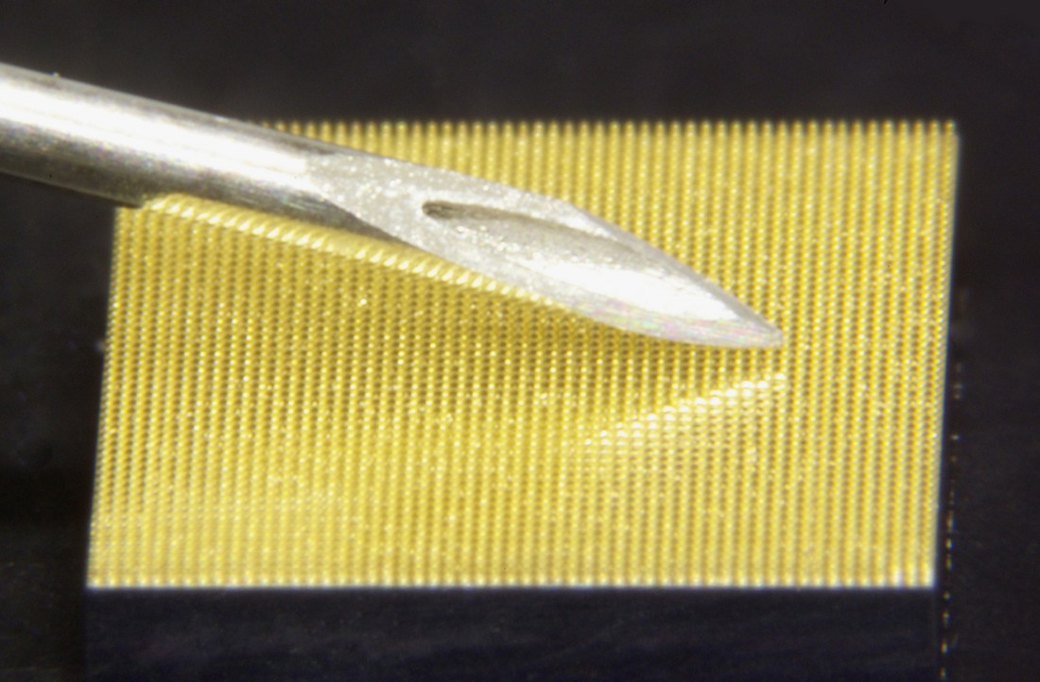
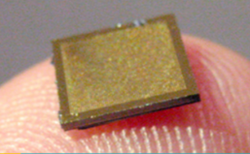

Slide 4
How Does it Work?
When applied, the microprojections painlessly enter past the outermost layer of the skin
The array penetrates through the protective outer skin layer and targets immune-activating material to the immune-cell rich layers.
The vaccine material is released quickly, often in seconds, once in contact with moisture within the skin.

Slide 5
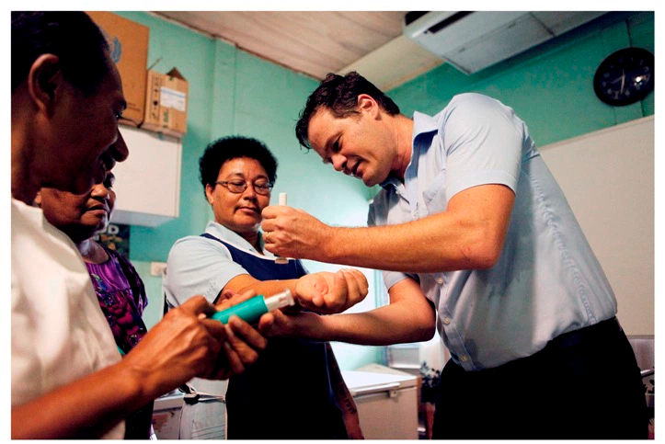
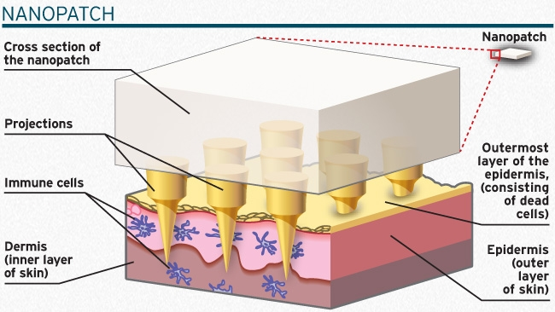

Slide 6
Results
Results have demonstrated in a mouse model an effective increase in immunogenicity,
With this you can do two different approaches:
  Either reducing the dose required to achieve efficacy
  Or for amplifying the vaccine efficacy
Pre-clinical experiments have also shown the ability of the Nanopatch to remove or significantly reduce the amount of adjuvant required for effective vaccination.

Slide 7
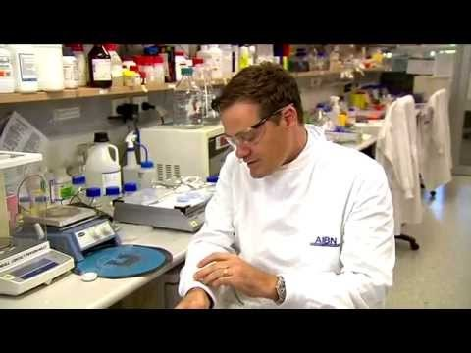

Slide 8
Benefits Drawbacks
Cost effective (compared to previous similar products)
Improved immune response
No cold chain
"Needle free"
Pain free
Years away from being in the market
A lot still unknown- Not enough human trials done

Slide 9
References
"Overview." Nanopatch Technology - Overview - Pain-free Vaccination. Web. 15 Mar. 2017. <http://www.vaxxas.com/nanopatch-technology>.
"Benefits." Nanopatch Technology - Benefits - Needle-free Vaccine Delivery. Web. 15 Mar. 2017. <http://www.vaxxas.com/nanopatch-technology/benefits>.
"Vaxxas Nanopatch - Ch 7 6 Pm News." YouTube. YouTube, 24 Feb. 2015. Web. 15 Mar. 2017. <https://www.youtube.com/watch?v=jgMXpp0e5TI>.

