Slide 1
TUG

Slide 2
What Is tug?
It's a self charging autonomous mobile delivery robot
Developed by Aethon
Has over 20 million deliveries to date
Used is hospital and manufacturing settings
Can make scheduled and on demand deliveries
Can haul up to 1000 lbs

Slide 3
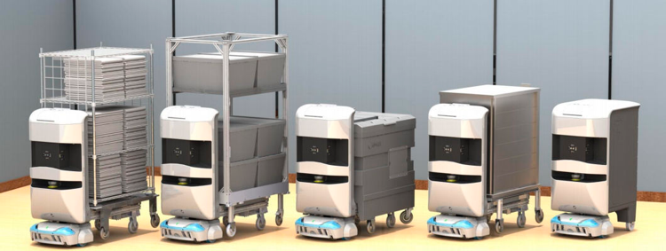

Slide 4
What does tug do?
Reduces workloads through autonomous delivery and transportation
Hospital setting
  Can deliver medications, supplies, meals, linens,
  Removes trash, medical waste, dirty linens
Manufacturing setting
  Transports materials and supplies

Slide 5
How does it work?
TUG doesn’t need any beacons, staging depots or specific infrastructure to be added to the facility. It uses its built in map and array of on-board sensors to navigate. Uses current WiFi to communicate with elevators, automatic doors and fire alarms.
TUG is sent or requested using a touch screen interface such as mobile devices, call boxes and touch screens.
TUG Robot has two basic types of configurations: fixed, secure carts and an exchange base platform
  The fixed carts are available in drawer and door configurations and are accessed using a personal pin code and biometric authentication.
  The exchange platform allows the transportation of materials loaded on a wide variety of racks. The racks are placed on the base and this base raises to lift the rack or shelf off the ground.

Slide 6
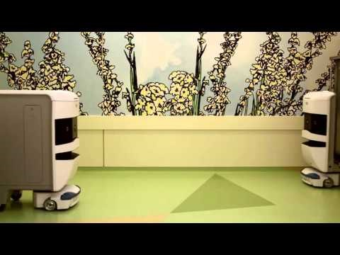

Slide 7
Benefits Drawbacks
Cost effective in long run
Increased safety
Decreased workload
Different than other products
Improved productivity
24/7 help
Expensive (about 1,500 per month or 140,000 per unit)
System integration
Extra training needed

Slide 8
References
"TUG Robots in Healthcare." Aethon. Web. 22 Mar. 2017. <http://www.aethon.com/tug/tughealthcare/>.
"TUG Autonomous Robot for Manufacturing." Aethon. Web. 22 Mar. 2017. <http://www.aethon.com/industrialtug/>.
"How the TUG Automomous Mobile Robot Works." Aethon. Web. 22 Mar. 2017. <http://www.aethon.com/tug/how-it-works/>.
Rhey, Erik. "Paging Dr. Robot: Aethon's Autonomous Hospital Helpers." PCMAG. PCMAG.COM, 15 Feb. 2011. Web. 22 Mar. 2017. <http://www.pcmag.com/article2/0,2817,2380318,00.asp>.
Chang, Althea. "Here's What Robots Are Doing at This Hospital." CNBC. CNBC, 04 May 2015. Web. 22 Mar. 2017. <http://www.cnbc.com/2015/04/30/pricy-robots-tug-hospital-supplies.html>.
IgorGabrielan. "TUG Autonomous Mobile Robot in Hospitals, Aethon Inc." YouTube. YouTube, 19 Jan. 2016. Web. 22 Mar. 2017. <https://www.youtube.com/watch?v=WafkcuhTtMc>.

