Slide 1
New England Breath Technologies

Slide 2
What is New England Breath Technologies?
It's a company that has developed a product for pain free diabetic monitoring
Currently has one device which is undergoing clinical testing

Slide 3
How does it work?
Every persons’ breath contains acetone
The breathalyzer contains multilayered films that undergo a chemical change when in contact with acetone
A major advantage of using this approach is that nothing containing a reactive carbonyl is found in concentrations above 0.5% of that of acetone, and none have shown variability with disease states.
Therefore, a blood glucose level, can be determined.
Unlike other techniques which suffered from interference from humidity, this approach will only detect ketones and/or aldehydes.

Slide 4
Blood Sugar Monitoring
A person with type one diabetes may need to check as many as 8-12 times a day. A person with type two diabetes may check up to 4-5 times a day.
This is done by pricking your finger with a lancet and having the sugar levels in a blood droplet read by a device.
Blood sugar levels are very important for treatment plans.
Adherence for self monitoring is not good-
  Rates as low as 44% and 24% for type one and type two diabetes have been seen

Slide 5
The Device
Currently does not have a name
Works similarly to an alcohol breathalyzer device
Currently being tested in controlled human trials**********

Slide 6
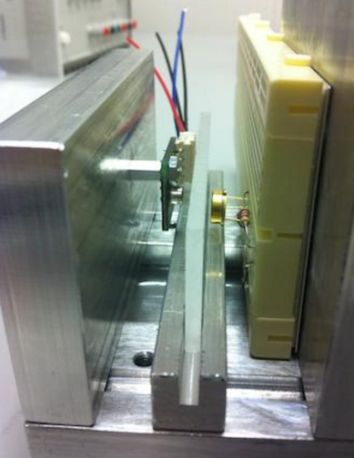
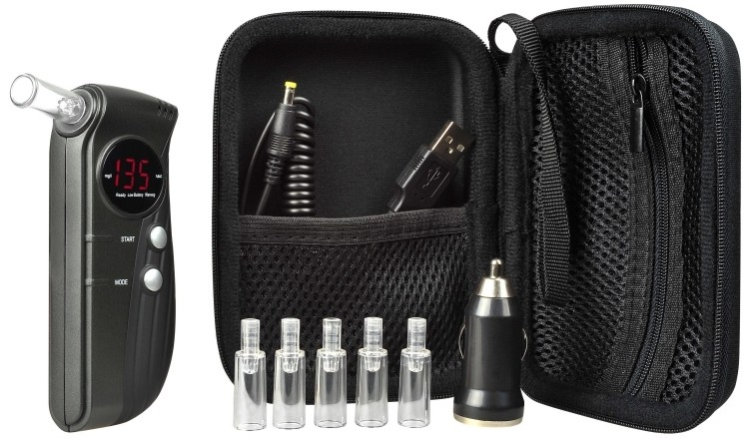

Slide 7
Benefits Drawbacks
Needle-free
Easy to use
Pain free
Accurate
May be difficult for persons with breathing problems
Still in testing
Expensive

Slide 8
References
Patton, Susana R. "Adherence to Glycemic Monitoring in Diabetes." Journal of Diabetes Science and Technology. SAGE Publications, May 2015. Web. 20 Mar. 2017. <https://www.ncbi.nlm.nih.gov/pmc/articles/PMC4604539/>.
Whiteman, Honor. "New Breathalyzer 'monitors Blood Glucose' in Diabetics." Medical News Today. MediLexicon International, 13 Nov. 2013. Web. 20 Mar. 2017. <http://www.medicalnewstoday.com/articles/268726.php>.
"Our Device." Home. Web. 20 Mar. 2017. <http://www.newenglandbreath.com/our-device.html>.

